Slide 1

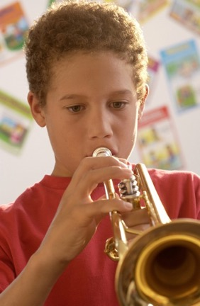
Keeping “Reflection” in Mind
Students need to realize how music-making IMPACTS their lives and ENRICHES them.
Music Makes the Difference Because. . .
23

Slide 2
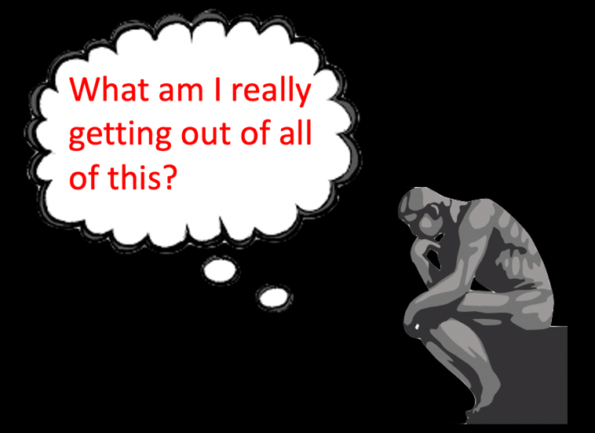
“Reflection”
24

Slide 3

“Reflection”
Have Each Class Build a Word Cloud
25

Slide 4
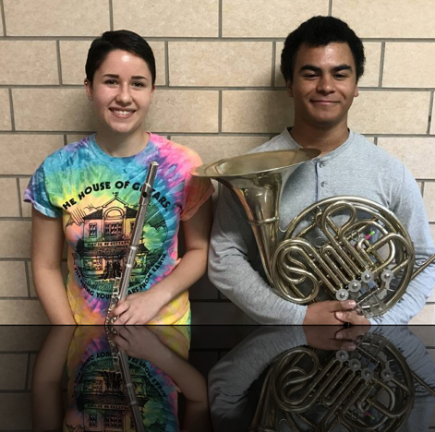
“Reflection”
Making New Friends
26

Slide 5
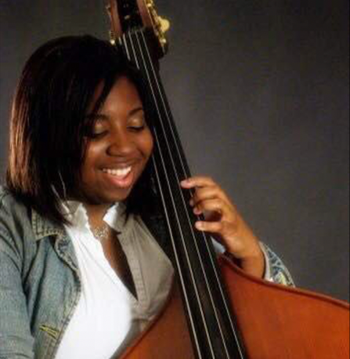
“Reflection”
Experiencing the Joy of Music-Making
27

Slide 6

“Reflection”
It’s Fun!
28

Slide 7
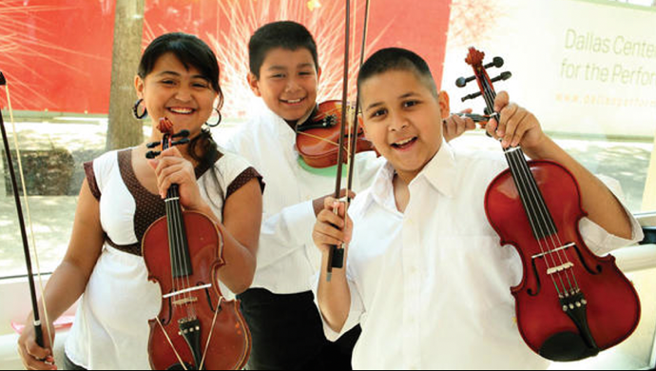
“Reflection”
It Gives Us a Unified Purpose!
29

Slide 8
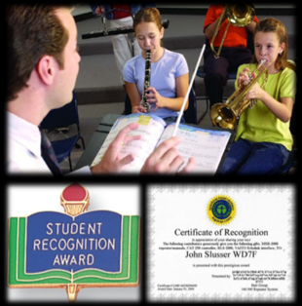
Keeping the “Total” Picture in Mind
WHY and HOW
WHY: Make music because it helps us to realize a more fulfilling life.
HOW: Build appreciation for the ensemble because it builds trust.
HOW: Provide recognition and reinforcement because
it bolsters confidence.
30

Slide 9
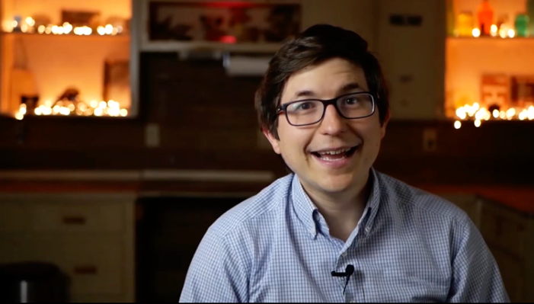
Keeping the “Total” Picture in Mind
Remaining Relevant
Stephen Cox, Band Director
Eastland HS, TX
31

Slide 10
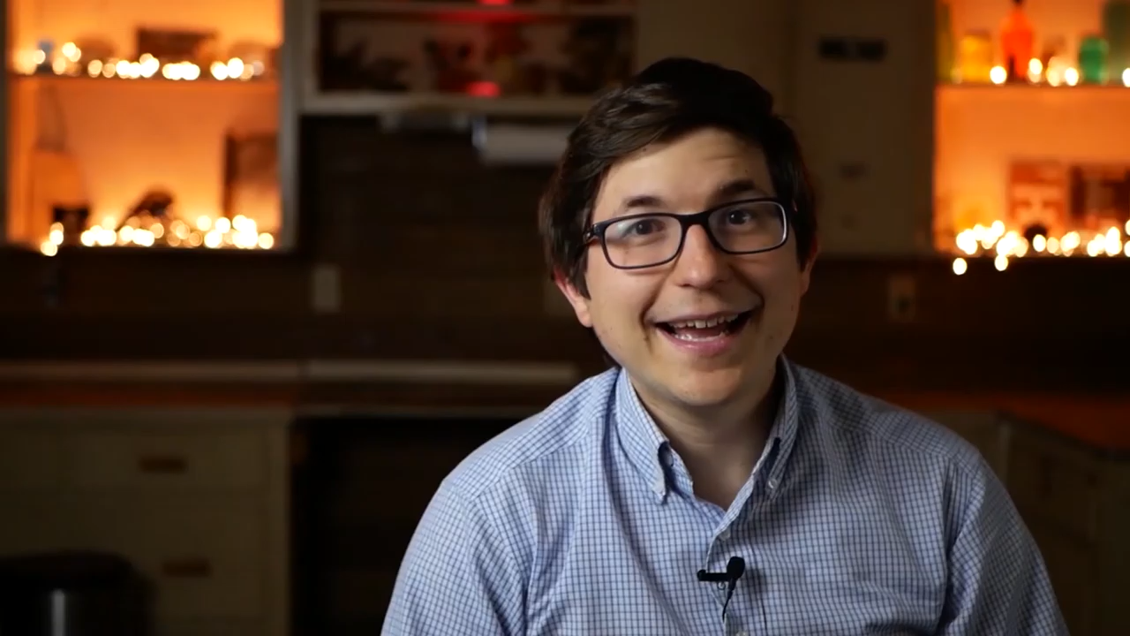
Keeping the “Total” Picture in Mind
Remaining Relevant
Stephen Cox, Band Director
Eastland HS, TX
32

Slide 11
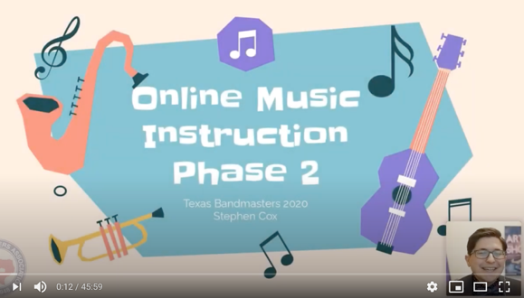
Keeping the “Total” Picture in Mind
Remaining Relevant
https://bit.ly/33Ylh5g
Stephen Cox, Band Director
Eastland HS, TX
33

Slide 12
The S.M.A.R.T. Approach to Retention
Success
Modeling
Activities
Reflection
Total Picture
34

Slide 13



Your Enthusiasm is
What Matters!
35

Slide 14

36

Slide 15


Thanks to Our Sustaining Sponsors!

Slide 16


MusicAchievementCouncil.org
Thank You!
Posted:
musicedconsultants.net/
conference-materials
marcia@musicedconsultants.net
38

