Slide 1
DID YOU KNOW . . .
Engaged students are 2.5 times more likely to say that they get excellent grades and do well in school, and they are 4.5 times more likely to be hopeful about the future than their actively disengaged peers.
Gallup, Oct 2018
www.musicedconsultants.net/conference-materials.html

Slide 2

DID YOU KNOW . . .
96 percent of public school principals
believe that participating in music
education encourages and motivates
students to stay in school longer.
(Harris Poll)
www.musicedconsultants.net/conference-materials.html

Slide 3
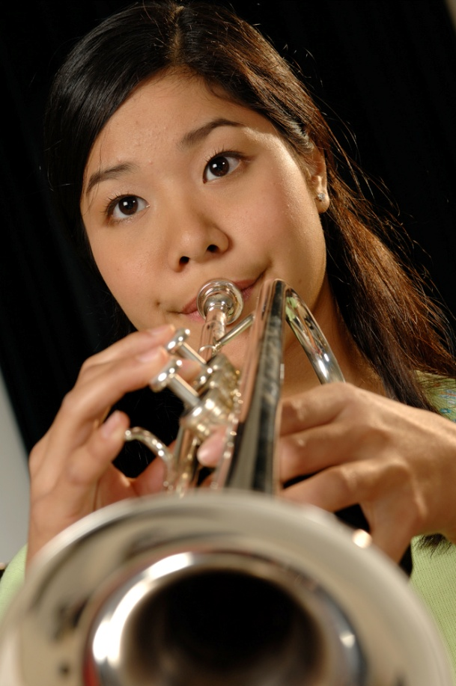
DID YOU KNOW . . .
An interactive poll confirms that music education at an early age greatly increases the likelihood that a child will grow up to seek higher education and ultimately even earn a higher salary. (2007 Harris Poll)
www.musicedconsultants.net/conference-materials.html

Slide 4

THE MESSAGE IS. . .
If you want to be a CEO, College President, or
even a Rock Star,
TAKE MUSIC!
www.musicedconsultants.net/conference-materials.html

Slide 5

THE MESSAGE IS. . .
If you want to be a CEO, College President, or
even a Rock Star,
TAKE MUSIC!
www.musicedconsultants.net/conference-materials.html

Slide 6
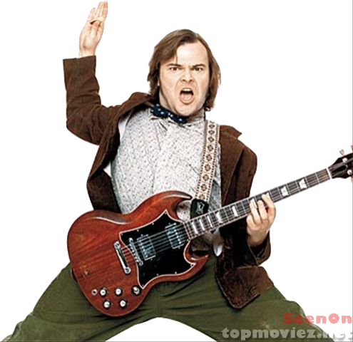


THE MESSAGE IS. . .
If you want to be a CEO, College President, or
even a Rock Star,
TAKE MUSIC!
www.musicedconsultants.net/conference-materials.html

Slide 7
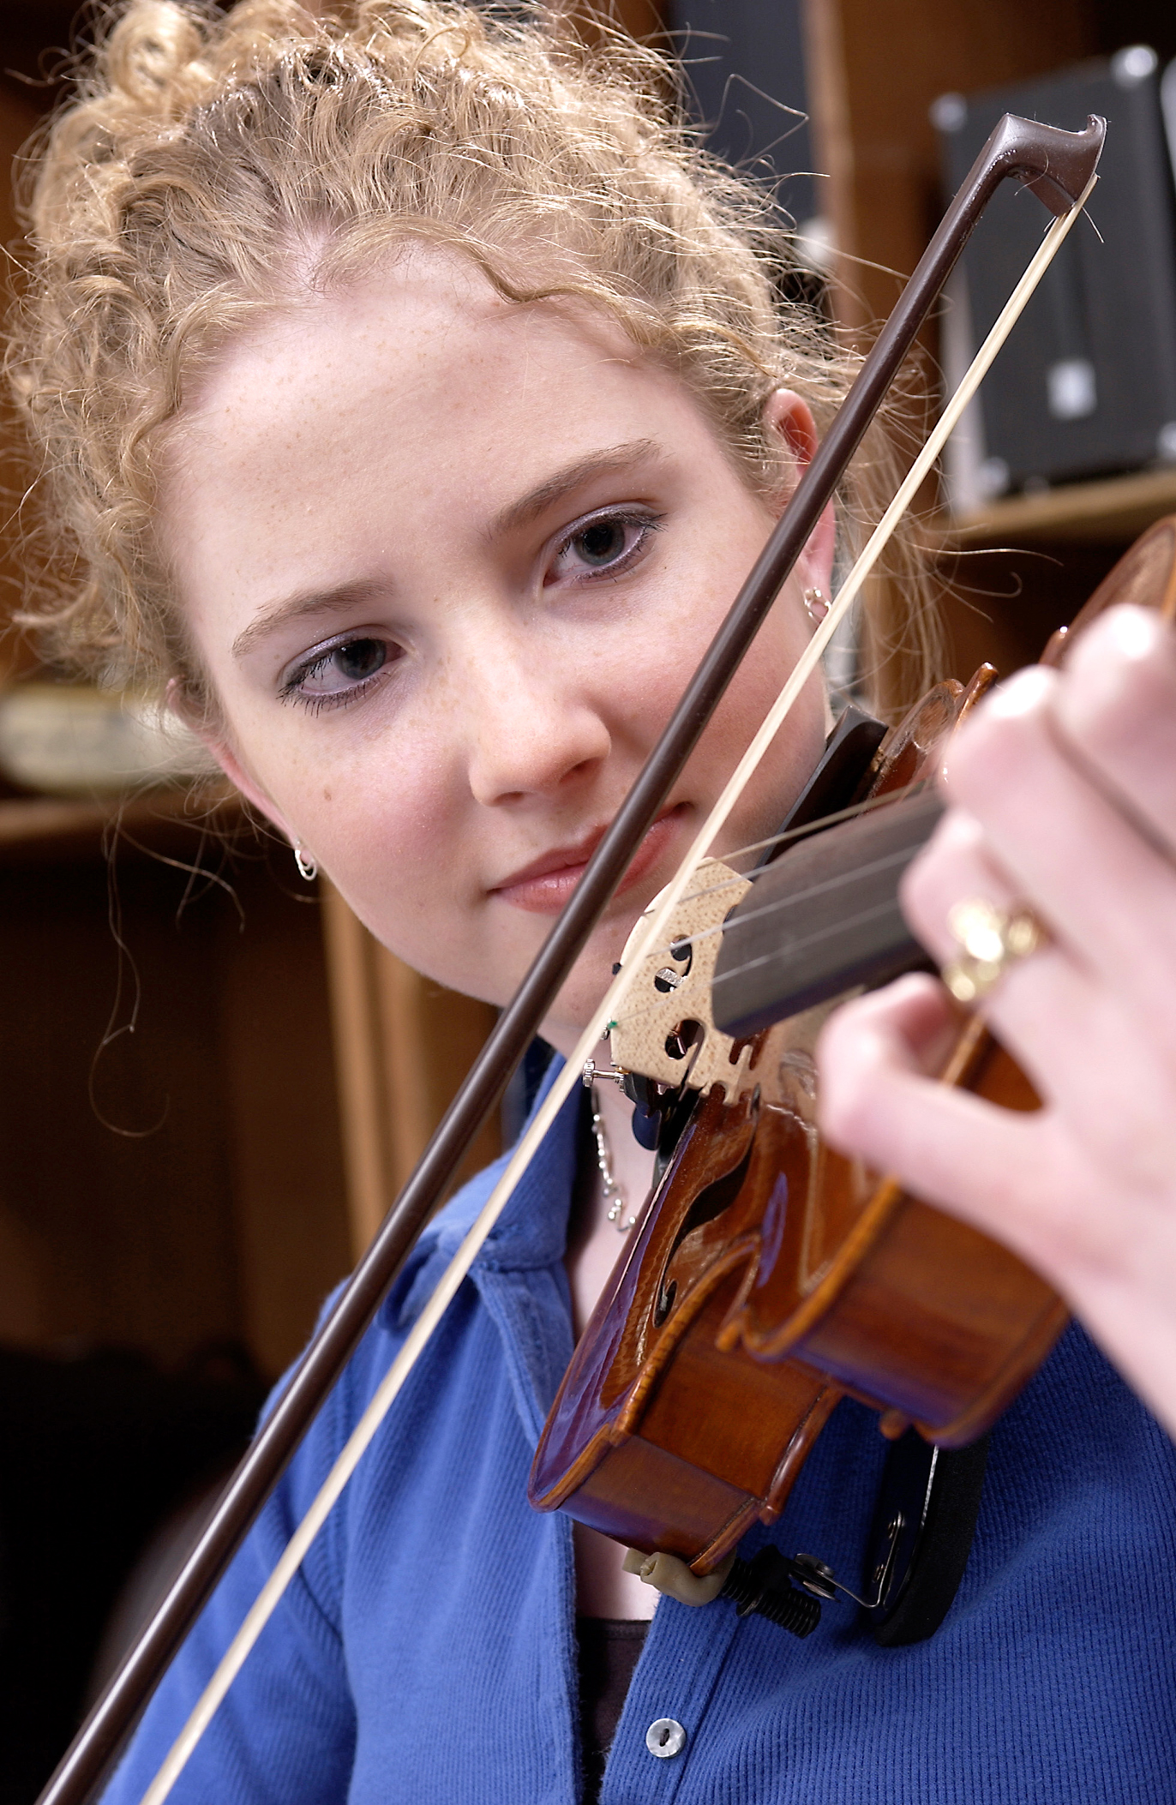
DID YOU KNOW . . .
82 percent of Americans who don’t currently play an instrument wish they had learned to play one. (Gallup Poll)
www.musicedconsultants.net/conference-materials.html

Slide 8
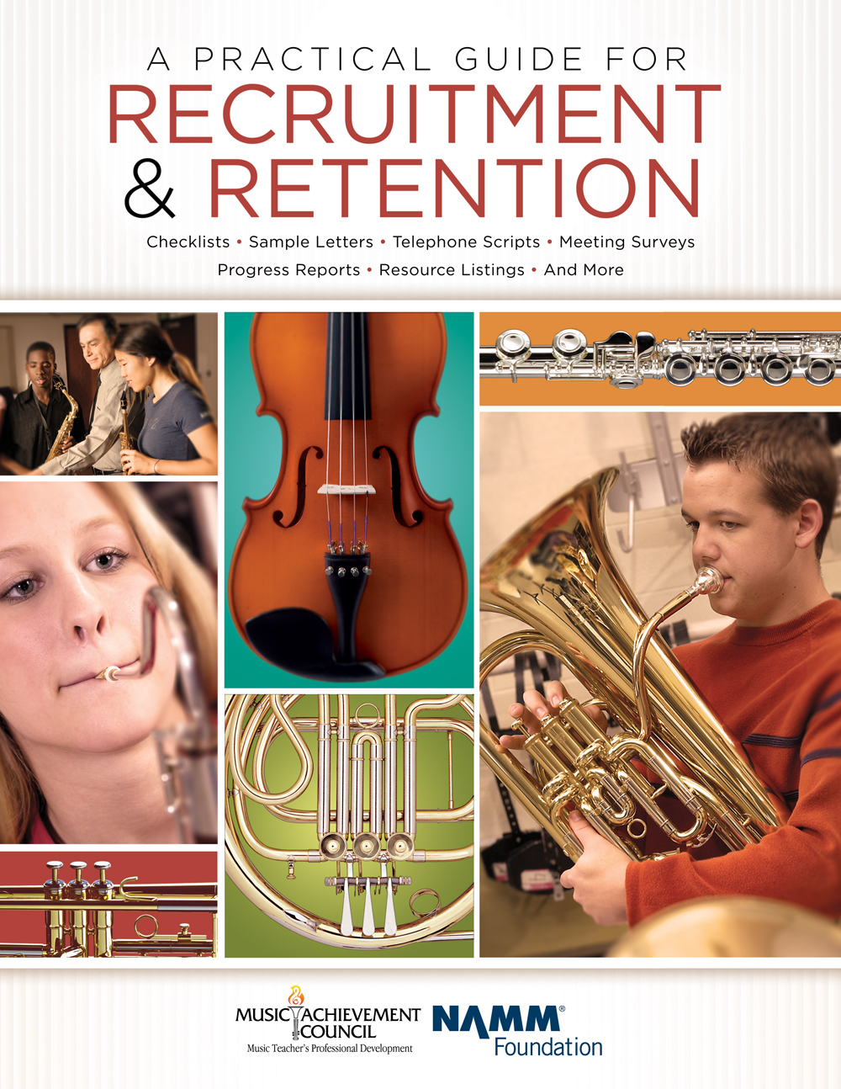
DID YOU KNOW . . .
All of today’s session attendees will receive FREE COPIES of:
A Practical Guide for Recruitment and Retention
www.musicachievementcouncil.org

Slide 9
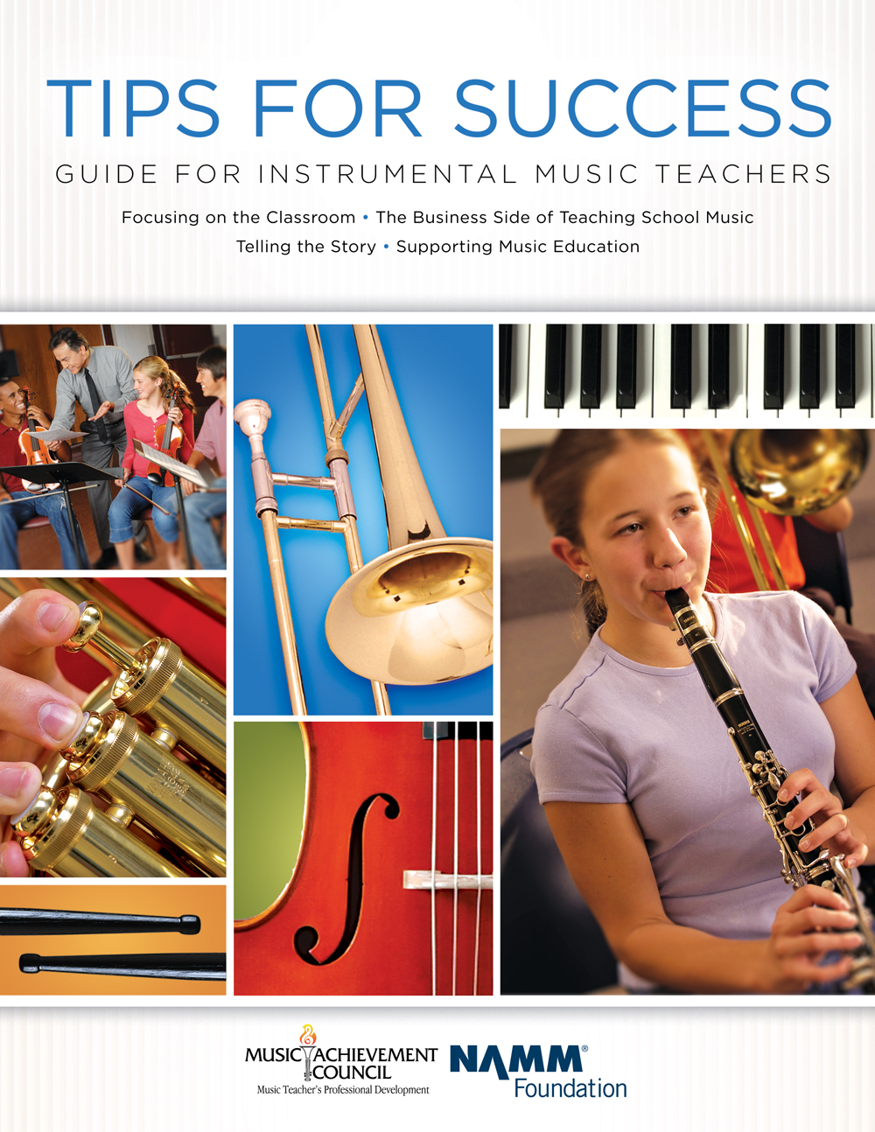
DID YOU KNOW . . .
All of today’s session attendees will receive FREE COPIES of:
Tips for Success:
A Guide for Instrumental Music Teachers
www.musicachievementcouncil.org

Slide 10
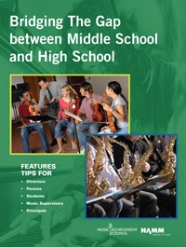
DID YOU KNOW . . .
All of today’s session attendees will receive FREE COPIES of:
Bridging the Gap between
Middle School and High School
www.musicachievementcouncil.org

Slide 11
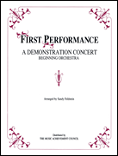
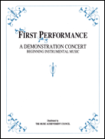
DID YOU KNOW . . .
First Performance Demo Concert for Band and/or Orchestra features sheet music, parts, sample letters, programs and student certificates for beginning ensembles. Students can perform a composition in seven short weeks with the materials provided!
www.musicachievementcouncil.org

Slide 12
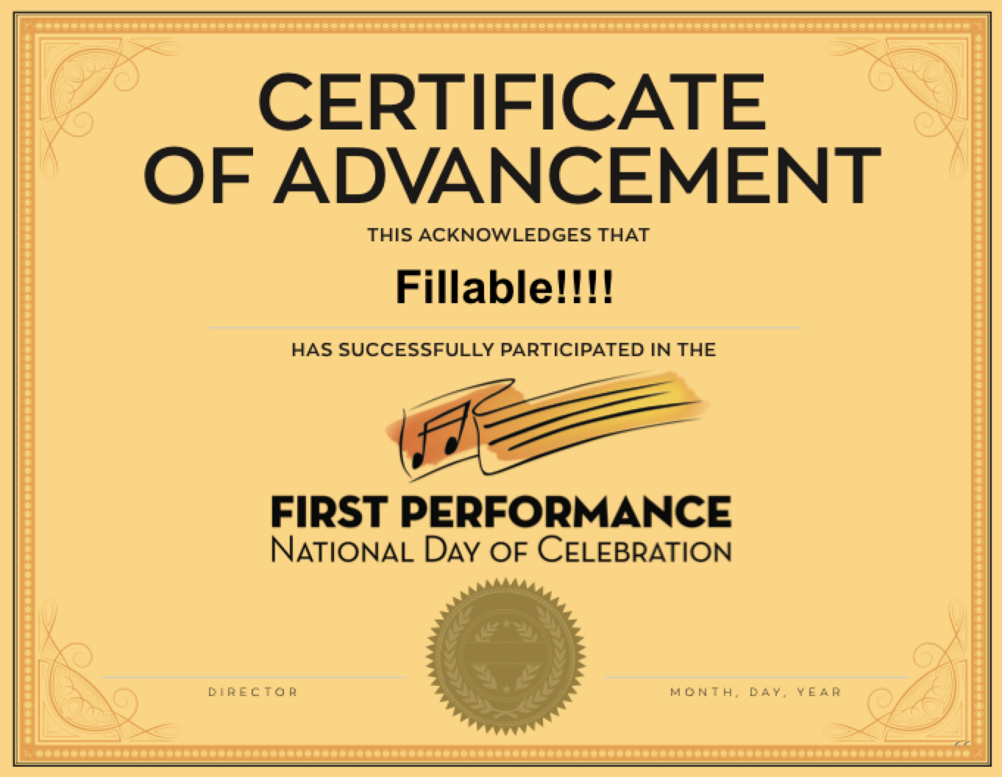
DID YOU KNOW . . .
The First Performance National Day of Celebration is held on the 3rd Thursday of November annually to recognize the achievements of your Beginning instrumental students?
www.musicachievementcouncil.org

Slide 13
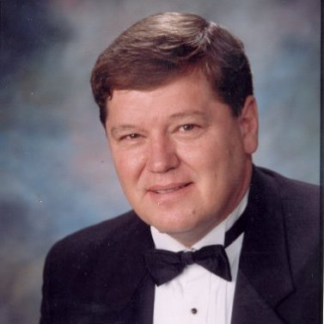
DID YOU KNOW . . .
Three of these publications are provided online at no charge by the Music Achievement Council.
They are based on real world strategies shared by the profession’s most successful music educators.
Greg Bimm

Slide 14
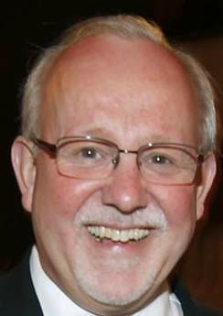
DID YOU KNOW . . .
Three of these publications are provided online at no charge by the Music Achievement Council.
They are based on real world strategies shared by the profession’s most successful music educators.
Charlie Menghini

Slide 15
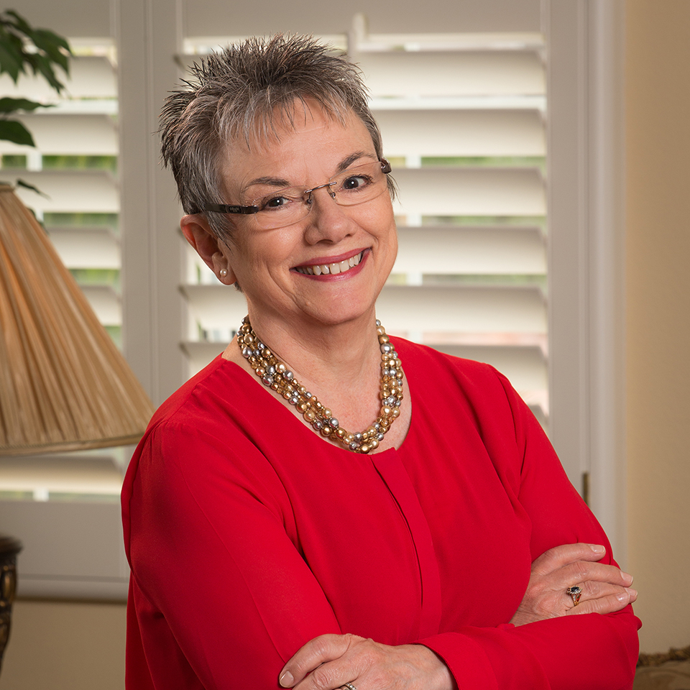
DID YOU KNOW . . .
Three of these publications are provided online at no charge by the Music Achievement Council.
They are based on real world strategies shared by the profession’s most successful music educators.
Marcia Neel

Slide 16
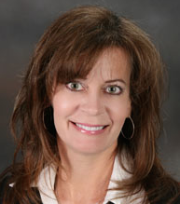
DID YOU KNOW . . .
Three of these publications are provided online at no charge by the Music Achievement Council.
They are based on real world strategies shared by the profession’s most successful music educators.
Terry Shade

Slide 17
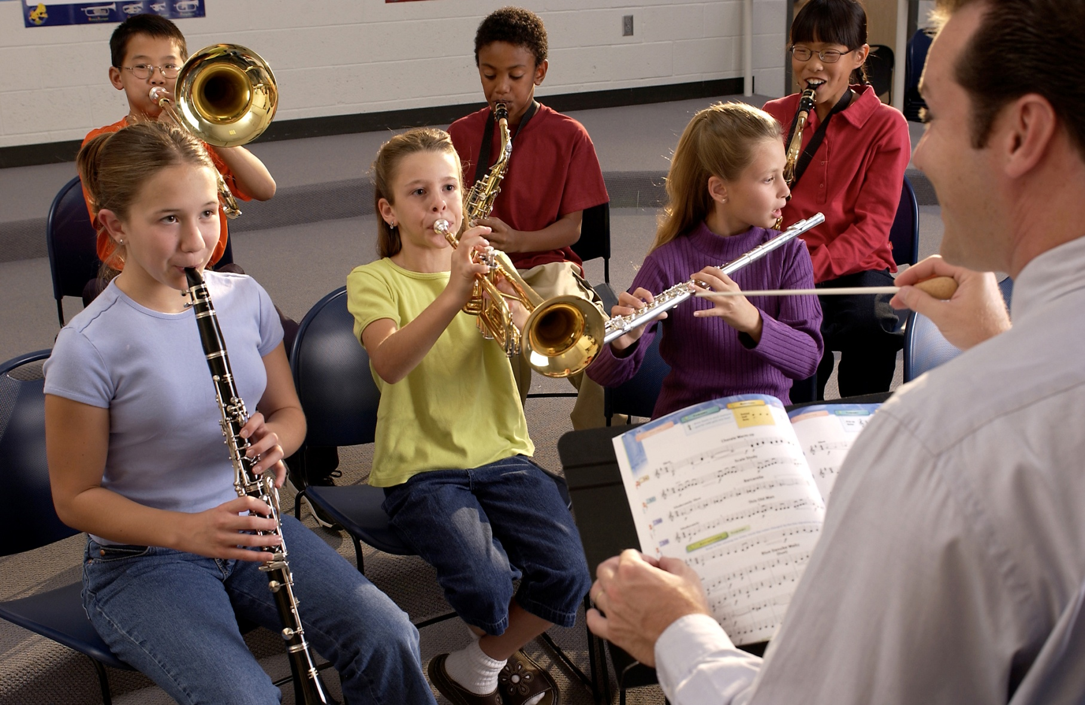

DID YOU KNOW . . .
www.musicedconsultants.net/conference-materials.html

Slide 18
DID YOU KNOW . . .
Music making has been scientifically proven to:
Exercise the brain
Inspire creativity
Increase productivity
Fight memory loss
Reduce stress
Lower blood pressure
Build confidence
Stave off depression

Slide 19

DID YOU KNOW . . .
Metropolitan Nashville Public Schools found that ATTENDANCE RATES ROSE with increased study in music.
No Music:
< 1 Year of Music:
> 1 Year of Music:
87% Attendance
91% Attendance
93% Attendance

Slide 20
DID YOU KNOW . . .
Metropolitan Nashville Public Schools found that DISCIPLINE REPORTS FELL with increased study in music.
No Music:
< 1 Year of Music:
> 1 Year of Music:
4.34 over 4 years
3.75 over 4 years
3.23 over 4 years

Slide 21
DID YOU KNOW . . .
Metropolitan Nashville Public Schools found that GPAs ROSE with increased study in music.
No Music:
< 1 Year of Music:
> 1 Year of Music:
2.51 Average
2.61 Average
2.89 Average

Slide 22
DID YOU KNOW . . .
Metropolitan Nashville Public Schools found that GRADUATION RATES ROSE with increased study in music.
No Music:
< 1 Year of Music:
> 1 Year of Music:
60% Average
81% Average
91% Average

Slide 23
DID YOU KNOW . . .
Metropolitan Nashville Public Schools found that ACT SCORES ROSE with increased study in music.
No Music:
< 1 Year of Music:
> 1 Year of Music:
16.95 Eng, 17.20 Math
17.64 Eng, 17.62 Math
19.58 Eng, 18.67 Math

Slide 24
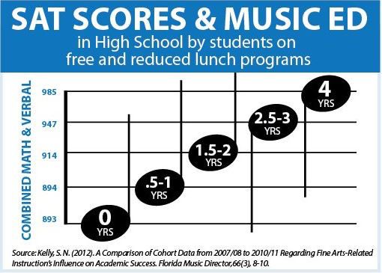

Slide 25
WHAT WAS LEARNED?
The MORE a student participates in MUSIC,
the more POSITIVE these BENEFITS become.

Slide 26
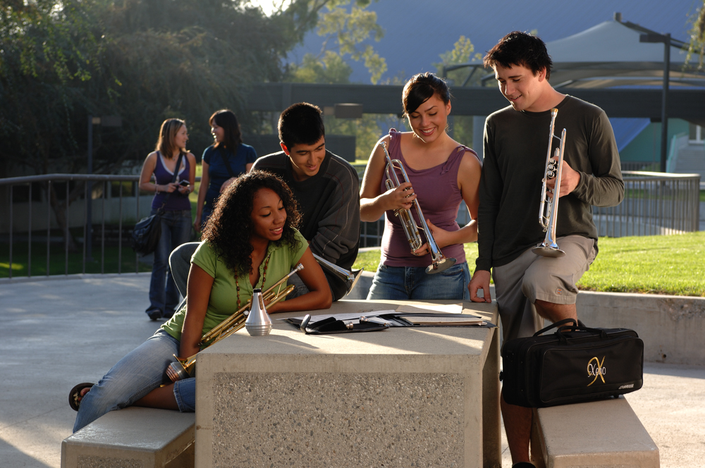
FAMOUS QUOTES. . .
Music has the power of producing a
certain effect on the moral character of
of the soul.
. . . Aristotle

Slide 27
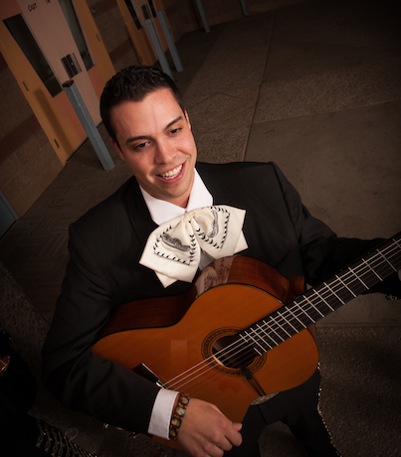
FAMOUS QUOTES. . .
Music furnishes a delightful recreation
for the hours of respite from the cares of the day, and lasts us through life.
. . . Thomas Jefferson

Slide 28






Bridging the Gap Between
Middle School High School
Marcia Neel
Nick Averwater Hal Cooper Ron Kuykendall
PPT, Session, and Videos will be Posted Online at:
www.MusicEdConsultants.net/conference-materials.html

Slide 29
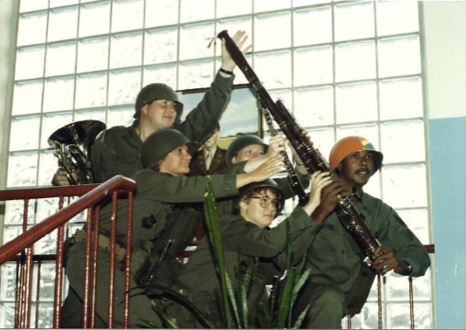
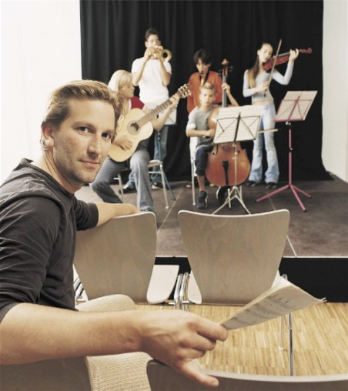
Today’s Session: Bridging the Gap Between Middle and High School
WE WANT (TO KEEP) YOU!
The WHAT
The WHY
The HOW

Slide 30

WHAT Other Teachers Think I Do!

Slide 31

WHAT Society Thinks I Do!

Slide 32
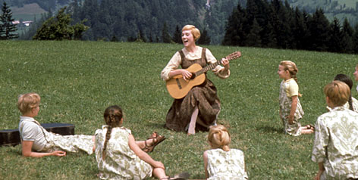
WHAT My Mom Thinks I Do!

Slide 33
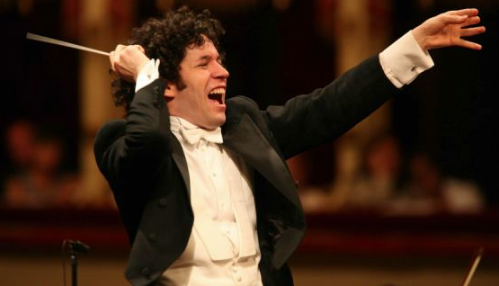
WHAT I Think I Do!

Slide 34
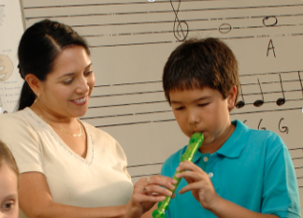


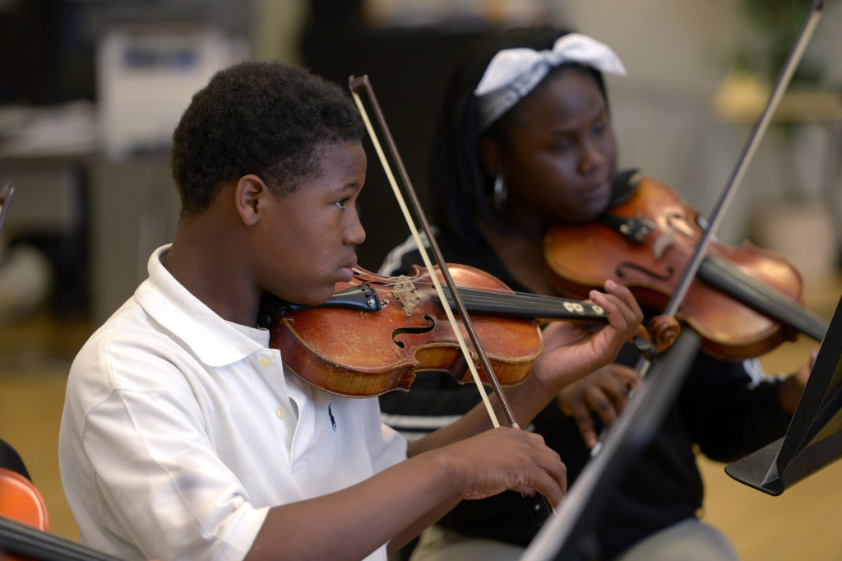
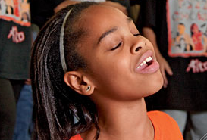
WHAT I Really Get to Do!
Facilitate Success and Fulfillment in Life!
www.musicedconsultants.net/conference-materials.html

Slide 35
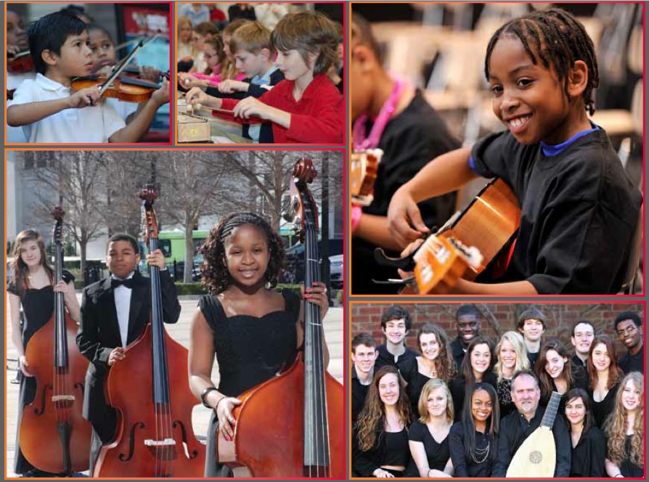

The WHY of Staying in Music
Music Makes Us
Baseline Research Report
http://musicmakesus.org/resources/research

Slide 36
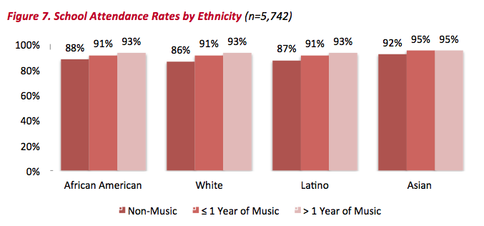
The WHY of Staying in Music
ATTENDANCE RATES
http://musicmakesus.org/resources/research

Slide 37
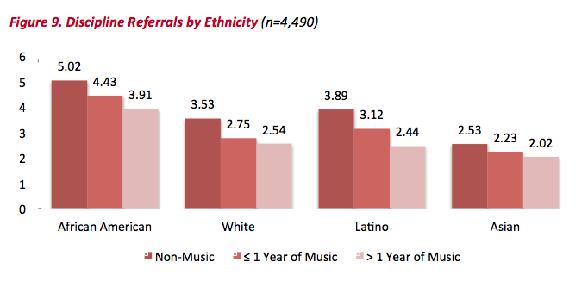
The WHY of Staying in Music
DISCIPLINE REFERRALS
http://musicmakesus.org/resources/research

Slide 38
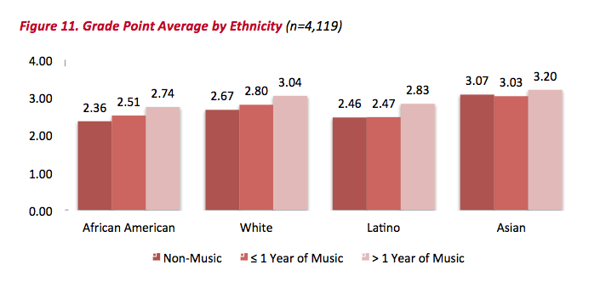
The WHY of Staying in Music
GPAS
http://musicmakesus.org/resources/research

Slide 39
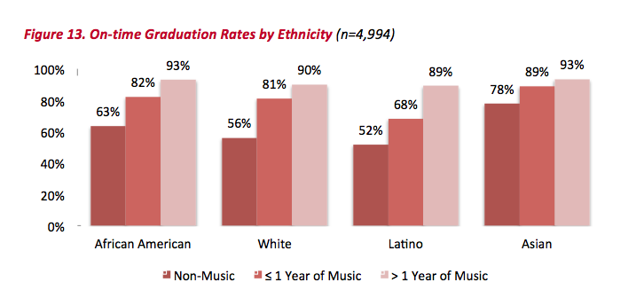
The WHY of Staying in Music
ON-TIME GRADUATION RATES
http://musicmakesus.org/resources/research

Slide 40
The WHY of Staying in Music
SUMMARY: What Was Learned?
“The more a student participates
in music, the more positive
these benefits become.”
http://musicmakesus.org/resources/research

Slide 41
The HOW of Staying in Music
STRATEGIES TO BRIDGE THE GAP
What Music Educators Can Do
What HS/MS Parents Can Do
What HS/MS Students Can Do
What HS/MS Principals Can Do
What Music Supervisors Can Do

Slide 42
The HOW: What Music Educators Can Do
Partner with Colleagues
1. Work more as one District-wide Faculty
with one Goal:
To ensure continued,
active music-making.
www.musicedconsultants.net/conference-materials.html

Slide 43
The HOW: What Music Educators Can Do
Partner with Colleagues
2. Establish a District-wide Vision (Destination) Good Examples: (“We envision. . .”)
A. Life is Good T-Shirts
. . .a world where all
children grow up feeling safe, loved, and joyful.
. . .great
public schools for all students.
B. National Education Association (NEA)
www.musicedconsultants.net/conference-materials.html

Slide 44
The HOW: What Music Educators Can Do
Partner with Colleagues
3. Establish a District-wide Mission (Purpose) Good Examples: (“We exist to. . .”)
A. Google
. . .organize the world’s information
and make it universally accessible and useful.
B. NAfME
. . .advance music education by
encouraging the studying and making of music
by all.
www.musicedconsultants.net/conference-materials.html

Slide 45
The HOW: What Music Educators Can Do
Partner with Colleagues
4. Vision/Mission Ideas for your district’s
Music Education Program:
A. Vision:
We envision a community where all
children grow up experiencing the joy of
active music-making
B. Mission:
We exist to prepare all students for
fulfilling, life-long music-making experiences.
www.musicedconsultants.net/conference-materials.html

Slide 46
The HOW: What Music Educators Can Do
Partner with Colleagues
5. Extra Idea: How about a Tag Line?
Good example:
What happens in Vegas. . .
www.musicedconsultants.net/conference-materials.html

Slide 47

The HOW: What Music Educators Can Do
Partner with Colleagues

Slide 48
The HOW: What Music Educators Can Do
Partner with Colleagues
6. Extra Idea: How about a Tag Line?
Good example:
What happens in Music. . .
Lasts for a Lifetime!
www.musicedconsultants.net/conference-materials.html

Slide 49

The HOW: What Music Educators Can Do
Partner with Colleagues
7. More Ideas
Meet regularly as a district-wide Faculty to establish goals and assess progress.
Plan performances/activities strategically
Conduct each other’s ensembles
Chaperone each other’s trips
Hang out with each other
Schedule “Switch Days” with each other
www.musicedconsultants.net/conference-materials.html

Slide 50
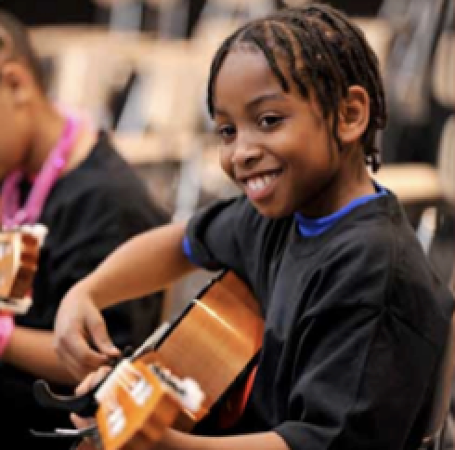
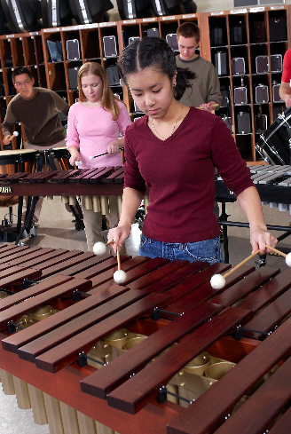
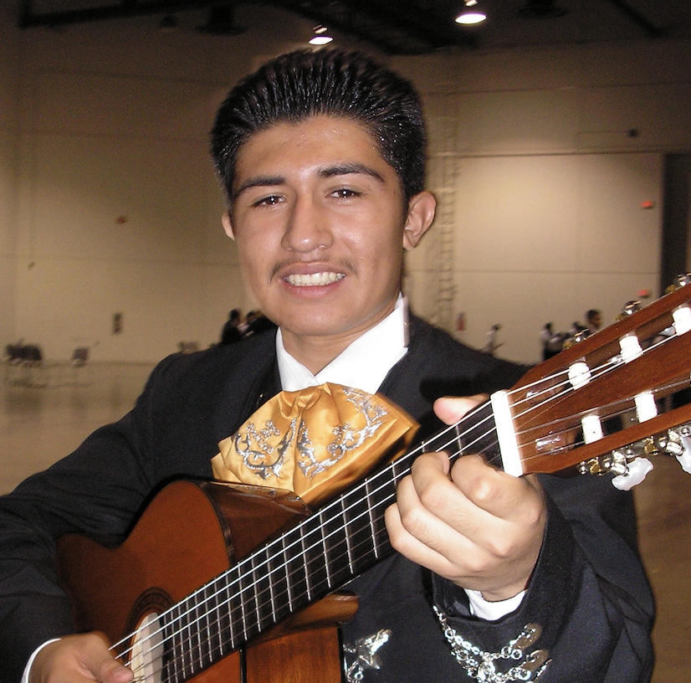

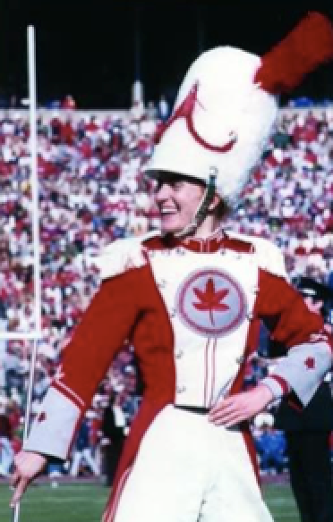
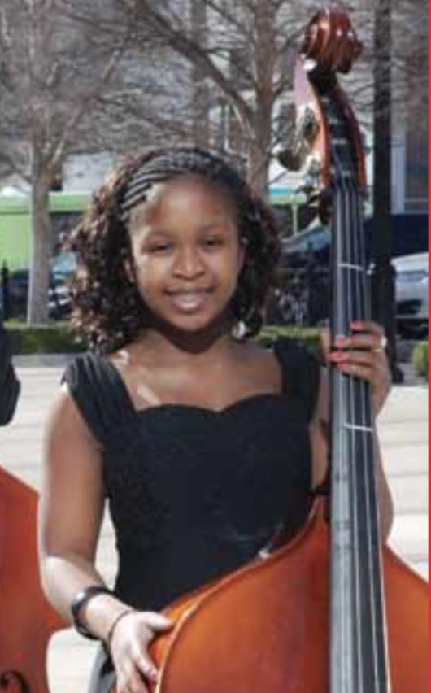
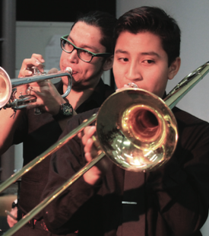
The HOW: What Music Educators Can Do
8. Help Them See Their Futures Early On

Slide 51
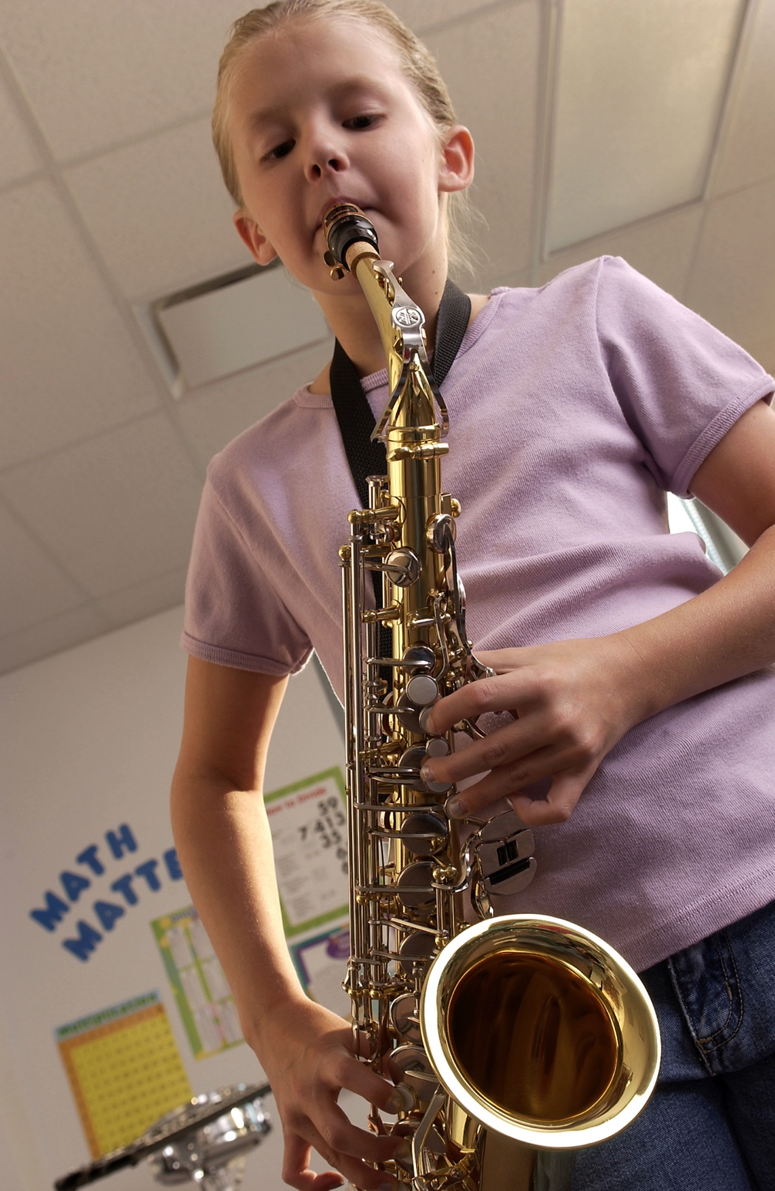
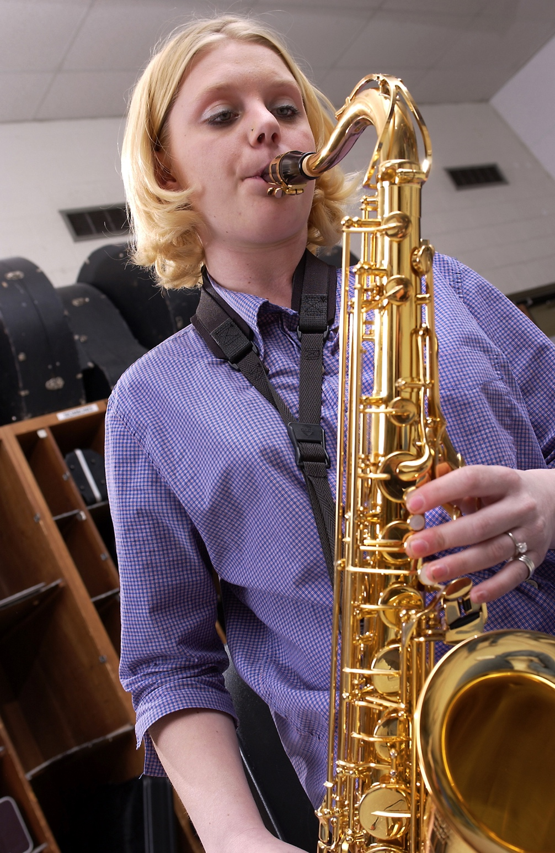
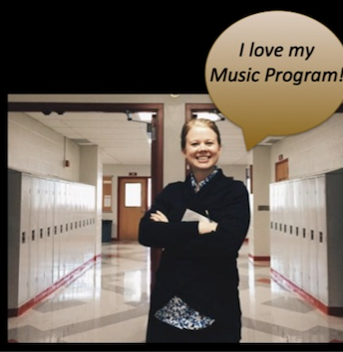
9. A Vision Board Photo is Worth 1000 Words!
The HOW: What Music Educators Can Do
  Elementary and middle school students, parents, directors, and principals with their high school
  counterparts.
Include lots of photos of:

Slide 52
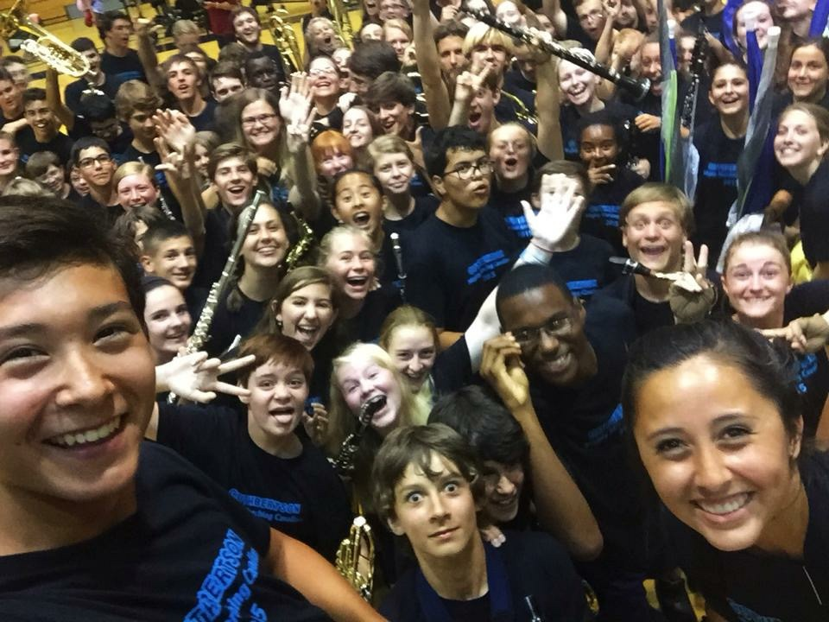
9. A Vision Board Photo is Worth 1000 Words!
The HOW: What Music Educators Can Do
  Include photos of elementary and middle school students having fun!

Slide 53
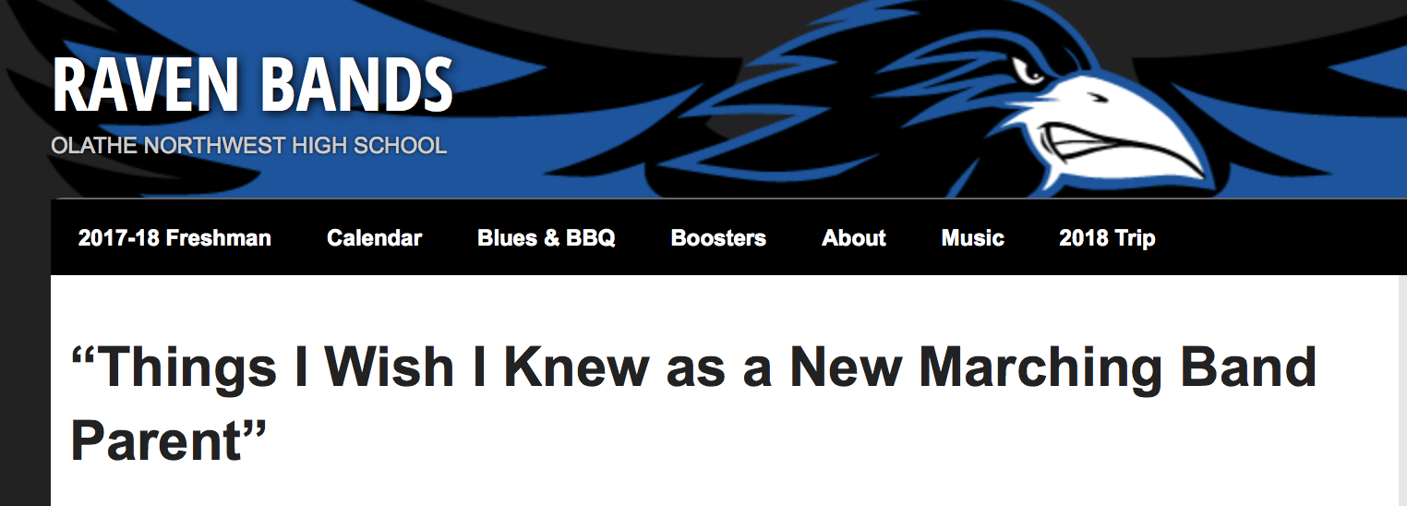
The HOW: What Parents Can Do
1. Have Parents Teach Parents
www.musicedconsultants.net/conference-materials.html

Slide 54
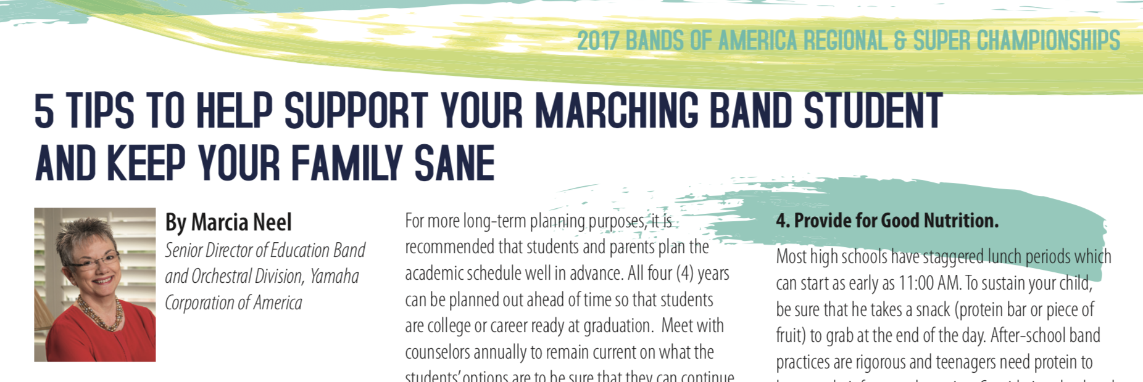
The HOW: What Parents Can Do
1. Have Parents Teach Parents
www.musicedconsultants.net/conference-materials.html

Slide 55


The HOW: What Parents Can Do
2. Engage with
Prospective Parents
Can your child read this?
Music can change your
child’s future!
Share their own stories.
Sign up for
Music!
Provide advocacy
information –
and teasers?

Slide 56

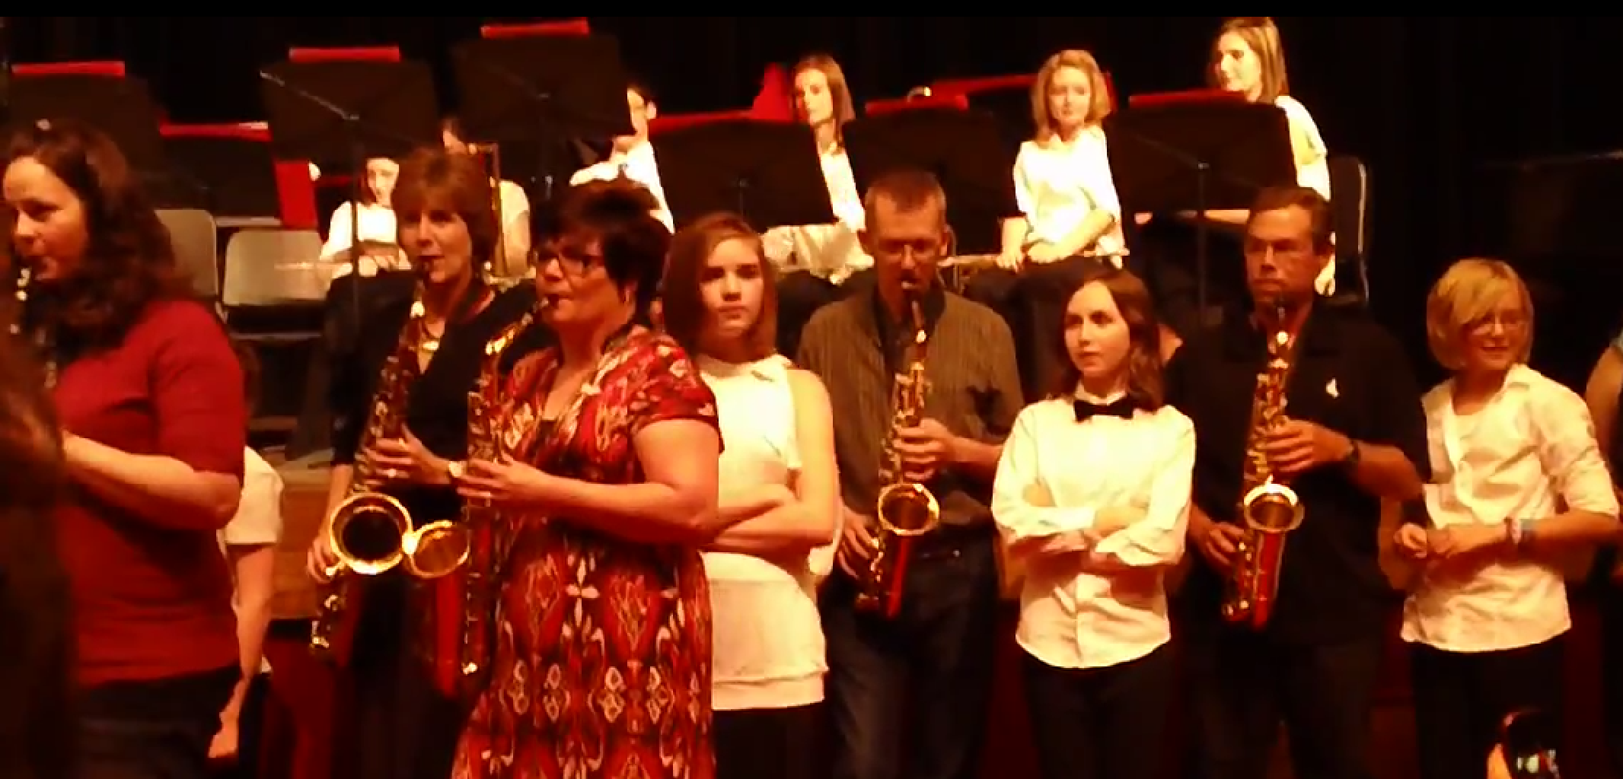
The HOW: What Parents Can Do
3. Provide opportunity for quality
interaction.
. . . The Parent Band

Slide 57
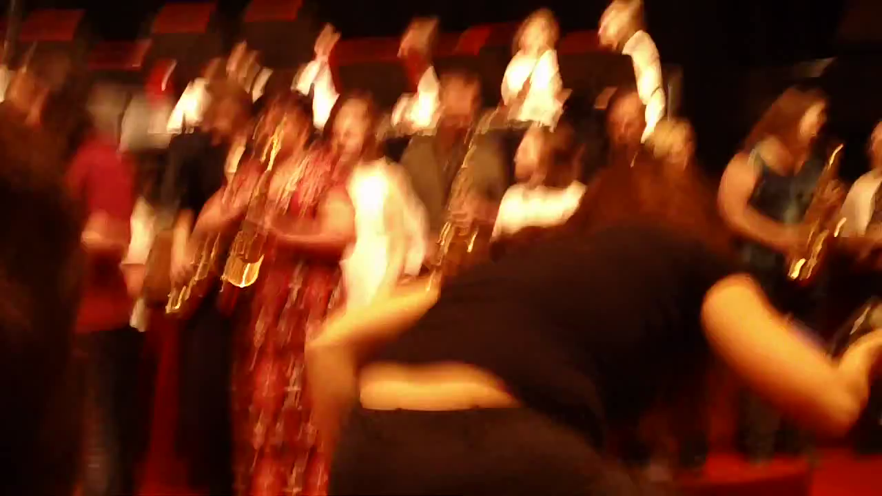
The HOW: What Parents Can Do
The Parent Band

Slide 58
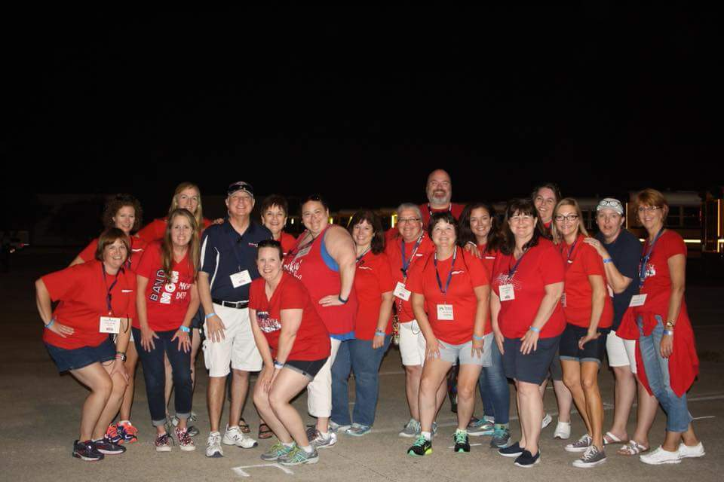
The HOW: What Parents Can Do
4. Let parents help—They want to help!
Students don’t quit if their parents
remain involved ACTIVELY in the program!

Slide 59
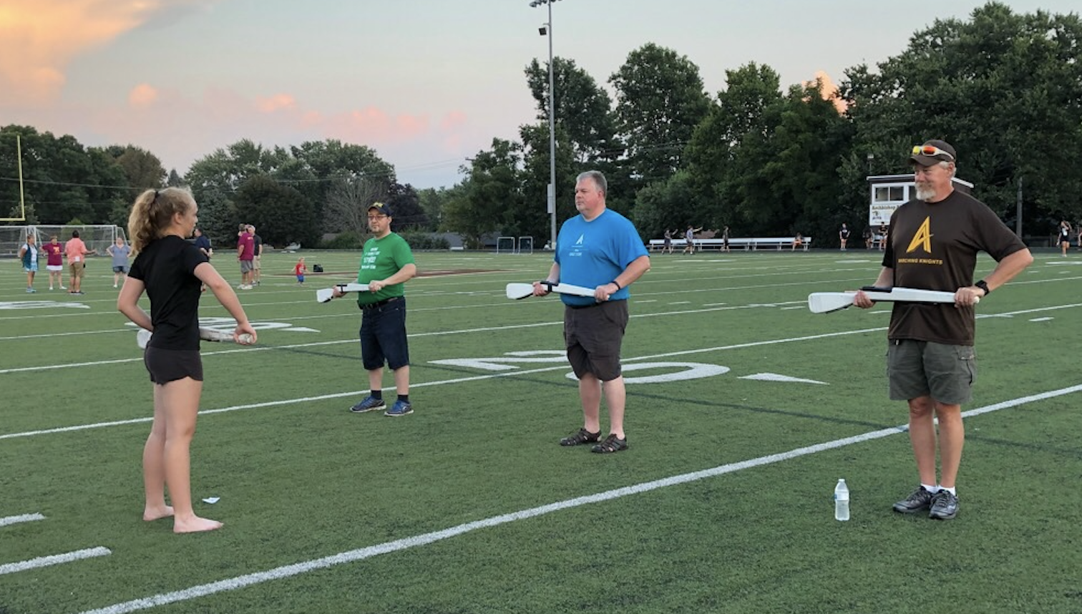
The HOW: What Parents Can Do
4. Have them “Walk in their Students’ Shoes”

Slide 60
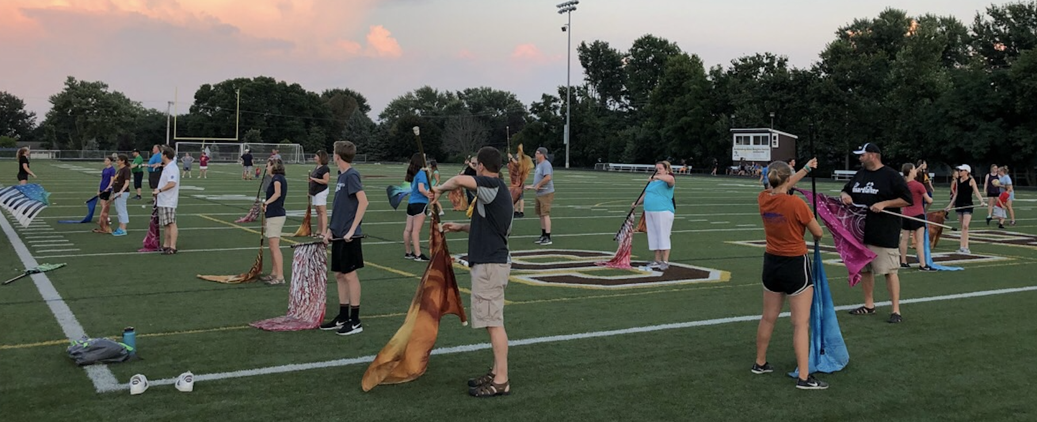
The HOW: What Parents Can Do
4. Have them “Walk in their Students’ Shoes”

Slide 61
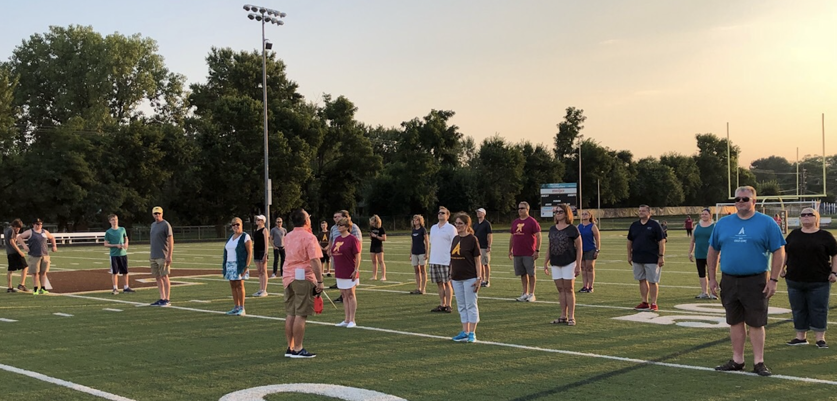
The HOW: What Parents Can Do
4. Have them “Walk in their Students’ Shoes”

Slide 62
The HOW: What Parents Can Do
5. Promote Parent Leadership!
a. Structure the Parent Organization
b. Give big jobs to a few and small jobs to
many
c. Always focus on community-building—
keep what’s best for the students at the
center of all decision-making.

Slide 63
The HOW: What Parents Can Do
5. Promote Parent Leadership!
d. Schedule a VIP Parent Night for MS
parents at a joint concert/halftime show
performance
e. HS Parents host MS/ES parent meetings at
the high school

Slide 64
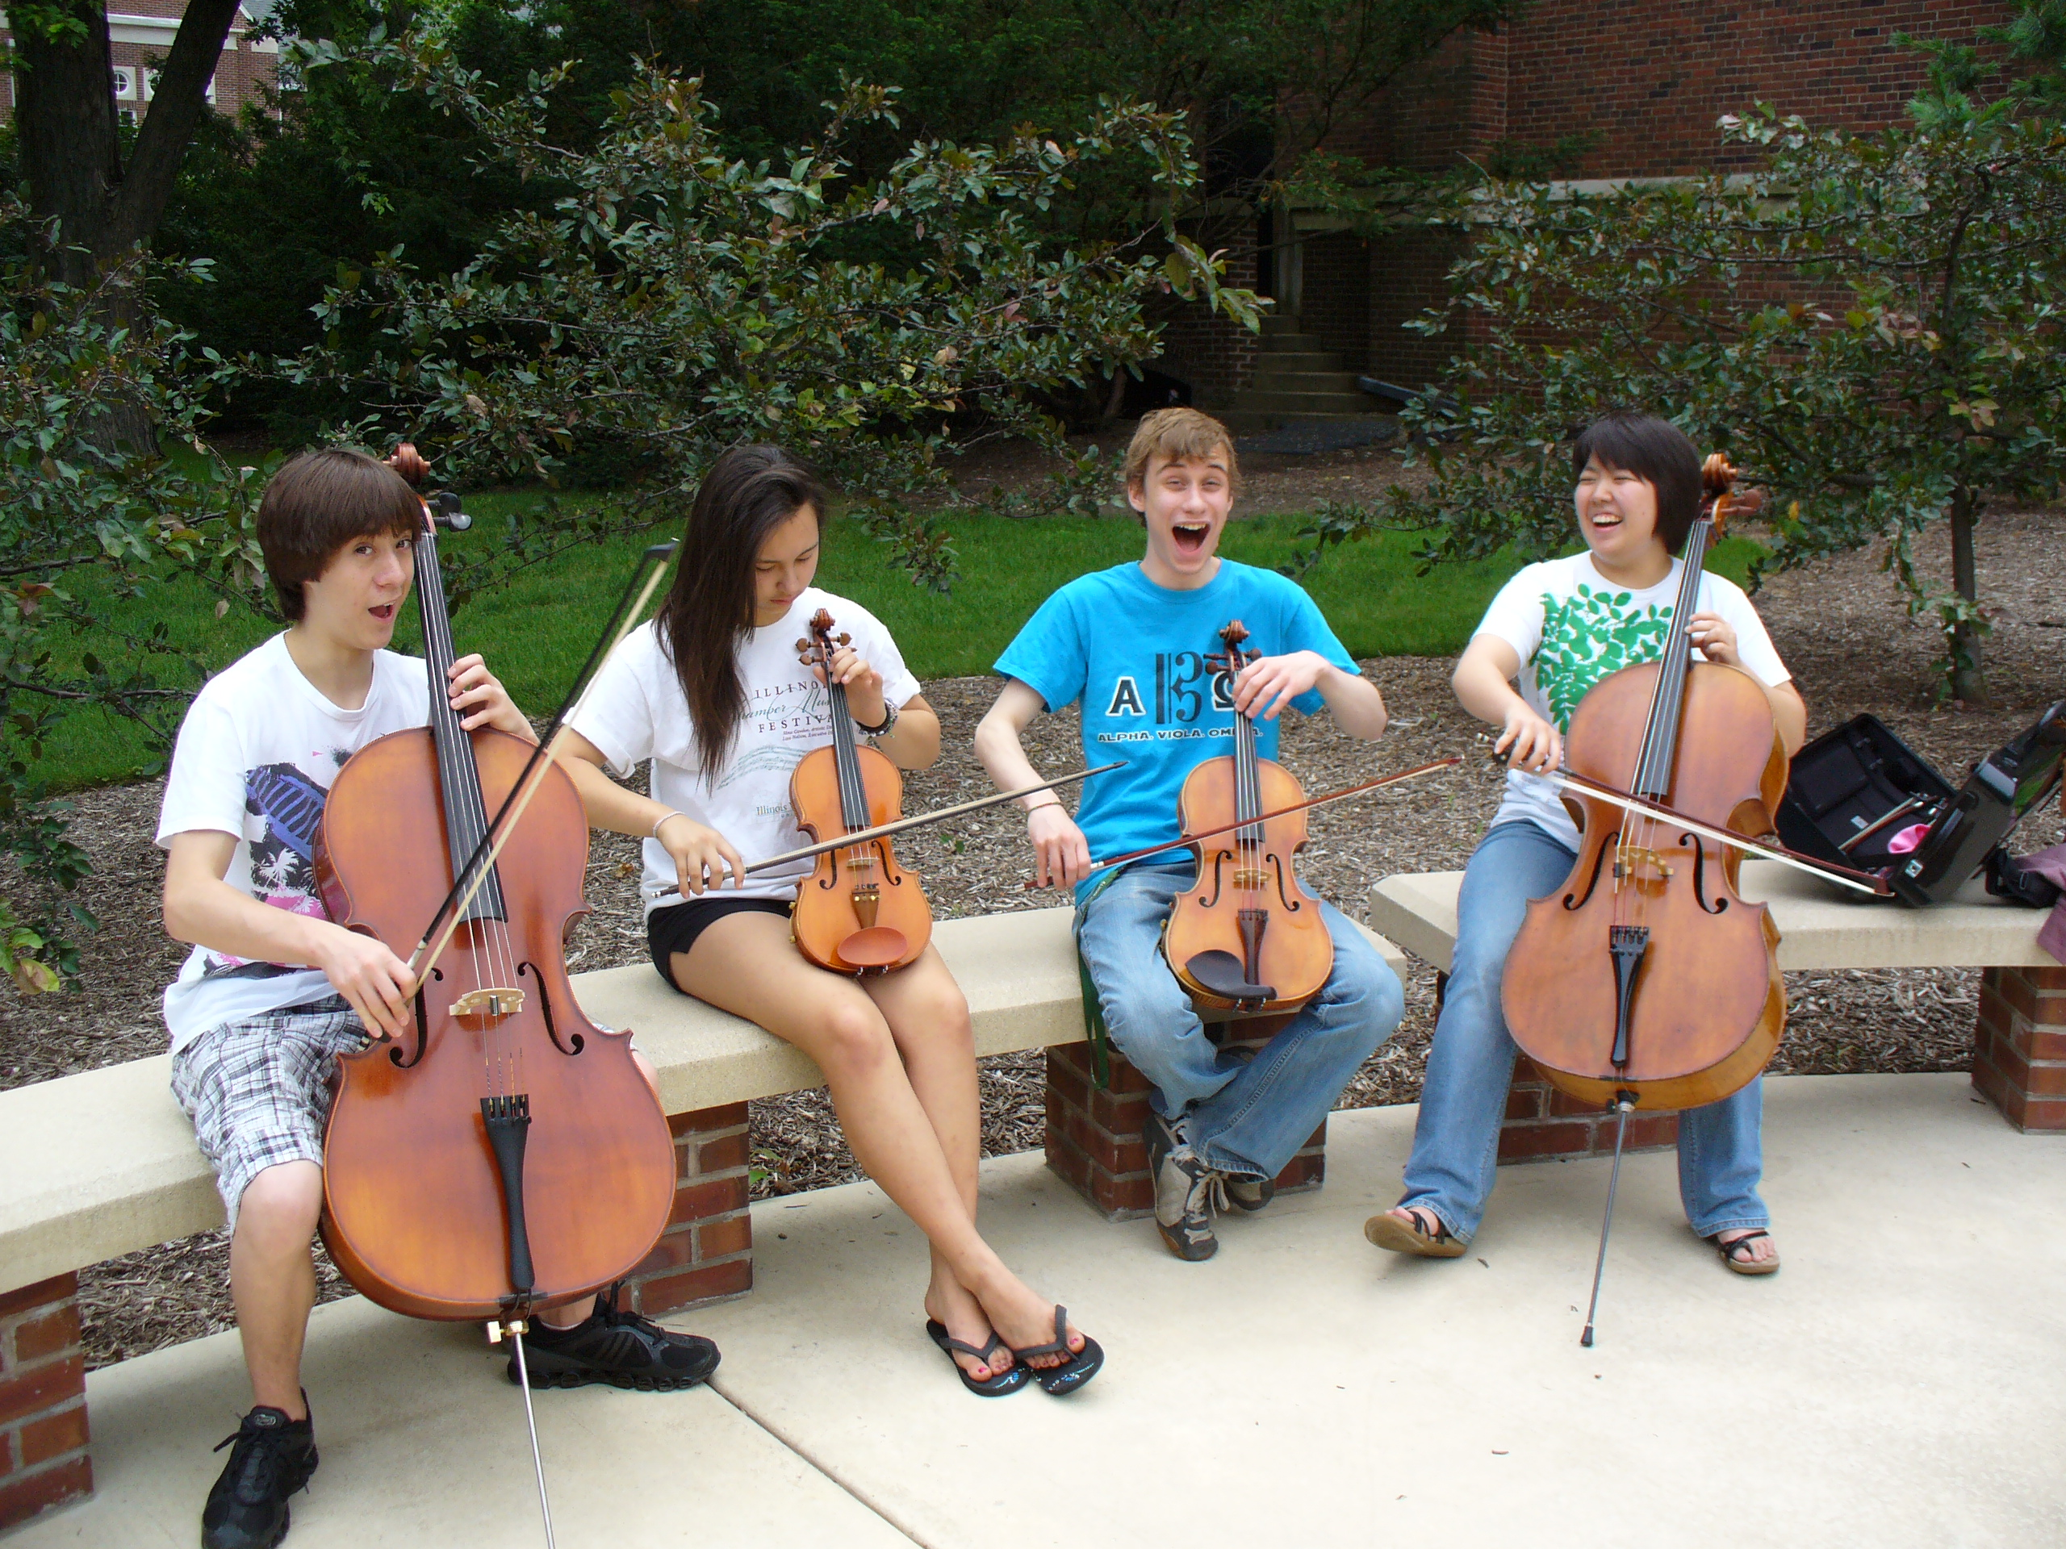
The HOW: What Students Can Do
1. Serve as “Intern Instructors” for FREE Summer Lesson Program for beginning students.

Slide 65
The HOW: What Students Can Do
1. Serve as “Intern Instructors” for FREE Summer Lesson Program for beginning (at-risk) students.
2. Participate ACTIVELY in ALL retention
efforts – give “testamonials.”

Slide 66
The HOW: What Students Can Do
Serve as “Intern Instructors” for Summer
Lesson Program for beginning students
2. Participate ACTIVELY in ALL recruitment efforts – give “testimonials”
3. Remain engaged with former programs
A. Mentor upcoming students. . .Give back!
B. Coach upcoming students.
C. Serve that program: Usher, sell refreshments

Slide 67
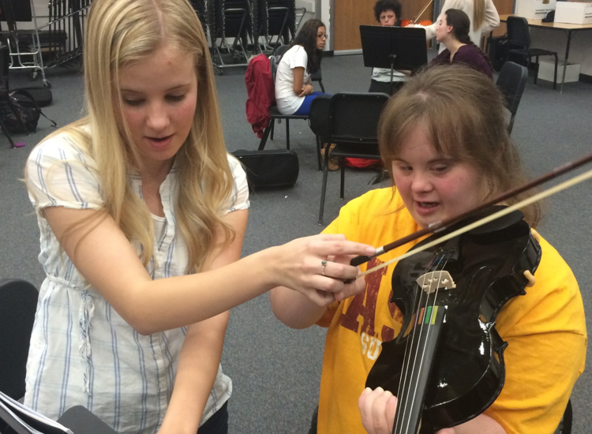
The HOW: What Students Can Do
ENGAGE new learners and EMPOWER
current students.
United Sound

Slide 68

The HOW: What Students Can Do
ENGAGE new learners and EMPOWER
current students.

Slide 69


The HOW: What Students Can Do
5. Write invitations (like a “Big Bro/Sis”)
or other notes as appropriate.
  “Congratulations!
  You have been chosen to
  play (insert instrument)
  in the (name of school) band!”
  Giving a “Golden Invitation” to
  band/orchestra makes them feel special!”

Slide 70
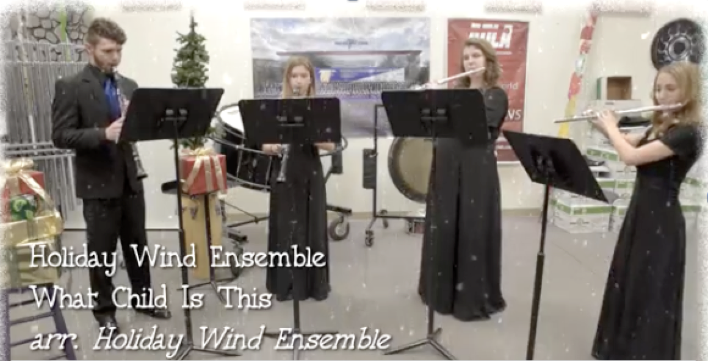
The HOW: What Students Can Do
6. Arrange and send musical greetings cards
Foothill High School AP Music Theory Card

Slide 71
The HOW: What Students Can Do
6. Send musical greetings cards
Foothill High School AP Music Theory Card

Slide 72

The HOW: What Principals Can Do

Slide 73
The HOW: What Principals Can Do
1. Help facilitate recruitment assemblies/
events/activities at feeder schools

Slide 74
The HOW: What Principals Can Do
1. Help facilitate recruitment assemblies/
events/activities at feeder schools
2. Work with feeder principals on
scheduling

Slide 75
The HOW: What Principals Can Do
1. Help facilitate recruitment assemblies/
events/activities at feeder schools
2. Work with feeder principals on
scheduling
3. Create joint presentation for (feeder)
parents

Slide 76
The HOW: What Principals Can Do
1. Help facilitate recruitment assemblies/
events/activities at feeder schools
2. Work with feeder principals on
scheduling
3. Create joint presentation for (feeder)
parents
4. Provide opening remarks at each other’s
concerts

Slide 77
The HOW: What Music Supervisors Can Do
1. Ensure that faculty sees itself as part of
one, K–12 Music Program –
build purpose and unity!

Slide 78

The HOW: What Music Supervisors Can Do
1. Ensure that faculty sees itself as part of
one, K–12 Music Program –
build purpose and unity!
2. Track articulation/ achievement/
participation data
Data
Knowledge
Action

Slide 79




Slide 80
The HOW: What Music Supervisors Can Do
3. Provide sample student schedules
Wind Symphony
Algebra I
Biology
AP English
Music Theory
Orchestra
Jazz Band
Geometry
Chemistry
Chamber Ensemble
Algebra II
Algebra XV
Calculus

Slide 81

The HOW: What Music Supervisors Can Do
4. Ensure that all students receive quality
learning opportunities and experiences

Slide 82
The HOW: What Music Supervisors Can Do
4. Ensure that all students receive quality
learning opportunities and experiences
Honor Band Opportunities
Solo and Ensemble Festivals
Large Group Festivals

Slide 83


Slide 84



Slide 85
Complimentary Recruitment and Retention Materials
MusicAchievementCouncil.org
This PPT and Videos will be Posted at:
MusicEdConsultants.net/conference-materials
Contact Information
Marcia Neel
marcia@musicedconsultants.net
@MusicEdConsult on Twitter
702.361.3553

