Slide 1

“Modern Classroom” with
Thanks to “Modern Family”
Marcia Neel
Will be posted at:
www.musiceducationconsultants.net/KCOMTEP2013

Slide 2
The What

Slide 3

What Other Teachers Think I Do

Slide 4
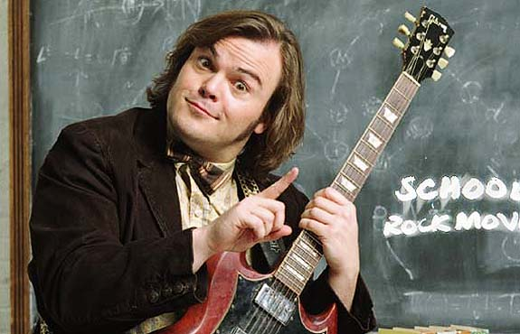
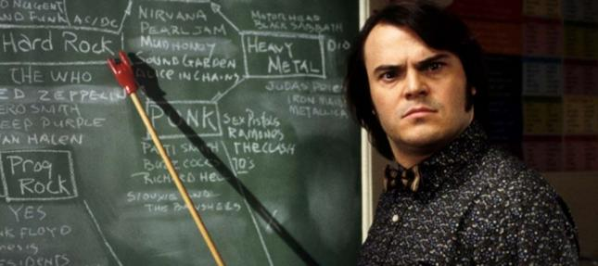
What the Kids Think I Do

Slide 5

What Society Thinks I Do

Slide 6
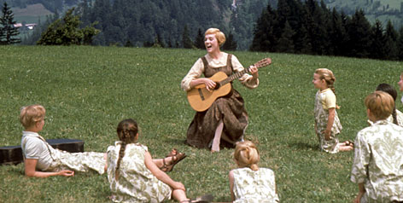
What My Mom Thinks I Do

Slide 7
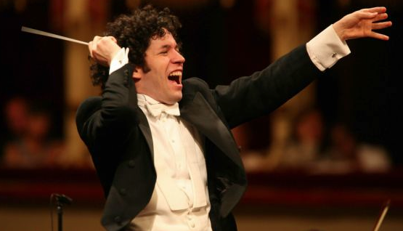
What I Think I Do

Slide 8
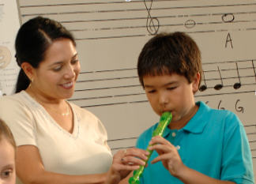
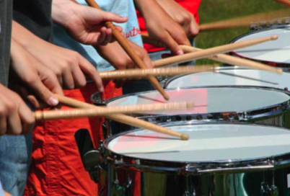

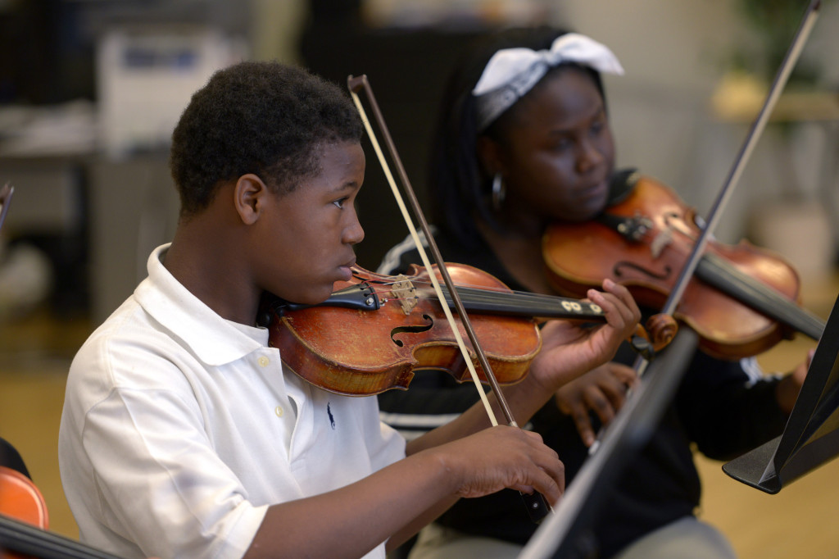
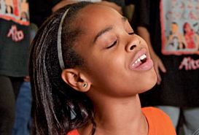
What I Really Get To Do. . .
Give Kids Opportunities to Succeed

Slide 9
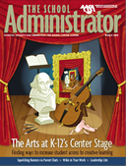
What “They” Say About
What “We” Do For Kids
American Association of School Administrators
http://bit.ly/Yr2l2n

Slide 10
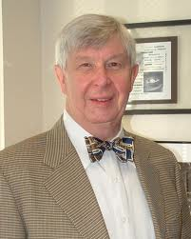
What “They” Say About
What “We” Do For Kids
Dick Deasy, Former Director
Arts Education Partnership
www.aep-arts.org
Offer opportunities for creative learning
Create positive/empowering learning environments
Prepare students for family life and citizenship

Slide 11
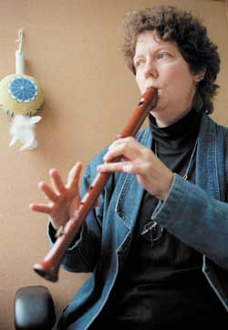
What “They” Say About
What “We” Do For Kids
Lois Hetland
Associate, Project Zero at Harvard
www.pz.harvard.edu
Teach habits of higher-order thinking to help students. . .learn to solve problems in novel ways

Slide 12
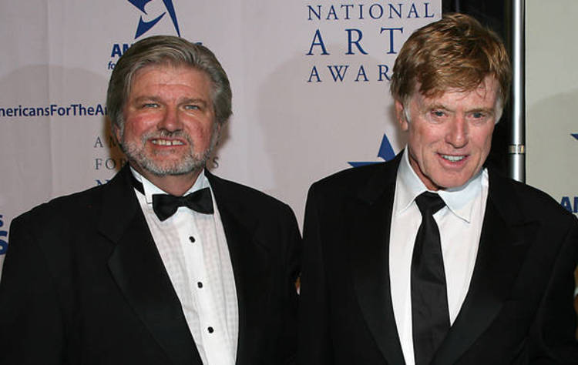
What “They” Say About
What “We” Do For Kids
Robert Lynch, President/CEO of
Americans for the Arts
Robert Redford, Actor
artsusa.org
Teach skills (creative thinking, self-discipline, collaboration, abstract reasoning and innovation) that will contribute to a knowledge-based economy

Slide 13
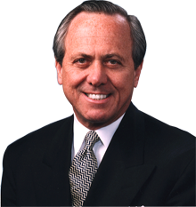
What “They” Say About
What “We” Do For Kids
John Eger, Author
The Creative Community; Linking Art,
Culture, Commerce and Community
www.smartcommunities.org
Teach creativity, imagination and innovation

Slide 14
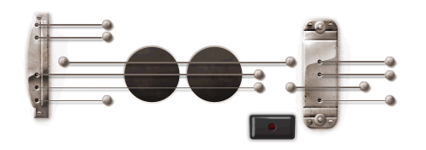
What “They” Say About
What “We” Do For Kids
Teach creativity, imagination and innovation

Slide 15
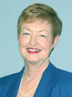
What “They” Say About
What “We” Do For Kids
Sarah D. Jerome, 2007-08 President
American Association of School Administrators
Teach about other people and cultures
Expose students to themes, ideas, and perspectives in new and different ways
Teach how to work with others

Slide 16
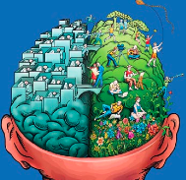
What “They” Say About
What “We” Do For Kids
Daniel Pink, Author
Why Right-brainers Will Rule the Future
Teach artistic and emotional beauty
Enable the ability to find joy in one’s self and
to elicit it in others

Slide 17
The How

Slide 18
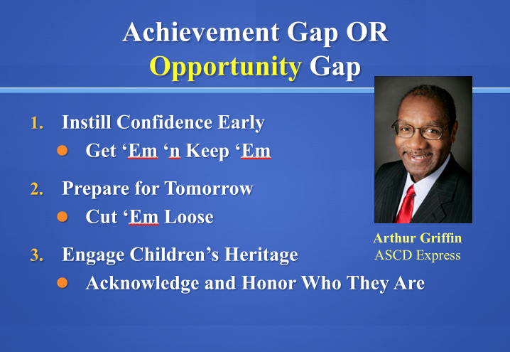

Slide 19
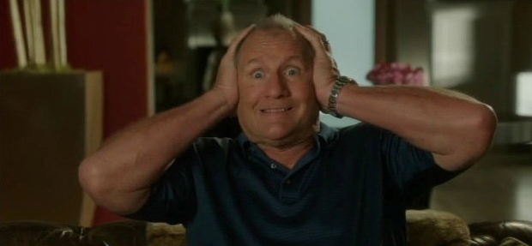
OMG! Does this mean that I have to Learn Something New???

Slide 20
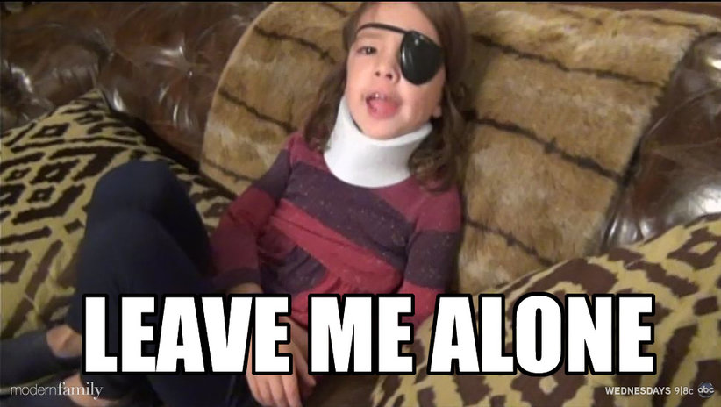
But I Don’t Want to Learn
Anything New!!!!!

Slide 21
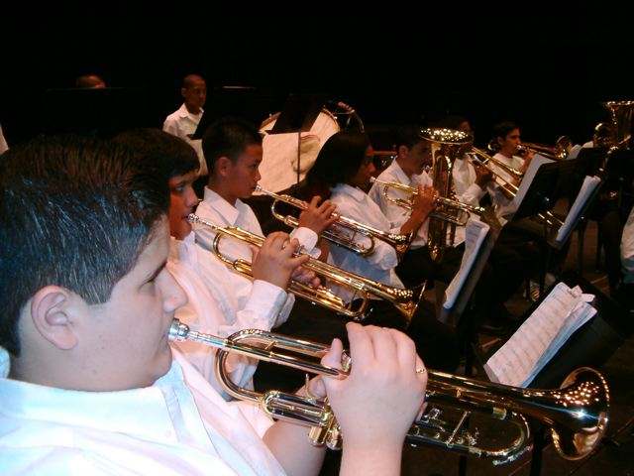
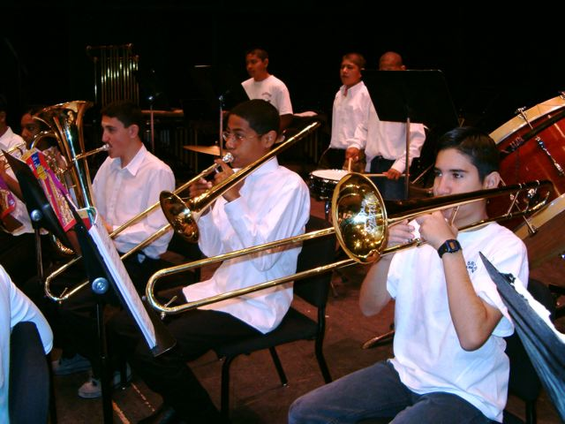
We Have the Power!!!
Music Is Our Vessel
So. . .How Can We Become a More Modern Classroom and Awaken, Engage and Challenge even MORE Students in This INCREDIBLE, LIFE-CHANGING Art Form That We Teach!

Slide 22

We Have the Power!!!
The Joy of Music-Making
Larry Livingston’s Trio of Recommendations
Broaden the base
Teach so that students will be able to go on and DO music without us
Acknowledge and honor ALL music

Slide 23
1. Ideas to Broaden the Base
A. Look at Who We Are Teaching
Do our programs reflect our demographic?
Do we cater to a select few?
Do we really want more students in conservatories?

Slide 24
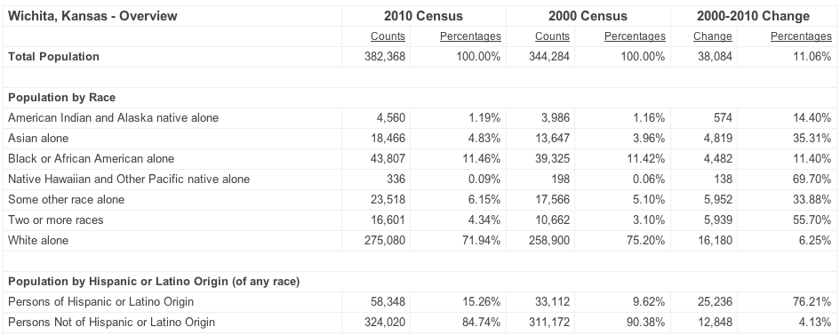
U.S. Dept of Commerce
Kansas “Quick Facts”

Slide 25
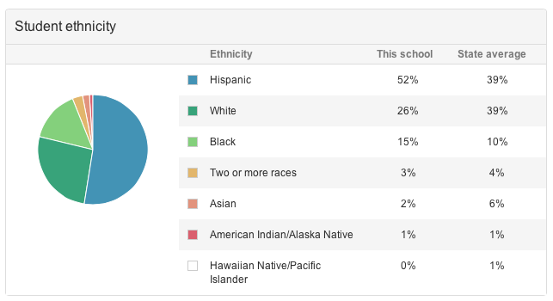
Ideas to Broaden the Base
Who Are We Teaching? www.greatschools.org
Bailey Middle School Las Vegas, NV

Slide 26

Bailey Middle School–2nd Year Mariachi
Las Vegas, NV

Slide 27
1. Ideas to Broaden the Base
B. Maximize the “Kids and Music” Relationship
OLD: If you want to be a musician, you have to play an instrument and take lessons
NEW: If provided with an opportunity to study music through the exploration of the power of music in their lives, our classes would be overflowing

Slide 28
1. Ideas to Broaden the Base
Broaden Course Offerings to Address Student Interests/Needs/Cultural Background
Guitar Steel Drum
Drumming Bluegrass
Music Technology Gospel Music
Mariachi Dixieland
Song Writing Ukelele Ensembles???

Slide 29
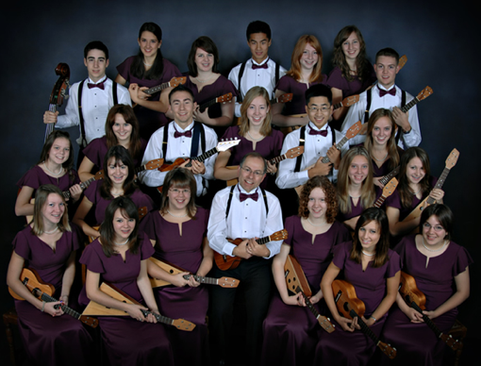
Langley HS Ukelele Ensemble from B.C. Canada

Slide 30
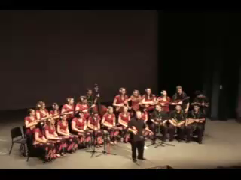
Langley HS Ukelele Ensemble
http://www.youtube.com/watch?v=IHRY1snb4l4

Slide 31
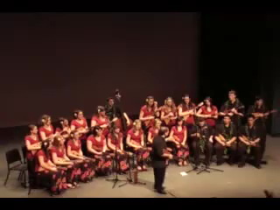
Langley HS Ukelele Ensemble
http://www.youtube.com/watch?v=n22iN3yO0G4

Slide 32
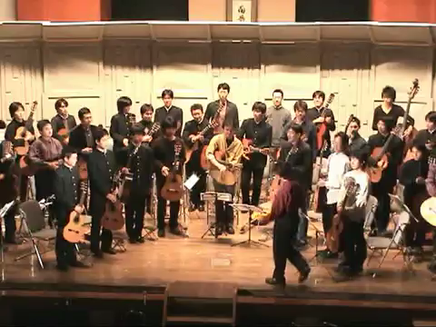
Guitar Orchestra

Slide 33
2. Ideas to Teach So That Students
Will Be Able To Go On and
DO Music Without Us
A. Use conceptual teaching methods
    Give them the tools
B. Think fulfillment
    Instill them with passion
Allow students to experience your joys of music-making
    Give them the power

Slide 34
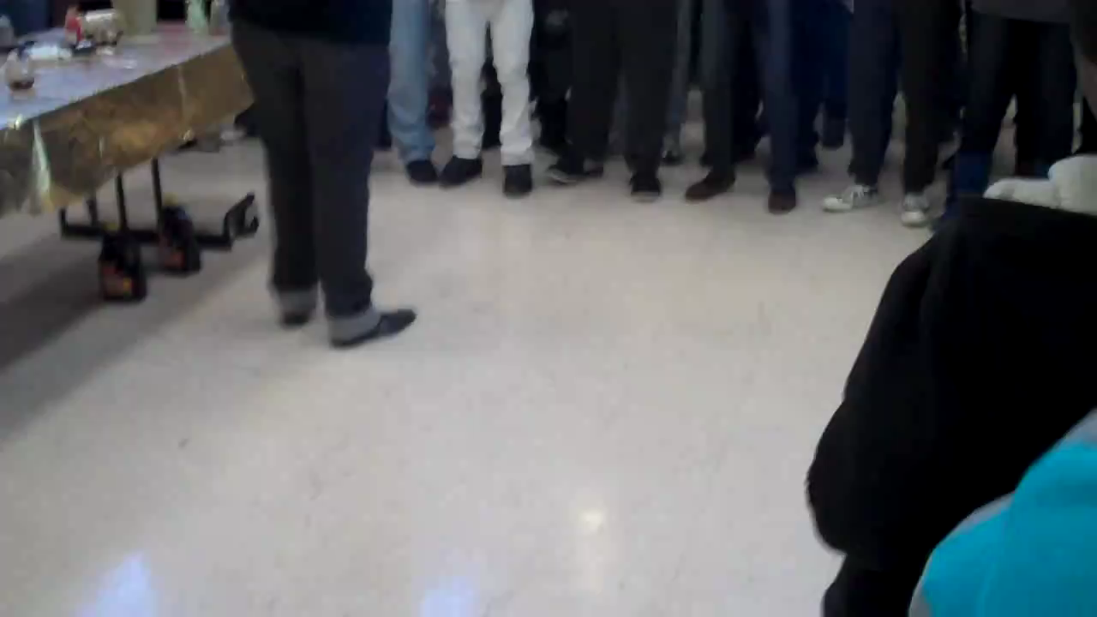
Go On and DO Music Without Us!
Cleveland Hgts HS Gospel Choir

Slide 35
3. Ideas to Acknowledge and Honor ALL Musical Values
Marcia’s GINZU Philosophy:
MOZART is My Favorite. . .
BUT WAIT! . . .THERE’S MORE!!!!!

Slide 36


3. Ideas to Acknowledge and Honor ALL Musical Values
Music Tech (YIKES! What do I do with THIS!!!!!)

Slide 37

3. Ideas to Acknowledge and Honor ALL Musical Values
Answer: Whatever You (Or They) Want!

Slide 38
3. Ideas to Acknowledge and Honor ALL Musical Values
B. De-mythalize “Classical Music” and Try:
Mariachi Gospel Music
Dixieland World Music Drumming
Ukelele Ensembles Bluegrass???????

Slide 39
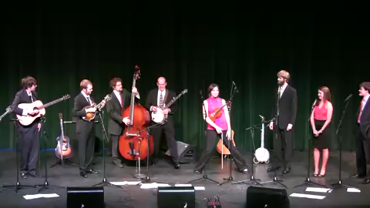
Belmont University
Bluegrass Ensemble

Slide 40
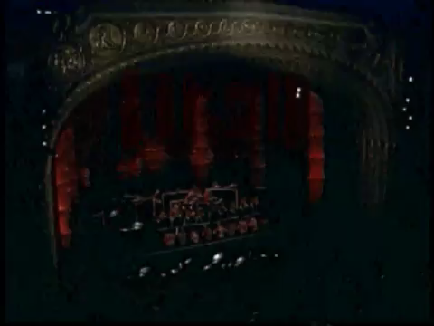
Tucson High School
Steel Drum Ensemble
musiceducationconsultants.net/KCOMTEP2013
40
http://www.youtube.com/watch?v=IxZoKykvo6Q

Slide 41
Let’s Review. . .
How many students are in the music program and who are they? (Know your demographics)
How long will they keep “doing” music as amateurs once they leave us? (Teach musical independence)
Have we blessed and honored ALL music as possible and wonderful? (Be open to all genres of self-expression)

Slide 42

A Superlative Example of the
Modern Classroom
Crespi High School Music Program

Slide 43
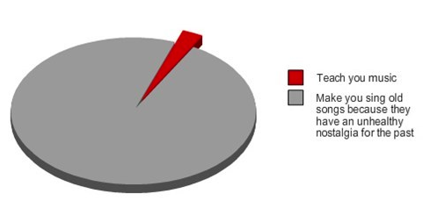
OLD: What Music Teachers Do

Slide 44
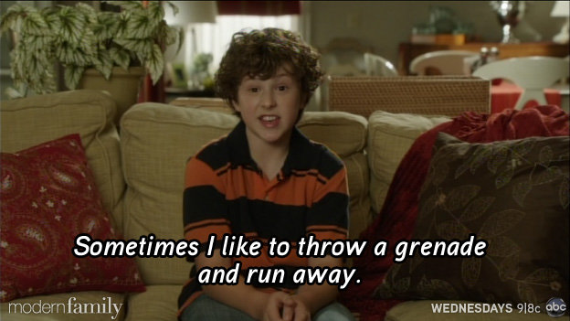
NEW: What Music Teachers Do
YOU CAN DO IT!

Slide 45
In Closing. . .Pablo Casals
Each second we live is a new and unique moment in the universe, a moment that never was before and will never be again.
And what do we teach our children in school? We teach them that two and two make four and that Paris is the capital of France.
We should also teach them who they are.

Slide 46


Marcia Neel
Contact Information
marcia@musicedconsultants.net
www.musiceducationconsultants.net/KCOMTEP2013
@MusicEdConsult
On Twitter

