Slide 1




“Modern Classroom” with
Thanks to “Modern Family”
2013 KMEA In-Service Workshop
Marcia Neel
Music Education
Consultants, Inc.
Sponsored by
Manning Music
R.E.W Music
Senseney Music
Will be posted at:
www.musiceducationconsultants.net/KMEA2013

Slide 2
The What

Slide 3
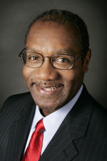
Achievement Gap OR
Opportunity Gap
Arthur Griffin, ASCD Express
Instill Confidence Early
  Get ‘Em ‘n Keep ‘Em
Prepare for Tomorrow
  Cut ‘Em Loose
Engage Children’s Heritage
  Acknowledge and Honor Who They Are
McGraw-Hill Education

Slide 4
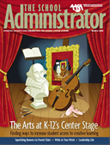
What “They” Say About
What “We” Do For Kids
American Association of School Administrators
http://bit.ly/Yr2l2n

Slide 5
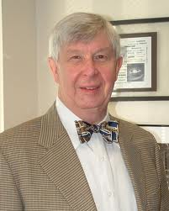
What “They” Say About
What “We” Do For Kids
Dick Deasy, Former Director
Arts Education Partnership
www.aep-arts.org
Offer opportunities for creative learning
Create positive/empowering learning environments
Prepare students for family life and citizenship

Slide 6
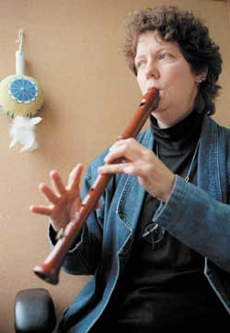
What “They” Say About
What “We” Do For Kids
Lois Hetland
Associate, Project Zero at Harvard
www.pz.harvard.edu
Teach habits of higher-order thinking to help students. . .learn to solve problems in novel ways

Slide 7
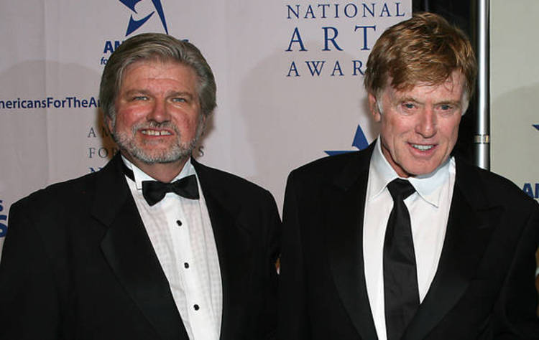
What “They” Say About
What “We” Do For Kids
Robert Lynch, President/CEO of
Americans for the Arts
Robert Redford, Actor
artsusa.org
Teach skills (creative thinking, self-discipline, collaboration, abstract reasoning and innovation) that will contribute to a knowledge-based economy

Slide 8
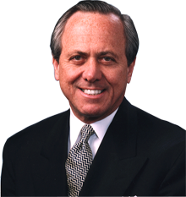
What “They” Say About
What “We” Do For Kids
John Eger, Author
The Creative Community; Linking Art,
Culture, Commerce and Community
www.smartcommunities.org
Teach creativity, imagination and innovation

Slide 9
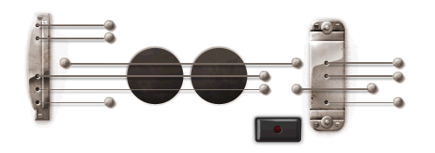
What “They” Say About
What “We” Do For Kids
Teach creativity, imagination and innovation

Slide 10
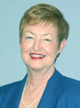
What “They” Say About
What “We” Do For Kids
Sarah D. Jerome, 2007-08 President
American Association of School Administrators
Teach about other people and cultures
Expose students to themes, ideas, and perspectives in new and different ways
Teach how to work with others

Slide 11
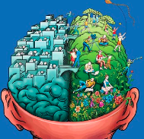
What “They” Say About
What “We” Do For Kids
Daniel Pink, Author
Why Right-brainers Will Rule the Future
Teach artistic and emotional beauty
Enable the ability to find joy in one’s self and
to elicit it in others

Slide 12
The How

Slide 13
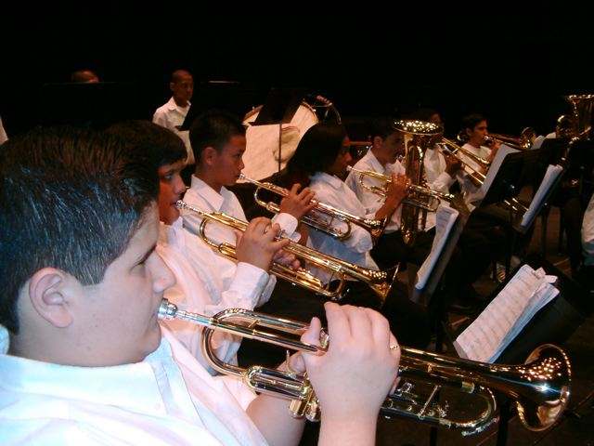
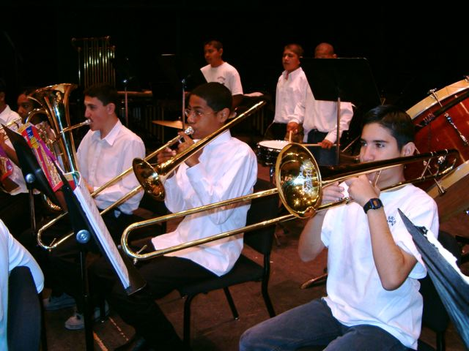
We Have the Power!!!
Music Is Our Vessel
So. . .How Can We Become a More Modern Classroom and Awaken, Engage and Challenge even MORE Students in This INCREDIBLE, LIFE-CHANGING Art Form That We Teach!

Slide 14

We Have the Power!!!
Let’s NOT Be The Best Kept Secret in the School!
Larry Livingston’s Trio of Recommendations
Broaden the base
Teach so that students will be able to go on and DO music without us
Acknowledge and honor ALL music

Slide 15
1. Ideas to Broaden the Base
A. Look at Who We Are Teaching
Do our programs reflect our demographic?
Do we cater to a select few?
Do we really want more students in conservatories?

Slide 16
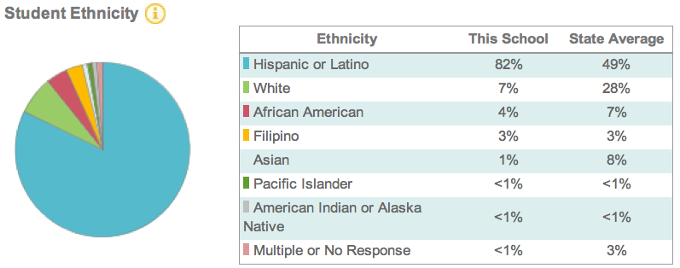
Ideas to Broaden the Base
Who Are We Teaching?
Chula Vista High School

Slide 17

Mariachi Chula Vista
Sweetwater Union High School District

Slide 18
1. Ideas to Broaden the Base
B. Maximize the “Kids and Music” Relationship
OLD: If you want to be a musician, you have to play an instrument and take lessons
NEW: If provided with an opportunity to study music through the exploration of the power of music in their lives, classes would be overflowing

Slide 19
1. Ideas to Broaden the Base
Broaden Course Offerings to Address Student Interests/Needs/Cultural Background
Guitar Steel Drum
Drumming Bluegrass
Music Technology Gospel Music
Mariachi Dixieland
Song Writing Ukelele Ensembles???

Slide 20
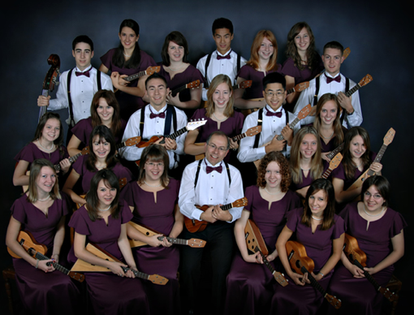
Langley HS Ukelele Ensemble from B.C. Canada

Slide 21
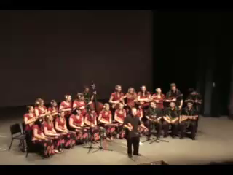
Langley HS Ukelele Ensemble
http://www.youtube.com/watch?v=IHRY1snb4l4

Slide 22
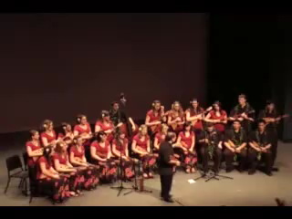
Langley HS Ukelele Ensemble
http://www.youtube.com/watch?v=n22iN3yO0G4

Slide 23
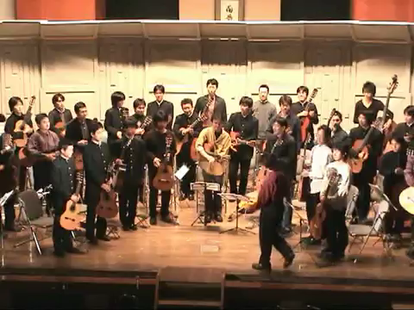
Guitar Orchestra

Slide 24
2.Ideas to Teach So That Students Will Be Able To Go On and DO Music Without Us
A. Use conceptual teaching methods
    Give them the tools
B. Think fulfillment
    Instill them with passion
Allow students to experience your joys of music-making
    Give them the power

Slide 25
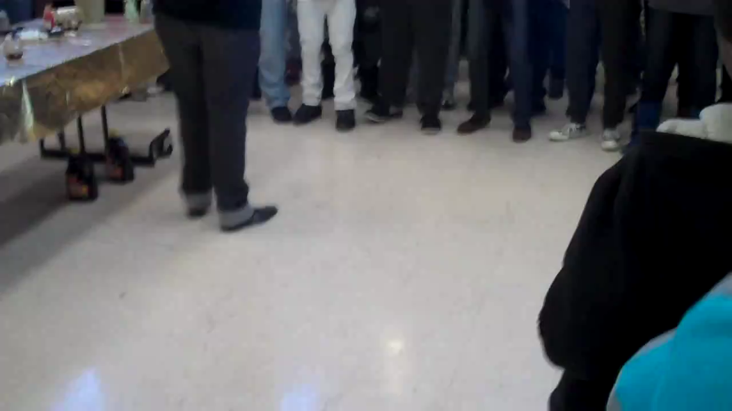
Go On and DO Music Without Us!
Cleveland Hgts HS Gospel Choir, Student

Slide 26
3. Ideas to Acknowledge and Honor ALL Musical Values
Marcia’s GINZU Philosophy:
MOZART is My Favorite. . .
BUT WAIT! . . .THERE’S MORE!!!!!

Slide 27


3. Ideas to Acknowledge and Honor ALL Musical Values
Music Technology (YIKES! What do I do with THIS!!!!!)

Slide 28

3. Ideas to Acknowledge and Honor ALL Musical Values
Music Technology (YIKES! What do I do with THIS!!!!!)
  ANSWER: WHATEVER YOU (OR THEY) WANT!

Slide 29
3. Ideas to Acknowledge and Honor ALL Musical Values
B. De-mythalize “Classical Music” and Try:
Mariachi Gospel Music
Dixieland World Music Drumming
Ukelele Ensembles Bluegrass???????

Slide 30
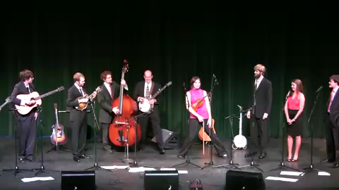
Belmont University
Bluegrass Ensemble

Slide 31
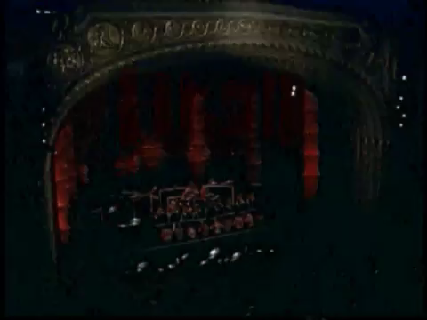
Tucson High School
Steel Drum Ensemble
musiceducationconsultants.net/CSI2011
31
http://www.youtube.com/watch?v=IxZoKykvo6Q

Slide 32
Let’s Review. . .
How many students are in the music program and who are they? (Know your demographics)
How long will they keep “doing” music as amateurs once they leave us? (Teach musical independence)
Have we blessed and honored ALL music as possible and wonderful? (Be open to all genres of self-expression)

Slide 33

A Superlative Example of the
Modern Classroom
Crespi High School Music Program

Slide 34
In Closing. . .Pablo Casals
Each second we live is a new and unique moment in the universe, a moment that never was before and will never be again.
And what do we teach our children in school? We teach them that two and two make four and that Paris is the capital of France.
We should also teach them who they are.

Slide 35

Contact Information:
marcia@musicedconsultants.net
www.musiceducationconsultants.net/KMEA2013
@MusicEdConsult
On Twitter
Thank You, Sponsors!

