Slide 1
Making an Advocate
Out of Your Principal:
10 Things You Can Do Monday!
Have Your SmartPhone/QR Code Reader Handy!
Utah Music Educators Assocation
Marcia Neel
February 1, 2013
www.musiceducationconsultants.net/UMEA2013

Slide 2
Let’s Ask Two Questions…
What Do Principals Really Think?
What I love best about my music teacher is that he/she is. . .
What troubles me most about my music teacher is that he/she is. . .
In order to improve my school music department, I would ask my music teacher to. . .
2. What Have You Done to Make an Advocate out of Your Principal?

Slide 3
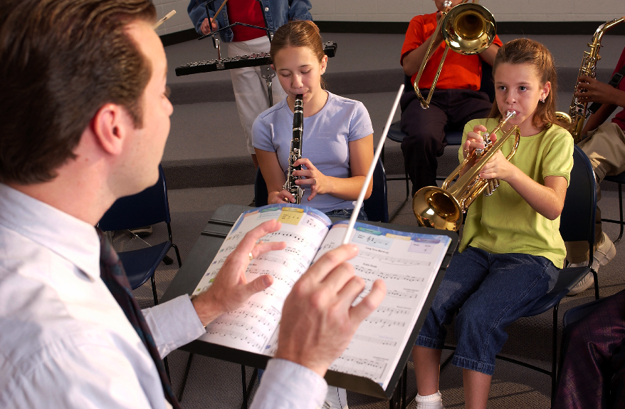
1. What Do Principals Really Think?
What I love best about my music teacher is
that he/she is. . .(here we go!)
Caring
Dedicated
Passionate
Committed
Success-oriented
Organized
Dynamic
Positive
A Team Player/Builder with Students/Staff
www.musiceducationconsultants.net/UMEA2013

Slide 4
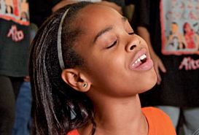
1. What Do Principals Really Think?
What I love best about my music teacher is
that he/she is. . .
Communicative
Encouraging
Flexible
Professional
Creative
Talented
Intense (In a Good Way)
Effective with Pedagogy
www.musiceducationconsultants.net/UMEA2013

Slide 5
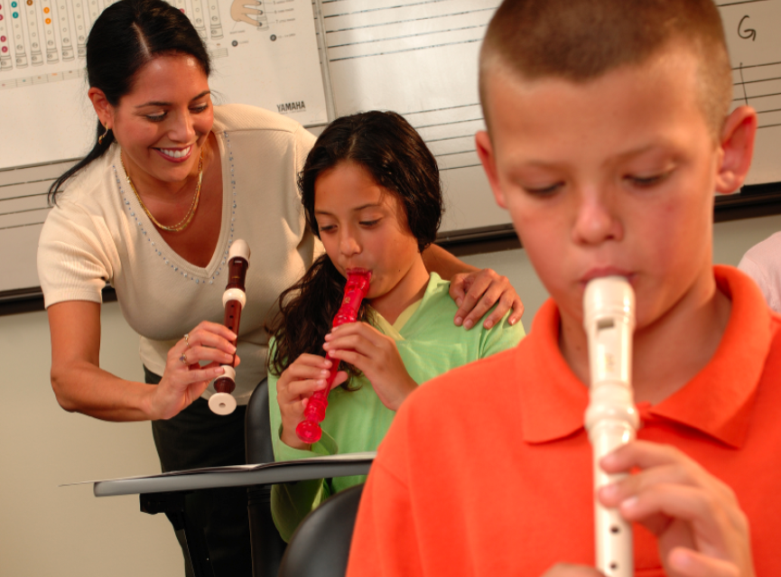
1. What Do Principals Really Think?
What I love best about my music teacher is
that he/she is. . .
Responsible
Collegial
Motivational
Inspirational
Helpful
Content-oriented
A Music Advocate (Recruiter)
Demanding (Self and Students)
www.musiceducationconsultants.net/UMEA2013

Slide 6
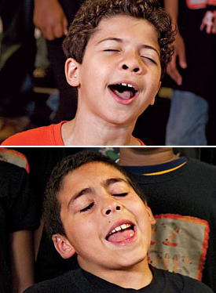
1. What Do Principals Really Think?
To improve the music program, I would ask my
music teachers to. . .
Communicate ! Communicate! Communicate!
Coordinate/Collborate with Colleagues
Articulate with Feeder Schools
Recruit/Retain More
Develop Pride in Groups
Expect Excellence
Promote More
Perform More
www.musiceducationconsultants.net/UMEA2013

Slide 7
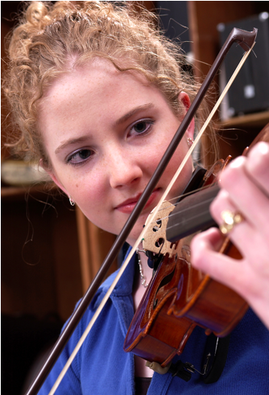
1. What Do Principals Really Think?
To improve the music program, I would ask my
music teachers to. . .(cont.)
Help Administrators to Help Them
(esp. Class Sizes)
Extend Learning Into the Community
Develop Partnerships
Incorporate School-wide Objectives
Analyze Their Own Programs More
Often
www.musiceducationconsultants.net/UMEA2013

Slide 8

1. What Do Principals Really Think?
What troubles me most is that he/she is not. . .
Passionate about Music/Teaching
Considerate of the “Big Picture”
Communicative
Demanding Enough
A Classroom Manager
Taking Care of Self
An Effective Lesson Planner Even-tempered
A Team Player Organized
www.musiceducationconsultants.net/UMEA2013

Slide 9



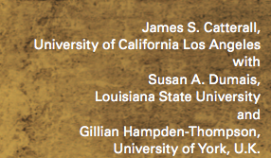
What Have You Done to Make an Advocate Out of Your Principal?
“I keep my principal informed.”

Slide 10

What Have You Done to Make an Advocate Out of Your Principal?
COMMUNICATION DOESN’T ALWAYS HAVE TO BE SO SERIOUS!
“We have to talk!”
www.musiceducationconsultants.net/UMEA2013

Slide 11
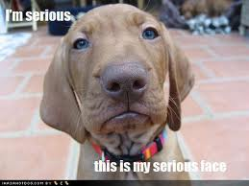
What Have You Done to Make an Advocate Out of Your Principal?
COMMUNICATION DOESN’T ALWAYS HAVE TO BE SO SERIOUS!
www.musiceducationconsultants.net/UMEA2013

Slide 12
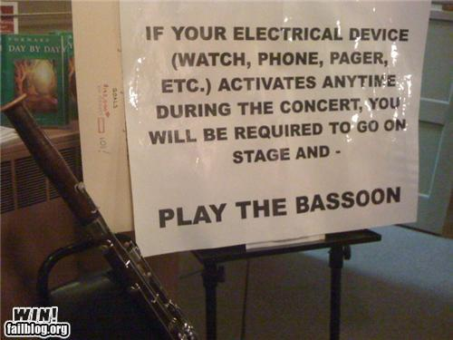
COMMUNICATION DOESN’T ALWAYS HAVE TO BE SO SERIOUS!
www.musiceducationconsultants.net/UMEA2013

Slide 13
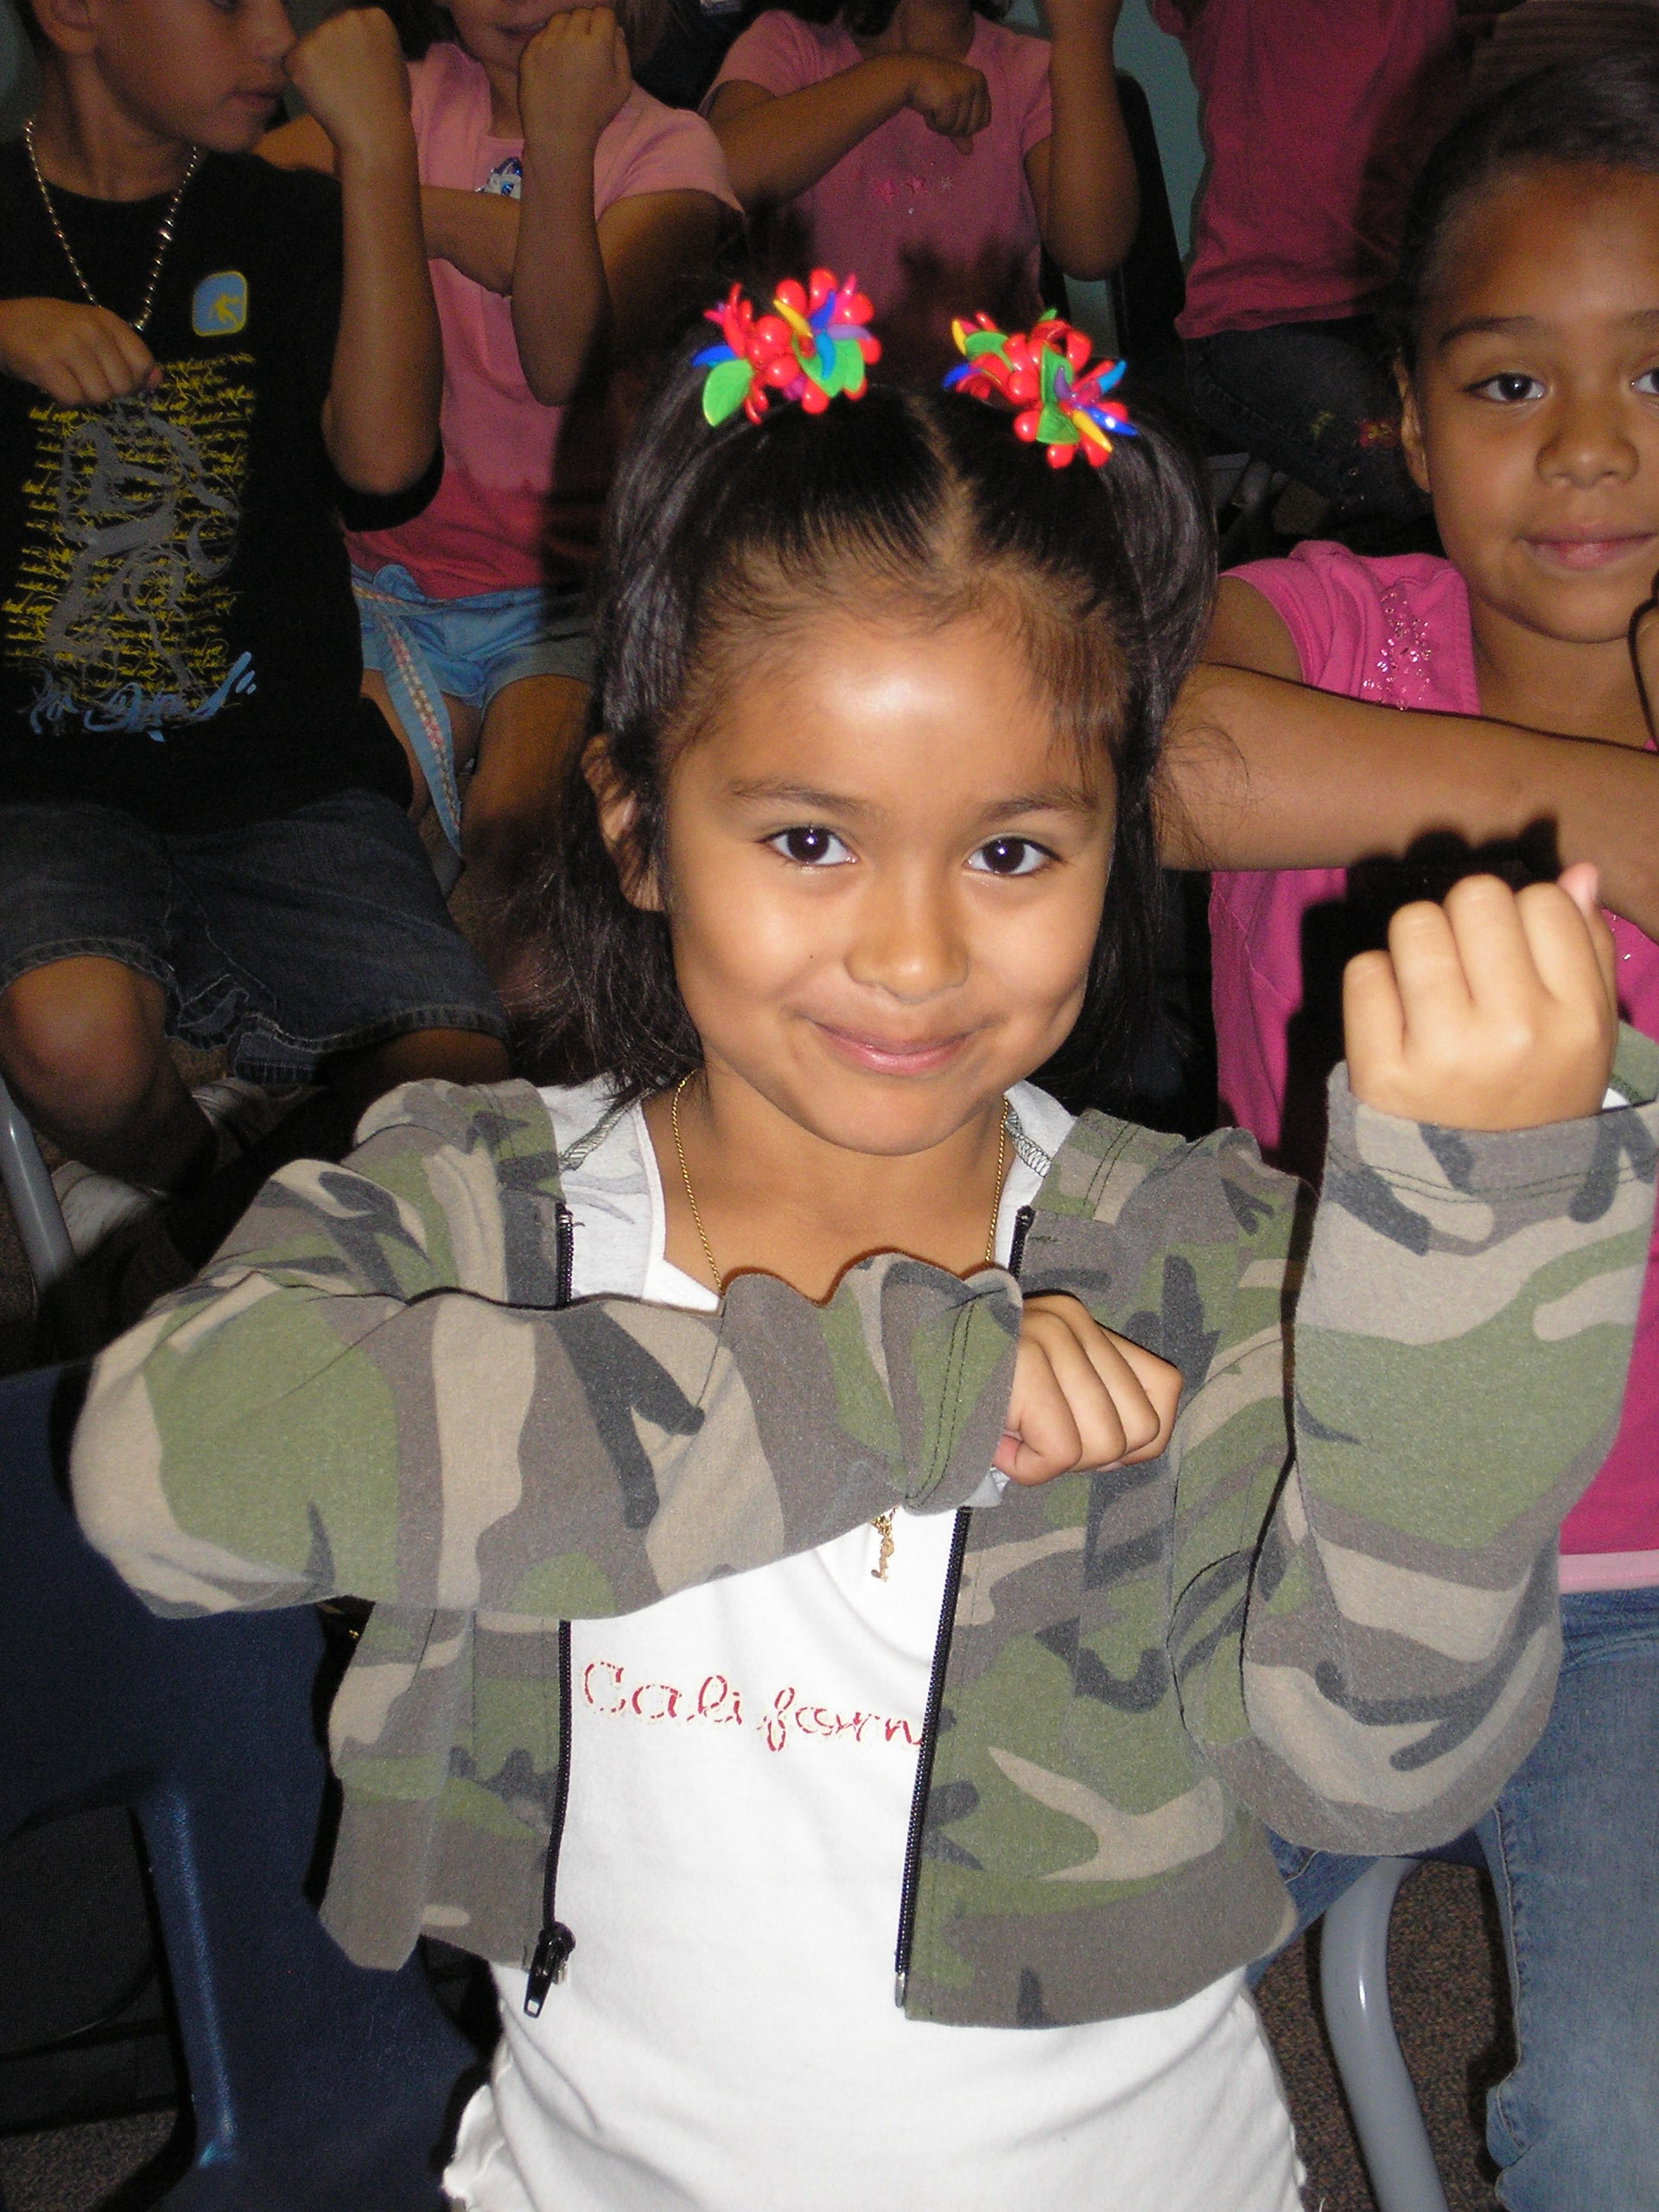
What Have You Done to Make an Advocate Out of Your Principal?
How About. . .
“Come On Down. . .
We’re about to give out
instruments to the kids!”
www.musiceducationconsultants.net/UMEA2013

Slide 14
What Have You Done to Make an Advocate Out of Your Principal?
Always Have Small Ensembles READY to Perform
Invite Her (and Faculty) to PERFORM in the Holiday Concert
Copy Him on All Correspondence
Communicate Music Advocacy Information Via Email
Work at Flexibility, Organization, and Communication
Took Him Golfing -- He WON!!!
www.musiceducationconsultants.net/UMEA2013

Slide 15
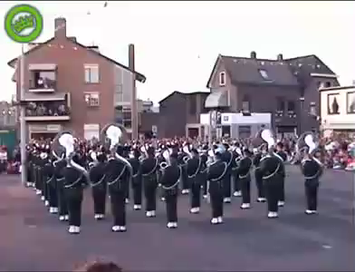
Sometimes It Seems As If Principals
TRY To Trip Us UP!
http://www.youtube.com/watch?v=dzuVvlAuZmY

Slide 16
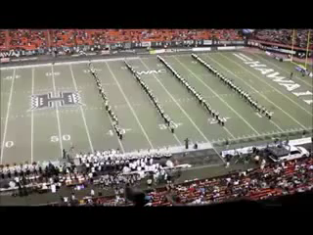
“Kick it” as a Team! Get ‘Em on YOUR Page!

Slide 17
10 Things You Can Do MONDAY!
1. Ask your students to complete the sentence, “Music makes the difference because. . .” Use their responses. . .
a. In your upcoming concert programs
  b. In your school newspaper’s “music corner” (Don’t have a “music corner?” You know what to do!)
  c. As copy for making banners/posters to display around the school
  d. As copy for recruitment fliers and posters at feeder schools
  e. As copy for STATE MEA publications
  f. As copy for a publication about your school’s FANTASTIC music program
www.musiceducationconsultants.net/UMEA2013

Slide 18
Music Makes the Difference Because…
…when you’re sad and then you hear music, it will cheer you up. And when you’re
down, it will make you get up from where you are and start dancing. Music will
always be there for you.
…it makes me feel free and like nobody is judging me.
…it helps me express my feelings into something other than words. Music makes
you want to dance, and sing out loud; it can cheer you up, even on the gloomiest days.
…it’s a perfect way to tell and show how you feel.
…hearing music helps me work and helps me be the person I want to be.
…it gives you a feeling; a feeling that makes you think you can do anything whether
it’s doing chores, finishing your homework, or even reaching your goals in life. So,
whenever you feel down or just think you’re worthless, turn that music on and boost
your self-esteem again because that’s what is going to get you out of bed in the morning
www.musiceducationconsultants.net/UMEA2013

Slide 19
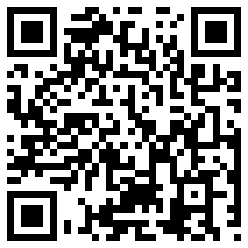
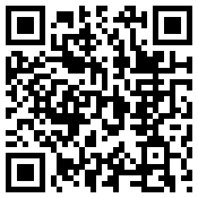
10 Things You Can Do MONDAY!
2. Retrieve information about the value of studying music and quote it in any of the above outlets but especially on any recruitment information you may be preparing for next year.
HINT: Start by visiting:
musiced.nafme.org/resources
supportmusic.com
www.musiceducationconsultants.net/UMEA2013

Slide 20
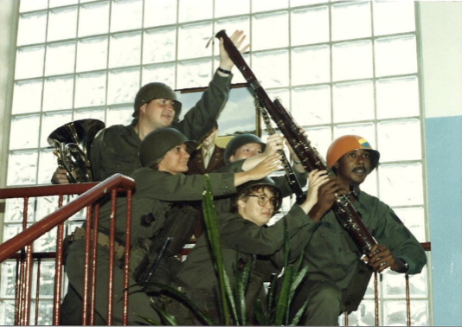
10 Things You Can Do MONDAY
3. Recruit 24/7

Slide 21


3. Recruit 24/7 – Keep Music Education Strong
GREAT FOR PARENT NIGHTS!!!!!
Recently Revised to Include the Very Latest Research and Statistics on the Benefits of Music Education.
FREE COPIES of assorted brochures available from:
SupportMusic.com
www.musiceducationconsultants.net/UMEA2013

Slide 22
10 Things You Can Do MONDAY!
4. In your next concert program, include an insert designating each attendee as a member of the newly-formed Mozart Middle School Coalition for Music Education/Music Boosters Club/Committee to Promote Music Education --choose a name that works best for you! The point of designating an interest group is as follows:
  a. To help make the program better for those they love
  b. To help establish the program as a school-wide entity using a positive approach
  c. To be your voice if and/or when needed
  d. To feel invested -- i.e. “buy-in”
  continued. . .

Slide 23
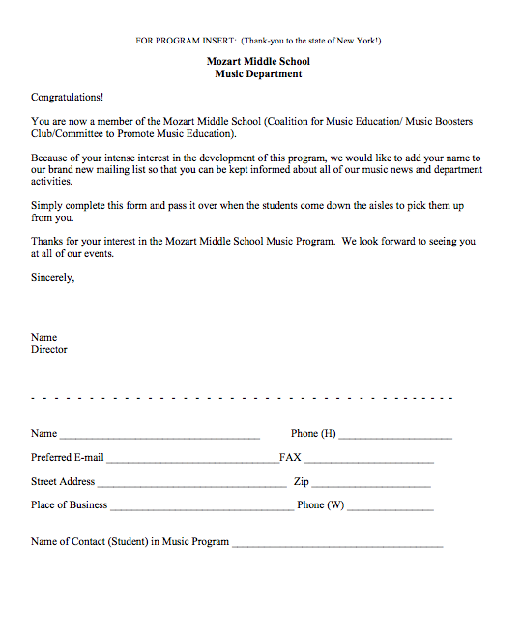
10 Things You Can Do MONDAY!
  Parents are the ones who have the most important interest at hand. It is THEIR child’s music education.
    They can become your voice if needed.

Slide 24
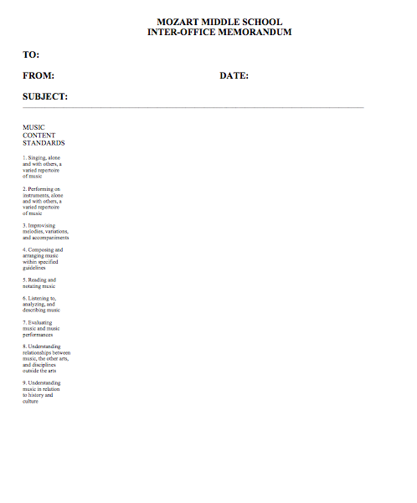
10 Things You Can Do MONDAY!
5. Design letterhead, memos, and concert program which
  include the Standards

Slide 25
10 Things You Can Do MONDAY!
6. Stay informed! Refer to these sites. . .
supportmusic.com
nafme.org
musicachievementcouncil.org
mustcreate.org
amparents.org
www.nammfoundation.org
childrensmusicworkshop.com/advocacy

Slide 26






10 Things You Can Do MONDAY!
6a. Better Yet. . .
Let the Information Come Directly to YOU!!!
Get on Twitter and start following!!!
@NAfME
@MaryLNAMM
@pisanojm
@MusicEdConsult
@MusicAchCouncil
@EricWhitacre

Slide 27

10 Things You Can Do MONDAY!
7. Arrange for a performance for the school board, principal’s meeting, city council, state legislature, etc. They will appreciate the “good news” for a change. Your Parent Group can help with setting up these performance “showcases.”
BE READY AND PERFORM WELL!!!!
8. Create a website and communicate, communicate, communicate. Share the GOOD NEWS!!!!

Slide 28
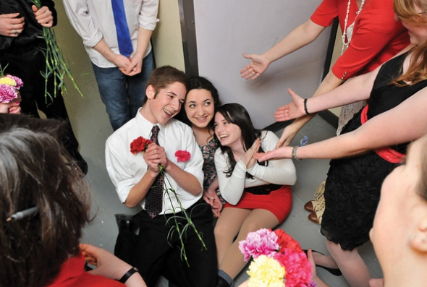
10 Things You Can Do MONDAY!
9. Come up with a clever version of a “Happy Birthday” song to serenade your school staff on their special day. THEY WILL LOVE YOU FOR IT! Give away FREEBIES!
Insert Serenade Photo

Slide 29
10 Things You Can Do MONDAY!
10. See your principal/mayor/congressional representative (or have one of your students do this) to ask him/her to present the Opening Remarks at your next concert. They LOVE to speak to parents/constituents and YOU GET THEM ON THE RECORD and make them HEROES! (Check with admin first!)
Remember to praise that person for their commitment and do something special for him/her at the concert. Have a student(s) present them with a framed print with all of your student’s signatures and a brief “thanks!” It means more than you will ever know!

Slide 30
10 Things You Can Do MONDAY!
Remember. . .Your principal needs YOU!
Be an active, involved member of the faculty.
Take part in as many school activities as you can.
Volunteer to help out when needed. (Organize faculty functions, school food drives, etc.)
Ask how you/your program can help build school spirit.
Students, parents, faculty, and your administrators will see YOU as a LEADER – something that comes naturally to you.
www.musiceducationconsultants.net/UMEA2013

Slide 31
11 Leadership Truths from “Dr. Tim”
(From: Leadership, Vision, Commitment, Action)
Keep these in mind as you think about positioning your program to become central to the personality of your school.
1. If you let other people do it for you, they will do it to you.
2. The harder I work, the luckier I get.
3. 99% responsibility doesn’t work.
4. Yesterday was the deadline for all complaints.
5. Good leaders are scarce so I’m following myself.
6. The things that come to those who wait,
may be the things left by those who get there first.

Slide 32
11 Leadership Truths from “Dr. Tim”
(From: Leadership, Vision, Commitment, Action)
7. There is no growth without discontent.
8. We move toward what we picture in our minds.
9. People who believe things can’t be done will go
out and prove they are right!
10. Real leaders are the cause, NOT the effect.
11. Learn to create, NOT to compete.
www.musiceducationconsultants.net/UMEA2013

Slide 33
12. One Last Thought. . .
Stay Focused
On the “Why!”
We are ALL in this
for the Kids!
www.musiceducationconsultants.net/UMEA2013

Slide 34
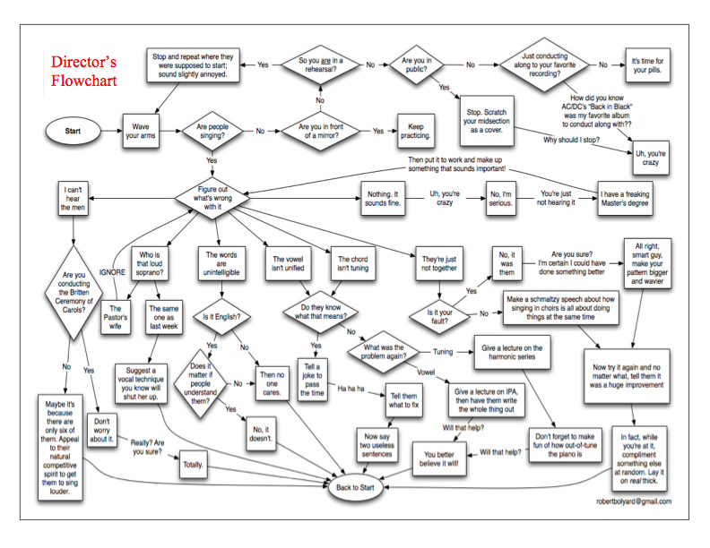
How Can I Do It All?

Slide 35
Music and Arts Education
Even though it’s
Even though it’s
Even though it’s a
IMPORTANT!
THE LAW!
CORE SUBJECT!
It’s STILL. . .
Notes:
35

Slide 36
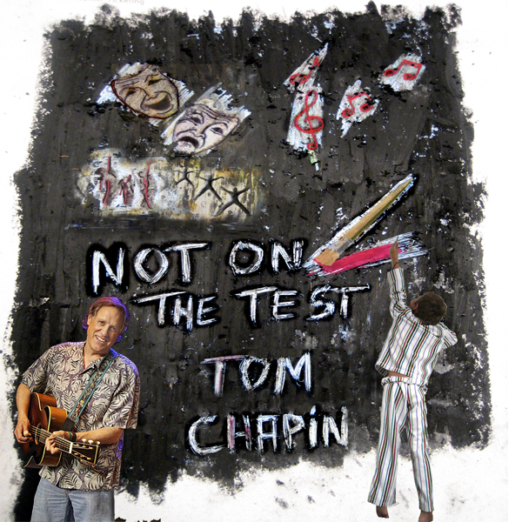

Slide 37


Slide 38

Thank You!
Contact Information:
marcia@musicedconsultants.net
@MusicEdConsult on Twitter
www.musiceducationconsultants.net/UMEA2013

Slide 39
Thank You!
Contact Information:
marcia@musicedconsultants.net
@MusicEdConsult on Twitter
www.musiceducationconsultants.net/UMEA2013

