Slide 1




You CAN Successfully Recruit and Retain
Even MORE Music Students!
www.musicedconsultants.net/UMEA2013
musicachievementcouncil.org
nasmd.com

Slide 2
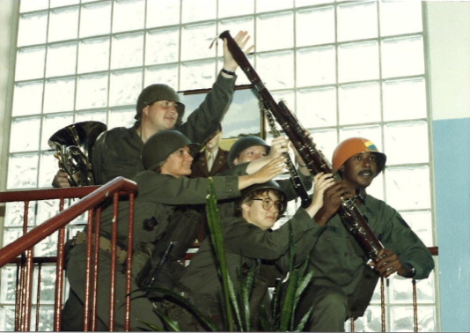
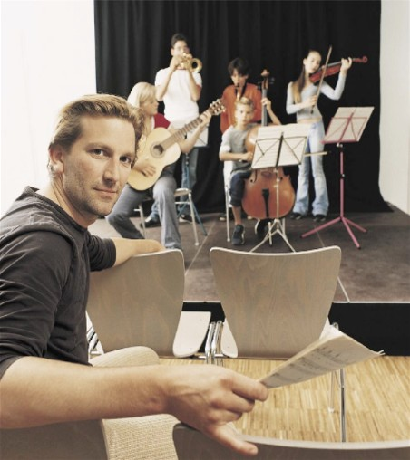
Today’s Session
Tips for Recruiting Students
Tips for Retaining Students
First Performance Program

Slide 3
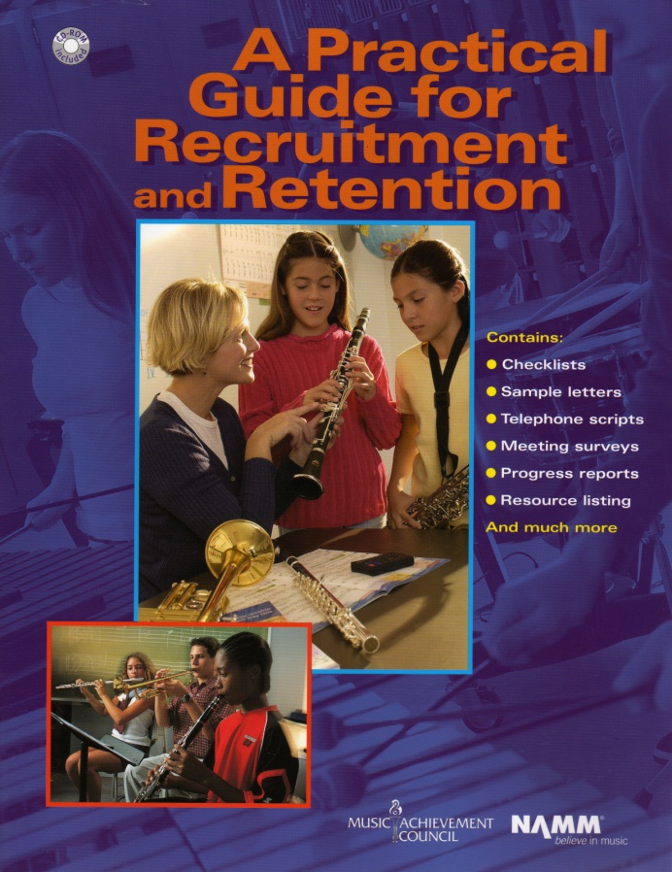
Materials Available for You to Use
Comprehensive Manual
12 pages of proven methods
10 pages of sample forms
Disk copy of book in back
Guidelines for teachers
Complete year round planning tool

Slide 4
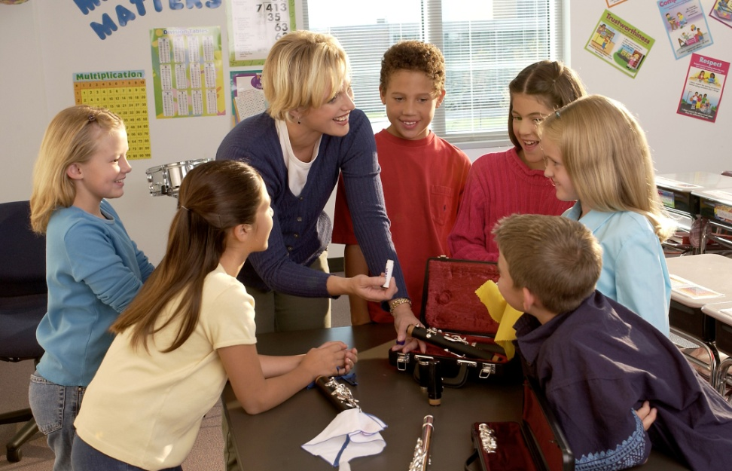
Fundamental Beliefs of
Effective Recruiters:
Every student will be interested
All students will have an equal opportunity to succeed
Music is an integral part of their total education
Every student is eagerly welcome-- regardless of talent or ability
Students want to play because it looks like fun

Slide 5
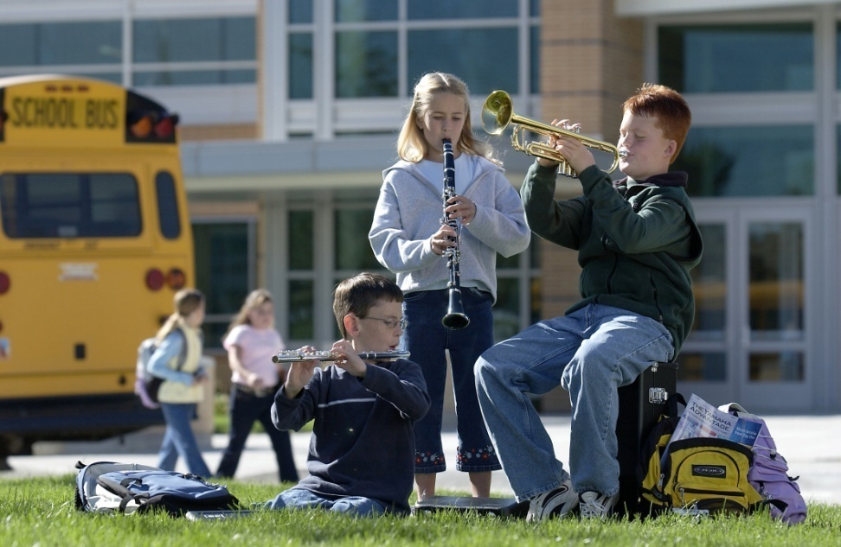
Key Steps in Recruiting:
Attracting Students. . .
Foster student interest
Inform parents of benefits of music
Build and nurture support among administration & classroom teachers

Slide 6

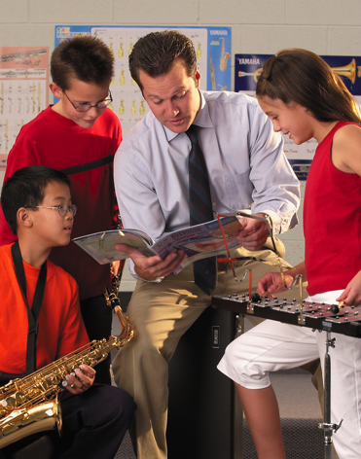
Key Steps in Recruiting
Done properly, recruiting is a YEAR-ROUND process including:
Regular visits with feeder programs/teachers
Effective PR: Bulletin boards, school newsletters, PTA announcements, concert programs, school announcements, other teachers
Mass concerts with feeder programs
including recorder classes
Recruitment meetings with
students and parents
Instrument demos, if appropriate
Instrument try out/petting zoo
Surveys
Follow-ups
www.musicachievementcouncil.org
Notes:
6

Slide 7
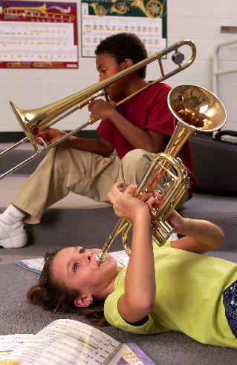
Key Steps in Recruiting:
Some Things to Remember. . .
Ensure HIGH quality and fulfillment
Your enthusiasm matters
Learning can be fun - SMILE!
A positive image of your program draws positive students
Be friendly, approachable
Students have big dreams of success
It’s never to early to recruit
Have fun! SMILE!!!!
www.musicachievementcouncil.org
Notes:
7

Slide 8
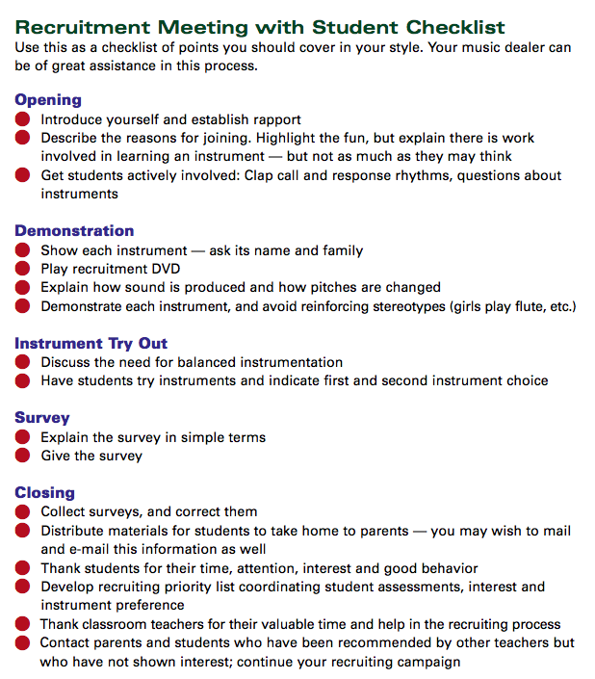


Key Steps in Recruiting: Plan Way Ahead
  Meet with feeder/classroom teachers to identify future instrumentalists
  Select recruitment materials: DVDs, posters, surveys, forms, pamphlets, PR items
  Enlist dealer help well in advance--let them know what you need
  Kids change so keep trying new techniques

Slide 9

Presentation Day
Can be: Musical Aptitude Survey
Instrument Try-out
  Best in classroom setting
  Show up unannounced
  Don’t assume that they know what they want to play
  Value of “testing” the students is the incentive, not the results
  Never ask, “how many want to be in the band, choir, orchestra. . .”
    Instead, ask for a who of hands “how many of you want to try an instrument?”
  Keep presentation to 30 minutes
  BE ENTHUSIASTIC!!!!!
www.musicachievementcouncil.org
Notes:
9

Slide 10
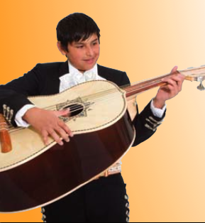
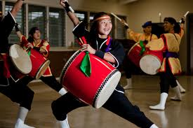
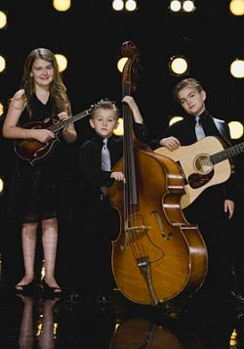
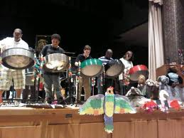
Engage Your Demographic

Slide 11

Engage Parent Support
Recruitment Letters
  Keep them simple, upbeat and informational
  Emphasize rewards, details,
  your expectations
  RSVP form
Best Ambassador is an Excited Child
Initial Meeting
  BE PREPARED
  Involve current parents
  Explain rental program
  Provide advocacy materials
  Hint: PARENTS DON’T LIKE SURPRISES!

Slide 12
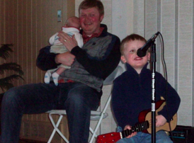
Engage Parent Support
Guide the PARENTS
  Teach PARENTS how to support their child’s practicing
  Give PARENTS ideas of how to keep their children motivated
  Encourage PARENTS to play an active role in the learning process and to become involved
  Communicate with Parents REGULARLY to keep them engaged
  Remember. . .in most cases, PARENTS have NO IDEA what normal is!
Notes:
www.musiceducationconsultants.net/mmea2010
12

Slide 13
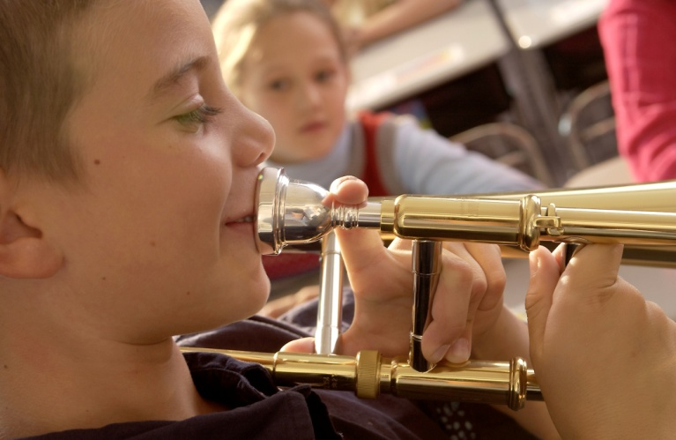
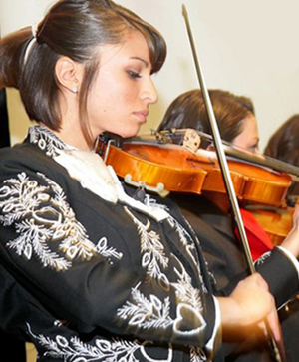
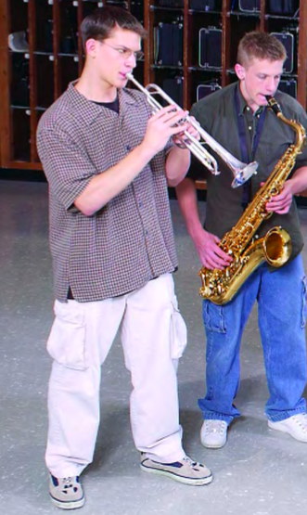
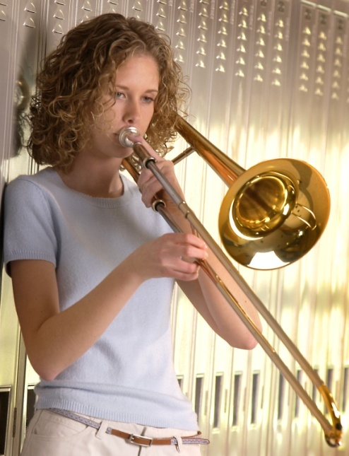
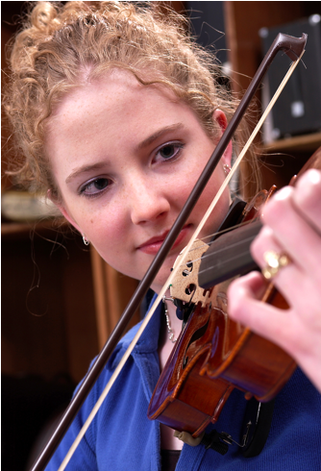
Keeping Your New Recruits

Slide 14
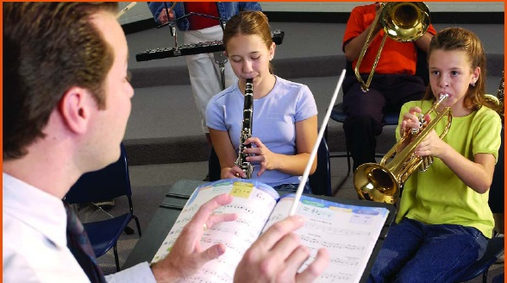

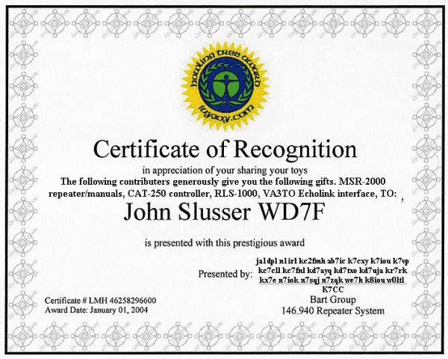
Retention: Keys to Student Success
Provide a satisfying experience from the day they receive their instruments
Build appreciation for the ensemble
Give recognition and reinforcement
Guarantee student success

Slide 15

Retention: Be A Music Educator!
By-products of an Education in Music include:
  Social skills
  Self-confidence
  Coordination
  Teamwork
MOST
IMPORTANT:
Do not lose sight of the fact that you are developing students who will have a lifelong appreciation of music.
Keep musical values on the top of your list!!!
www.musicachievementcouncil.org
Notes:
15

Slide 16
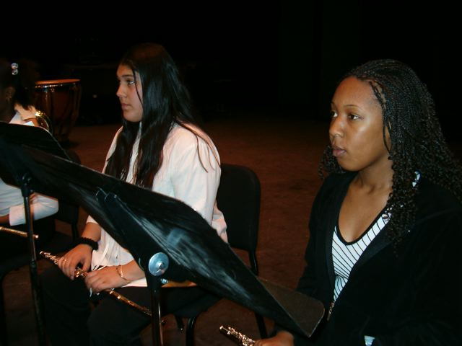
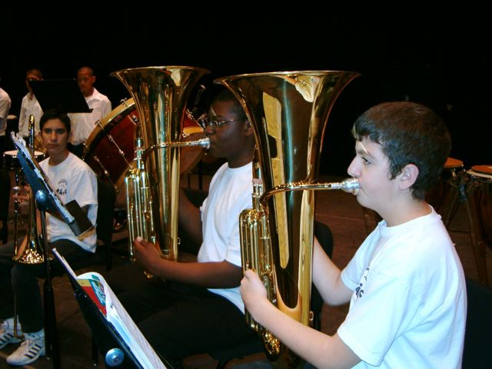

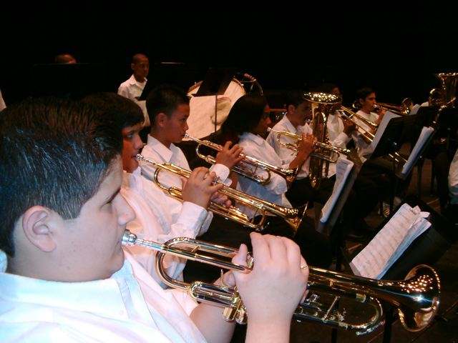
Retention: Be A Music Educator!
Keep musical values on the top of your list!!!
www.musicachievementcouncil.org
Notes:
16

Slide 17
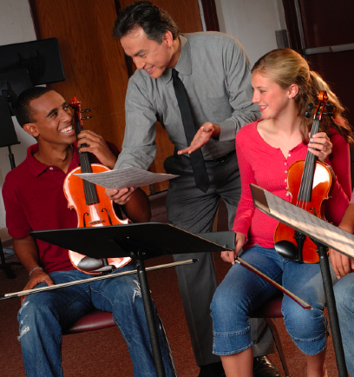
Actions That Help Retain Students
Developing group pride
Improving communication with parents
Being creative
Evaluating yourself on a continual basis
Understanding each student as an individual
Being positive and enthusiastic
Providing engaging lessons consistently
www.musicachievementcouncil.org
Notes:
17

Slide 18
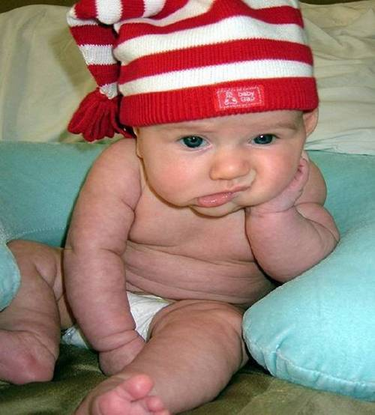

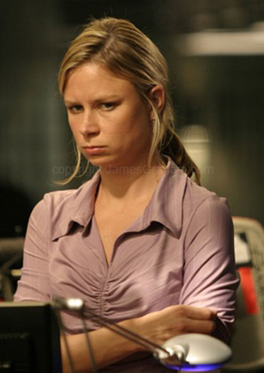

Common Reasons for Drop-outs?
The first disappointment
Lost interest
Didn’t like the teacher
Conflicts
www.musicachievementcouncil.org
Notes:
18

Slide 19
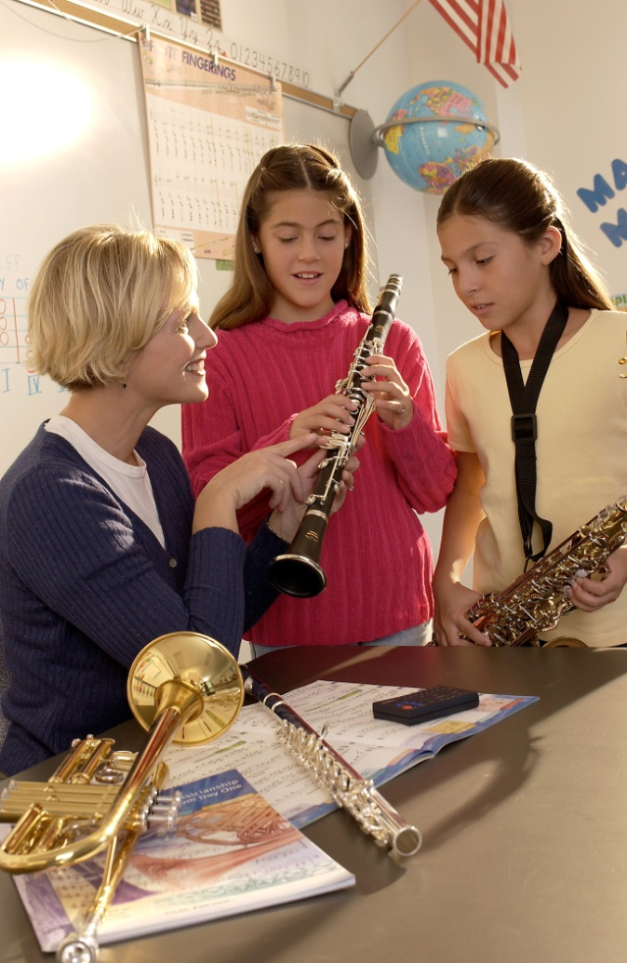
What Can You Do?
Talk to the student
  Probe for real reason they want to quit
  Show interest
Check their instrument
Talk with the parents
Don’t try to avoid dropouts--rather, strive to improve retention

Slide 20
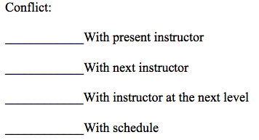
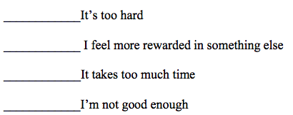
What Can You Do?
Iowa Bandmasters
Association
EXIT SURVEY: Checklist (Posted online in entirety)
What is your reason for no longer participating in the band (orchestra/choir) program?
What does “I’ve lost interest” mean?
Etc.
www.musicachievementcouncil.org
Notes:
20

Slide 21
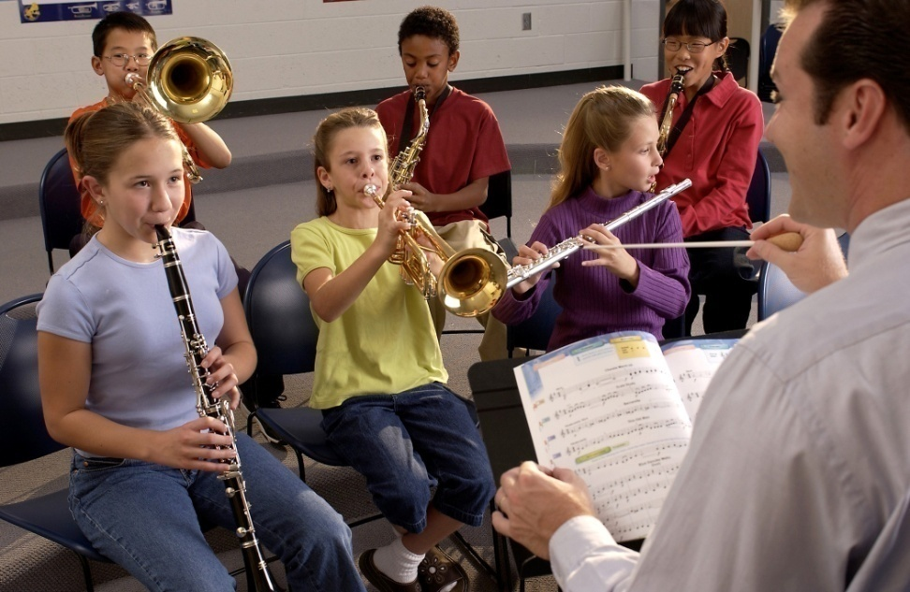
What If …
Students saw immediate success?
Parents heard their kids play/sing their first performance just weeks after they started?
Learning to sing/play was really fun?

Slide 22
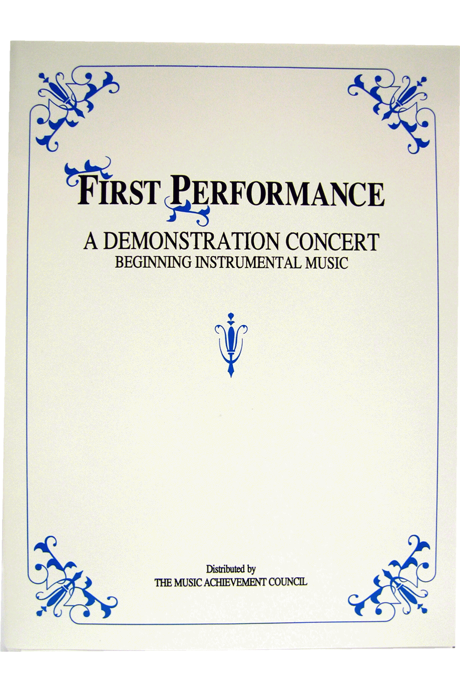
First Performance Concert!
A scripted demonstration of what your students have learned

Slide 23
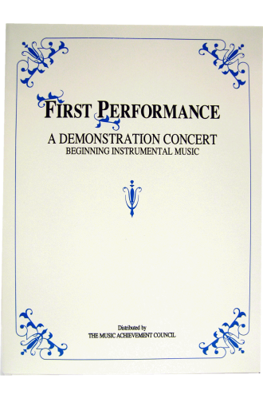
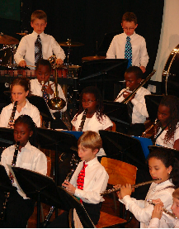
First Performance Demonstration Concert for Band or Orchestra
Schedule 6-8 weeks after the first class
Complete “turn-key” package
May be the best performance in terms of excitement and audience!

Slide 24

First Performance Demonstration

Slide 25
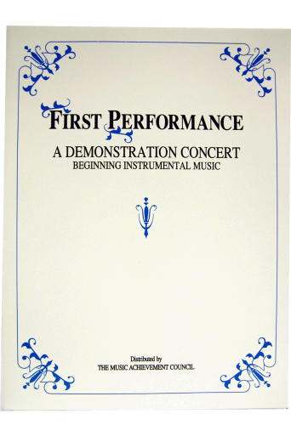
Why Does First Performance Work?
The timing of the performance
  Parents want to hear their kids play
  Student interest soars and they learn to love performing
Students practice more prior to a performance
It works with any group … any schedule … any situation … and any method book
The audience will be large … enthusiastic … and will arrive early -- lots of quality time with those who care most about the outcome -- the parents!

Slide 26

Parents will be amazed … most have no idea how much their child has learned based on what they hear at home!

Slide 27


Students enjoy the satisfaction of a performance after good preparation – the process starts early
Many schools have the principal serve as the narrator -- GREAT PR!
The sound of
applause is
infectious

Slide 28
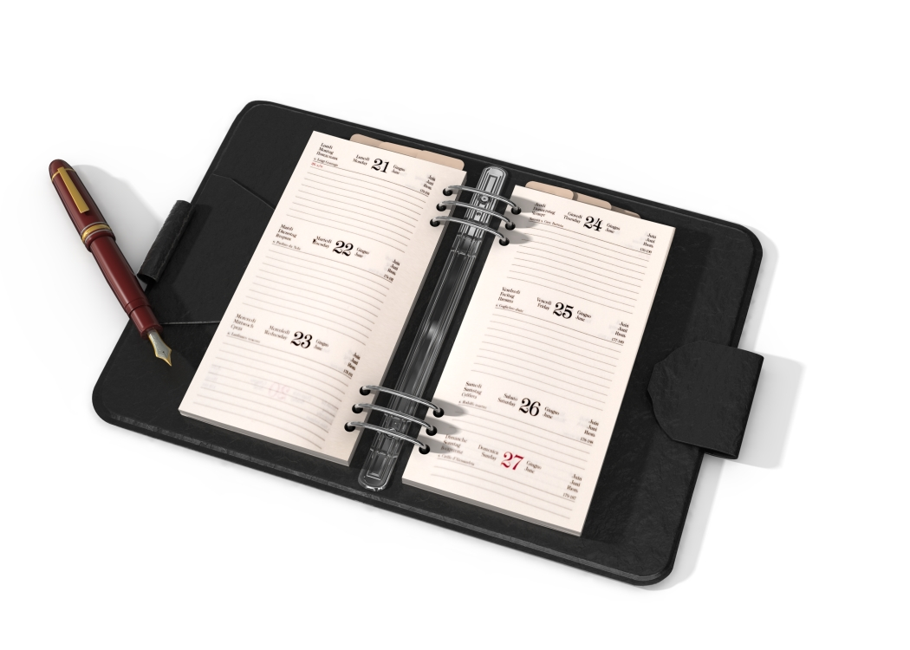
Put the Date on Your Calendar!
Schedule First Concert NOW!

Slide 29
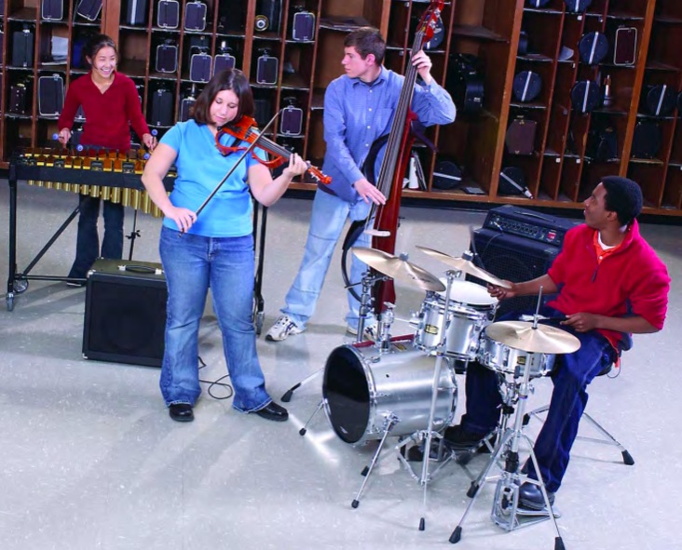
The Key Person Missing is YOU!
Rewrite the sample letters
Design your own forms
Set up schedules that fit
your school
Give everything YOUR
personal touch
www.musicachievementcouncil.org
Notes:
29

Slide 30
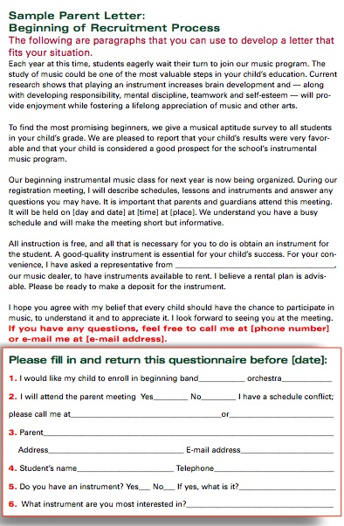
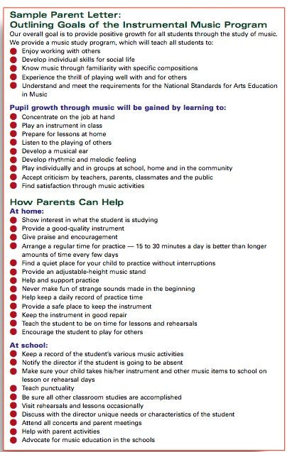
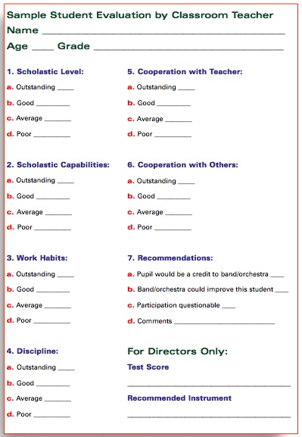
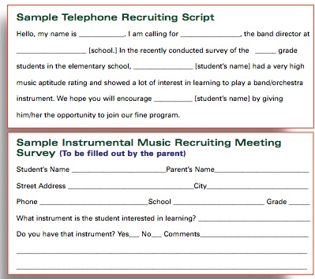
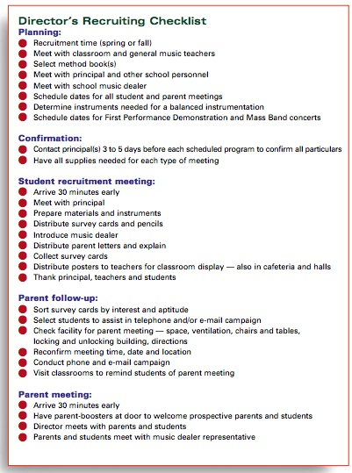
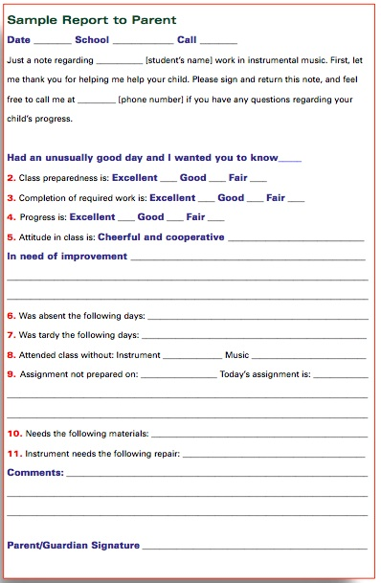
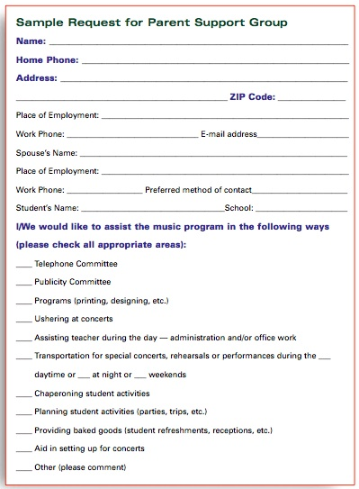
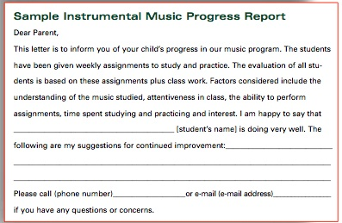
Samples
www.musicachievementcouncil.org
Notes:
30

Slide 31

What Is It?
Network of organizations, businesses, teachers, parents, school
and community leaders working to keep music education strong
Provides tools and resources for local advocacy, federal level issue and policy updates; news and sharing on advocacy trends and activities
Offers resources to support your efforts to communicate with school boards, school and community leaders about the importance of music for all children
Offers support and motivation to advocate for music education
www.musicachievementcouncil.org
Notes:
www.musiceducationconsultants.net/mmea2010
31

Slide 32
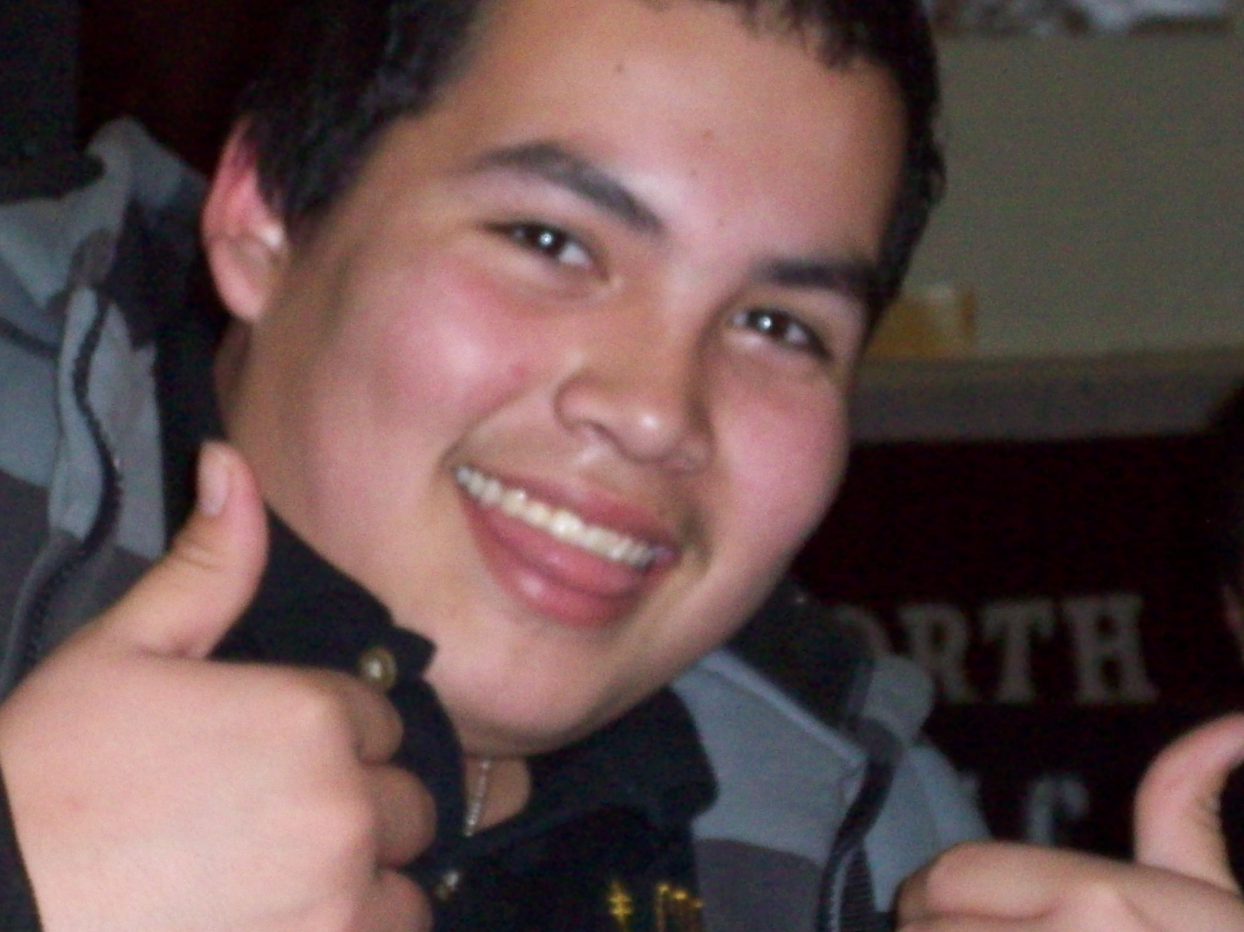
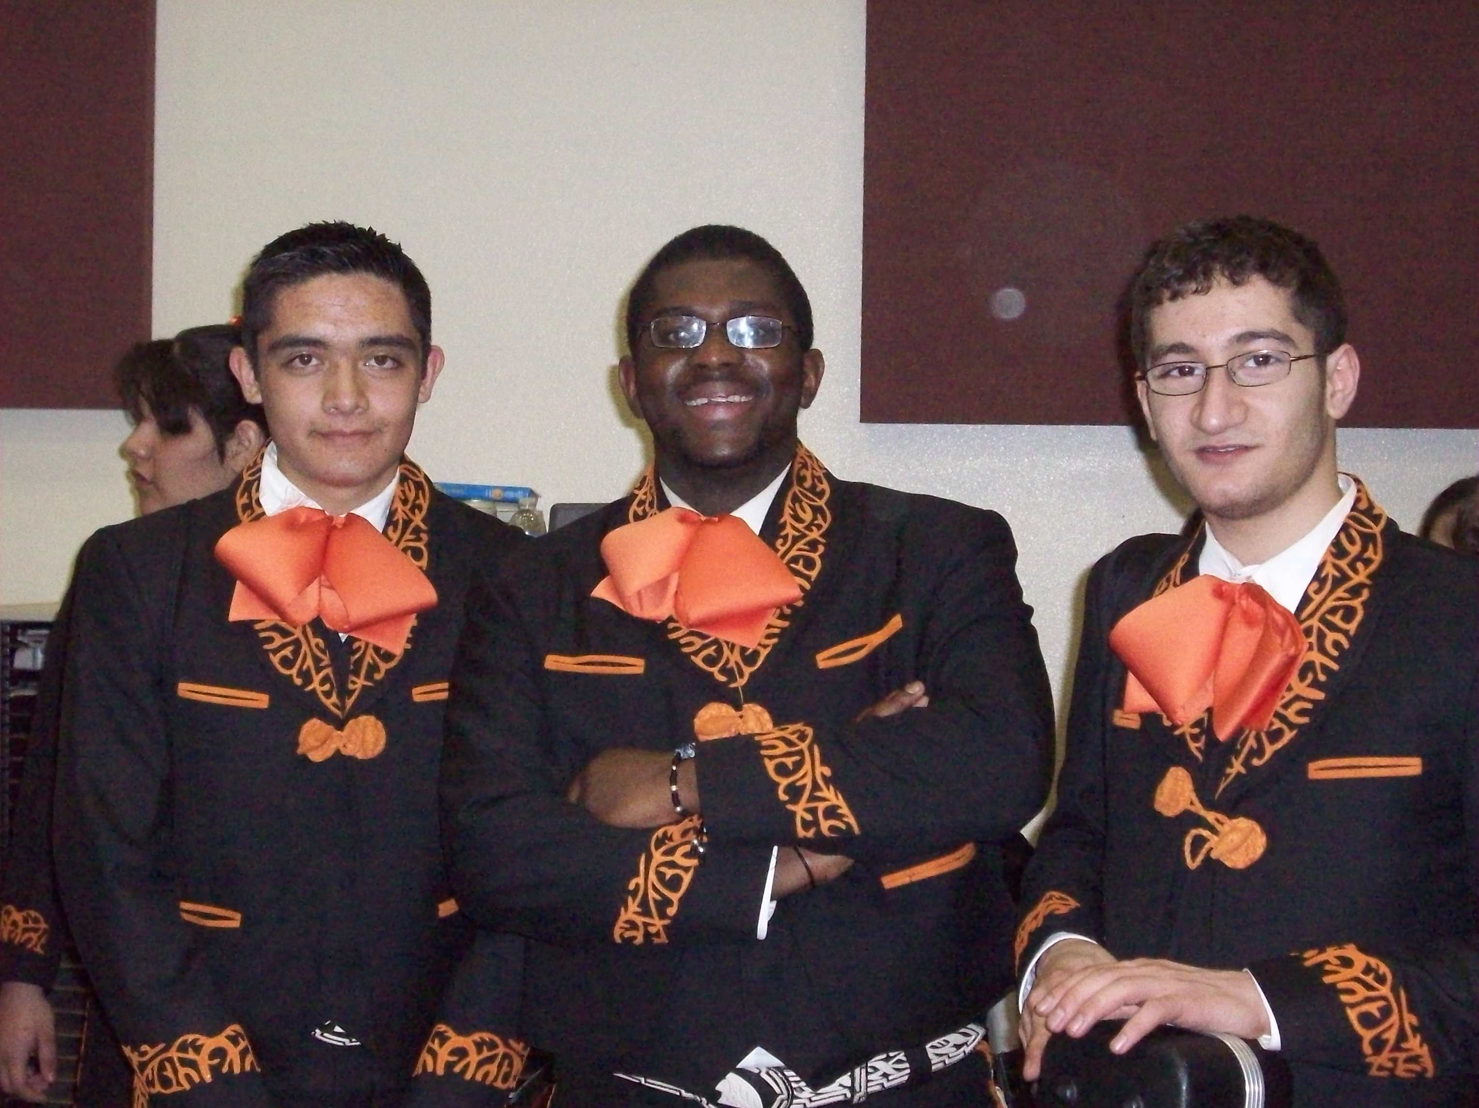
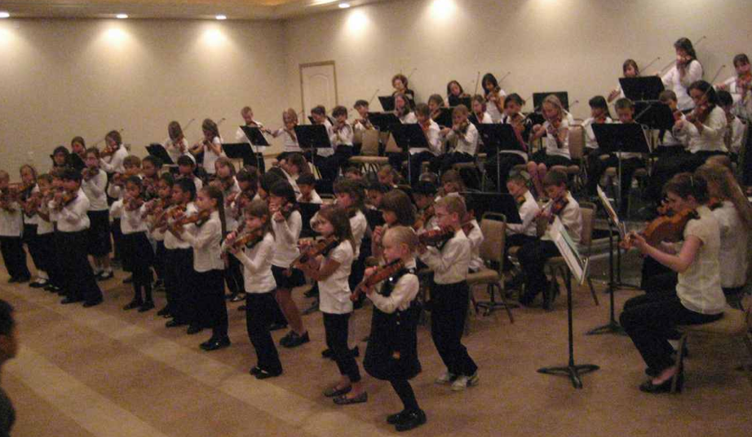
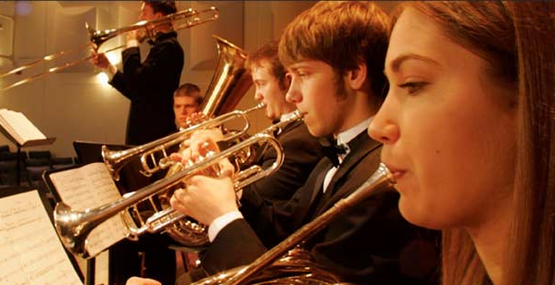
It’s True. . .
If You Build It. . .They Will Come!
A
N
D
S
T
A
Y

Slide 33
Got Smart Phone?

Slide 34
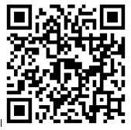













Thanks to These Quality Companies!
Contact: marcia@musicedconsultants.net
www.musicachievementcouncil.org
Will be posted at: www.musicedconsultants.net/UMEA2013
@MusicEdConsult
Notes:
www.musiceducationconsultants.net/mmea2010
34

Slide 35
Thanks to These Quality Companies!
Contact: marcia@musicedconsultants.net
www.musicachievementcouncil.org
Will be posted at: www.musicedconsultants.net/UMEA2013
@MusicEdConsult
Notes:
www.musiceducationconsultants.net/mmea2010
35

