Slide 1
Interviewing Skills:
The Rules of the Road
KCOMTEP
Marcia Neel
September 30, 2013
www.musiceducationconsultants.net/KCOMTEP2013

Slide 2
Interviewing Skills Much MORE than Knowing
Your Music!
Make a great impression!
Firm handshake and a smile
Good body language
Professional dress--check your gig line!

Slide 3
Interviewing Skills Much MORE than Knowing
Your Music!
2. Put yourself in my place. Would you hire you? Why? Why not?
Exude confidence
Smile!

Slide 4
Interviewing Skills Much MORE than Knowing
Your Music!
3. Be prepared.
Completed (and neat) application
Transcripts to date (copy will do for the interview, but originals are required eventually)
University Placement File
Resume (not required, but extremely helpful--a way to “blow your own horn”)

Slide 5
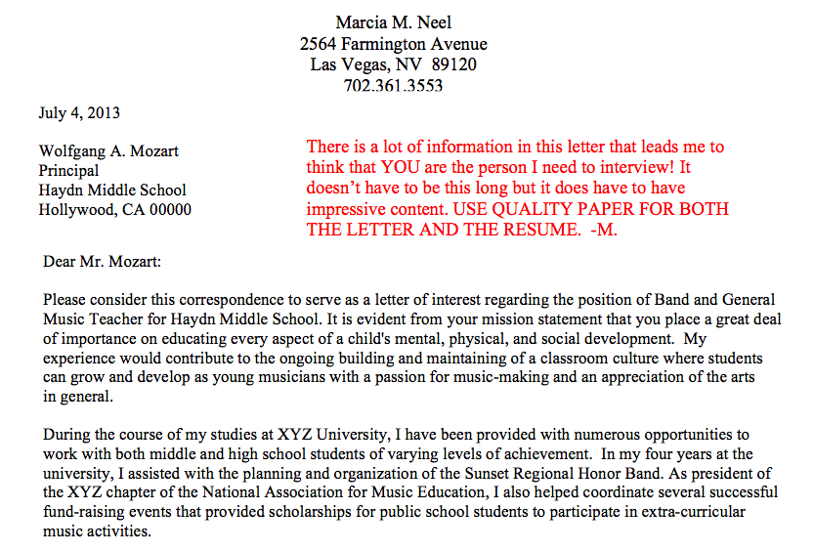
Sample Letter of Introduction

Slide 6
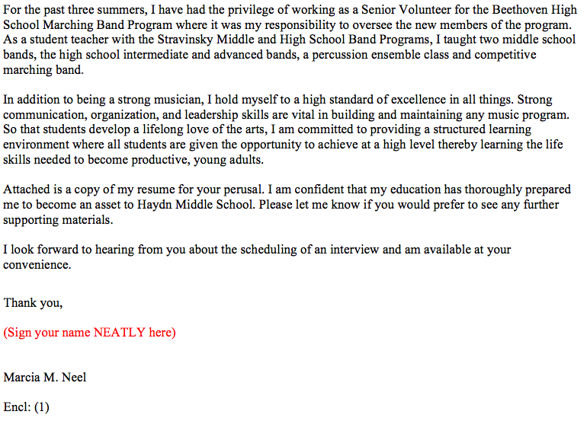
Sample Letter of Introduction p. 2

Slide 7
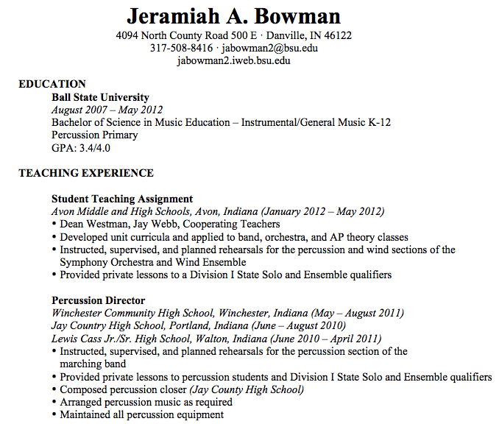
Sample Resume

Slide 8
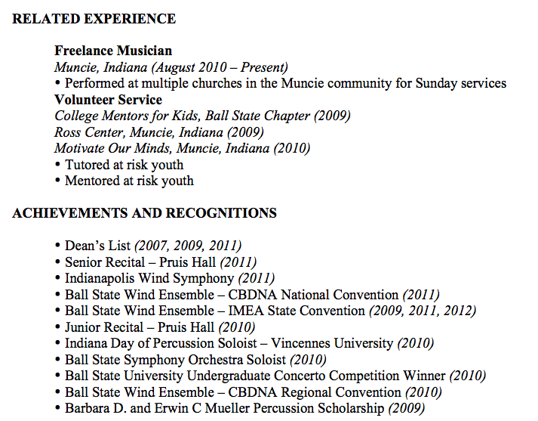
Sample Resume

Slide 9
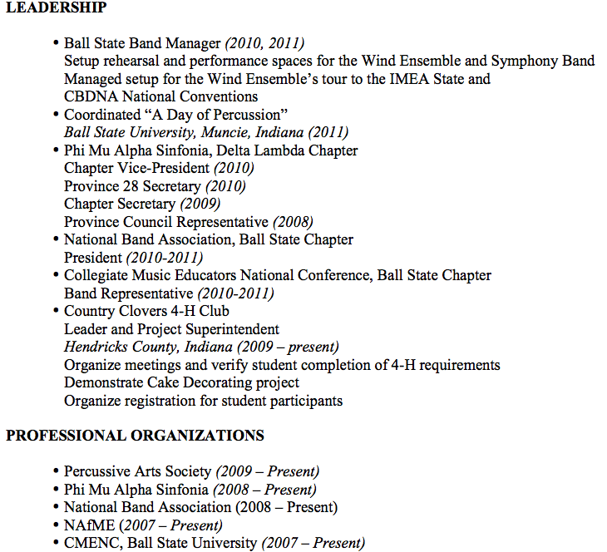
Sample Resume

Slide 10
Interviewing Skills Much MORE than Knowing
Your Music!
4. Do Your Homework
Find out everything you can about the school district and its programs
If you can, visit local programs
Attend concerts from that district

Slide 11
Interviewing Skills Much MORE than Knowing
Your Music!
Do mock interviews with fellow students/friends
Practice makes perfect--sound familiar?
Believe what you say--don’t just give “a right answer”

Slide 12
Interviewing Skills Be Ready to Discuss. . .
Appropriate Literature and Concert Design
Introducing and teaching of SOLID playing/singing skills -- PEDAGOGY!
Instructional Objectives
Content Standards/Expectations
Classroom Management Strategies
Non-musical Responsibilities
Classroom Routine
Motivational Techniques/Strategies

Slide 13
Interviewing Skills: Sample Questions
CURRENT EXPERIENCE/BACKGROUND: EX: BAND
Warm-up: Tell me about yourself.
What is your major instrument?
Describe your proficiency on all other instruments including strings
What do you consider to be typical problems for beginning (wind/brass/percussion students)?

Slide 14
Interviewing Skills: Sample Questions
Describe your high school and college/university background and training. How have these experiences prepared you to be a band director.
5. Describe your ability to develop and chart a marching band show.
6. What are your Jazz Band pedagogical skills and describe how you teach improvisation.

Slide 15
Interviewing Skills: Sample Questions
7. Discuss your expectations regarding performance.
What are your instructional objectives?
9. Describe your method of lesson planning.
10. Discuss some of your considerations in selecting
literature for your band.
Describe some of the methods you would use in
gaining and maintaining appropriate classroom
management. How will you handle behavior
problems?

Slide 16
Interviewing Skills: Sample Questions
Describe some of the strategies you would use in
recruiting students for the band program.
13. Describe what an observer might see in a typical,
daily rehearsal?
14. Provide an example of a standards-based lesson.

Slide 17
Interviewing Skills: Sample Questions
15. In your opinion, what constitutes a superior,
meaningful performance?
16. Describe what you consider to be your
obligations in planning and running fundraising
activities.
17. Explain some of the non-musical responsibilities
you have to your students.
What are your plans for professional
development?

Slide 18
Interviewing Skills: Sample Questions
Wrap-up: Is there anything that we haven’t covered in the interview that you would like for me to know?

Slide 19
Saying Thank You
Show Your Appreciation!
Be Professional
Shake Hands
Look them in the Eye
Send a NEATLY Handwritten Note:
For Their Time
To Re-express Your Interest
To Follow-up (Depends on how interview ended)

Slide 20
Marcia Neel
Contact Information
marcia@musicedconsultants.net
www.musiceducationconsultants.net/
KCOMTEP2013
@MusicEdConsult
On Twitter

