Slide 1
DID YOU KNOW . . .
The Music Achievement Council (MAC) is an action-oriented, non-profit organization whose sole
purpose is to enable more students to begin and continue in instrumental music programs.
www.musicachievementcouncil.org

Slide 2
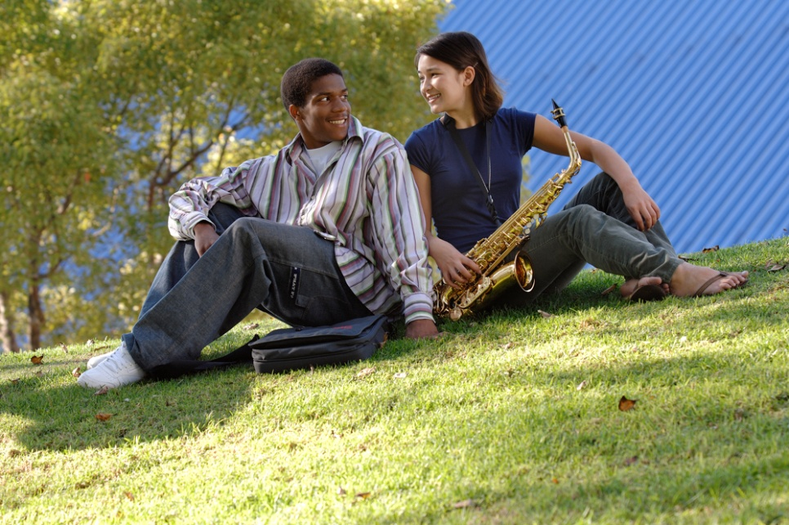
DID YOU KNOW . . .
96 percent of public school principals
believe that participating in music
education encourages and motivates
students to stay in school longer.
(Harris Poll)
www.musicachievementcouncil.org

Slide 3
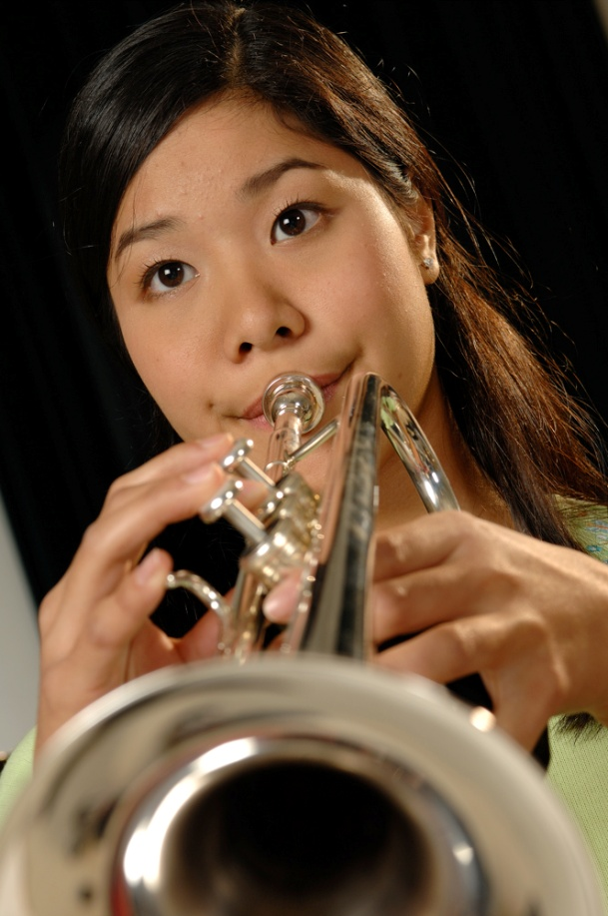
DID YOU KNOW . . .
An interactive poll confirms that music education at an early age greatly increases the likelihood that a child will grow up to seek higher education and ultimately even earn a higher salary. (2007 Harris Poll)
www.musicachievementcouncil.org

Slide 4
THE MESSAGE IS. . .
If you want to be a CEO, College President, or
even a Rock Star,
TAKE MUSIC!
www.musicachievementcouncil.org

Slide 5
THE MESSAGE IS. . .
If you want to be a CEO, College President, or
even a Rock Star,
TAKE MUSIC!
www.musicachievementcouncil.org

Slide 6
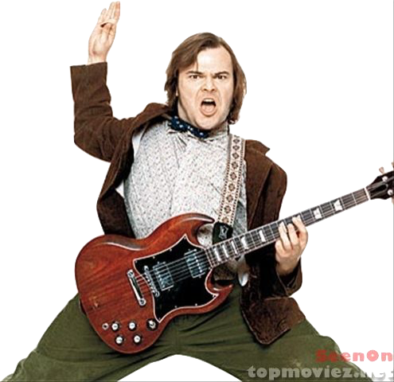
THE MESSAGE IS. . .
If you want to be a CEO, College President, or
even a Rock Star,
TAKE MUSIC!
www.musicachievementcouncil.org

Slide 7
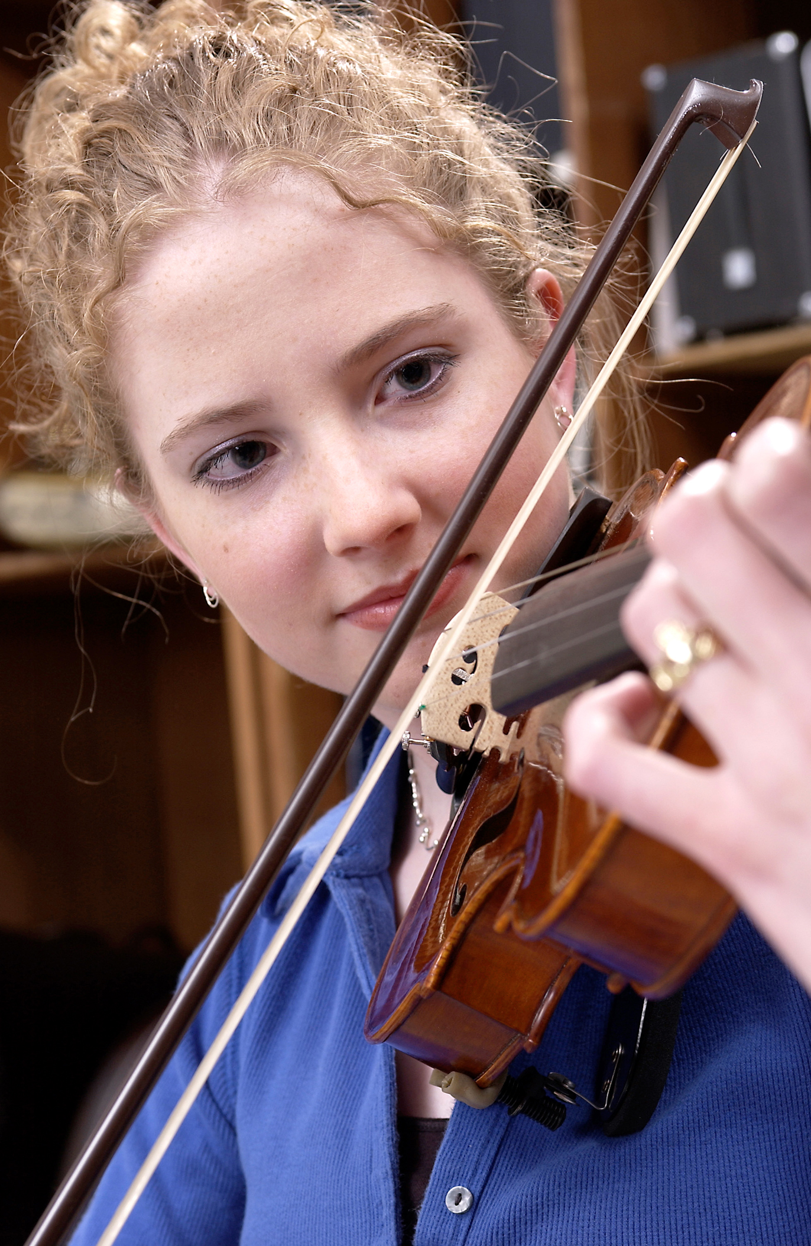
DID YOU KNOW . . .
82 percent of Americans who don’t currently play an instrument wish they had learned to play one. (Gallup Poll)
www.musicachievementcouncil.org

Slide 8
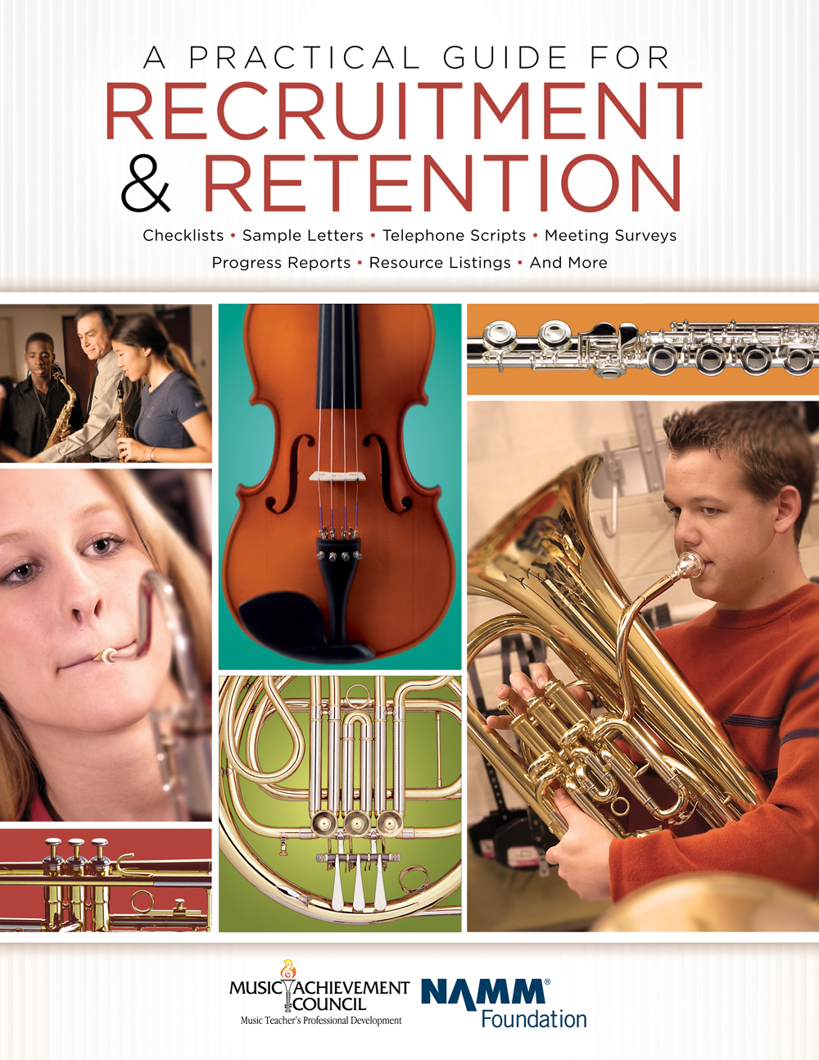
DID YOU KNOW . . .
All of today’s session attendees will receive FREE COPIES of:
A Practical Guide for Recruitment and Retention
www.musicachievementcouncil.org

Slide 9
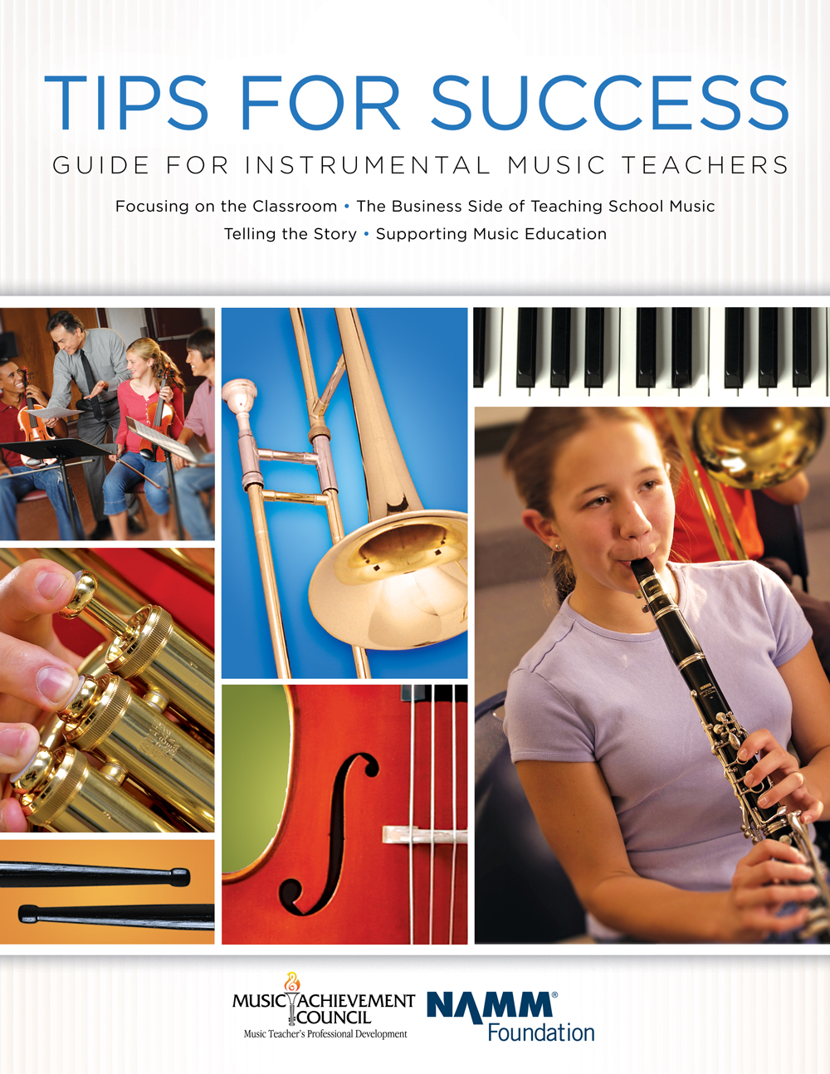
DID YOU KNOW . . .
All of today’s session attendees will receive FREE COPIES of:
Tips for Success:
A Guide for Instrumental Music Teachers
www.musicachievementcouncil.org

Slide 10
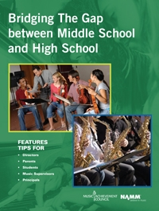
DID YOU KNOW . . .
All of today’s session attendees will receive FREE COPIES of:
Bridging the Gap between
Middle School and High School
www.musicachievementcouncil.org

Slide 11
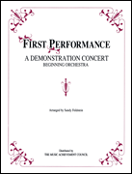
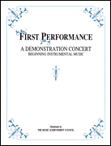
DID YOU KNOW . . .
First Performance Demo Concert for Band and/or Orchestra features sheet music, parts, sample letters, programs and student certificates for beginning ensembles. Students can perform a composition in seven short weeks with the materials provided!
www.musicachievementcouncil.org

Slide 12
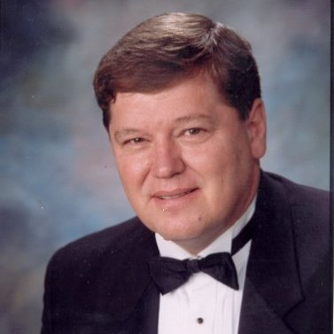
DID YOU KNOW . . .
Three of these publications are provided online at no charge by the Music Achievement Council.
They are based on real world strategies shared by the profession’s most successful music educators.
Greg Bimm

Slide 13
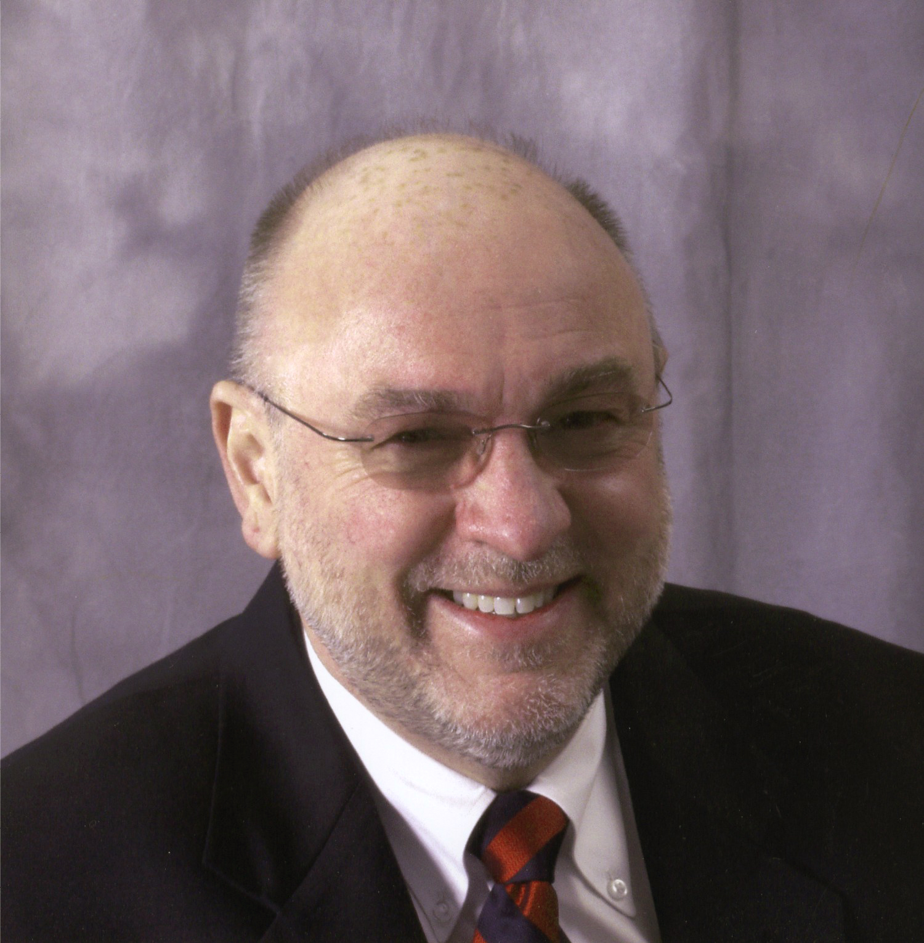
DID YOU KNOW . . .
Three of these publications are provided online at no charge by the Music Achievement Council.
They are based on real world strategies shared by the profession’s most successful music educators.
Tim Lautzenheiser

Slide 14
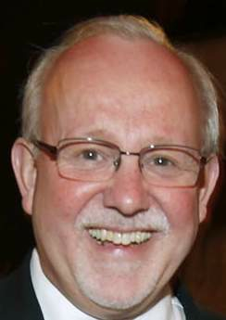
DID YOU KNOW . . .
Three of these publications are provided online at no charge by the Music Achievement Council.
They are based on real world strategies shared by the profession’s most successful music educators.
Charlie Menghini

Slide 15
DID YOU KNOW . . .
Three of these publications are provided online at no charge by the Music Achievement Council.
They are based on real world strategies shared by the profession’s most successful music educators.
Marcia Neel

Slide 16
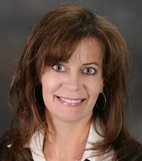
DID YOU KNOW . . .
Three of these publications are provided online at no charge by the Music Achievement Council.
They are based on real world strategies shared by the profession’s most successful music educators.
Terry Shade

Slide 17
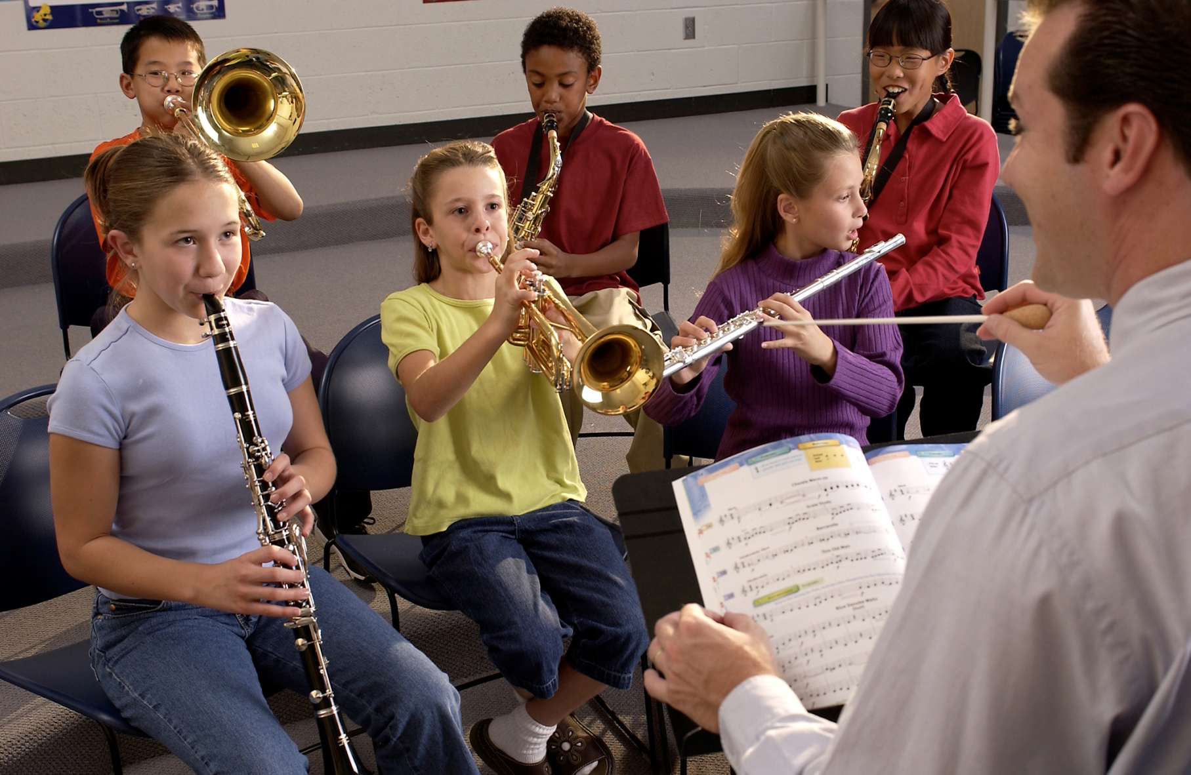
DID YOU KNOW . . .
www.musicachievementcouncil.org

Slide 18
DID YOU KNOW . . .
Music making has been scientifically proven to:
Exercise the brain
Inspire creativity
Increase productivity
Fight memory loss
Reduce stress
Lower blood pressure
Build confidence
Stave off depression

Slide 19
DID YOU KNOW . . .
Metropolitan Nashville Public Schools found that ATTENDANCE RATES ROSE with increased study in music.
No Music:
< 1 Year of Music:
> 1 Year of Music:
87% Attendance
91% Attendance
93% Attendance

Slide 20
DID YOU KNOW . . .
Metropolitan Nashville Public Schools found that DISCIPLINE REPORTS FELL with increased study in music.
No Music:
< 1 Year of Music:
> 1 Year of Music:
4.34 over 4 years
3.75 over 4 years
3.23 over 4 years

Slide 21
DID YOU KNOW . . .
Metropolitan Nashville Public Schools found that GPAs ROSE with increased study in music.
No Music:
< 1 Year of Music:
> 1 Year of Music:
2.51 Average
2.61 Average
2.89 Average

Slide 22
DID YOU KNOW . . .
Metropolitan Nashville Public Schools found that GRADUATION RATES ROSE with increased study in music.
No Music:
< 1 Year of Music:
> 1 Year of Music:
60% Average
81% Average
91% Average

Slide 23
DID YOU KNOW . . .
Metropolitan Nashville Public Schools found that ACT SCORES ROSE with increased study in music.
No Music:
< 1 Year of Music:
> 1 Year of Music:
16.95 Eng, 17.20 Math
17.64 Eng, 17.62 Math
19.58 Eng, 18.67 Math

Slide 24
WHAT WAS LEARNED?
The MORE a student participates in MUSIC,
the more POSITIVE these BENEFITS become.

Slide 25
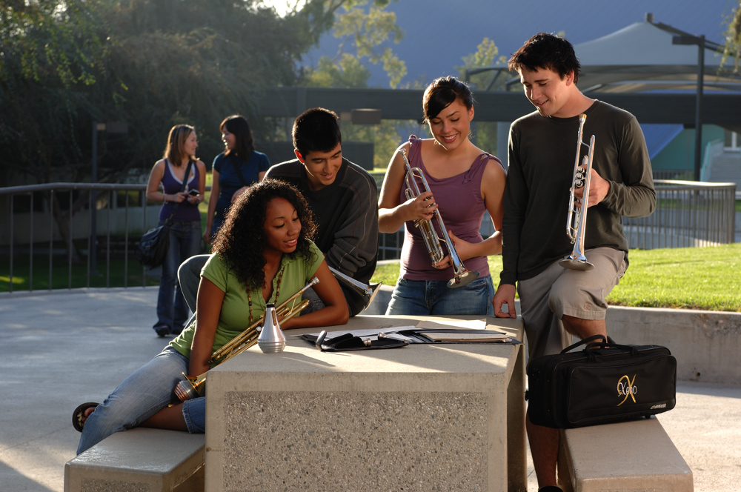
FAMOUS QUOTES. . .
Music has the power of producing a
certain effect on the moral character of
of the soul.
. . . Aristotle

Slide 26
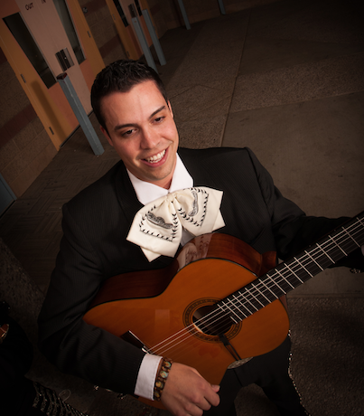
FAMOUS QUOTES. . .
Music furnishes a delightful recreation
for the hours of respite from the cares of the day, and lasts us through life.
. . . Thomas Jefferson

Slide 27
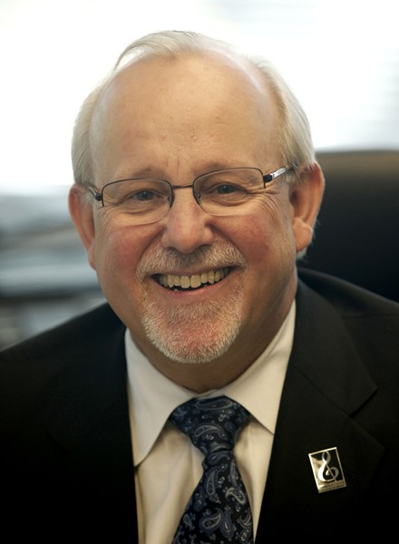
2015 MIDWEST CLINIC
December 16, 2015 4:00 PM Room #181W
Bridging the Gap Between Middle School and High School
Greg Bimm
Tim Lautzenheiser
Charlie Menghini
Marcia Neel
Terry Shade
The Music Achievement Council
www.musicachievementcouncil.org

Slide 28
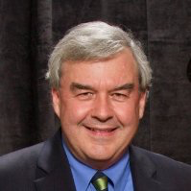
2015 MIDWEST CLINIC
December 16, 2015 4:00 PM Room #181W
Rick Young, MAC Chair
www.musicachievementcouncil.org

Slide 29
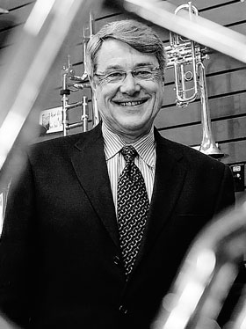
2015 MIDWEST CLINIC
December 16, 2015 4:00 PM Room #181W
Steve West
www.musicachievementcouncil.org

Slide 30
Today’s Session:
WE WANT (TO KEEP) YOU!
The WHAT
The WHY
The HOW

Slide 31
WHAT Other Teachers Think I Do!

Slide 32
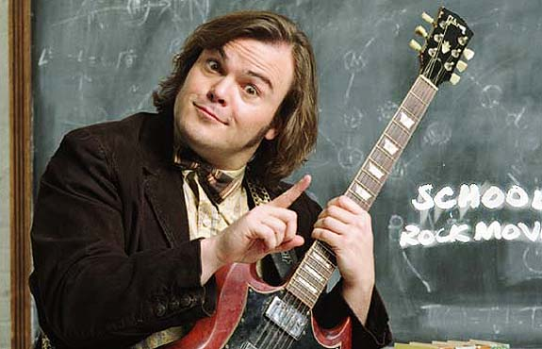
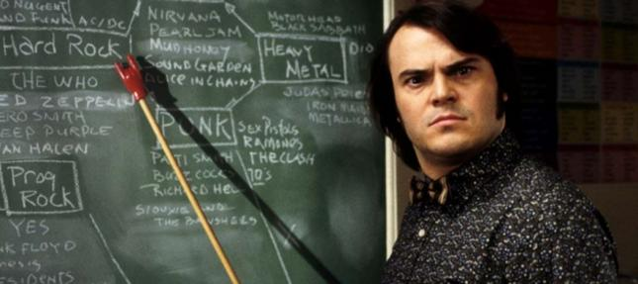
WHAT the Kids (I Don’t Already Teach) Think I Do!

Slide 33
WHAT Society Thinks I Do!

Slide 34
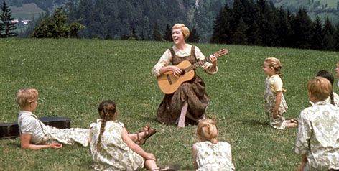
WHAT My Mom Thinks I Do!

Slide 35
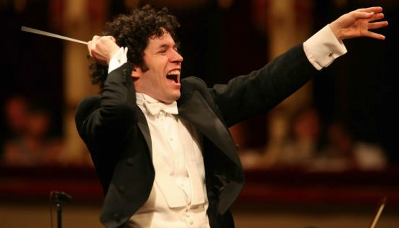
What I Think I Do!

Slide 36
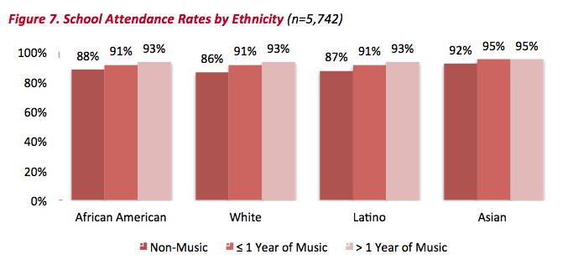
THE WHY. . . “ATTENDANCE”
http://musicmakesus.org/resources/research

Slide 37
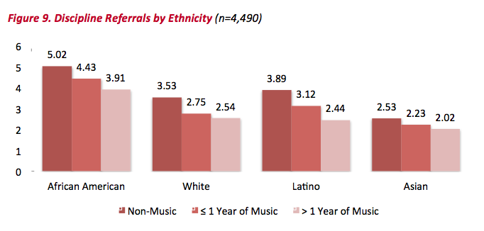
THE WHY. . . “DISCIPLINE”
http://musicmakesus.org/resources/research

Slide 38
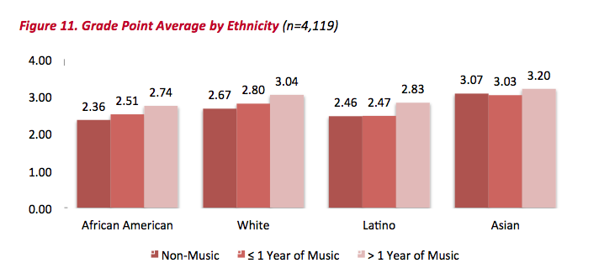
THE WHY. . . “GPA”
http://musicmakesus.org/resources/research

Slide 39
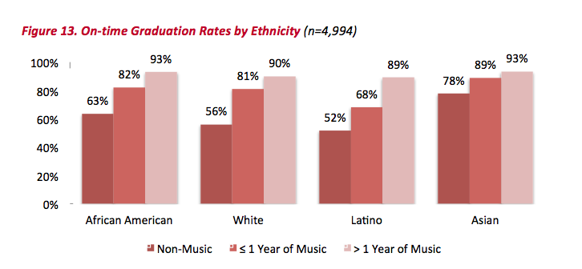
THE WHY. . .
“ON TIME GRADUATION”

Slide 40
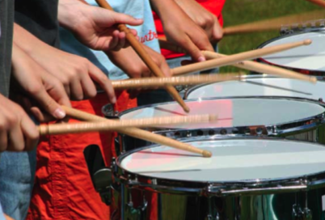
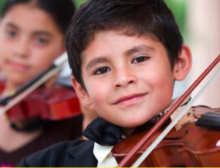
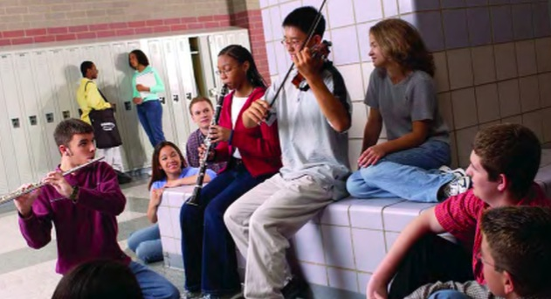
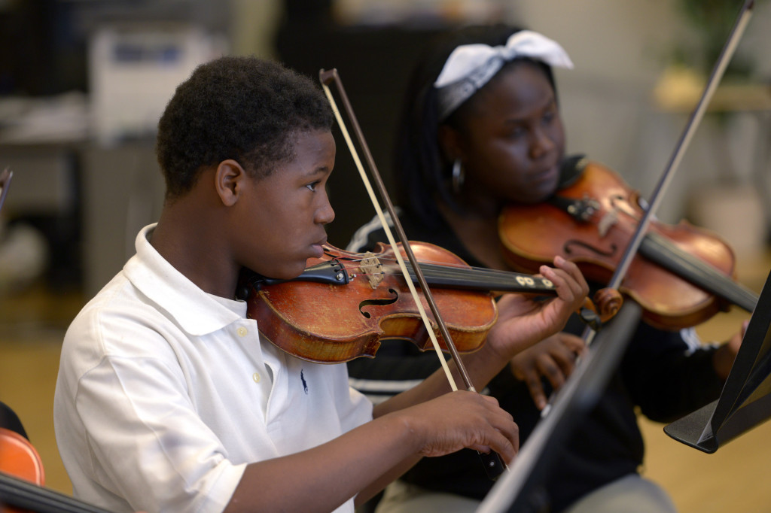
THE REAL REASON WHY. . .
A MORE FULFILLING LIFE!

Slide 41
THE HOW. . .
STRATEGIES TO BRIDGE THE GAP
BETWEEN MS AND HS
What Music Educators Can Do
What HS/MS Parents Can Do
What HS/MS Students Can Do
What HS/MS Principals Can Do
What Music Supervisors Can Do

Slide 42
THE HOW. . .
What Music Educators Can Do
Greg Bimm
Director of Bands
Marian Catholic HS
Chicago Heights, IL
www.musicachievementcouncil.org

Slide 43
THE HOW. . .
What Music Educators Can Do
Open House: First Sunday in December, entire
school is open prospective students and parents.
Step-Up Day: Tuesday after Grand Nationals, 7th
graders from multiple grade schools visit Marian.
Spartan Snapshot: Much like an open house, but a quick evening visit into “life” at Marian.
www.musicachievementcouncil.org

Slide 44
THE HOW. . .
What Music Educators Can Do
Shadow Program: 7th and 8th grade students visit Marian for a day and “shadow” a student for the entire day. Band students shadow band students and can sit in, etc.
Recruitment Corps: Marian students and faculty travel to catholic schools to present information about Marian. (We work to keep our students high on the list.)
www.musicachievementcouncil.org

Slide 45
THE HOW. . .
What Music Educators Can Do
Host Youth Concerts
Distribute fliers, recordings, etc.
Facebook, Twitter: “Contact us and we will
send recordngs and videos
Provide clinics to help prepare for contest
Have high school students “sit in” and help by
demonstrating appropriate modeling
“Thank you” for your alumni pictures
www.musicachievementcouncil.org

Slide 46
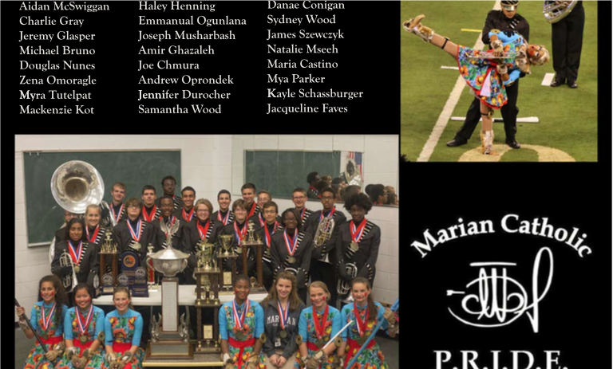
THE HOW. . .
Middle School Alumni Photo Card

Slide 47
THE HOW. . .
What Music Educators Can Do
Terry Shade
Director of Orchestras
Pacific Cascade MS
Issaquah, WA
www.musicachievementcouncil.org

Slide 48
THE HOW. . .
What Music Educators Can Do
1. Collaboration: Establish a positive working relationship with the High School Director!
2. Articulation: Work with HS and MS Principals to schedule a daily articulation period where the HS director comes to the middle school each day for team-teaching.
If this isn't workable, then schedule "switch days" each quarter or semester. Kids will get to know their future teacher!

Slide 49
THE HOW. . .
What Music Educators Can Do
Invite high school students to the middle school to coach students, teach a sectional or help organize a concert. High schoolers often need community service.
Conduct on each other’s concerts.
Attend each other’s concerts.
Chaperone each other’s trips to get to know/better supervise the students.

Slide 50
THE HOW. . .
What Music Educators Can Do
3. Communication: Send out emails inviting middle school families to the high school concerts. Middle school directors should offer extra credit! They will attend!
Have on-going discussions with middle school students about the music program as a "long-term, 7 year" program. Use words like, “When
you get to high school. . .”
www.musicachievementcouncil.org

Slide 51
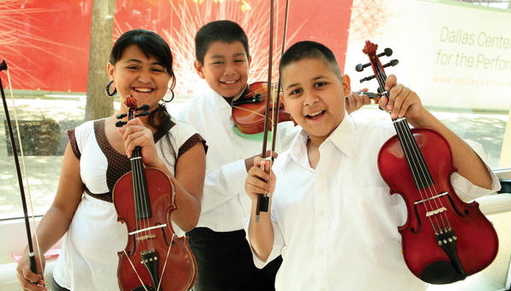
THE HOW. . .
What Music Educators Can Do
Grab them early, describing the many advantages; scholarships, travel, rising
SAT/ACT scores, long-term friendships, etc.

Slide 52
THE HOW. . .
What Music Parents Can Do
Marcia Neel
Secondary Fine Arts,
Ret.
Clark County Schools
Las Vegas, NV
www.musicachievementcouncil.org

Slide 53
THE HOW. . .
What Music Parents Can Do
1. Schedule a VIP Parent Night at a joint
concert/halftime show performance.
2. Host MS parent meetings at the high
school.
3. Mentor parent leaders of feeder
programs.
4. Involve parents directly in the learning
process. They’ll love it! (vid)

Slide 54
THE PARENT BAND

Slide 55
THE HOW. . .
What HS-MS Principals Can Do
1. Help facilitate recruitment assemblies/
events/activities at feeder schools.
2. Work with each other on effective
scheduling.
3. Create joint presentations for (feeder)
parents.
4. Provide opening remarks at each
other’s concerts.

Slide 56
THE HOW. . .
What Music Supervisors Can Do
1. Ensure that faculty sees itself as part of
one, K–12 Music Program – build purpose
and unity! Logo and tag line?
What happens in Music. . .
What happens in Music. . .
Lasts for a Lifetime!
2. Track articulation data

Slide 57
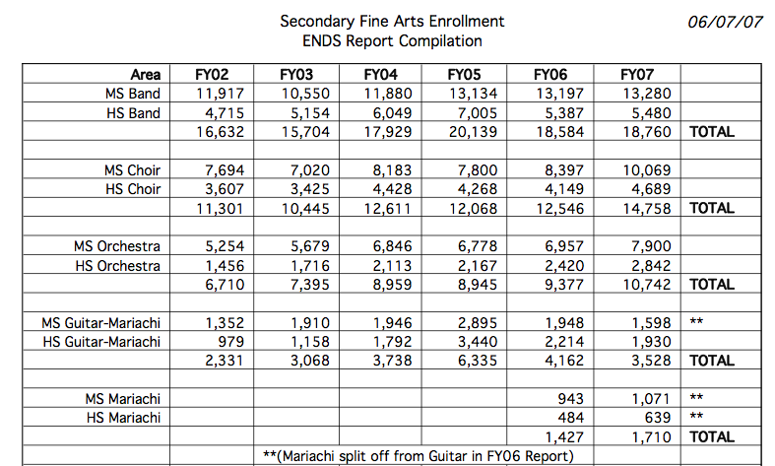
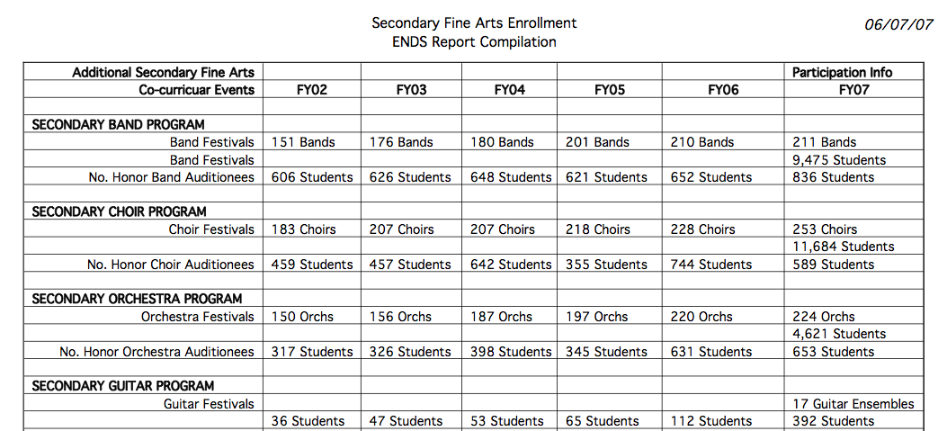
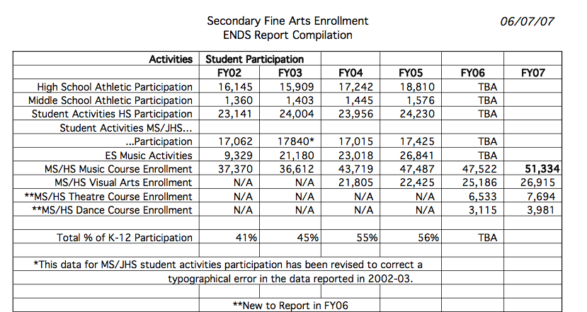
THE HOW. . .
What Music Supervisors Can Do
What happens in Music. . .

Slide 58
THE HOW. . .
What Music Supervisors Can Do
3. Provide sample student schedules.
Wind Symphony
Algebra I
Biology
Music Theory
Orchestra
AP English
Geometry
Chemistry
Algebra II
Chamber Ensemble
Jazz Band
Algebra XV
Calculus

Slide 59
THE HOW. . .
What Music Students Can Do
“Dr. Tim” Lautzenheiser
VP of Education
Conn-Selmer, Inc.
www.musicachievementcouncil.org

Slide 60
THE HOW. . .
What Music Students Can Do
Create a bridge with your high school students with the middle school students. (The high schooler’s are the “I wanna be like,” group for the younger ones.
Part of the Student Leadership Program for the high school students is to adopt a brother/
sister (maybe 2 or 3) to mentor/communicate with throughout the year in preparation for the younger one’s first year in high school band/orchestra/choir.

Slide 61
THE HOW. . .
What Music Students Can Do
3. A “sit beside” concert…or, in this case, CONCERTS. One at the high school (during the high school concert), and one at the middle school (during the middle school concert..the second one may be the most important because more parents will be attending that event.)
www.musicachievementcouncil.org

Slide 62
THE HOW. . .
What Music Students Can Do
4. For the marching band (during the fall)…each band person has a “mini-me”, and at the finale of the show, all the young ones join their high school partner and play the last song together…perhaps even do some simple drill…spotlight
on the young ones! “We present today’s Pride of Hometown High School, along with tomorrow’s
PRIDE TO BE!”
www.musicachievementcouncil.org

Slide 63
THE HOW. . .
What Music Students Can Do
5. The entire orchestra/band/choir attends the middle school concert, serves as hosts and hostesses, helps pass out programs, has a reception afterwards focusing on the young students and THEIR PARENTS!
www.musicachievementcouncil.org

Slide 64
THE HOW. . .
What Music Students Can Do
6. A PERSONAL INVITATION: Prior to “registration time for the middle schoolers,” the high school
students (as per their section) create a handwritten invitation to become part of the given section of the ensemble, then the section goes to the middle school, has photo taken along with the new members, gives them their band
pin, etc. (Facebook frenzy!)
www.musicachievementcouncil.org

Slide 65
THE HOW. . .
What Music Students Can Do
In other words, play on the assumption they WILL be a part of the organization when they transfer to high school…you are going to be part of our FAMILY.

Slide 66
THE HOW. . .
What Music Students Can Do
7. PARENT NIGHT (or after a concert): Key high schoolers create 2 minute testimonials to share with the NEWBIE PARENT CANDIDATES: “This is what being in the group has meant to me, and the benefits I continue to receive; the positive difference it has made in my entire school career.” It would also be prudent to have some key boosters/parents present their thoughts about the value of being a part of the group; what they have observed.

Slide 67
THE HOW. . .
What Music Students Can Do
8. The directors from both middle school and high school can MUTUALLY PRESENT the immeasurable impact music-learning and music-making has on the child’s total development. (Carefully selected advocacy data framed to help parents make a worthwhile decision for the welfare of their child’s education. You simply cannot deny the compelling data available…not just talk, but
hand out the KNOCK-OUT PUNCH DATA!

Slide 68
THE HOW. . .
What Music Students Can Do
9. Mi Casa, Su Casa: Our home is your home. If there is a close proximity between the middle school and high school, it opens the opportunity to do chamber ensembles with both sets of personnel, a one-room-schoolhouse private lesson (group lesson) program. Sectionals given by the high schoolers, etc.
www.musicachievementcouncil.org

Slide 69
THE HOW. . .
What Music Students Can Do
10. COMMUNICATE, COMMUNICATE, COMMUNICATE! Any situation where the students can be together, or the parents, or the directors staff, it creates a SAFE ENVIRONMENT and a COMFORTABLE CULTURE.
Anytime a high school student can make a middle school student feel worthy/important, the chances of them becoming part of the high
school ensemble increases dramatically.

Slide 70
Give Your Music Program
the Recognition It Deserves!
https://www.surveymonkey.com/r/2016BCME

Slide 71
Session Materials Posted:
www.musicedconsultants.net/conference-materials
Thanks to the Music Achievement Council
and these Quality Organizations!
www.musicachievementcouncil.org

