Slide 1




TIPS for Success!
Secrets Revealed From Our Very Best!
Marcia Neel
2013 KMEA
In-Service Workshop
www.MusicAchievementCouncil.org

Slide 2
Consider the Education/Training Needed for These Careers
This is YOUR Job! How is it going?
Accountant
Politician
Architect
Psychologist
Author
Public Relations Executive
Career Planner
Quality Assurance Executive
Financial Planner
Sales Executive
Travel Agent
Magician

Slide 3
1. Focusing on the
Classroom

Slide 4

Focusing on the Classroom
What does a Music Teacher Do?
Teach (Standards-based)
Communicate
Share Love of Music
Develop Curriculum
Prepare Lesson Plans
Assess Student Progress
Notes:
Produced by the Music Achievement Council
4

Slide 5
Focusing on the Classroom
A Checklist for Teachers
How can we help students reach their FULL potential?
Be genuine
Be enthusiastic
Be fair to ALL students
Be professional
Communicate clearly and often

Slide 6

Focusing on the Classroom
Recruitment and Retention
Promoting the VALUE of Music Education
To RECRUIT, take action through positive experiences
Publicize the nature and benefits of participation in music
Address costs and time involved clearly
Compete with other student options
Students JOIN music programs and stick with it IF the. . .
Director is enthusiastic and makes learning fun
Parents, community and school board support the program
Program is visible
SOOOOOOOOOOOOOO…

Slide 7

Focusing on the Classroom
Recruitment and Retention
Your task is to. . .
Foster student interest
Inform parents
Develop a continuing
  program for nurturing
  the support of the school,
  the administration, and
  the community
Get ‘Em and Keep ‘Em

Slide 8
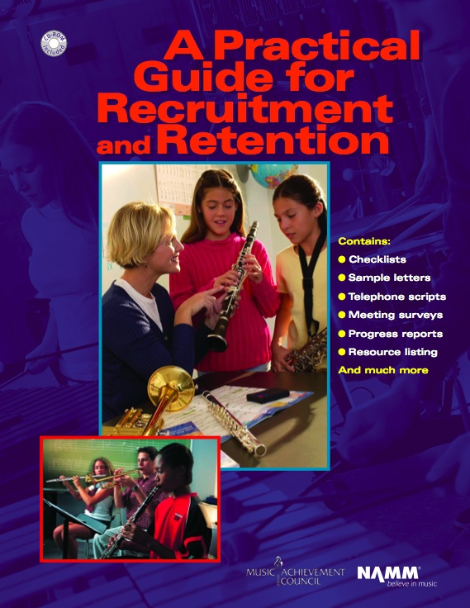
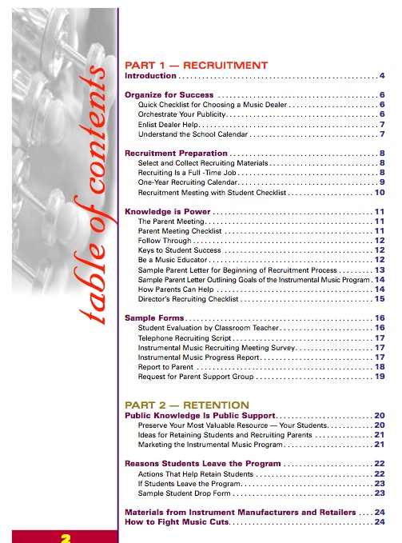
PGRR

Slide 9

Focusing on the Classroom
Recruiting and Retaining Students
First Performance
Reduces beginner drop-out rate
Provides short-term incentive goals
Encourages communication with parents
Strengthens administrative support

Slide 10

Focusing on the Classroom
Recruiting and Retaining Students
Notes:
Produced by the Music Achievement Council
10

Slide 11

Focusing on the Classroom
Recruitment and Retention
Remember:
Your Most Valuable Resources are. . .
YOUR STUDENTS
1. Make aesthetic pleasure the top priority
2. Foster pride and group recognition
3. Give credit to individual accomplishments
4. Make sure all instruments are in excellent playing condition
5. Make instrument care an important part of your program (pianos too!)

Slide 12
2. The Business Side of
Teaching

Slide 13
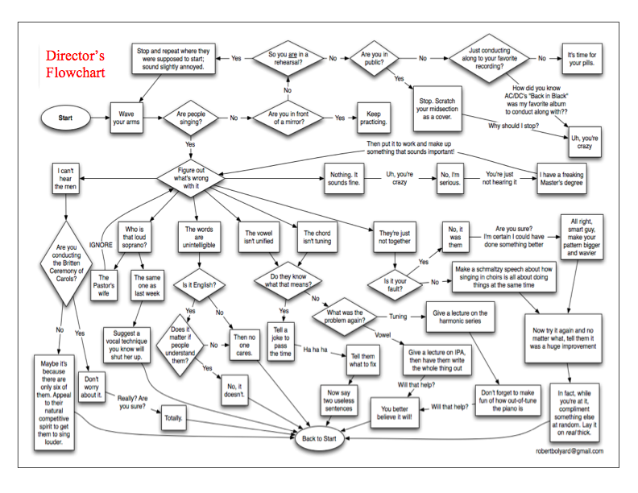
www.musiceducationconsultants.net/WMEA2011
Notes:
Produced by the Music Achievement Council
13

Slide 14
The Business Side of Teaching
Working with Administrators
Think BIG PICTURE
Include the principal and other faculty members as special guest soloists or narrators on concerts
Help your principal prepare congratulatory letters to your students
Keep faculty informed of activities/concerts and
THANK THEM for their cooperation and assistance
Have students send personal invitations to administration, faculty, and school board
Sign up to chaperone a dance, cover a class, attend a game and serve on committees
Notes:
Produced by the Music Achievement Council
14

Slide 15

The Business Side of Teaching
Choosing a Music Dealer
You Should Expect. . .
Honesty and fairness
An understanding, professional dealer rep
Regular service calls
A complete, in-house repair shop
Competitive prices
Lease programs for new instrument purchases
Specially priced folders, calendars, nametags, etc.
Comprehensive student-recruiting support for your program

Slide 16
The Business Side of Teaching
Choosing a Music Dealer
The Dealer Should…
Be an authorized selling agent for a variety of brands, method books, and materials
Provide loaner instruments for repair needs
Provide advocacy materials and educational research reports
Be a partner in helping to develop your program
Notes:
Produced by the Music Achievement Council
16

Slide 17
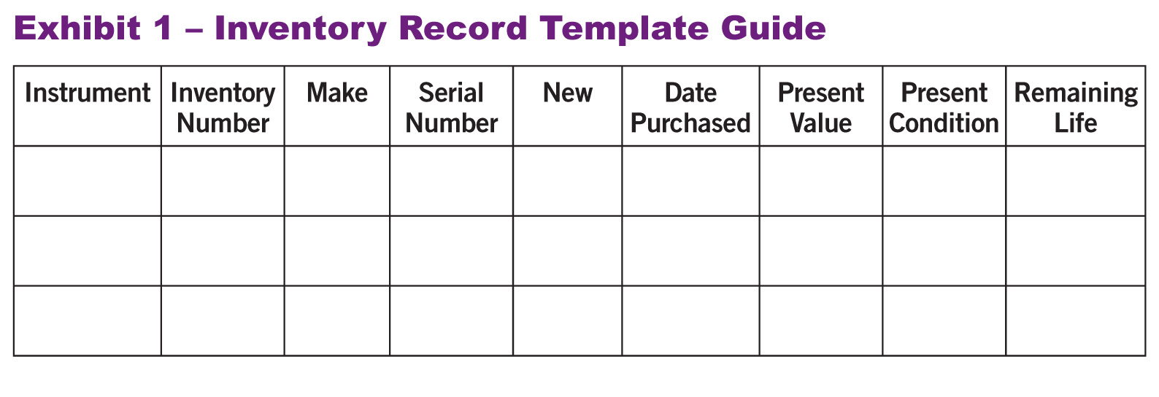
The Business Side of Teaching
Instrument Replacement Plan
Four (4) Steps to Preparing a Proposal for Your Supervisor
1. Evaluate the instruments. Create an Inventory Record Guide

Slide 18
The Business Side of Teaching
Instrument Replacement Plan
Four (4) Steps to Preparing a Proposal for Your Supervisor
2. Prioritize a list that should be replaced within 5 years. Estimate probable growth of program.
Write up a complete 5-YEAR PLAN that begins
with a clear explanation. Provide the plan to
your supervising administrator.
KEEP YOUR RATIONALE STUDENT-CENTERED.
Notes:
Produced by the Music Achievement Council
18

Slide 19
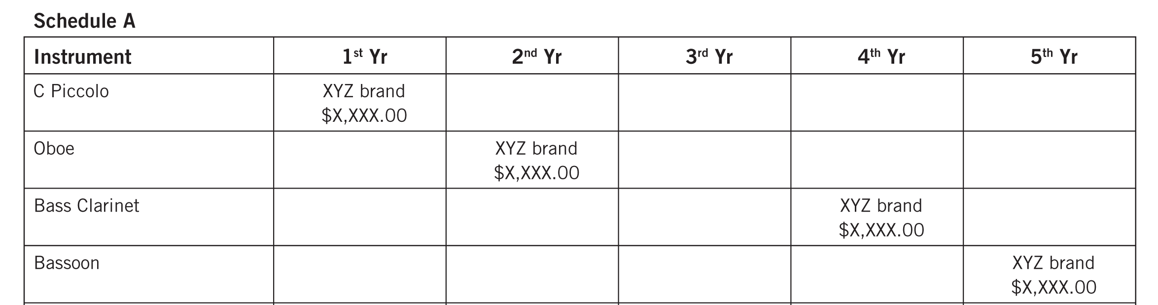
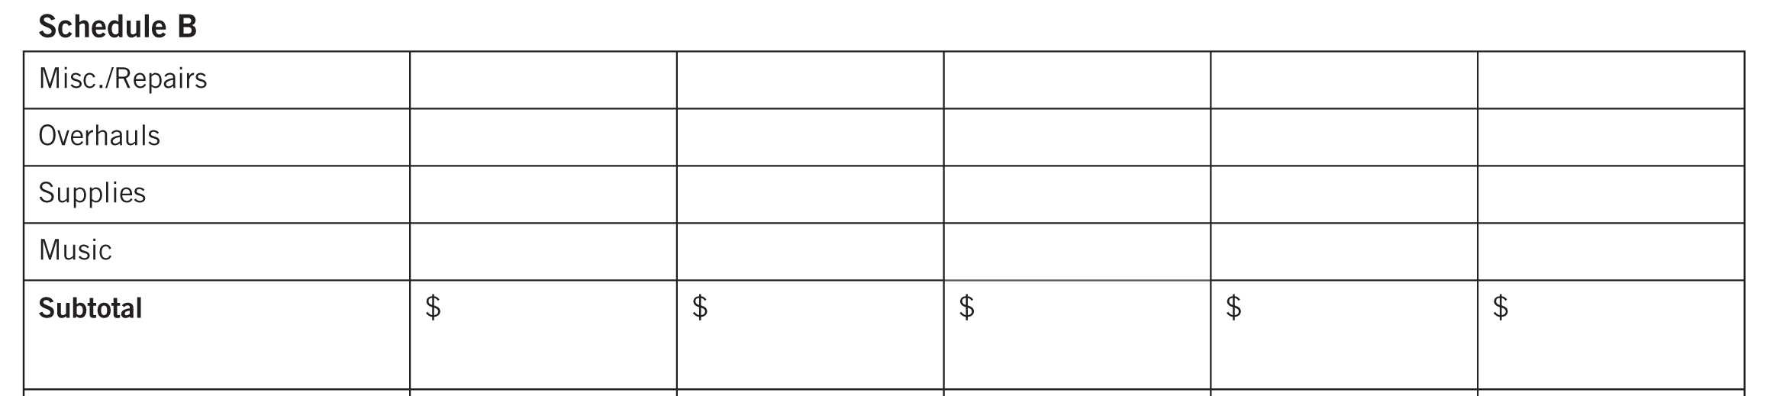
The Business Side of Teaching
Instrument Replacement Plan
Sample Forms to Use to Develop Your Plan. . .

Slide 20
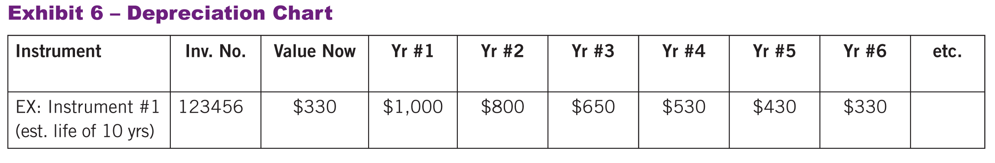
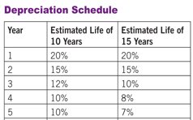
The Business Side of Teaching
Instrument Replacement Plan
Maintain a Depreciation Chart.

Slide 21
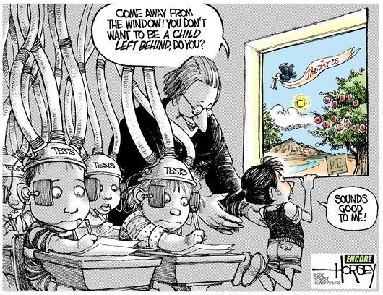
3. Telling
The Story

Slide 22
Telling the Story
Great Ways to Get Out Your Message
ALWAYS promote the benefits of an education in music.
Have students tell their stories. Music Makes the
Difference Because. . .
Have students write letters inviting decision-makers to
concerts to speak, perform, or even conduct.
Stage a Music Open House for your community. Engage
senior population!
Profile Student Artists -- Student Artist of the Week.
Engage your school faculty -- involve them in the
learning process.
Provide Beginner of the Month Awards; make it a BIG
DEAL!!!
Notes:
Produced by the Music Achievement Council
22

Slide 23
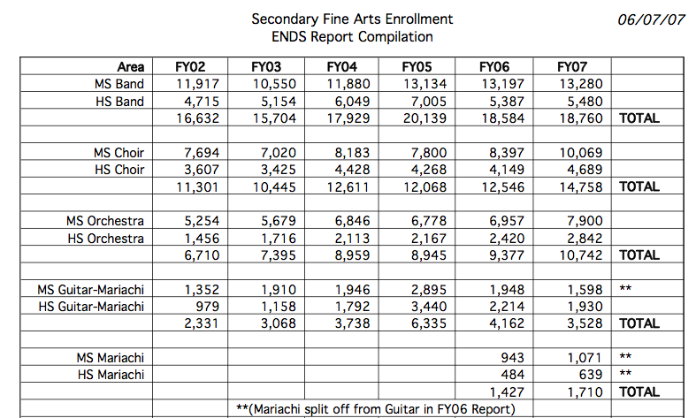
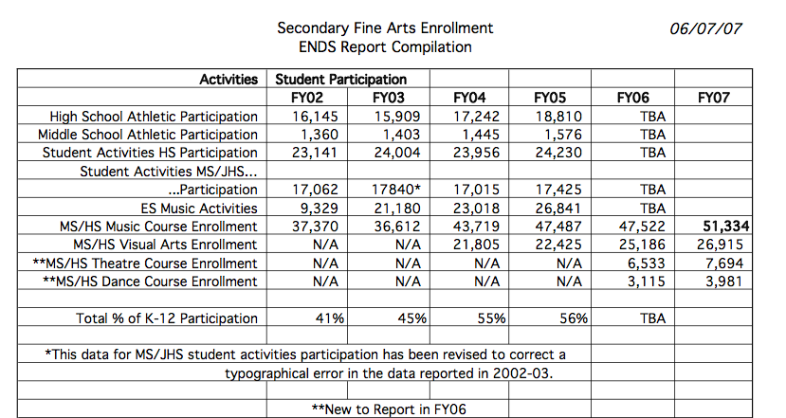
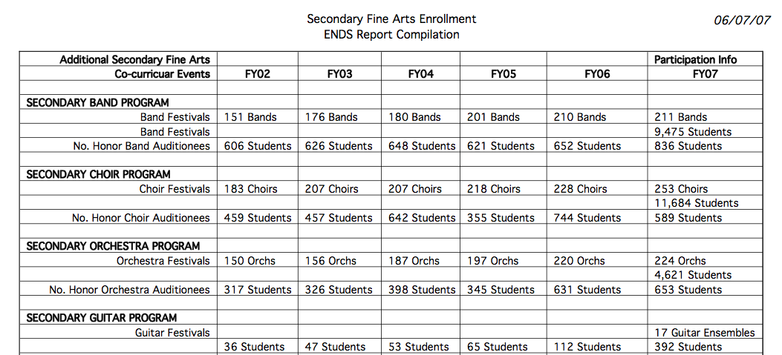
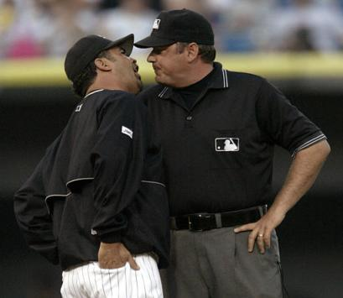
Telling the Story: DATA! DATA! DATA!
Communicating
Content
DATA! DATA! DATA!
General Information
Write Professionally/Check Spelling
and Grammar
Process
Maintain an Annual Report File
Format
Ensure Organization/Use Categories
Include Spreadsheets for Reporting Data

Slide 24
4. Supporting Music Education
www.MusicAchievementCouncil.org

Slide 25
Supporting Music Education
Help Others Succeed
Recruit new, quality music educators to your school district
Offer to help with the interviewing process
Offer to Develop a Mentoring Program or Serve as a mentor
Give back to the profession

Slide 26
Supporting Music Education
Help Others Succeed
Your Local University Music Program
Offer to have MusicEd students observe your classes
Allow MusicEd students to “get their feet wet”
Attend university concerts and encourage your students to attend
Take student teachers and guide them appropriately
Notes:
Produced by the Music Achievement Council
26

Slide 27



24 Tips for Success
Traits of the Successful Teacher
Your Personal Checklist
Maintains high standards for self and others
Organizes class time with a variety of activities
Doesn’t bore students by talking too much
Maintains interest for all students
Recruits all year
Communicates clear goals

Slide 28
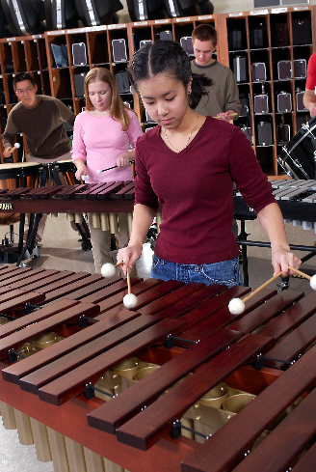
24 Tips for Success
Traits of the Successful Teacher
Your Personal Checklist
Maintains positive relationships with fellow teachers
Communicates often with parents
Performs in school and community OFTEN
Maintains a professional look and attitude in all performing ensembles
Develops connections among school, parents and community
Advocates for music education

Slide 29
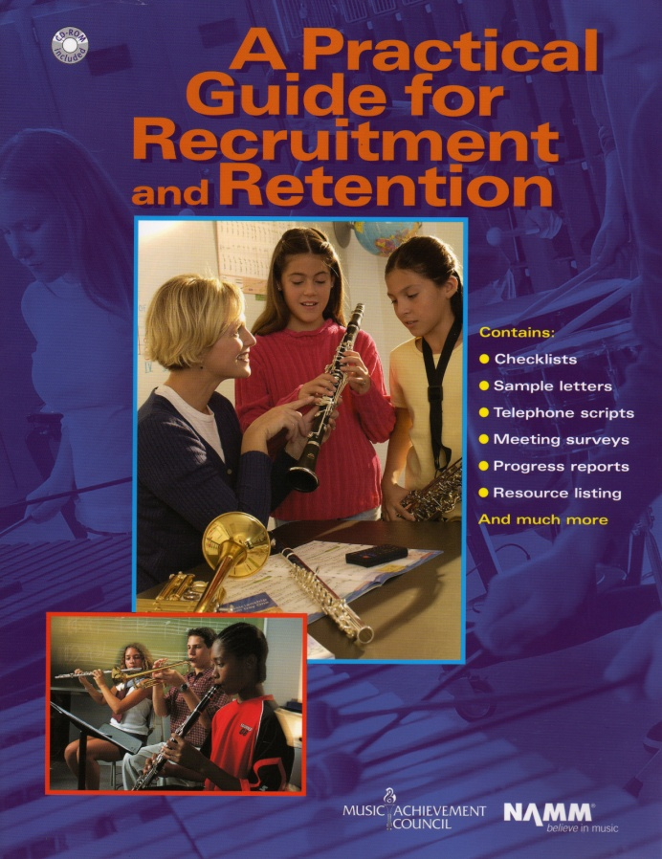
What’s Available to Help
www.MusicAchievementCouncil.org
Notes:
Produced by the Music Achievement Council
29

Slide 30
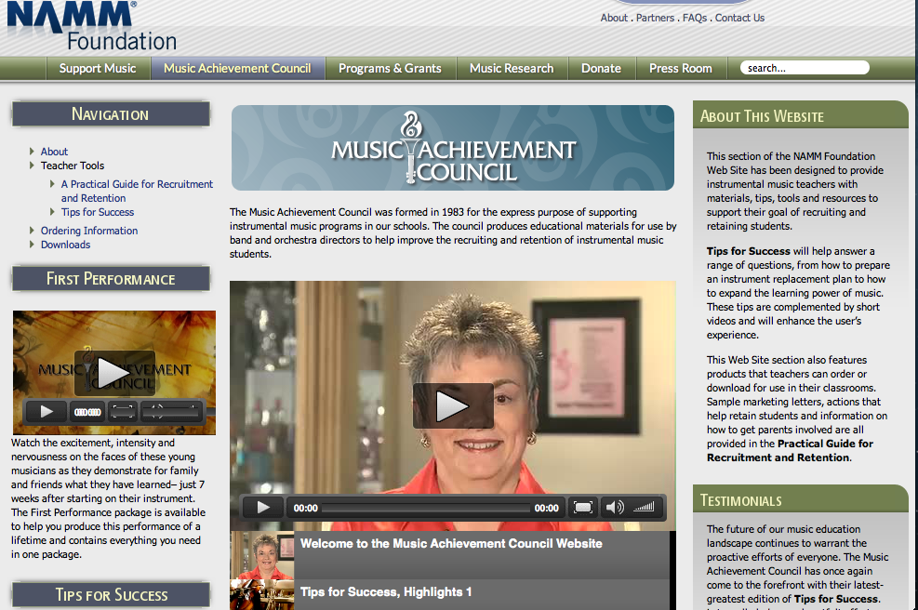
What’s Available to Help
www.MusicAchievementCouncil.org
Notes:
Produced by the Music Achievement Council
30

Slide 31
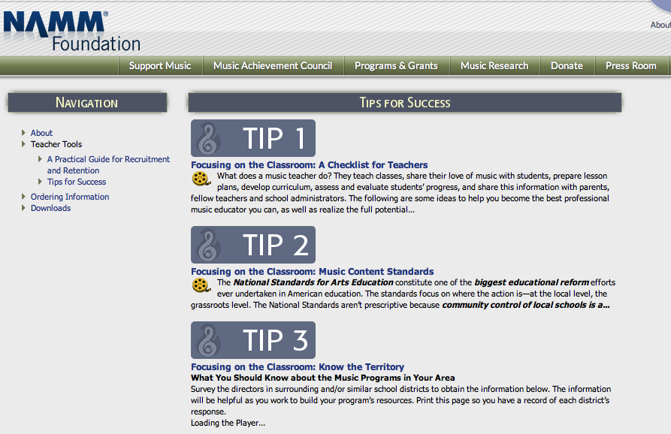
What’s Available to Help
www.MusicAchievementCouncil.org
Notes:
Produced by the Music Achievement Council
31

Slide 32
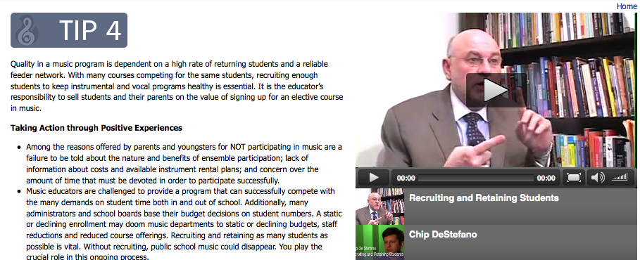
What’s Available to Help
www.MusicAchievementCouncil.org
Notes:
Produced by the Music Achievement Council
32

Slide 33
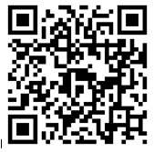
Got
Smart Phone?
www.surveymonkey.com/s/JHSZG77
www.MusicAchievementCouncil.org
Notes:
Produced by the Music Achievement Council
33

Slide 34
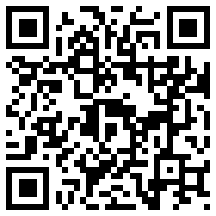












Please Complete our BRIEF Survey and give us YOUR BEST IDEAS TO SHARE!
www.MusicAchievementCouncil.org
Notes:
Produced by the Music Achievement Council
34

