Slide 1
“One is Too Small a Number
to Achieve Something Great”
2013 KMEA
In-Service Workshop
Presented by
Marcia Neel
February 22, 2013
www.musiceducationconsultants.net/KMEA2013

Slide 2
“One is Too Small a Number
to Achieve Something Great”
2013 KMEA
In-Service Workshop
Presented by
Marcia Neel
February 23, 2013
www.musiceducationconsultants.net/KMEA2013

Slide 3
School is. . .
Impressionistic
vs
Expressionistic
Music is. . .

Slide 4
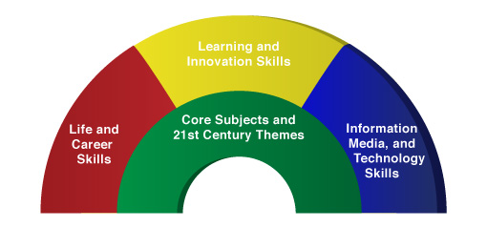
A focus on these 5 C’s is essential
to prepare students for the future.
Critical Thinking
Communication
Collaboration
Creativity
Confidence
Therefore. . .

Slide 5
The Music Skills Practice Room is. . .
The Life Skills Practice Room
1. Critical Thinking. . .
Ability to reason effectively and solve
problems
Ability to analyze how parts of a whole
interact with each other to produce overall
outcomes in complex systems

Slide 6
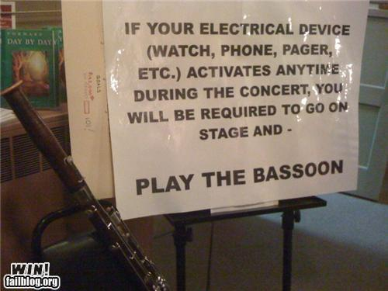
The Music Skills Practice Room is. . .
The Life Skills Practice Room
Problem Solving:
Ability to solve problems.
EX: Having a problem getting
people to turn off their phones and
beepers at your concerts? How
would you solve this problem?
Try this!!!!!!

Slide 7
The Music Skills Practice Room is. . .
The Life Skills Practice Room
EXAMPLE: Ability to analyze how parts
of a whole interact with each other to produce overall outcomes in complex systems.
See how this creative student used this concept to produce a remarkable outcome!

Slide 8
The Music Skills Practice Room is. . .
The Life Skills Practice Room

Slide 9
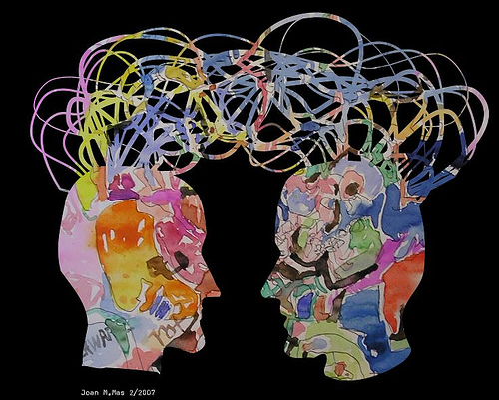
The Music Skills Practice Room is. . .
The Life Skills Practice Room
2. Communication. . .
Ability to listen
effectively
Ability to express
thoughts effectively
with others –
both verbally and non-verbally
Have you tried Result-driven Communication?

Slide 10
The Music Skills Practice Room is. . .
The Life Skills Practice Room
Result-driven Communication: Listening and
communicating effectively will guarantee success!

Slide 11
The Music Skills Practice Room is. . .
The Life Skills Practice Room
3. Collaboration (Teamwork). . .
Ability to work effectively and respectfully
with ALL

Slide 12
The Music Skills Practice Room is. . .
The Life Skills Practice Room
Teamwork: Effective when EVERYONE does their job.

Slide 13
The Music Skills Practice Room is. . .
The Life Skills Practice Room
Teamwork: NOT effective when even ONE PERSON
does NOT do their job.

Slide 14
The Music Skills Practice Room is. . .
The Life Skills Practice Room
4. Creativity (Innovation). . .
Ability to think creatively and work creatively with others
Ability to create new and more worthwhile
ideas and products as well as the need for the idea/product
“The MFA is the new MBA” Daniel Pink

Slide 15
The Music Skills Practice Room is. . .
The Life Skills Practice Room
(Innovation): Ability to think and work creatively with others

Slide 16
The Music Skills Practice Room is. . .
The Life Skills Practice Room
5. Confidence. . .
Ability to handle EVERY CIRCUMSTANCE
and grow from it

Slide 17
The Music Skills Practice Room is. . .
The Life Skills Practice Room
Confidence: Ability to handle EVERY CIRCUMSTANCE

Slide 18
but. . .
“ONE IS TOO SMALL A
NUMBER TO ACHIEVE
SOMETHING GREAT”
SOOOOOO. . .
WHAT CAN WE DO
TOGETHER TO ACHIEVE
GREATNESS?
Parents
Teachers
Principals
Custodians
Support Staff
Community

Slide 19
What Makes Our Programs Special?
Do We C.A.R.E.?
With GREAT THANKS to Dr. Tim!
C: Communication
Do we encourage one another to reach out to each other?
Do harmony and balance apply to more than great music-making?

Slide 20
What Makes Our Programs Special?
Do We C.A.R.E.?
A: Attitude
Do we generate the proper attitude?
Does our attitude play a crucial role in the outcome of the program’s success?

Slide 21
What Makes Our Programs Special?
Do We C.A.R.E.?
R: Responsibility
Do we come together ready to invest energy for ongoing growth and development of our goals?
Do we respond to each other in a fashion that will advance the entire program to the next level?

Slide 22
What Makes Our Programs Special?
Do We C.A.R.E.?
E: Excellence
Do we reflect a sense of excellence to go beyond the basic requirements -- to put forth extra effort?

Slide 23
“We either hang together, or
we hang separately” . . . Ben Franklin
When ALL of the people involved in a music program decide to unselfishly GIVE, it’s THEN that we realize the true value of the program --
a gathering of wonderful people who genuinely C.A.R.E. for one another.
. . . Tim Lautzenheiser

Slide 24
In Your Own Words:
Music makes the difference because. . .

Slide 25
In Your Own Words:
I will make a difference by. . .

Slide 26
Doesn’t she deserve our very best?

Slide 27
And finally. . .
Are YOU committed to the program by making the best of every situation NO MATTER WHAT?
One final bit of inspiration. . .
When life gives you lemons,
do you make lemonade?

Slide 28
Let’s Make the MOST of every moment!

Slide 29
Contact Information:
marcia@musicedconsultants.net
www.musiceducationconsultants.net/KMEA2013
@MusicEdConsult
On Twitter
Thank You!

