Slide 1
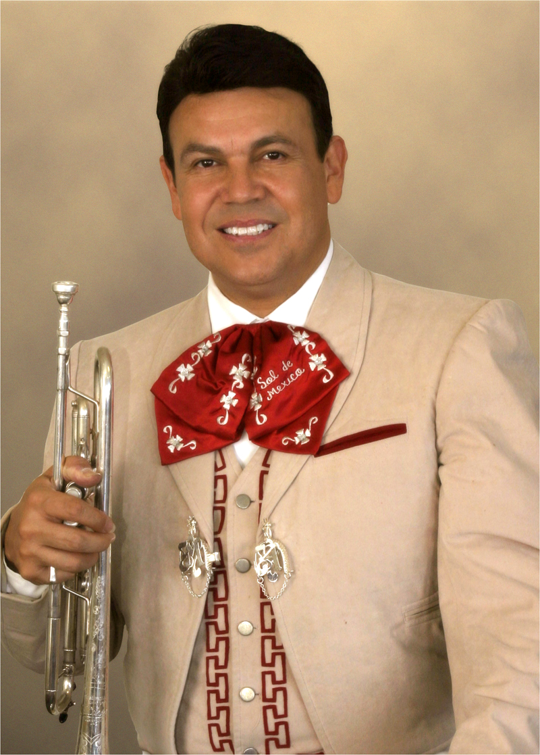



Broadening Your Base; From Zero to Mariachi!
Sponsored By:
Presenters:
Jose Hernandez, Marcia Neel
Guests:
Mariachi Acero
Members of
Mariachi Sol de Mexico
2013 NAMM Show Anaheim, CA
January 26, 2013 NAMM Foundation Lounge

Slide 2
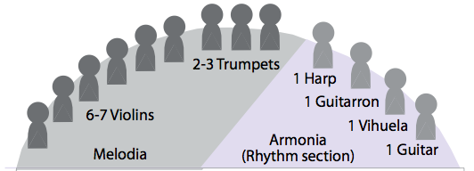
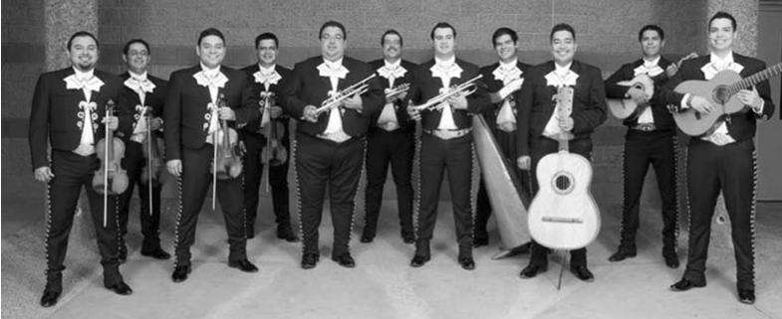
The Mariachi Ensemble
Use Photo of Sol de Mexico

Slide 3
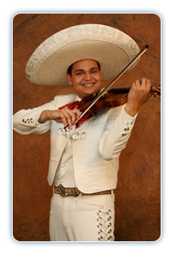
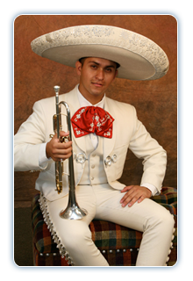
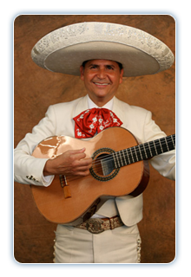
Instrumentation: Traditional Instruments
Erick Hernandez
Violin
Roberto Diaz
Trompeta
Jesus (Chuy) Hernandez
Guitarra
3
Notes:
3

Slide 4
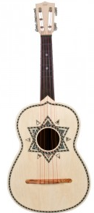

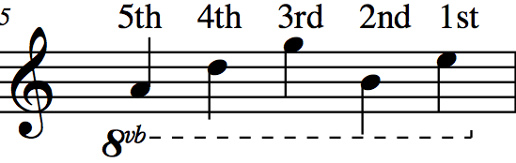
Characteristic Instruments: The Vihuela
A
D
G
B
E
5
4
3
2
1

Slide 5
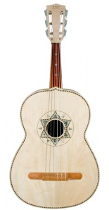
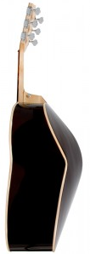
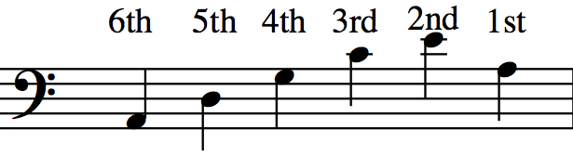
Characteristic Instruments: The Guitarron
A
D
G
C
E
A
T
Written Range/Sounds Octave Lower
6
5
4
3
2
1

Slide 6
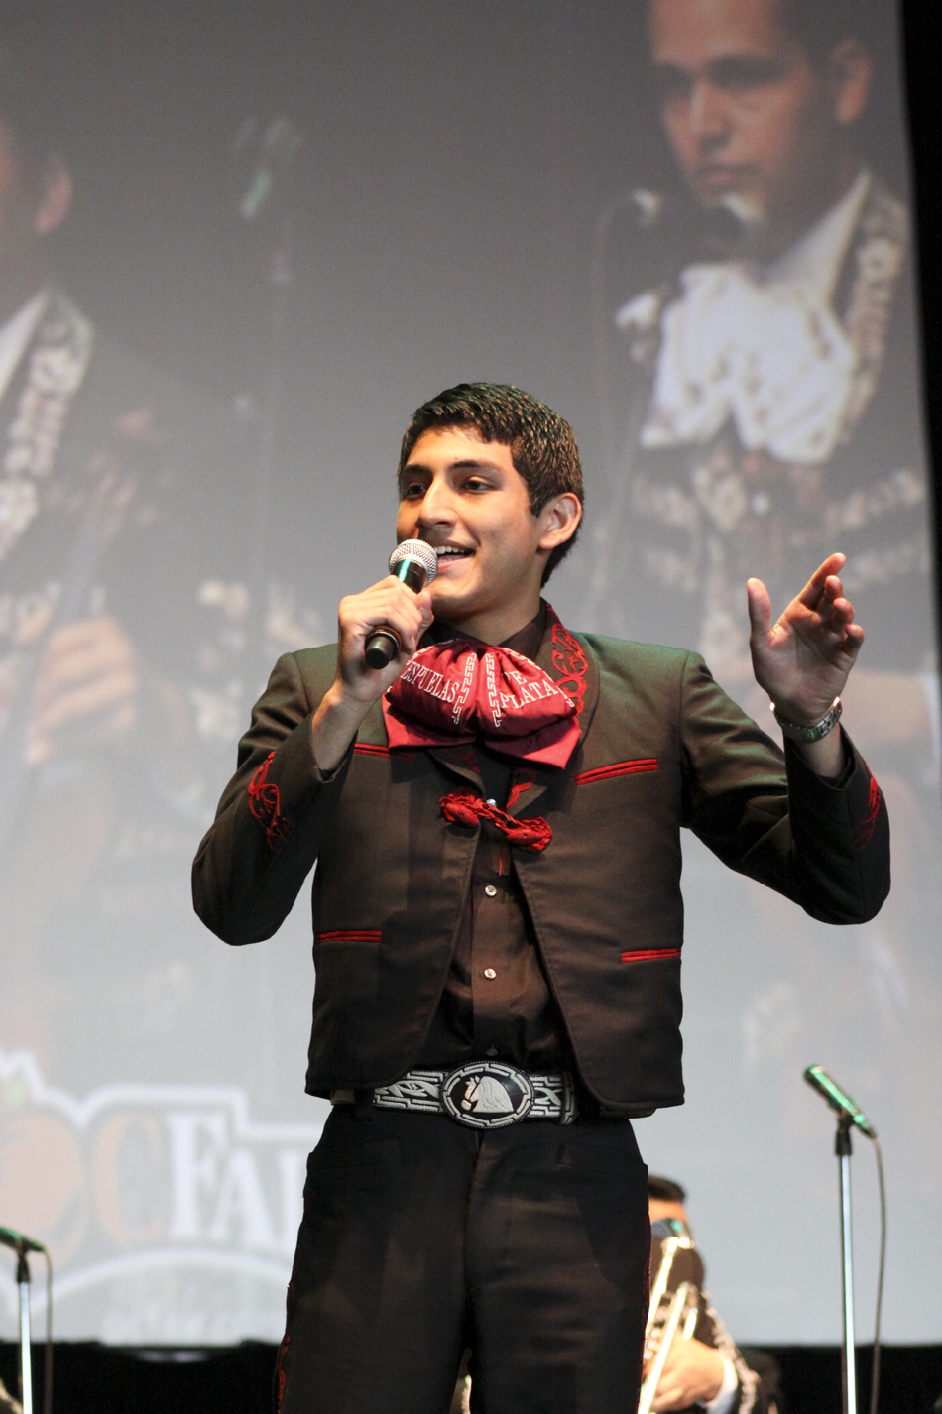
Some New Terms
1. Melodia
Violin, Trumpet
Vocal
2. Armonia:
The Rhythm Section
Guitar, Vihuela
Guitarron
3. Mánico
Strumming Pattern
6
Notes:
6

Slide 7
So. . .
How DIFFICULT is all of this, REALLY??????
7
Notes:
7

Slide 8
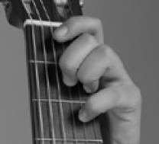
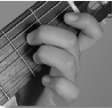
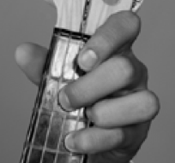
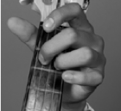
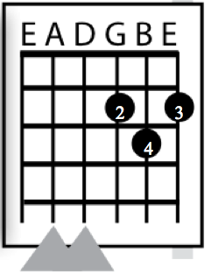
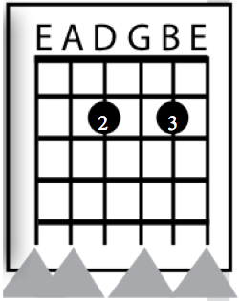
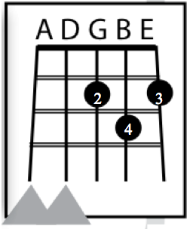
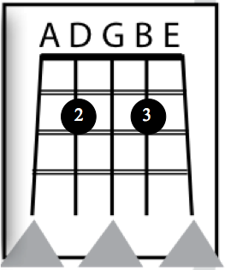
Today’s Chords: D Major and A7
(New Terms: Primera/Segunda, Key of D = Re)
Guitarra Vihuela
D Major
A7
D Major
A7
8

Slide 9
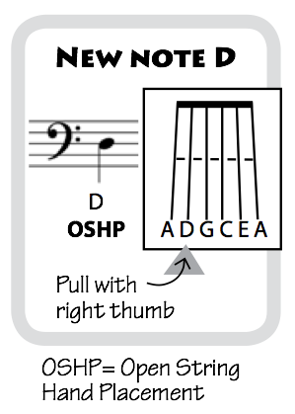
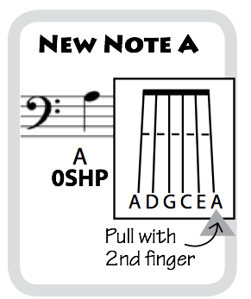
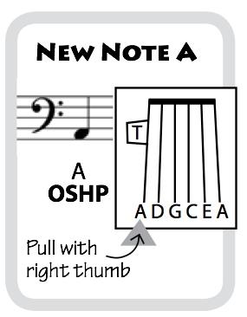
Today’s Guitarron Notes
Most Notes are Played in Octaves
9

Slide 10

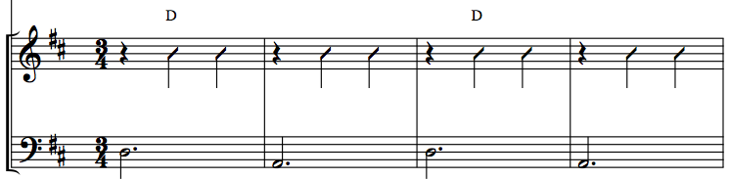
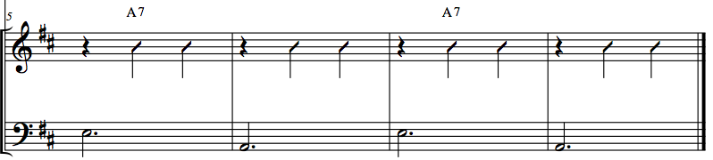
Ranchera Valseada Form
Hablando Claro
3/4 Time Signature Mánico: Down Strums
Mostly Major Keys Golpe Strum
Have students speak text in rhythm before playing.
Primera
Bass Play Play, Bass Play Play, Bass Play Play, Bass Play Play
Segunda
Bass Play Play, Bass Play Play, Bass Play Play, Bass Play Play

Slide 11
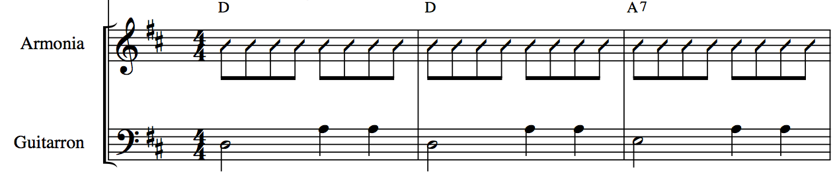
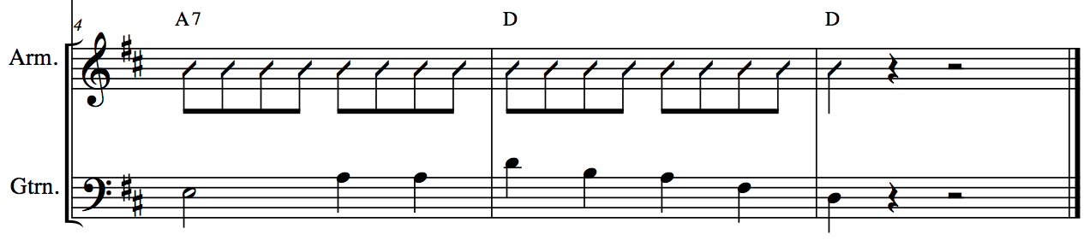
Bolero Form
Gema
Mánico: Note Down Strums Common Time
Note Guitarron Rhythm Mostly Major Keys
11
Notes:
11

Slide 12
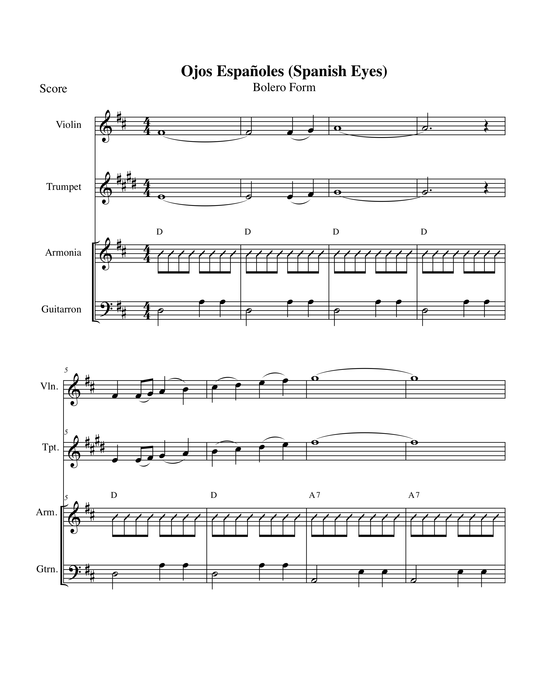

Slide 13
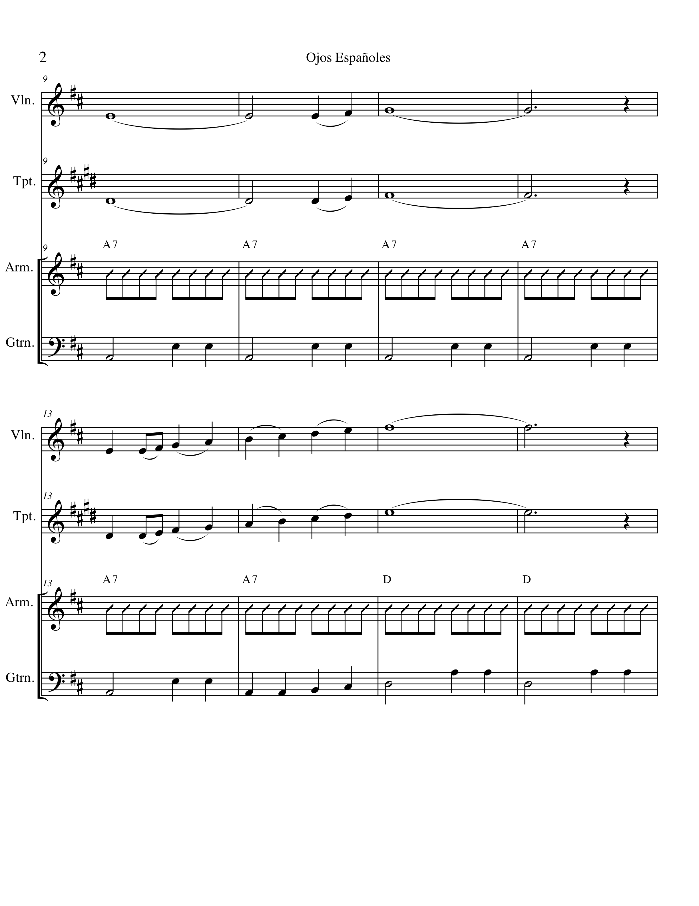

Slide 14
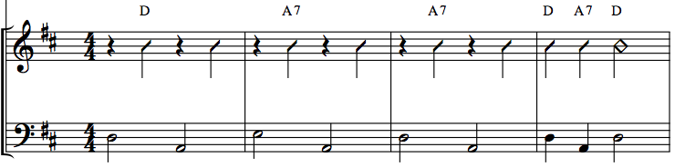
Ranchera Lenta (Romantica) Form
Las Ciudades
Characteristic Mánico:
Note Down Strums
Note Guitarron Rhythm
4/4 Time Signature
Mostly Major Keys
Articulation
Have students speak text in rhythm.
Bass Play Bass Play . . .

Slide 15
Everyone Sings!
Even YOU!!!!

Slide 16
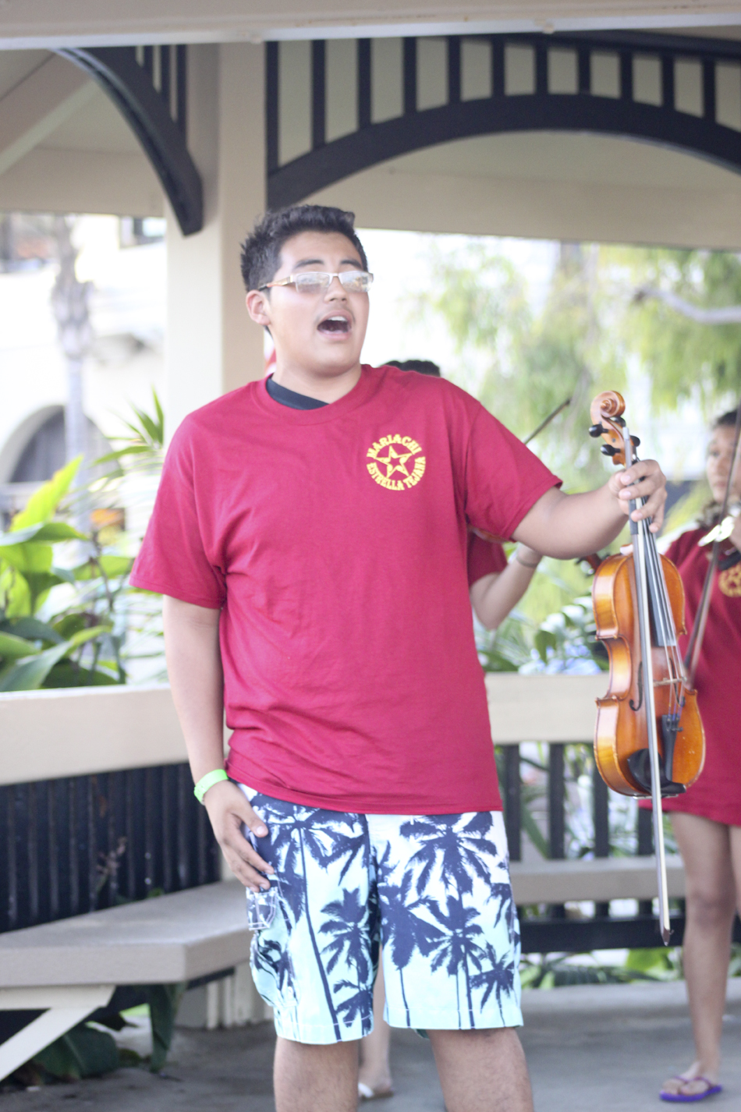
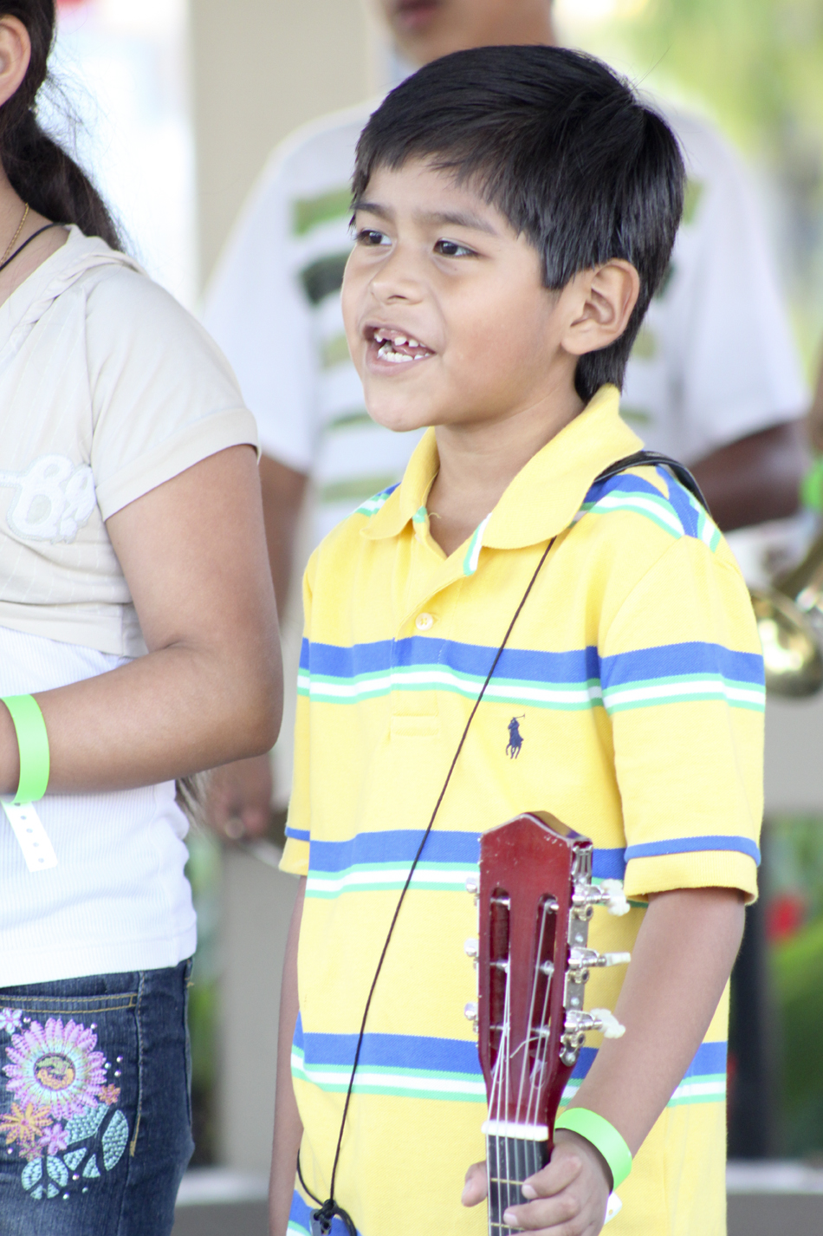
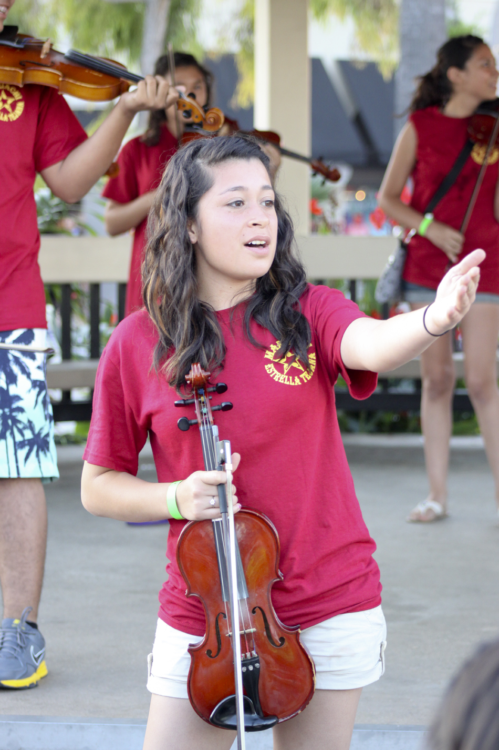
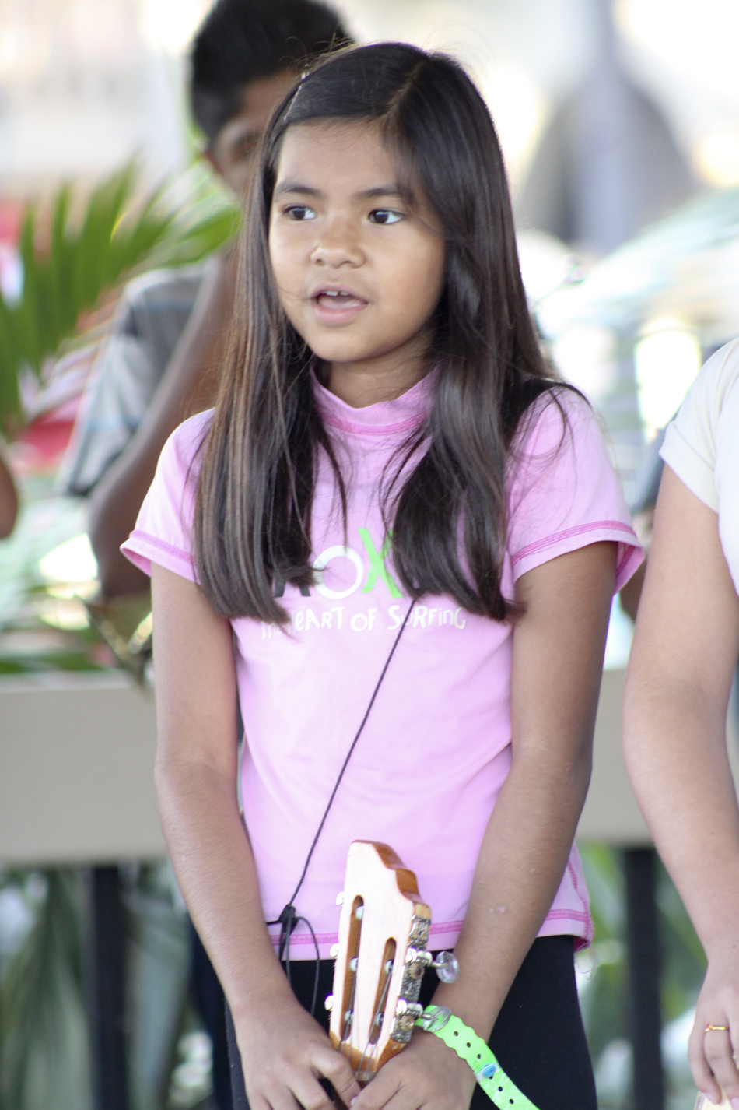
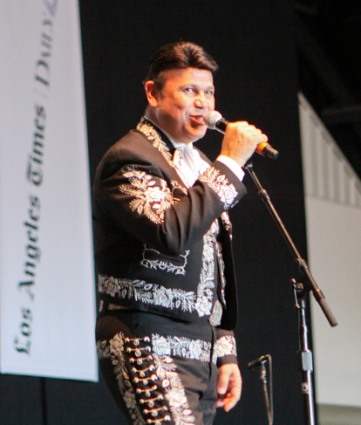
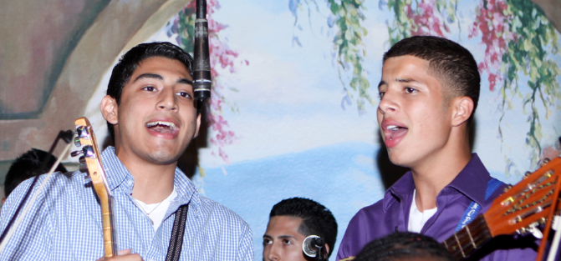
ALL AGES

Slide 17
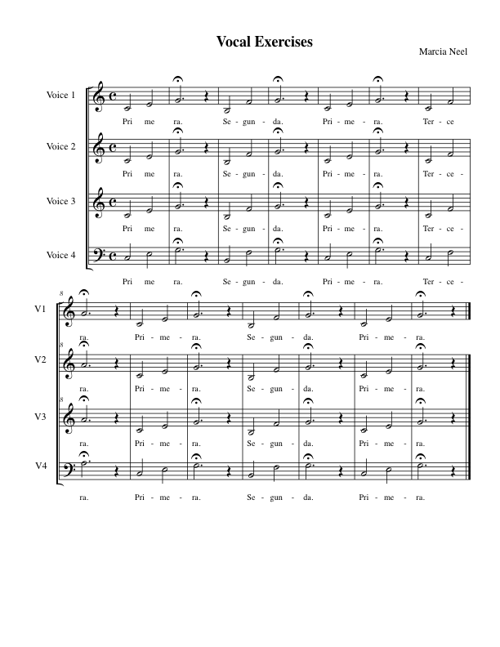

Slide 18
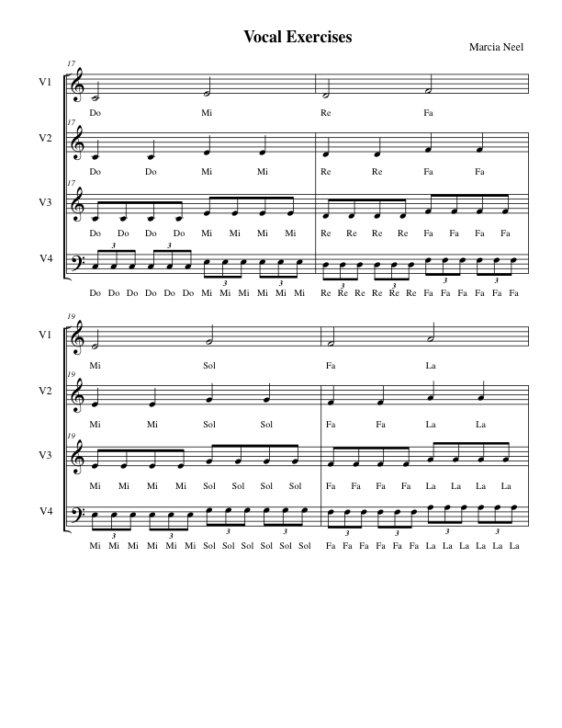
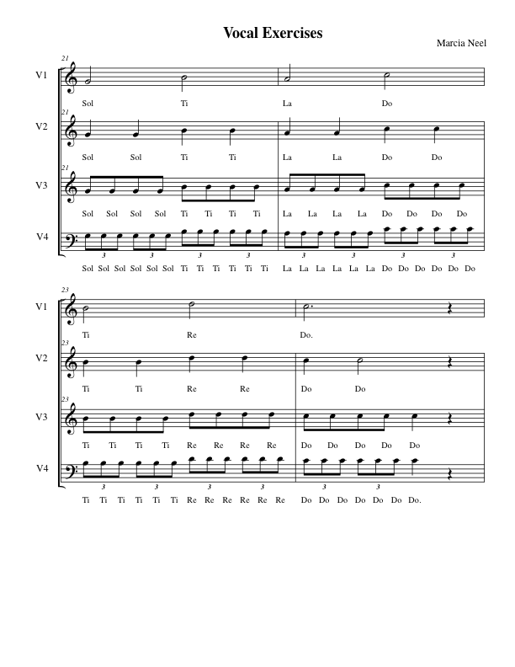

Slide 19
What is the
Son Form?

Slide 20
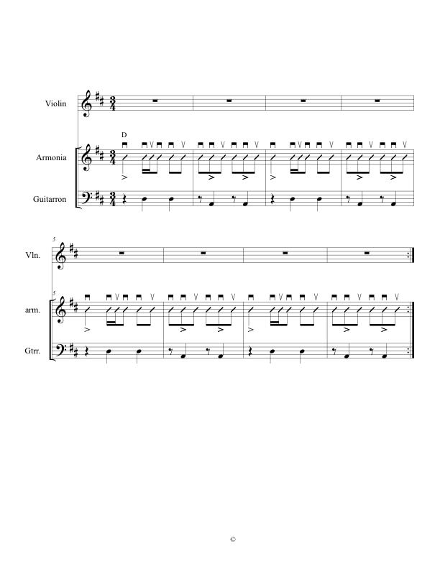
Son Form
Perhaps the most traditional song form in Mariachi genre.
Alternating 3/4-6/8 feel:

Slide 21
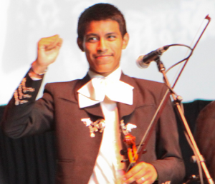
Benefits of a
School Mariachi Program
Involves More Students in Music
Entry-level music experience anytime
Keeps students in school
Effective use of multiple intelligences
Learning of life-long skills
Increases student self-esteem and
  self-confidence
Celebration of culture and heritage
Strengthens performing arts departments K-12
High/positive community visibility and outreach
Effective bridge to parental involvement
Creation of a school “Mosaic of Musical Experience”
Opportunity for students to serve as role models to younger students
(Academic Service Learning)
28

Slide 22

Bailey MS Mariachi Program Year 2
28

Slide 23
Scope and Goals
BEGINNING MARIACHI
Course Scope:
This one-year course is designed for the student who is interested in learning to play a mariachi instrument including violin, trumpet, guitar, vihuela and guitarron. It includes the development of skills necessary to become independent as a musician. This course concentrates on the development of note-reading skills, aural skills, singing skills, rhythmic patterns, intonation, and tonality inherent to the mariachi genre. A progression of fundamental and technical proficiency is expected.
Course Goals:
To develop age-appropriate individual singing and playing skills leading to independence as a mariachi musician.
To develop the singing and playing skills necessary to create an ensemble sound in the basic mariachi styles.
To identify and respond appropriately to music notation.
To develop the ability to play with correct intonation.
To demonstrate an understanding of the form and structure of the basic mariachi styles.
To demonstrate nuances inherent to the basic mariachi styles.
To demonstrate reasonable progression in fundamental and technical proficiency.

Slide 24

Scope and Goals
BEGINNING MARIACHI
Course Goals: (Continued). . .
To develop skills to compose and arrange simple melodies and harmonies in one of the basic mariachi styles.
To recognize the relationship between mariachi and ballet folklorico.
To recognize the relationship between simple mariachi styles and the historical significance of their roots from the various states of Mexico.
To discriminate with regard to quality of performance and composition through the demonstration of basic listening skills.
To prepare students for introductory mariachi performance experiences.
To develop attitudes enabling continued participation in musical experience throughout life.
Prerequisite: None
Middle School: Offered in FY 13 for grades 6 and 8 only
Offered in FY14 for grade 8 only
Course transitions to Armonia and Melodia Classes in FY14

Slide 25
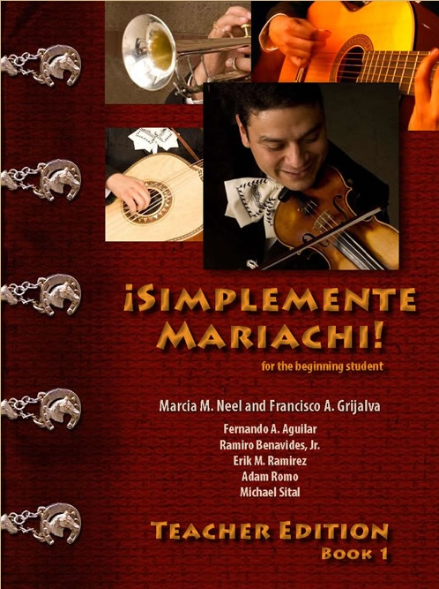
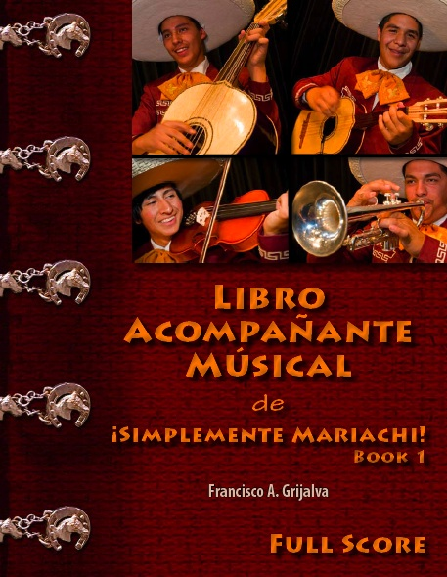
Standards-based
Materials for Beginning Level Programs
Method Series Song Book Series

Slide 26
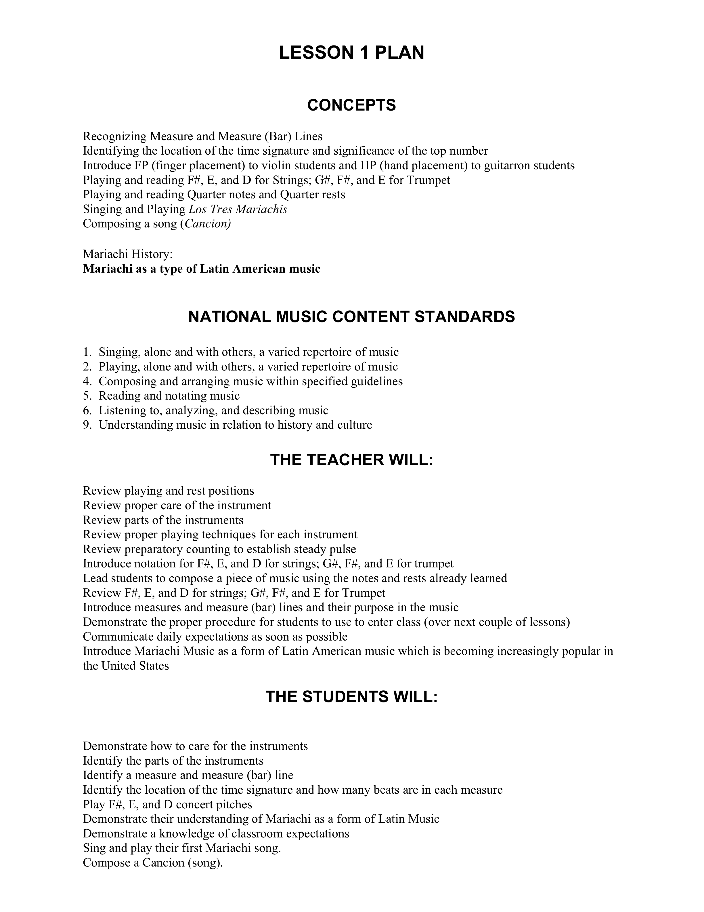
¡Simplemente Mariachi!
EX: Lesson 1 Plan
26
Notes:
26

Slide 27
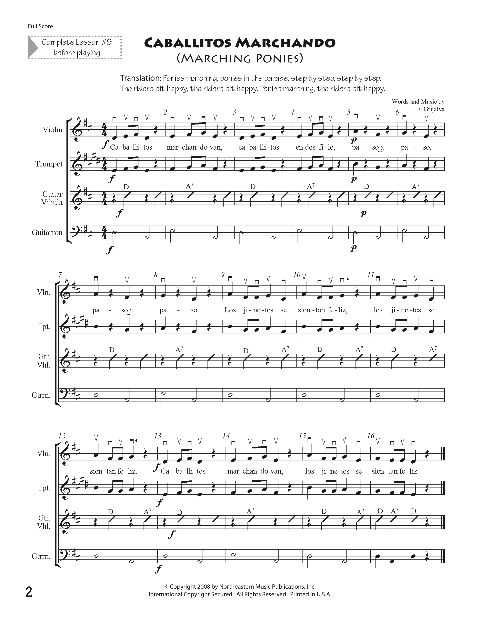
Libro Acompañante Musical
Song Book-10 Beginning Mariachi Songs
Notes:
27

Slide 28
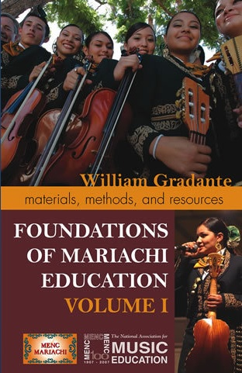
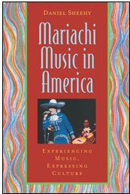
Materials for Beginning Level Programs
Must-have Reference Materials

Slide 29
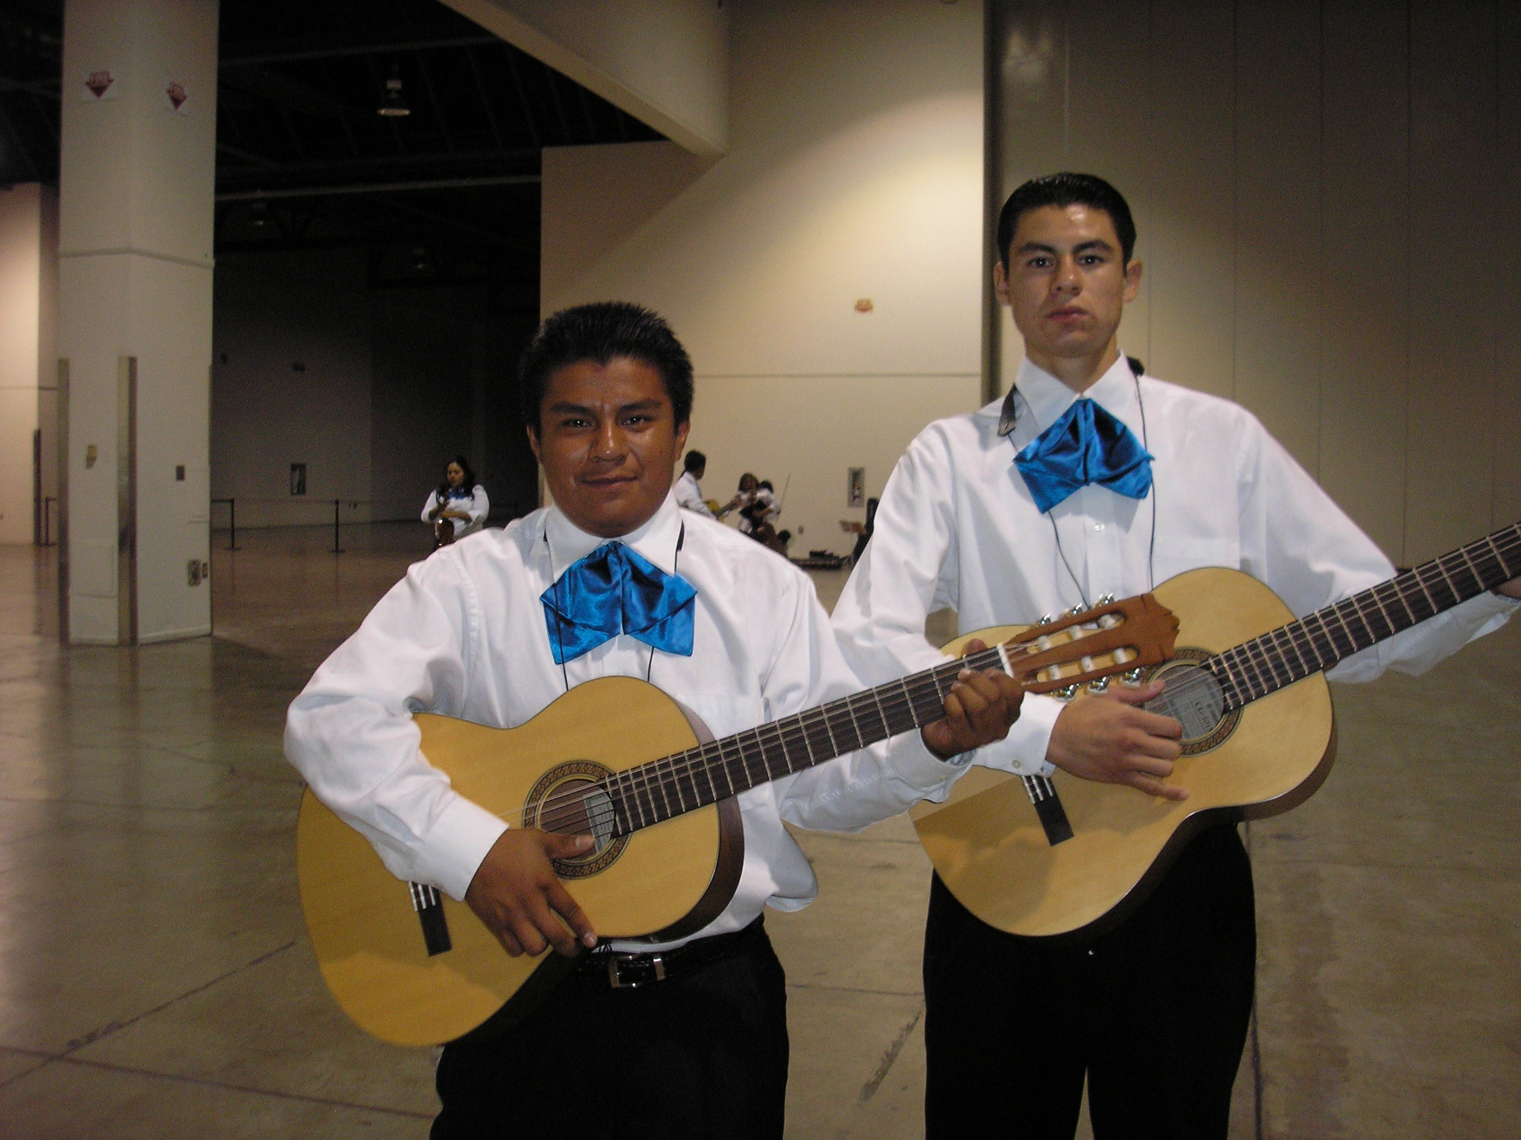
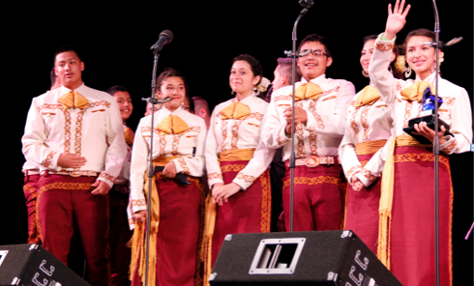
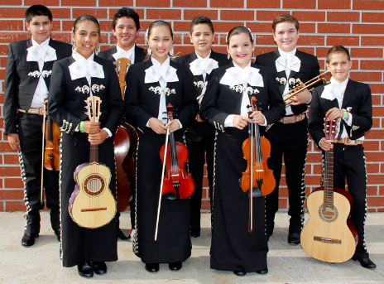
Uniform Options
White Shirt and Black Pant with Basic Moño
Traje de Gala
(Full Uniform)
Decorative Jacket
with pant/skirt
and coordinating Moño.
Vaquero Uniform
(Ranch/Cowboy)
Decorative pant/skirt
and shirt with
Coordinating Moño
33

Slide 30



Instrument Options
KNOW YOUR VENDOR!!!
You Get What You Pay For!
Buy from a Reputable Dealer!

Slide 31
WE WANT TO HELP
YOU BE SUCCESSFUL. . .

Slide 32

Conn-Selmer, Inc.
West Music, Wenger Corp

Slide 33

The Fabulous Golden Nugget
Hotel and Casino Las Vegas
Proudly Hosts
http://bit.ly/MariachiLV
National Mariachi Workshops
for Educators®
June 24-28, 2013

Slide 34


Slide 35

Muchas Gracias, Maestro Hernandez
and Mariachi Sol de Mexico

Slide 36

Muchas Gracias, Mariachi Acero
Mariachi Nationals Winners
Erik Ramirez, Director

Slide 37


MUCHAS GRACIAS!!!
@MusicEdConsult
@JoseSoldeMexico
Contact Information:
marcia@musicedconsultants.net
musicedconsultants.net/NAMM2013

