Slide 1




TIPS for Success!
Secrets Revealed From Our Very Best!
www.MusicAchievementCouncil.org

Slide 2
Consider the Education/Training Needed for These Careers
This is YOUR Job! How is it going?
Accountant
Politician
Architect
Psychologist
Author
Public Relations Executive
Career Planner
Quality Assurance Executive
Financial Planner
Sales Executive
Travel Agent
Magician

Slide 3
1. Focusing on the
Classroom

Slide 4

Focusing on the Classroom
What does a Music Teacher Do?
Teach (Standards-based)
Communicate
Share Love of Music
Communicate
Develop Curriculum
Communicate
Prepare Lesson Plans
Communicate
Assess Student Progress
Notes:
Produced by the Music Achievement Council
4

Slide 5

Focusing on the Classroom
A Checklist for Teachers
How can I help students reach their FULL potential?
Be genuine
Be enthusiastic
Keep things moving
Be fair to all students
Take an interest in what they
are doing outside of your class
Be professional
Communicate clearly and often
Hands down, this is
the best day of my life

Slide 6
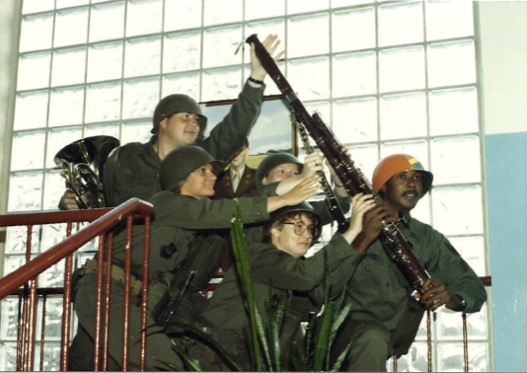
Focusing on the Classroom
Recruitment and Retention
Promoting the VALUE of Music Education
To RECRUIT, take action through positive experiences
Publicize the nature and benefits of participation in music
Address costs and time involved clearly
Compete with other student options
Students JOIN music programs and stick with it IF the. . .
Director is enthusiastic and makes learning fun
Parents, community and school board support the program
Program is visible
SOOOOOOOOOOOOOO…

Slide 7

Focusing on the Classroom
Recruitment and Retention
Your task is to. . .
Foster student interest
Inform parents
Develop a continuing
  program for nurturing
  the support of the school,
  the administration, and
  the community
Get ‘Em and Keep ‘Em

Slide 8
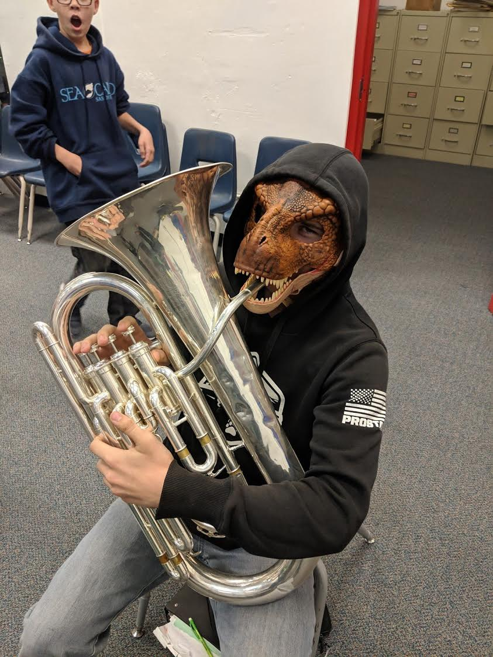
Let them see YOU enjoying music-making!

Slide 9

Focusing on the Classroom
Recruiting and Retaining Students
First Performance National Day of Celebration
Reduces beginner drop-out rate
Provides short-term incentive goals
Encourages communication with parents
Strengthens administrative support

Slide 10
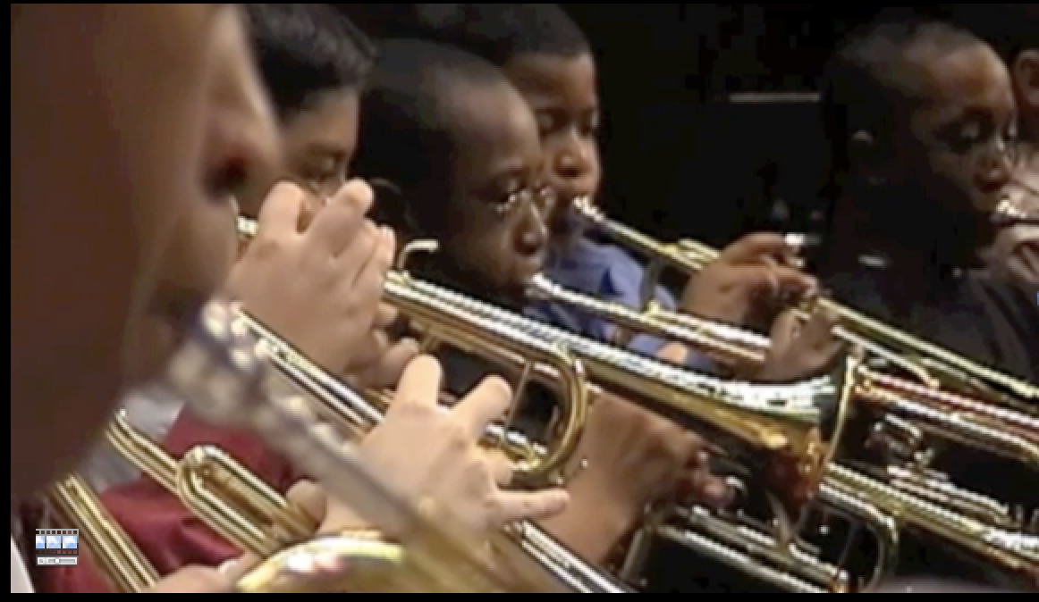
Focusing on the Classroom
Recruiting and Retaining Students
First Performance National Day of Celebration
Notes:
Produced by the Music Achievement Council
10

Slide 11

Focusing on the Classroom
Recruiting and Retaining Students
First Performance National Day of Celebration
Notes:
Produced by the Music Achievement Council
11

Slide 12

Focusing on the Classroom
Recruitment and Retention
Your Most Valuable Resources
YOUR STUDENTS
1. Make aesthetic pleasure the top priority
2. Foster pride and group recognition
3. Give credit to individual
accomplishments
4. Show interest in the music they like
5. Make sure all instruments are in excellent playing condition

Slide 13
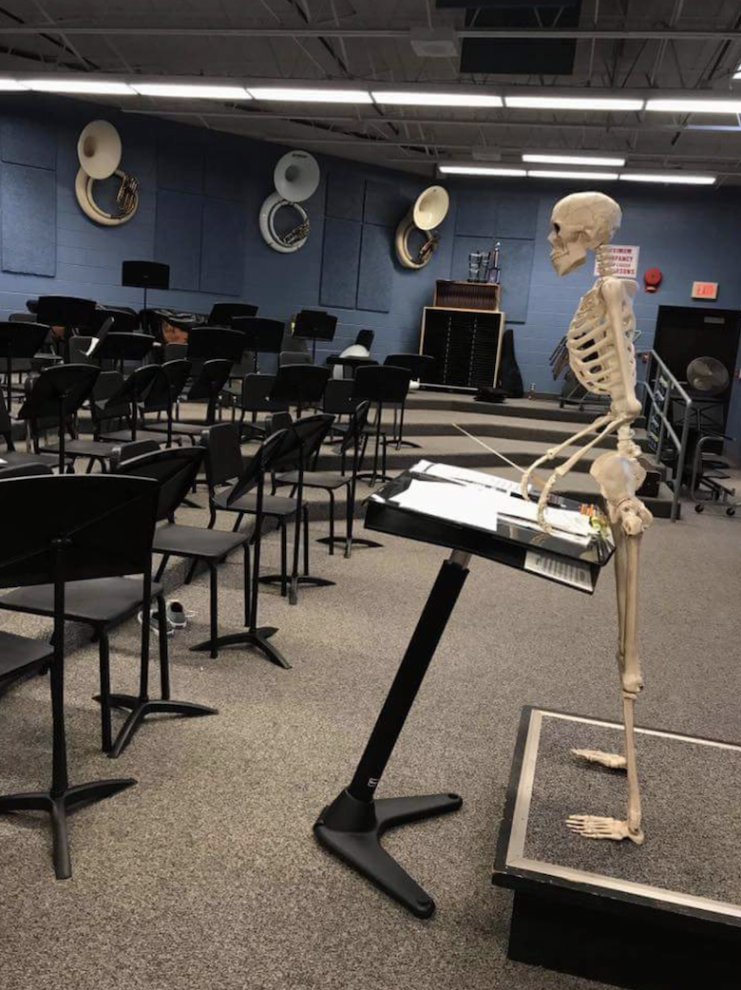
“I’m going to stand here until you get quiet!”!
Motivate Them to Play!

Slide 14
2. The Business Side of
Teaching

Slide 15
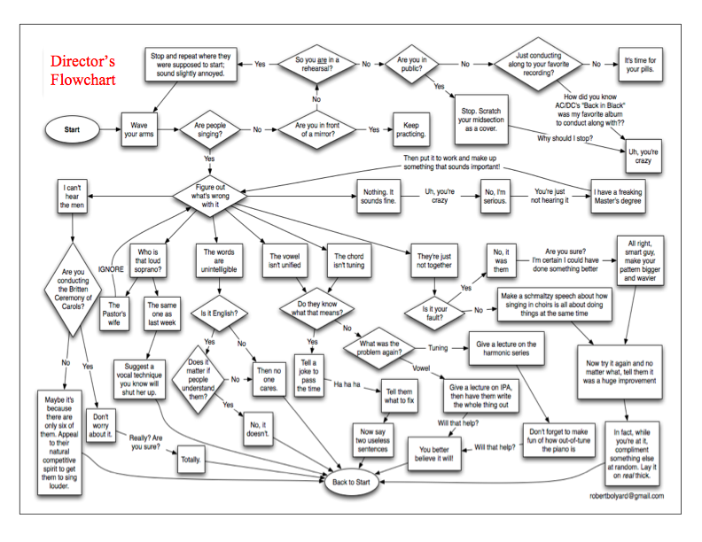
www.musiceducationconsultants.net/WMEA2011
Notes:
Produced by the Music Achievement Council
15

Slide 16
The Business Side of Teaching
Working with Administrators
Think BIG PICTURE
Include the principal and other faculty members as special guest soloists or narrators on concerts
Help your principal prepare congratulatory letters to students
Keep faculty informed of activities/concerts and
THANK THEM for their cooperation and assistance
Have students send personal invitations to administration, faculty, and school board
Sign up to chaperone a dance, cover a class, attend a game and serve on committees
Notes:
Produced by the Music Achievement Council
16

Slide 17

The Business Side of Teaching
Choosing a Music Dealer
You Should Expect. . .
Honesty and fairness
An understanding, professional dealer rep
Regular service calls
A complete, in-house repair shop
Competitive prices
Lease programs for new instrument purchases
Specially priced folders, calendars, nametags, etc.
Comprehensive student-recruiting support for your
program

Slide 18
The Business Side of Teaching
Choosing a Music Dealer
The Dealer Should…
Be an authorized selling agent for a variety of
brands, method books, and materials
Provide loaner instruments for repair needs
Provide advocacy materials and educational
research reports
Be a partner in helping to develop your program
Notes:
Produced by the Music Achievement Council
18

Slide 19
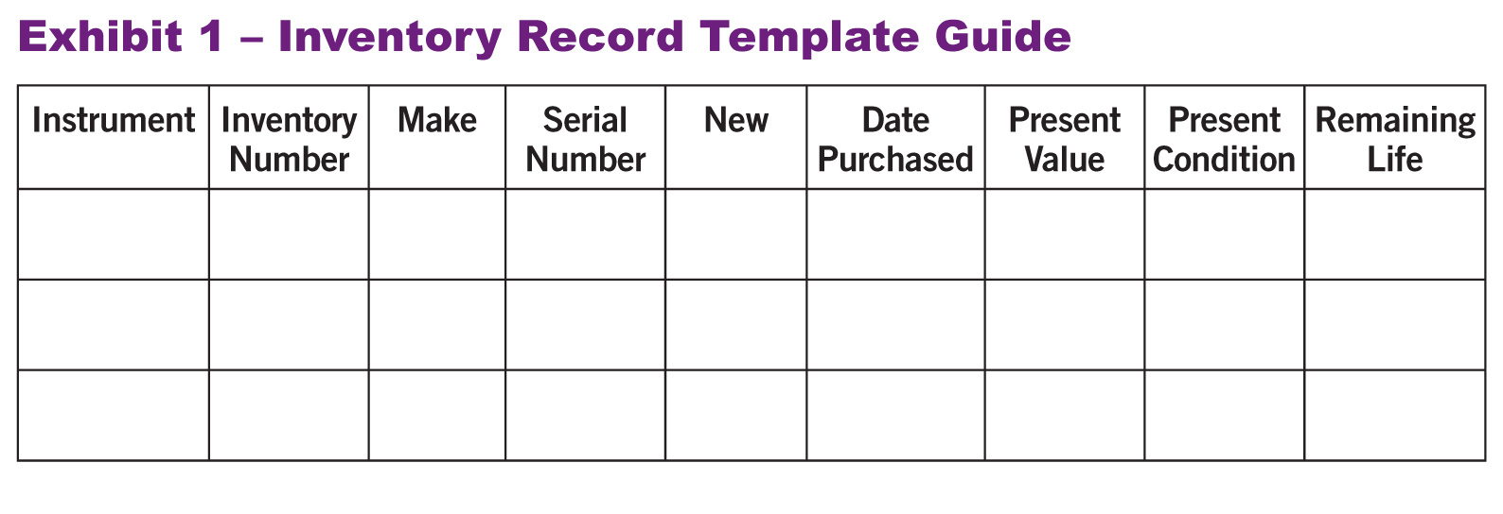
The Business Side of Teaching
Instrument Replacement Plan
Four (4) Steps to Preparing a Proposal for Your Supervisor
1. Evaluate the instruments. Create an Inventory Record Guide

Slide 20
The Business Side of Teaching
Instrument Replacement Plan
Four (4) Steps to Preparing a Proposal for Your Supervisor
2. Prioritize a list that should be replaced within 5 years. Estimate probable growth of program.
Write up a complete 5-YEAR PLAN that begins
with a clear explanation. Provide the plan to
your supervising administrator.
KEEP YOUR RATIONALE STUDENT-CENTERED.
Notes:
Produced by the Music Achievement Council
20

Slide 21
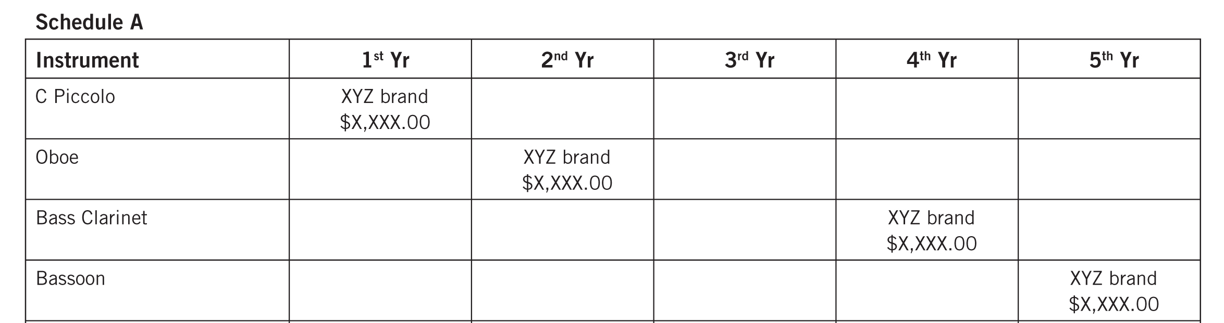
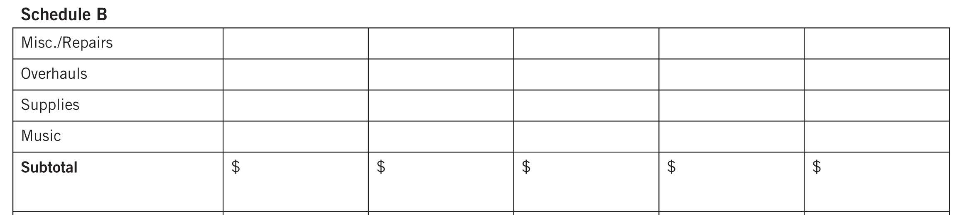
The Business Side of Teaching
Instrument Replacement Plan
Sample Forms to Use to Develop Your Plan. . .

Slide 22
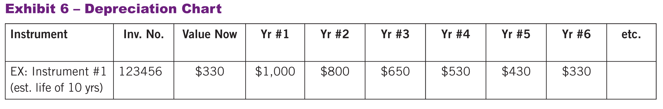
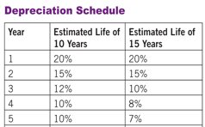
The Business Side of Teaching
Instrument Replacement Plan
Maintain a Depreciation Chart.

Slide 23
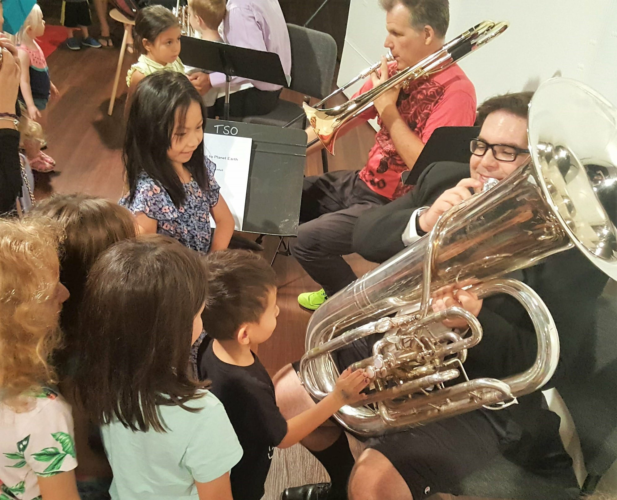
Telling the Story
Great Ways to Get Out Your Message
ALWAYS promote the benefits
of an education in music.
Have students tell their stories.
Music Makes the Difference
Because. . .
Have students write letters
inviting decision-makers to
concerts to speak, perform, or
even conduct.
Stage a Music Open House for
your community. Engage little
ones/senior population!
Notes:
Produced by the Music Achievement Council
23

Slide 24

Telling the Story
Great Ways to Get Out Your Message
Profile Student Artists –
Student Artist of the Week.
Engage your school faculty
--involve them in the
music-making process.
Provide Beginner of the
Month Awards--make it a
BIG DEAL!!!
Notes:
Produced by the Music Achievement Council
24

Slide 25

Telling the Story: DATA! DATA! DATA!
Data leads to Action!

Slide 26
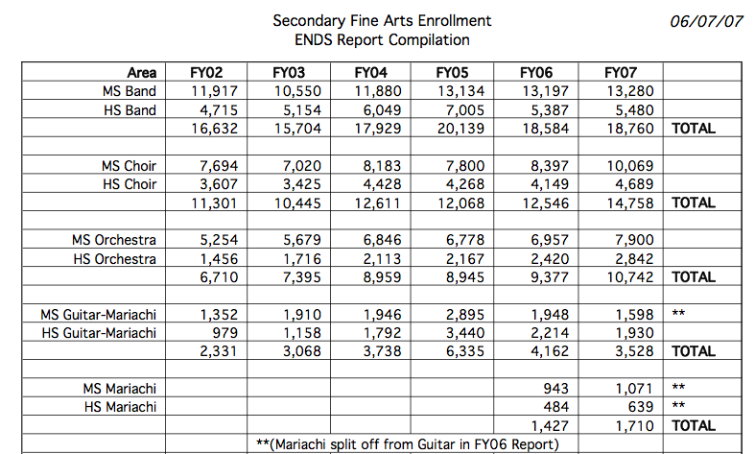
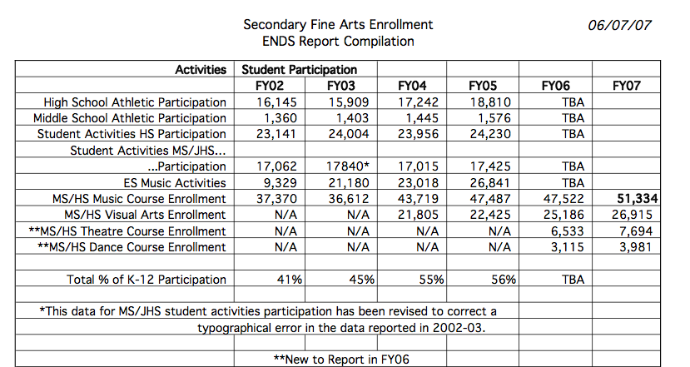
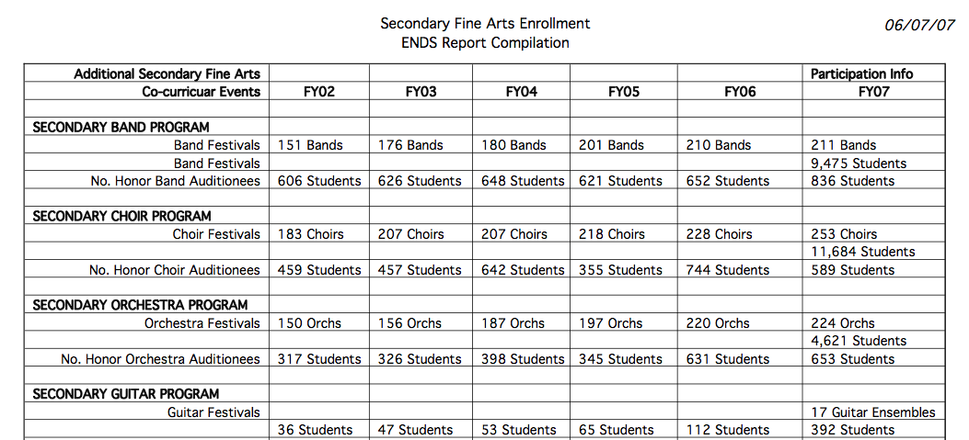
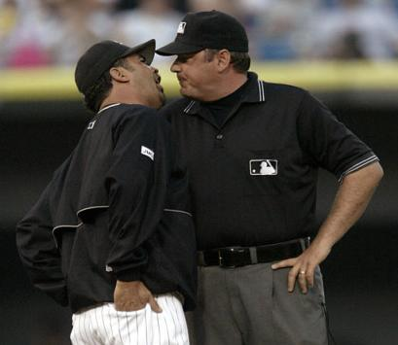
Telling the Story: DATA! DATA! DATA!
Communicating
Content
DATA! DATA! DATA!
General Information
Write Professionally/Check Spelling
and Grammar
Process
Maintain an Annual Report File
Format
Ensure Organization/Use Categories
Include Spreadsheets for Reporting Data

Slide 27
4. Supporting Music Education
www.MusicAchievementCouncil.org

Slide 28

Supporting Music Education
Help Others Succeed
Recruit new, quality music educators to your school district
Offer to help with the interviewing process
Offer to Develop a Mentoring Program or Serve as a mentor
Give back to the profession

Slide 29
Supporting Music Education
Help Others Succeed
Help Your Local University Music Program
Offer to have MusicEd students observe your classes
Allow MusicEd students to “get their feet wet”
Attend university concerts and encourage your students to attend
Take student teachers and guide them appropriately
Notes:
Produced by the Music Achievement Council
29

Slide 30
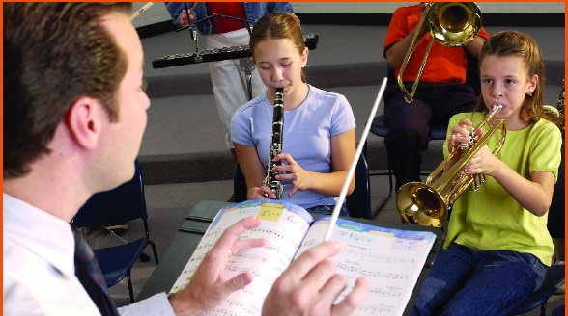
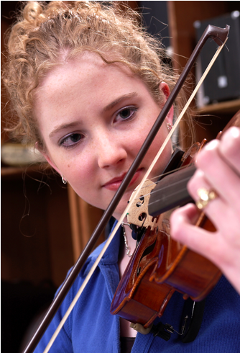

24 Tips for Success
Traits of the Successful Teacher
Your Personal Checklist
Maintain high standards for self and others
Organize class time with a variety of activities
Don’t bore students by
talking too much
Maintain interest for all students
Recruit all year
Communicate clear goals

Slide 31
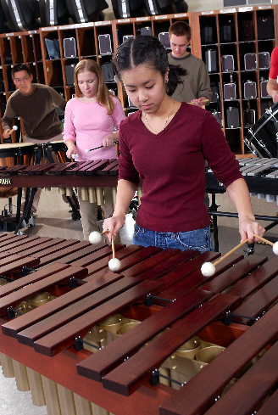
24 Tips for Success
Traits of the Successful Teacher
Your Personal Checklist
Maintains positive relationships with fellow teachers
Communicates with parents and guardians
Performs in school and community OFTEN
Maintains a professional look and attitude in all performing ensembles
Develops connections among school, parents and community
Advocates for music education

Slide 32
It’s AMAZING what
our kids can accomplish!
www.MusicAchievementCouncil.org
Notes:
Produced by the Music Achievement Council
32

Slide 33

Notes:
Produced by the Music Achievement Council
33

Slide 34
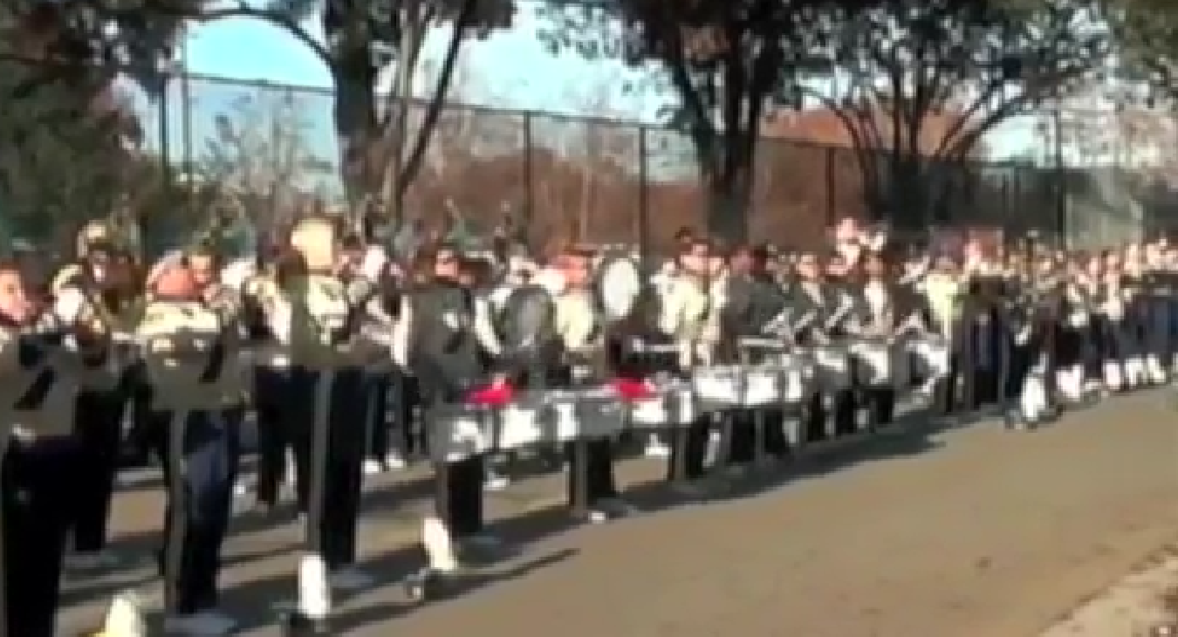
Let’s Make the MOST of every moment!
www.MusicAchievementCouncil.org
Notes:
Produced by the Music Achievement Council
34

Slide 35

Let’s Make the MOST of every moment!
www.MusicAchievementCouncil.org
Notes:
Produced by the Music Achievement Council
35

Slide 36












Sessions Posted at
www.musicedconsultants.net/conference-materials
Thank You to these Amazing Companies
Notes:
Produced by the Music Achievement Council
36

