Slide 1
Making an Advocate Out of Your Principal:
10 Things to do “on Monday”
and then some!!!!!
Marcia Neel
June 16, 2016

Slide 2
The Two Querries…
What Do Principals Really Think?
2.What Have You Done to Make an Advocate out of Your Principal?

Slide 3
1. What I love best about my music teacher is
that he/she is. . .(here we go!)
Caring
Dedicated
Passionate
Committed
Success-oriented
Organized
Dynamic
Positive
A Team Player/Builder
with Students, Staff and Parents

Slide 4
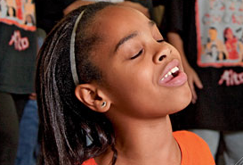
1. What I love best about my music teacher is
that he/she is. . . (cont.)
Communicative
Encouraging
Flexible
Professional
Creative
Talented (Performer)
Intense (In a Good Way)
Effective with Pedagogy

Slide 5
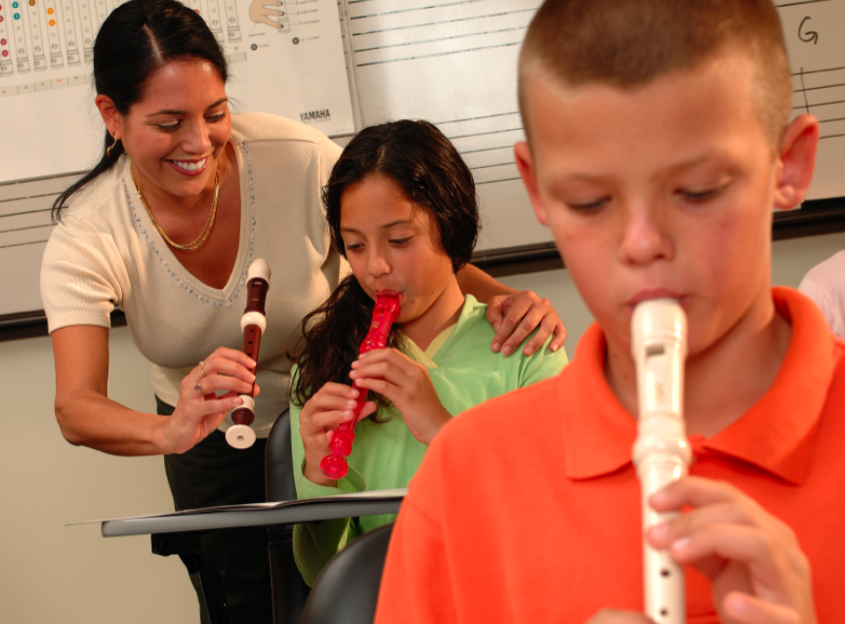
1. What I love best about my music teacher is
that he/she is. . . (cont.)
Responsible
Collegial
Motivational
Inspirational
Helpful
Content-oriented
A Music Advocate (Recruiter)
Demanding (Of Self and Students)

Slide 6
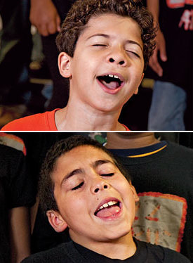
2. To improve the music program, I would ask my music teachers to. . .
Communicate ! Communicate! Communicate!
Coordinate/Collaborate with Colleagues
Articulate with Feeder Schools More
Recruit/Retain More
Focus on Building Group Identity
Promote More
Perform More

Slide 7
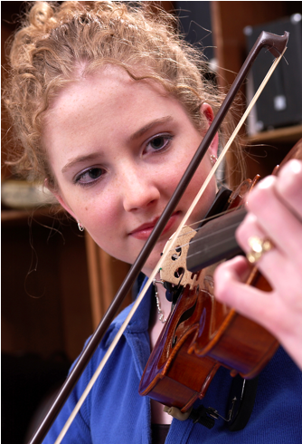
2. To improve the music program, I would ask my music teachers to. . .(cont.)
Help Administrators to Help Them
(esp: Class Sizes and
Program Building)
Extend Learning Into the Community
Develop More Partnerships
Incorporate School-wide Objectives
Assess Their Own Programs More
Often

Slide 8
3. What troubles me most is that he/she is not. . .
Passionate
Considerate of the “Big Picture”
Communicative
Demanding Enough
Managing the Classroom Well
Lesson-planning Effectively
Even-tempered
A Team Player
Organized

Slide 9
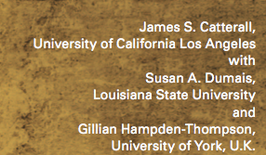
What Have You Done to Make an Advocate Out of Your Principal?
“I communicate and keep my principal informed.”

Slide 10
“I communicate and keep my principal informed.”

Slide 11
Always Have Small Ensembles READY to Perform
Invite Her (and Faculty) to PERFORM in the Holiday Concert
Copy Him on All Correspondence
Communicate Music Advocacy Information
Took him Golfing
. . .He Won!!!!

Slide 12
Sometimes Though -- It Seems As If Principals TRY To Trip Us UP!

Slide 13
In order to survive,
we must ALL be on the same TEAM!

Slide 14
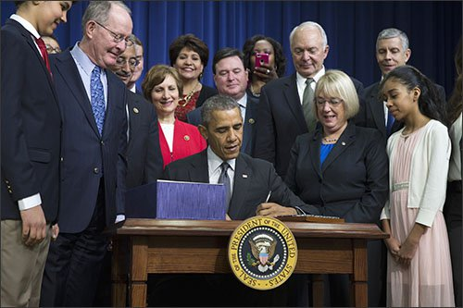
1. Help Your Principal Understand
ESSA: Every Student Succeeds Act

Slide 15
ESSA Terms to Look for:
“Well-rounded,” “Music,” “Arts”
The “Well-Rounded Education” provision (previously known as “Core Academic Subjects”) is a section (Sec. 8002) within ESSA that lists courses, activities, and programming in subjects deemed critical when providing students a broad and enriched educational experience. The provision includes “music” and “arts,” which articulates the importance of music as a part of every child’s education.

Slide 16
ESSA Terms to Look for:
“Well-rounded,” “Music,” “Arts”
This provides an unprecedented step forward for music education, as “Well-Rounded” is mentioned in a variety of other significant provisions throughout the bill.
Additional Terminology: Supplement not Supplant is a provision which states that federal funds that are made available must be used to supplement, and not take the place of, other Federal, non-Federal, or state funds that would have otherwise been used for the same purpose.

Slide 17
ESSA: So What’s New?
Another Education Law du Jour?
It ends the Federal School Improvement Strategies

Slide 18
ESSA: So What’s New?
Another Education Law du Jour?
Accountability is moving from Federal to State level.
Whereas No Child Left Behind prescribed a top-down, one-size fits all approach to struggling schools, this law offers the flexibility to find the best local solutions—while also ensuring that students are making progress.

Slide 19
ESSA: So What’s New?
Another Education Law du Jour?
Accountability is moving from Federal to State level.
ESSA, while encouraging rigorous and challenging state academic standards on which the state’s accountability system is built, does not require Common Core and in fact forbids the U.S. Department of Education from requiring any set of standards for any state.

Slide 20
ESSA: So What’s New?
Another Education Law du Jour?
Ends Federal Goal of 100% Proficiency by 2014
It ends the requirement that all schools that don’t meet goals for any subgroup of students are automatically identified as failing.
But wait. . .
there’s more!

Slide 21
ESSA
Why is this important for (NAf) ME?
A New and Clear Intent to Support Our Nation’s
Schools Through a Well-Rounded Education
2. Enumeration of Music as a Well-Rounded Subject
3. Requirements for Well-Rounded Education

Slide 22
ESSA
Why is this important for (NAf) ME?
4. Flexibility of Title I funds to support a
well-rounded education (ergo, Music Education)
5. More Professional Development for Music Educators through Title I funding
6. Flexible Accountability Systems
7. Protection from “Pull Outs”

Slide 23
ESSA Timeline
Credit: Foundation for Excellence in Education

Slide 24
So What Should I Do? Next Steps
Become familiar with ESSA
Google NAfME EVERYTHING ESSA
2. Meet with your Music Department Team
Schedule a meeting with your Principal
4. SERVE!

Slide 25
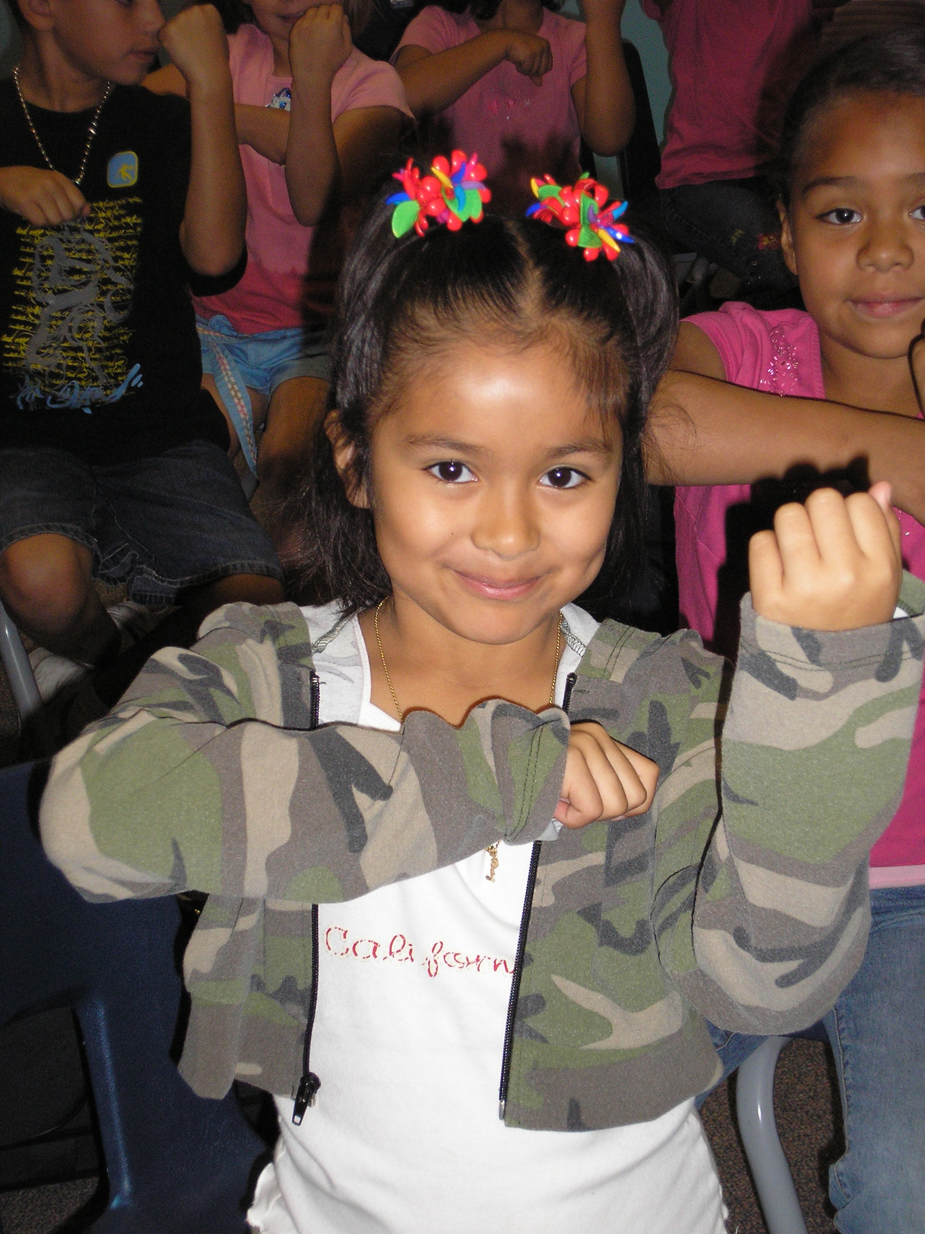
2. Engage Your Principal Directly
Come on down. . .
“Help me give out
instruments to the kids!”

Slide 26
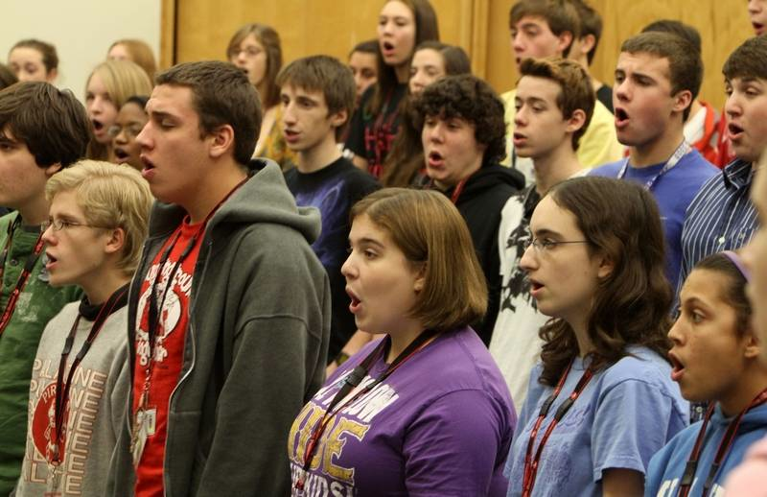
2. Engage Your Principal Directly
Come on down. . .
“I need an audience to help the students prepare for…”

Slide 27
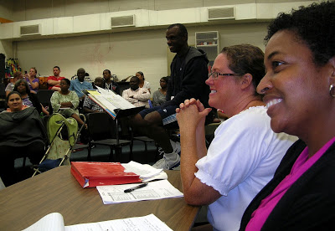
2. Engage Your Principal Directly
Come on down. . .
“Could you give a presentation to the Booster Parents?”

Slide 28
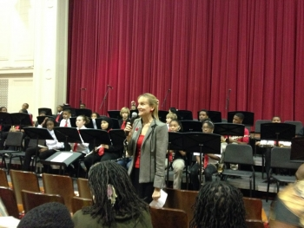
2. Engage Your Principal Directly
Come on down. . .
“Could you provide Opening Remarks at our upcoming concert?”
Praise your administrator in front of the
parents for their support.
Have students present a signed, framed print.

Slide 29
3. Ask your students to complete the sentence, “Music makes the difference because. . .” then use their responses.
“…when you’re sad and then you hear music, it will cheer you up. And when you’re down, it will make you get up from where you are and start dancing. Music will always be there for you.”

Slide 30
Music Makes the Difference Because…
“…it makes me feel free and like nobody is judging me.”
“…it helps me express my feelings into something other than words. Music makes you want to dance, and sing out loud; it can cheer you up, even on the gloomiest days.”

Slide 31
Music Makes the Difference Because…
“…it’s a perfect way to tell and show how you feel.”
“…hearing music helps me work and helps me be the person I want to be.”
“…it gives you a feeling; a feeling that makes you think you can do anything whether it’s doing chores, finishing your homework, or even reaching your goals in life.”

Slide 32
3. Ask your students to complete the sentence,
“Music makes the difference because. . .”
Use their responses. . .
a. In your upcoming concert programs
b. In your school newspaper’s “music corner” (Don’t have a “music corner?” You know what to do!)
c. As copy for making banners/posters to display around the school
d. As copy for recruitment fliers and posters at feeder schools
e. As copy for AMEA publications
f. As copy for a publication about your school’s FANTASTIC music program

Slide 33
4. Retrieve information about the value of studying music - quote it in any of the above outlets but especially on recruitment information! Share with your supervisor.
Resources:
musiced.nafme.org/resources
supportmusic.com
bit.ly/MusicEdFacts

Slide 34
5. Recruit 24/7

Slide 35
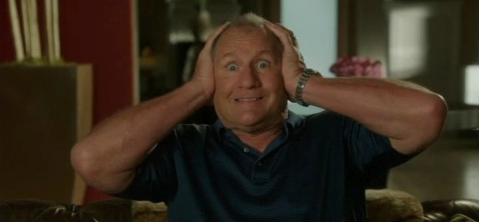
6. Expand
OMG! Does this mean that I have to Learn Something New???

Slide 36
6. Expand: Broaden Your Base
We Have the Power!!! The Joy of Music-Making
1. Broaden the base
2. Teach so that students will be able to go on and DO music without us
3. Acknowledge and honor ALL music

Slide 37
6. Expand: Broaden Your Base
A. Look at Who We Are Teaching
Do our programs reflect our demographic?
Are we maximing the kids and music relationship?
Do we really need more kids in conservatories?

Slide 38
6. Expand: Broaden Your Base
B. Maximize the “Kids and Music” Relationship
OLD SCHOOL:
If students wanted to be musicians, they had to play an instrument and take lessons
NEW:
If provided with an opportunity to study music through the exploration of the power of music in their lives, our classes would be overflowing

Slide 39
6. Expand: Broaden Your Base
C. “De-mythalize” Classical Music
Address Student Interests/Needs/Cultural Backgrounds
Guitar Steel Drum
Drumming Bluegrass
Music Technology Gospel Music
Mariachi Hip Hop
Song Writing Ukelele Ensembles???

Slide 40
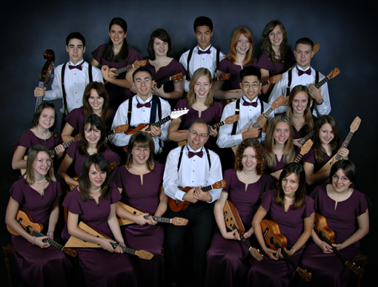
Langley HS Ukelele Ensemble from B.C. Canada

Slide 41
Langley HS Ukelele Ensemble from B.C. Canada
http://www.youtube.com/watch?v=n22iN3yO0G4

Slide 42
Ideas to Teach So That Students Can Go On Without Us!
A. Use conceptual teaching methods
Give them the tools
B. Teach fulfillment
Instill them with passion for music
C. Allow students to experience your joys of music-making
Give them the power

Slide 43
Go On and DO Music Without Us! Cleveland Hgts HS Gospel Choir

Slide 44
Tucson High School Steel Drum Ensemble

Slide 45
OLD: What Music Teachers Do

Slide 46
NEW: What Music Teachers Do

Slide 47
Pablo Casals Each second we live is a new and unique moment in the universe, a moment that never was before and will never be again. And what do we teach our children in school? We teach them that two and two make four and that Paris is the capital of France. We should also teach them who they are.

Slide 48
5. Recruit 24/7 – Keep Music Education Strong
GREAT FOR PARENT NIGHTS!!!!!
Recently Revised to include the Very Latest Research and Statistics on the Benefits of Music Education.
FREE COPIES of assorted brochures available from
SupportMusic.com

Slide 49
6. In your next concert program, include an insert designating each attendee as a member of the newly-formed Mozart Middle School Coalition for Music Education/Music Boosters Club/Committee to Promote Music Education
a. To help make the program better for those they love
b. To help establish the program as a school-wide entity using a positive approach
d. To feel invested -- i.e. “buy-in”
continued. . .

Slide 50
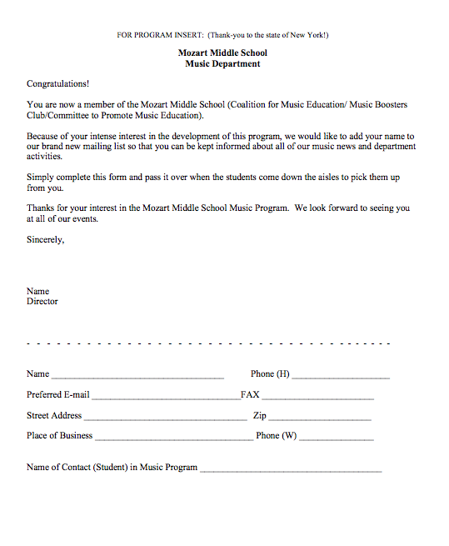
Parents are the ones who have the most important interest at hand. It is THEIR child’s music education.
They can become your voice if needed.

Slide 51
7. Let the Information Come Directly to YOU!!!
Get on Twitter and start following!!!
@NAfME
@MaryLNAMM
@MusicEdConsult
@MusicAchCouncil
@EricWhitacre

Slide 52
8. Arrange for a performance for the principal’s meeting, school board, city council, state legislature, etc. They will appreciate the “good news” for a change.
BE READY!!!!!!!!
PERFORM WELL!!!!

Slide 53
9. Create a website, Twitter Account, etc. and communicate, communicate, communicate. Share the GOOD NEWS!!!!

Slide 54
Website Videos Could Include:
Student Projects: with Permission

Slide 55
Website Videos Could Include:
School Announcements

Slide 56
Website Videos Could Include:
Performance Videos

Slide 57
11. Come up with a clever version of a “Happy Birthday” song to serenade your school staff on their special day. THEY WILL LOVE YOU FOR IT! Give away FREEBIES!
Insert Serenade Photo

Slide 58
Remember. . .Your principal needs YOU!
Be an active, involved member of the faculty.
Take part in as many school activities as you can.
Volunteer to help when needed.
Organize faculty functions, school food drives, etc. (at least one each semester)
Ask how you/your program can help build school spirit.

Slide 59
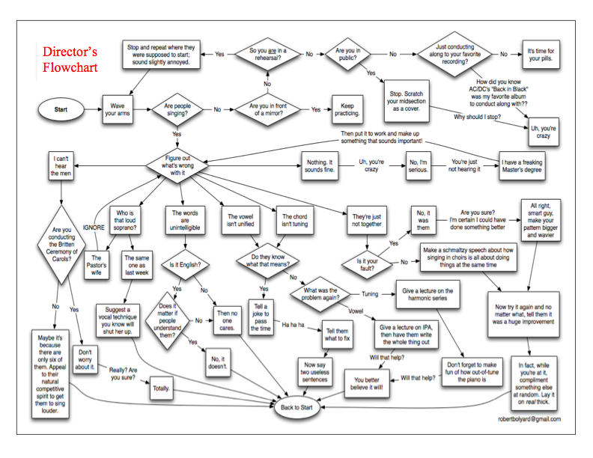
How Can I Do It All?

Slide 60
How Can I Do It All?
Stay Focused
on the “Why!”
We are ALL in this
for the Kids!

Slide 61
Thank You!
Contact Information:
Posted:
www.musicedconsultants.net/conference-materials
marcia@musicedconsultants.net
@MusicEdConsult on Twitter

