Slide 1
DID YOU KNOW . . .
The Music Achievement Council (MAC) is an action-oriented, non-profit organization whose sole
purpose is to enable more students to begin and continue in instrumental music programs.
www.musicachievementcouncil.org

Slide 2
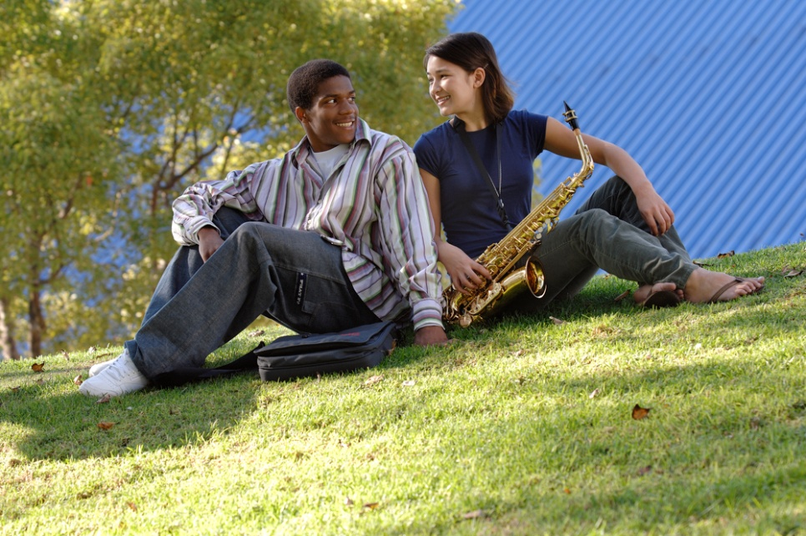
DID YOU KNOW . . .
96 percent of public school principals
believe that participating in music
education encourages and motivates
students to stay in school longer.
(Harris Poll)
www.musicachievementcouncil.org

Slide 3
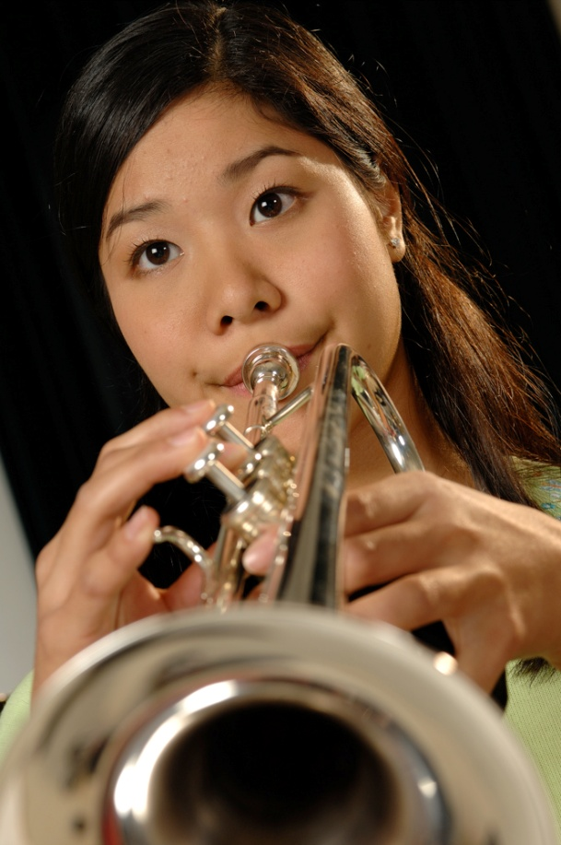
DID YOU KNOW . . .
An interactive poll confirms that music education at an early age greatly increases the likelihood that a child will grow up to seek higher education and ultimately even earn a higher salary. (2007 Harris Poll)
www.musicachievementcouncil.org

Slide 4
THE MESSAGE IS. . .
If you want to be a CEO, College President, or
even a Rock Star,
TAKE MUSIC!
www.musicachievementcouncil.org

Slide 5
THE MESSAGE IS. . .
If you want to be a CEO, College President, or
even a Rock Star,
TAKE MUSIC!
www.musicachievementcouncil.org

Slide 6
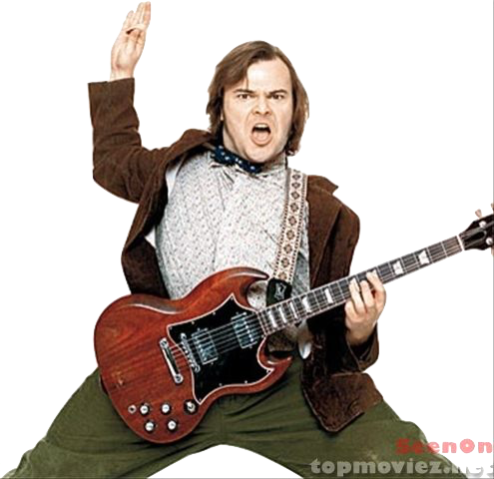
THE MESSAGE IS. . .
If you want to be a CEO, College President, or
even a Rock Star,
TAKE MUSIC!
www.musicachievementcouncil.org

Slide 7
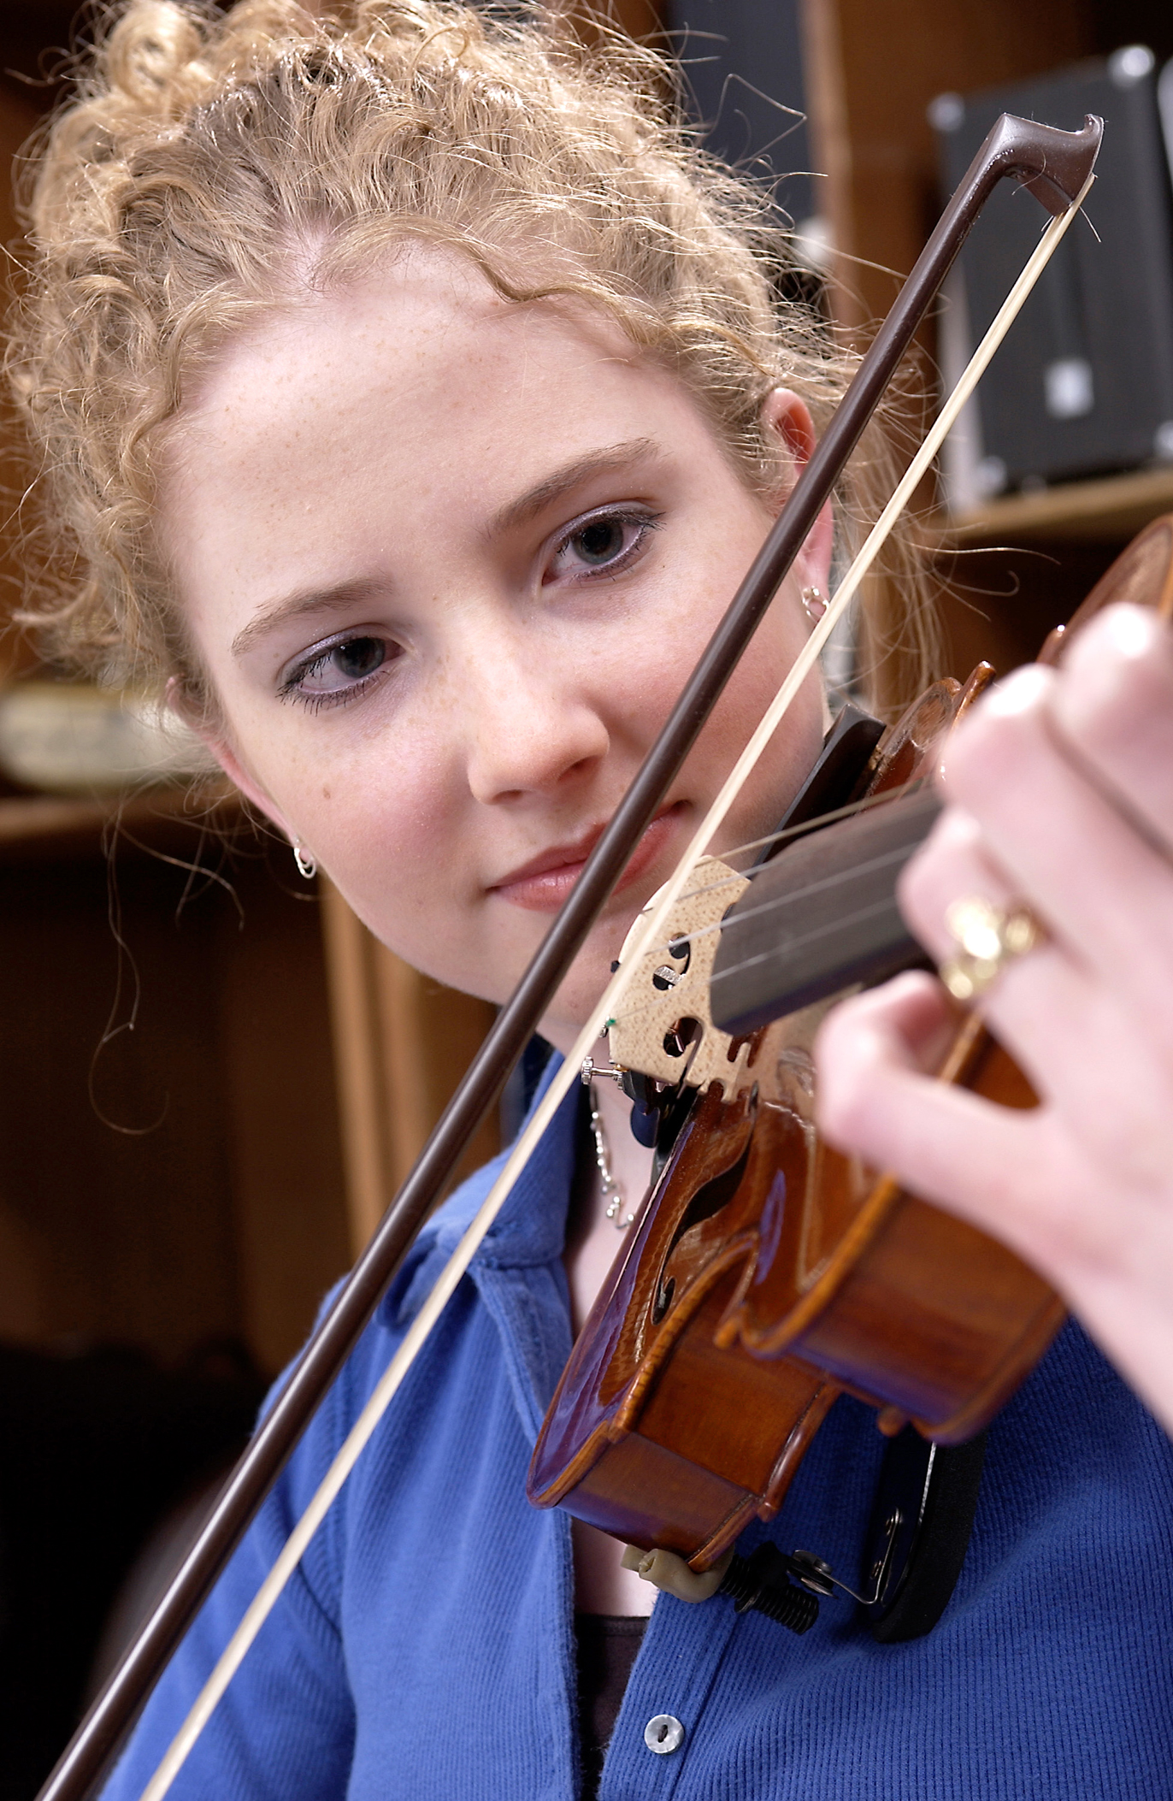
DID YOU KNOW . . .
82 percent of Americans who don’t currently play an instrument wish they had learned to play one. (Gallup Poll)
www.musicachievementcouncil.org

Slide 8
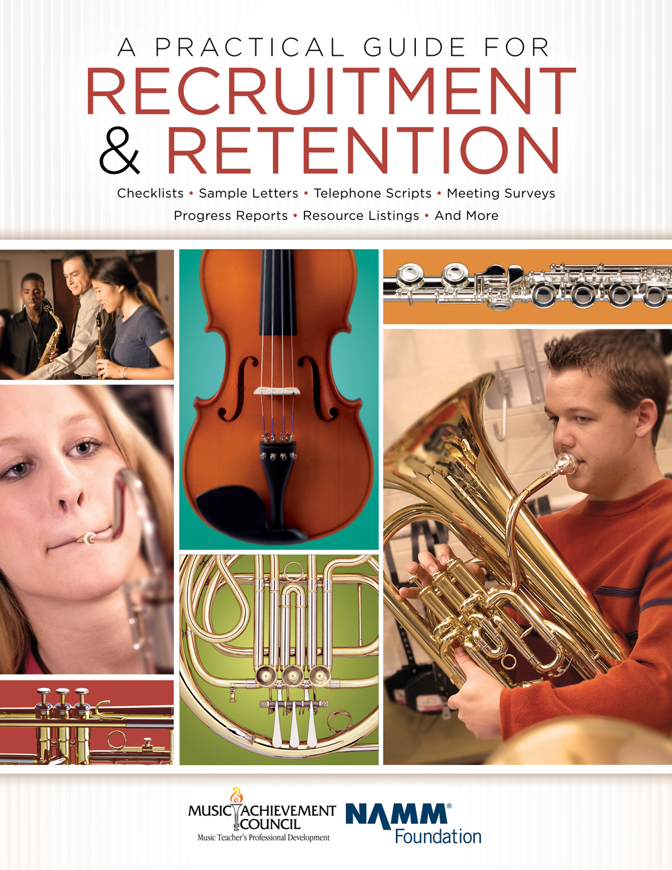
DID YOU KNOW . . .
All of today’s session attendees will receive FREE COPIES of:
A Practical Guide for Recruitment and Retention
www.musicachievementcouncil.org

Slide 9
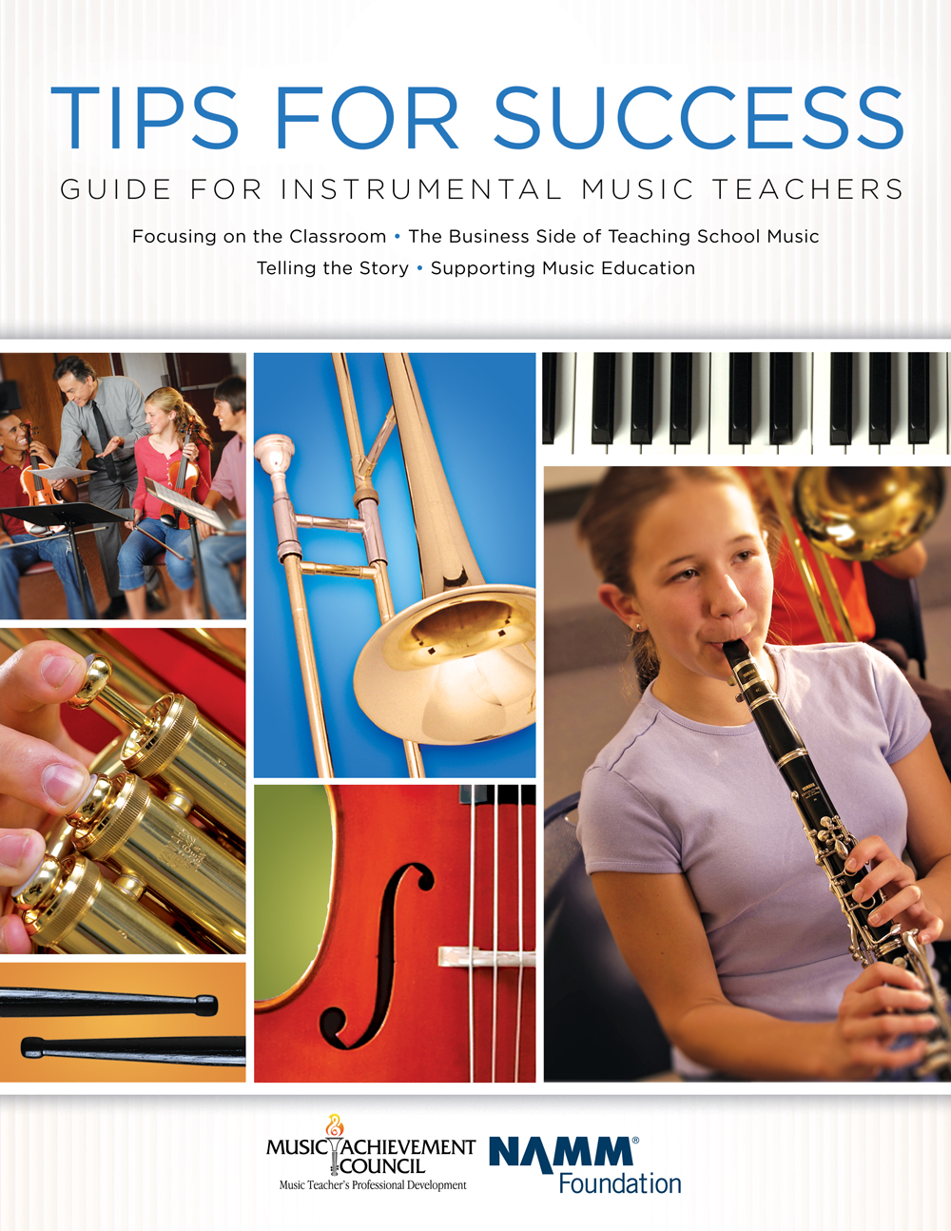
DID YOU KNOW . . .
All of today’s session attendees will receive FREE COPIES of:
Tips for Success:
A Guide for Instrumental Music Teachers
www.musicachievementcouncil.org

Slide 10
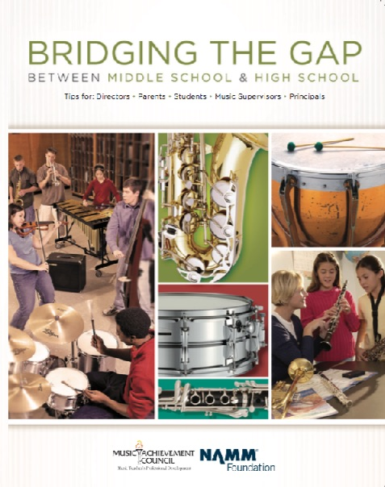
DID YOU KNOW . . .
All of today’s session attendees will receive FREE COPIES of:
Bridging the Gap between
Middle School and High School
www.musicachievementcouncil.org

Slide 11
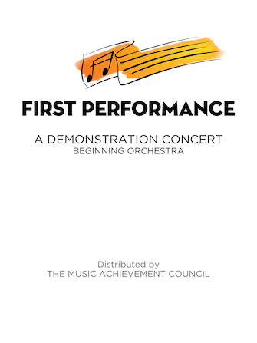
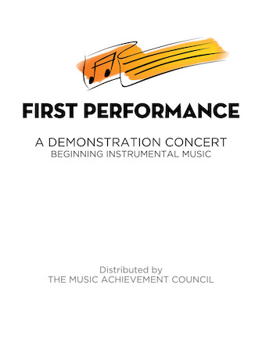
DID YOU KNOW . . .
The First Performance Demo Concert for Band and/or Orchestra features sample letters, programs and student certificates for beginning ensembles. Students can perform several compositions in 6-7 short weeks!
www.musicachievementcouncil.org

Slide 12
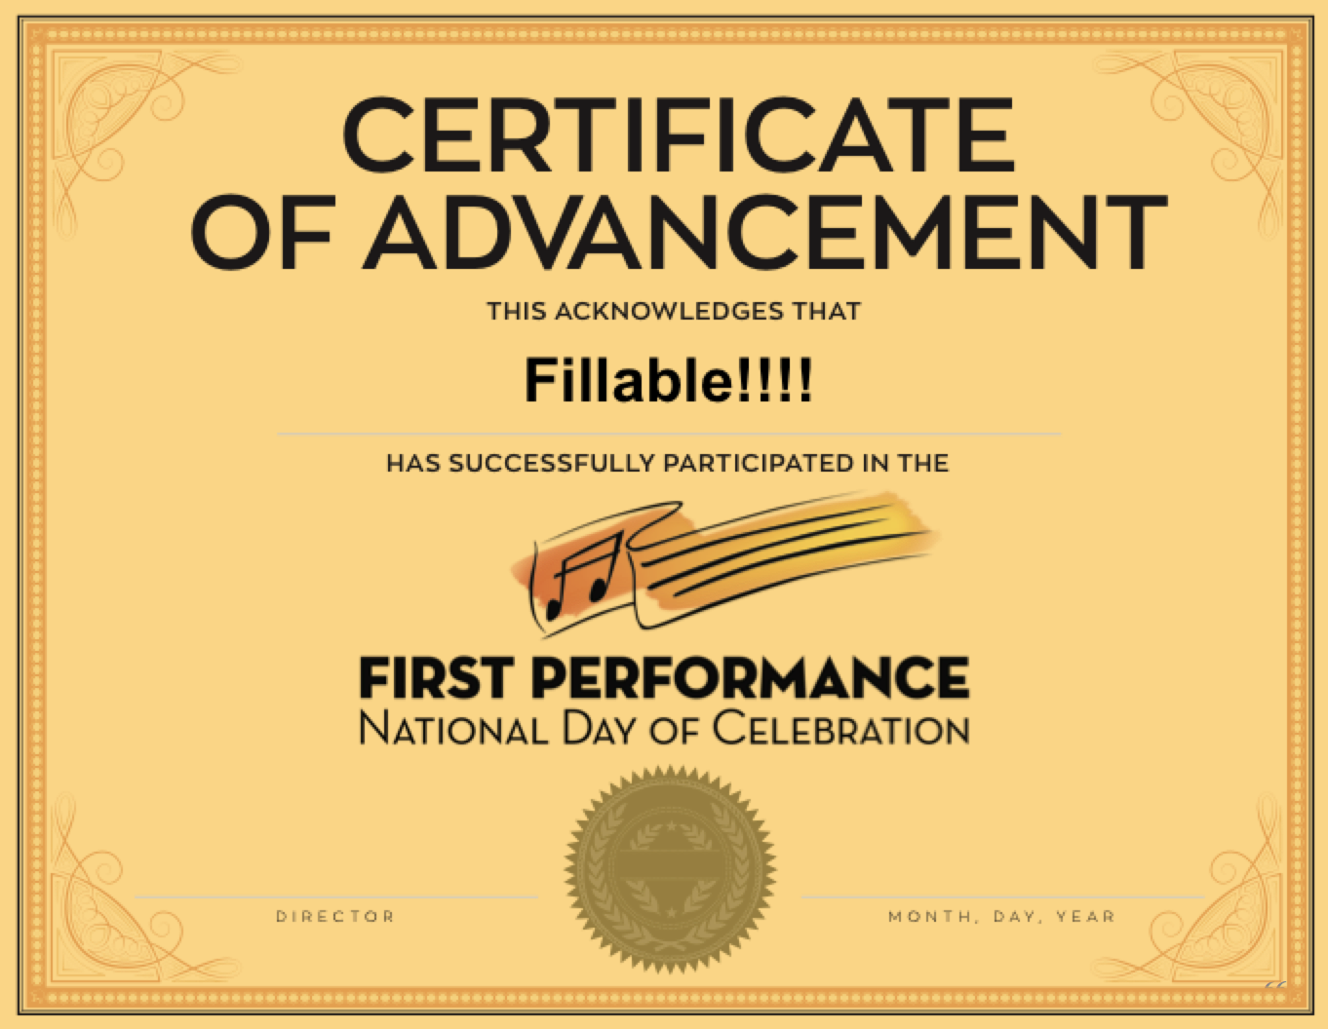
DID YOU KNOW . . .
The First Performance National Day of Celebration is held on the 3rd Thursday of November annually to recognize the achievements of your BEGINNING instrumental students?
www.musicachievementcouncil.org

Slide 13
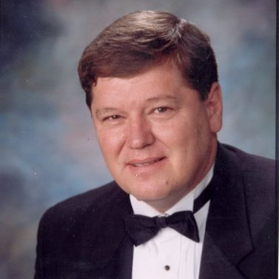
DID YOU KNOW . . .
Most of these publications are provided online at no charge by the Music Achievement Council.
Greg Bimm
They are based on real world strategies shared by the profession’s most successful music educators.

Slide 14
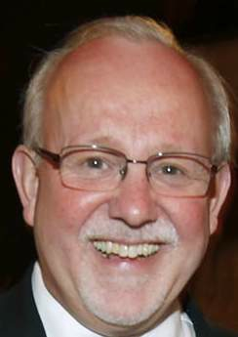
DID YOU KNOW . . .
Most of these publications are provided online at no charge by the Music Achievement Council.
Charlie Menghini
They are based on real world strategies shared by the profession’s most successful music educators.

Slide 15
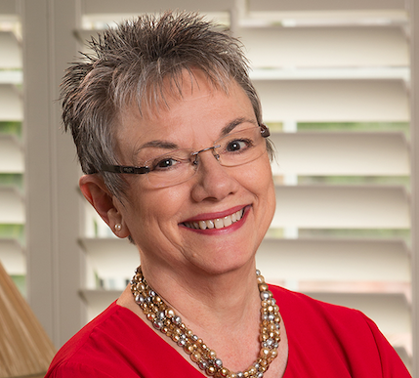
DID YOU KNOW . . .
Most of these publications are provided online at no charge by the Music Achievement Council.
Marcia Neel
They are based on real world strategies shared by the profession’s most successful music educators.

Slide 16
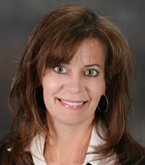
DID YOU KNOW . . .
Most of these publications are provided online at no charge by the Music Achievement Council.
Terry Shade
They are based on real world strategies shared by the profession’s most successful music educators.

Slide 17
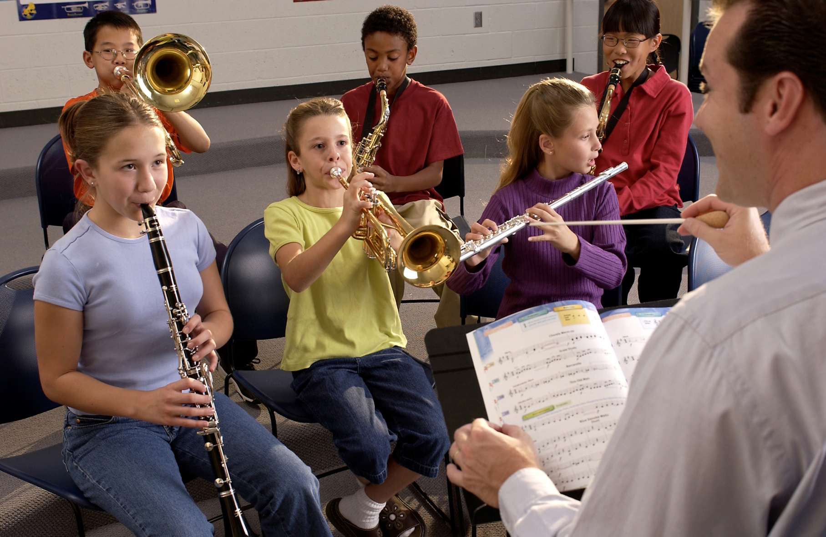
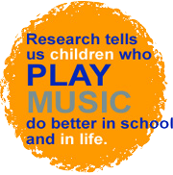
DID YOU KNOW . . .
www.musicachievementcouncil.org

Slide 18
DID YOU KNOW . . .
Music making has been scientifically proven to:
Exercise the brain
Inspire creativity
Increase productivity
Fight memory loss
Reduce stress
Lower blood pressure
Build confidence
Stave off depression

Slide 19
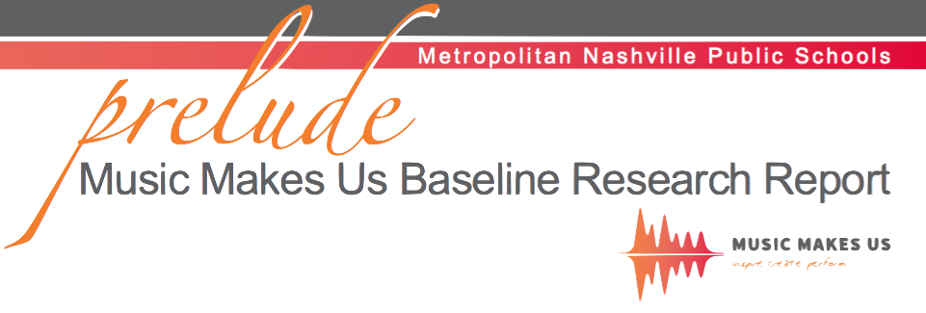
DID YOU KNOW . . .
Metropolitan Nashville Public Schools found that ATTENDANCE RATES ROSE with increased study in music.
No Music:
< 1 Year of Music:
> 1 Year of Music:
87% Attendance
91% Attendance
93% Attendance

Slide 20
DID YOU KNOW . . .
Metropolitan Nashville Public Schools found that DISCIPLINE REPORTS FELL with increased study in music.
No Music:
< 1 Year of Music:
> 1 Year of Music:
4.34 over 4 years
3.75 over 4 years
3.23 over 4 years

Slide 21
DID YOU KNOW . . .
Metropolitan Nashville Public Schools found that GPAs ROSE with increased study in music.
No Music:
< 1 Year of Music:
> 1 Year of Music:
2.51 Average
2.61 Average
2.89 Average

Slide 22
DID YOU KNOW . . .
Metropolitan Nashville Public Schools found that GRADUATION RATES ROSE with increased study in music.
No Music:
< 1 Year of Music:
> 1 Year of Music:
60% Average
81% Average
91% Average

Slide 23
DID YOU KNOW . . .
Metropolitan Nashville Public Schools found that ACT SCORES ROSE with increased study in music.
No Music:
< 1 Year of Music:
> 1 Year of Music:
16.95 Eng, 17.20 Math
17.64 Eng, 17.62 Math
19.58 Eng, 18.67 Math

Slide 24
WHAT WAS LEARNED?
The MORE a student participates in MUSIC,
the more POSITIVE these BENEFITS become.

Slide 25
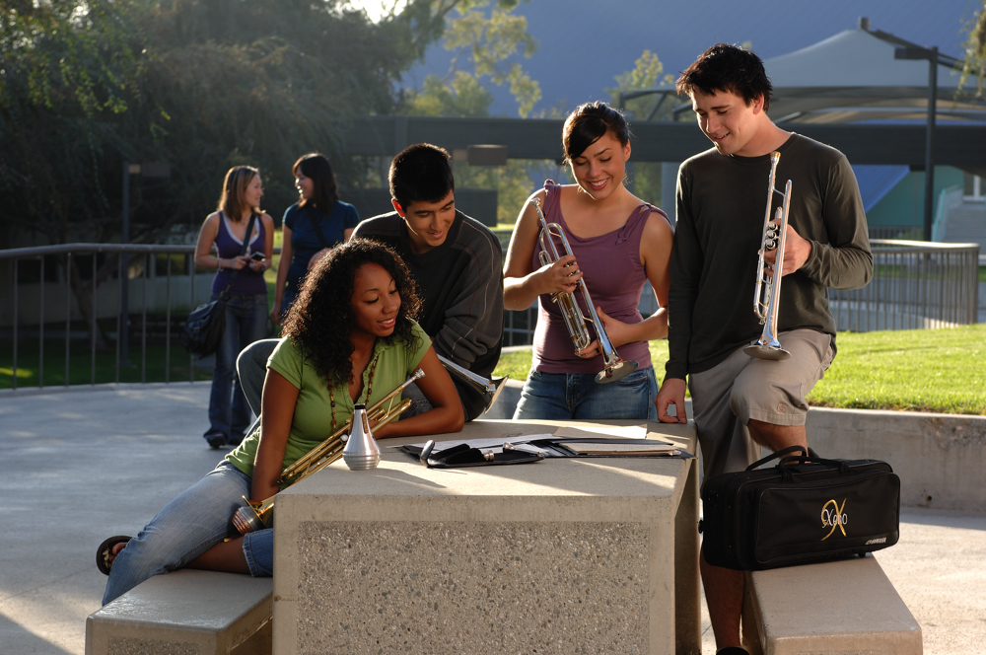
FAMOUS QUOTES. . .
Music has the power of producing a
certain effect on the moral character of
of the soul.
. . . Aristotle

Slide 26
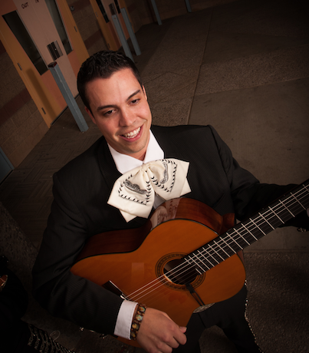
FAMOUS QUOTES. . .
Music furnishes a delightful recreation
for the hours of respite from the cares of the day, and lasts us through life.
. . . Thomas Jefferson

