Slide 1
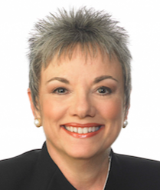
www.nafme.org/programs/all-in
All In for Advocacy and
Music Education
Larry Livingston and Marcia Neel
January 15, 2016
11:00 AM and 12:15 PM • Harrison B

Slide 2
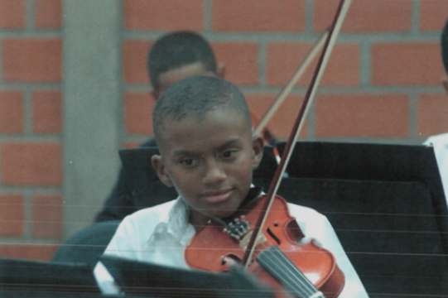
The Case for Music Education
The Global View
What the Research Shows

Slide 3
The Case for Music Education:
What the Research Shows

Slide 5
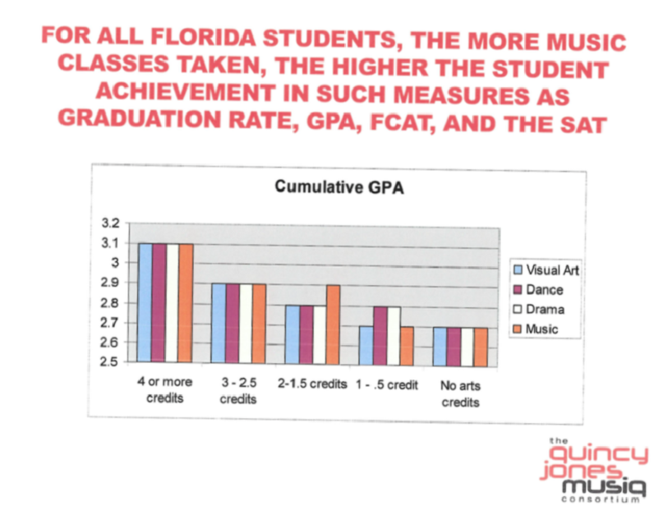

Slide 6
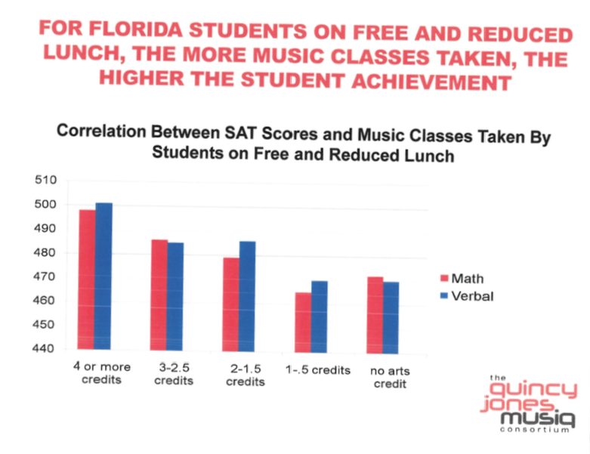

Slide 7
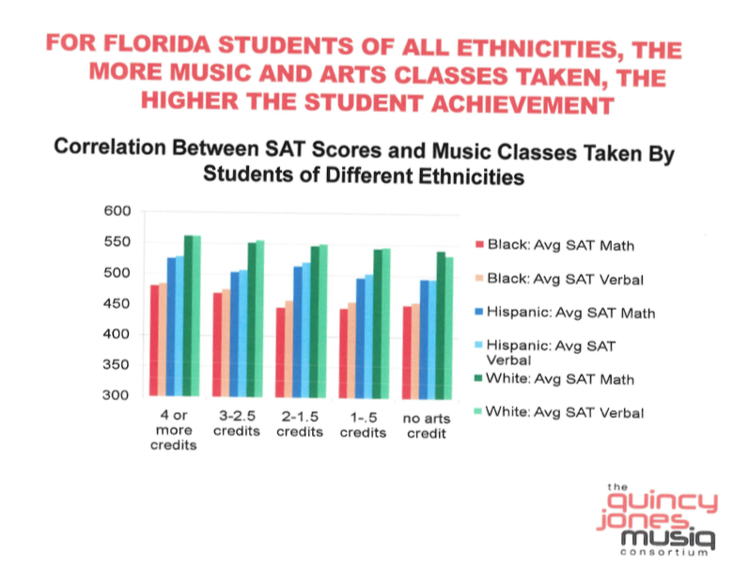

Slide 8
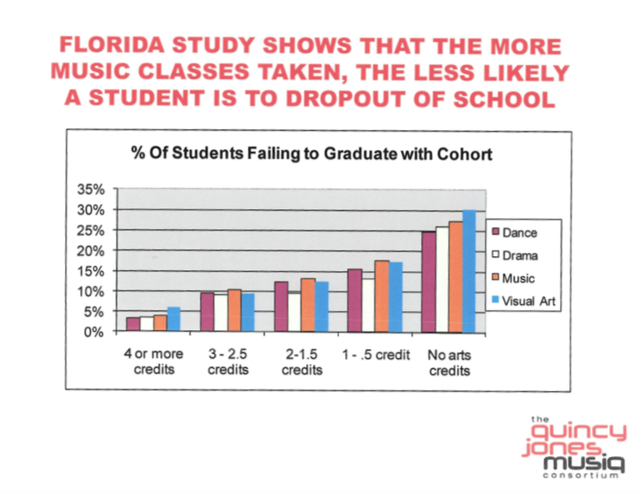

Slide 16
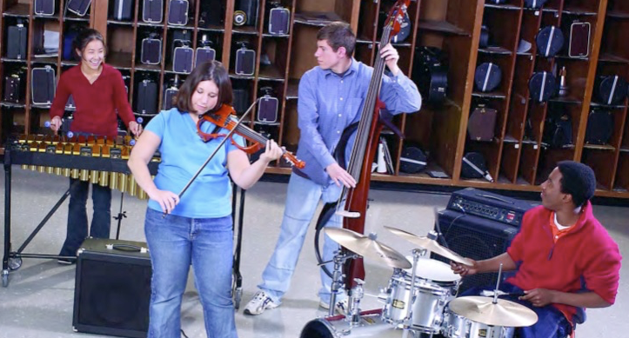
The Case for Music Education
10 Things You Can Do Monday!
10 Easy Strategies

Slide 17
The Two Querries…
What Do Principals Really Think?
2. What Have You Done to Make an Advocate out of Your Principal?

Slide 18
1. What I love best about my music teacher is
that he/she is. . .(here we go!)
Caring
Dedicated
Passionate
Committed
Success-oriented
Organized
Dynamic
Positive
A Team Player/Builder with Students, Staff and Parents

Slide 19
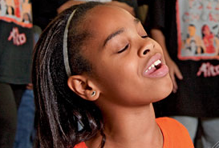
1. What I love best about my music teacher is
that he/she is. . . (cont.)
Communicative
Encouraging
Flexible
Professional
Creative
Talented (Performer)
Intense (In a Good Way)
Effective with Pedagogy

Slide 20
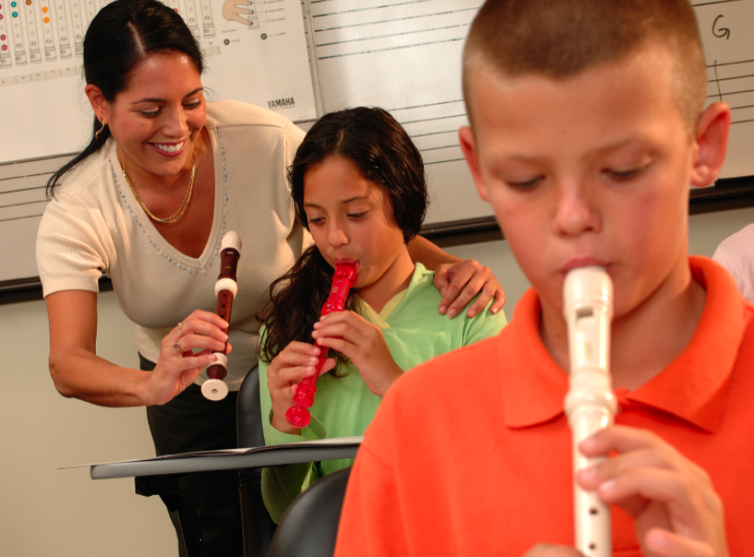
1. What I love best about my music teacher is
that he/she is. . . (cont.)
Responsible
Collegial
Motivational
Inspirational
Helpful
Content-oriented
A Music Advocate (Recruiter)
Demanding (Self and Students)

Slide 21
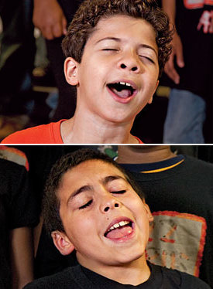
2. To improve the music program, I would ask my music teachers to. . .
Communicate ! Communicate! Communicate!
Coordinate/Collaborate with Colleagues
Articulate with Feeder Schools More
Recruit/Retain More
Focus on Building Group Identity
Promote More
Perform More

Slide 22
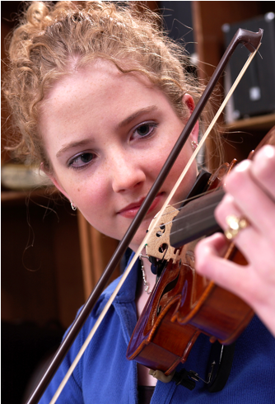
2. To improve the music program, I would ask my music teachers to. . .(cont.)
Help Administrators to Help Them
(esp. on Class Sizes)
Extend Learning Into the Community
Develop More Partnerships
Incorporate School-wide Objectives
Assess Their Own Programs More
Often

Slide 23
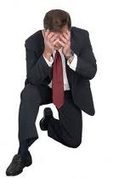
3. What troubles me most is that he/she is not. . .
Passionate
Considerate of the “Big Picture”
Communicative
Demanding Enough
Managing the Classroom Well
Lesson-planning Effectively
Even-tempered
A Team Player
Organized

Slide 24
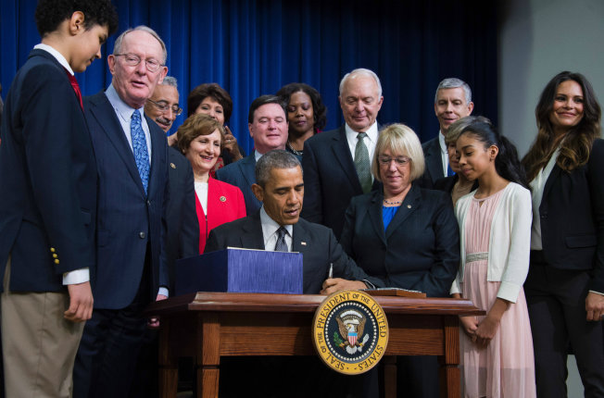
What Have You Done to Make an Advocate
Out of Your Principal?
“I communicate and keep my principal informed.”
Every
Student
Succeeds
Act
Google: “NAfME Everything ESSA”
#MusicStandsAlone

Slide 25
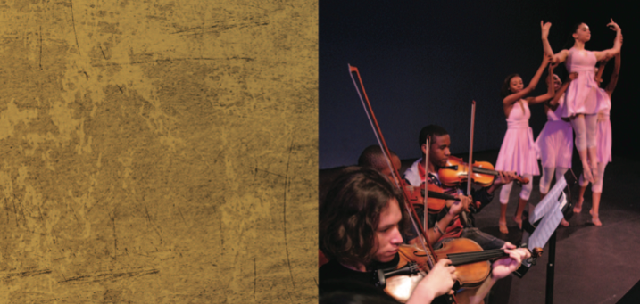
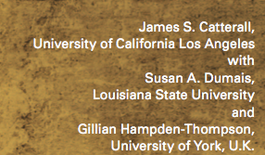
“I communicate and keep my principal informed.”

Slide 26
“I communicate and keep my principal informed.”

Slide 27
Always Have Small Ensembles READY to Perform
Invite Her (and Faculty) to PERFORM in the Holiday Concert
Copy Him on All Correspondence
Communicate Music Advocacy Information
Took him Golfing
. . .He Won!!!!

Slide 28
It’s a Team Effort!
Show Your Administrator The Way

Slide 29
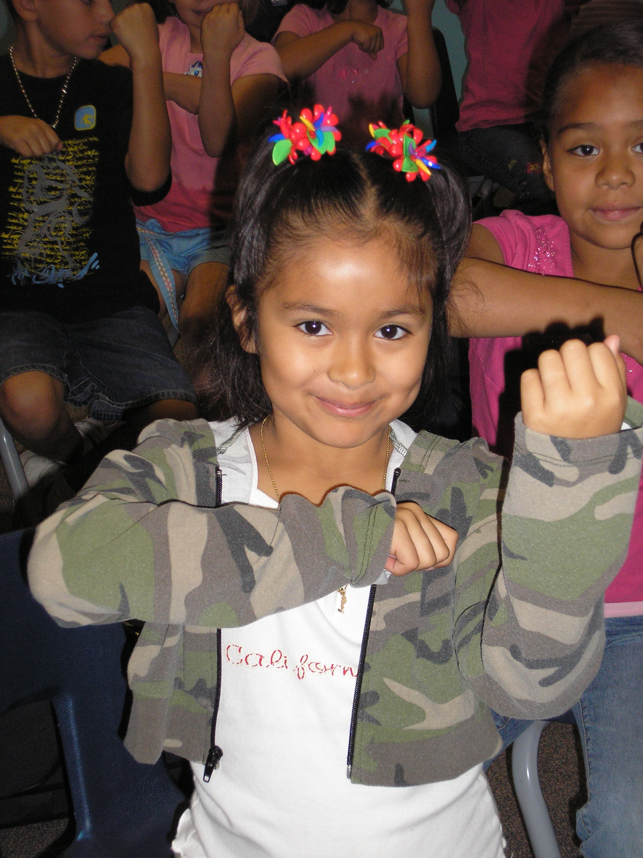
1. Engage Your Principal
Come on down. . .
“Help me give out
instruments to the kids!”

Slide 30
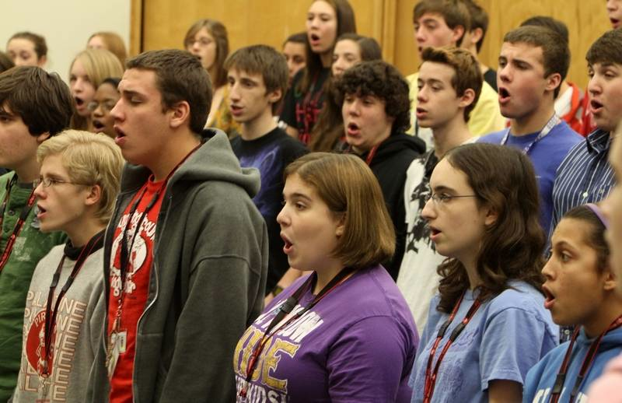
1. Engage Your Principal
Come on down. . .
“I need an audience to help the students prepare for…”

Slide 31
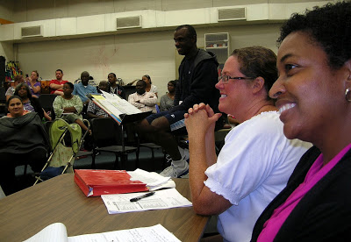
1. Engage Your Principal
Come on down. . .
“Could you give a ‘talk’ to the Boosters?”

Slide 32
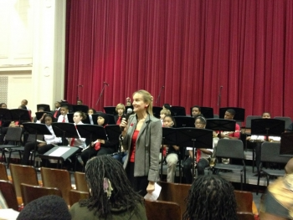
1. Engage Your Principal
Come on down. . .
“Could you provide Opening Remarks at our upcoming concert?”
Praise your administrator in front of the
parents for the support.
Have students present a signed print.

Slide 33
2. Ask your students to complete the sentence, “Music makes the difference because. . .” then use their responses.
“…when you’re sad and then you hear music, it will cheer you up. And when you’re down, it will make you get up from where you are and start dancing. Music will always be there for you.”

Slide 34
Music Makes the Difference Because…
“…it makes me feel free and like nobody is judging me.”
“…it helps me express my feelings into something other than words. Music makes you want to dance, and sing out loud; it can cheer you up, even on the gloomiest days.”

Slide 35
2. Ask your students to complete the sentence,
“Music makes the difference because. . .”
Use their responses. . .
a. In your upcoming concert programs
b. In your school newspaper’s “music corner” (Don’t have a “music corner?” You know what to do!)
c. As copy for making banners/posters to display around the school
d. As copy for recruitment fliers and posters at feeder schools
e. As copy for IMEA publications
f. As copy for a publication about your school’s FANTASTIC music program

Slide 36
3. Retrieve information about the value of studying music - quote it in any of the above outlets but especially on recruitment information! Share with your supervisor.
HINT: Start by visiting:
www.nafme.org/take-action/advocacy-resources/
supportmusic.com

Slide 37
4. Recruit 24/7

Slide 38
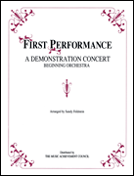
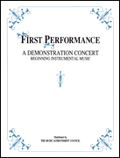
4. Recruit 24/7 First Performance Concert!
A scripted demonstration of what your students have learned

Slide 39
5. Recruit 24/7 – Keep Music Education Strong
GREAT FOR PARENT NIGHTS TOO!!!!!
Recently Revised to include the Very Latest Research and Statistics on the Benefits of Music Education.
FREE COPIES of assorted brochures available from
SupportMusic.com

Slide 40
6. In your next concert program, include an insert designating each attendee as a member of the newly-formed Mozart Middle School Coalition for Music Education/Music Boosters Club/Committee to Promote Music Education
a. To help make the program better for those they love
b. To help establish the program as a school-wide entity using a positive approach
d. To feel invested -- i.e. “buy-in”
continued. . .

Slide 41
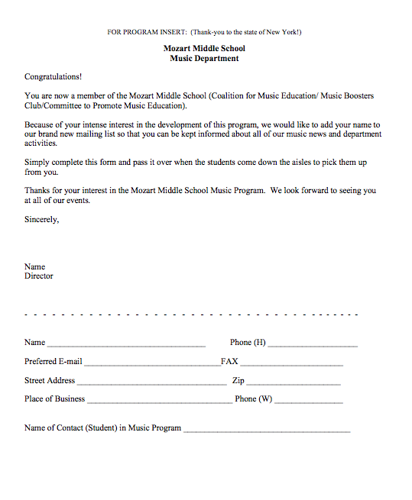
Parents are the ones who have the most important interest at hand. It is THEIR child’s music education.
They can become your voice if needed.

Slide 42
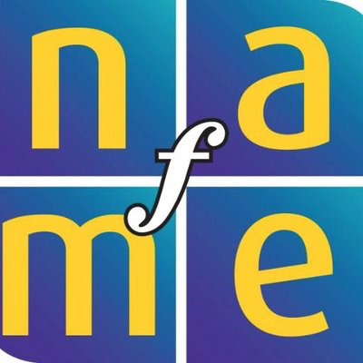
7. Let the Information Come Directly to YOU!!!
Get on Twitter and start following!!!
@NAfME
@NAMM Foundation
@MusicEdConsult
@MusicAchCouncil
@EricWhitacre

Slide 43
8. Arrange performances for the principal’s meeting, school board, city council, state legislature, etc. They will appreciate the “good news” for a change.
BE READY!!!!!!!!
PERFORM WELL!!!!

Slide 44
9. Create a website, Twitter account, etc. and communicate, communicate, communicate. Share the GOOD NEWS!!!!

Slide 45
Website Videos Could Include:
Student Projects: with Permission

Slide 46
Website Videos Could Include:
School Announcements

Slide 47
Website Videos Could Include:
Performance Videos

Slide 48
10. Come up with a clever version of a “Happy Birthday” song to serenade your school staff on their special day. THEY WILL LOVE YOU FOR IT! Give away FREEBIES!
Insert Serenade Photo

Slide 49
Remember. . .Your principal needs YOU!
Be an active, involved member of the faculty.
Take part in as many school activities as you can.
Volunteer to help when needed.
Organize faculty functions, school food drives, etc. (at least one each semester)
Ask how you/your program can help build school spirit.

Slide 50
11. BONUS:
Never stop refining your abilities
in all things.
Keep looking for
“a better way.”

Slide 51
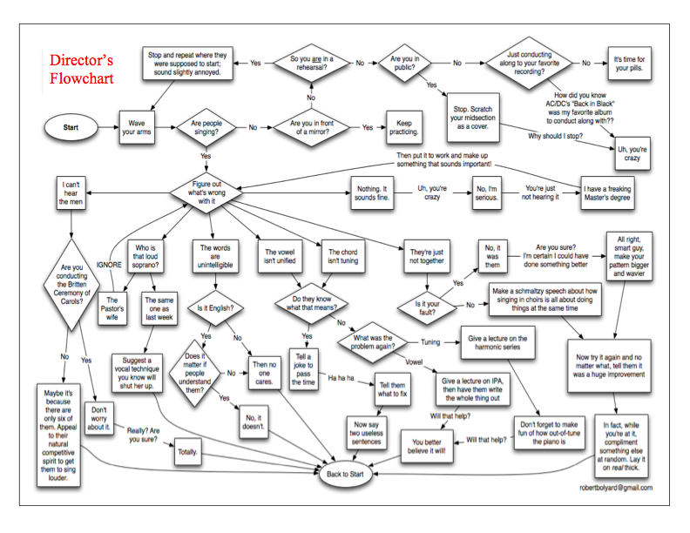
How Can I Do It All?

Slide 52
How Can I Do It All?
Stay Focused
on the “Why!”
We are ALL in this
for the Kids!

Slide 53
Thank You!
All Reports and PPT are Posted Online:
www.musicedconsultants.net/conference-materials
Contact Information:
marcia@musicedconsultants.net
@MusicEdConsult on Twitter
www.nafme.org/programs/all-in

