Slide 1
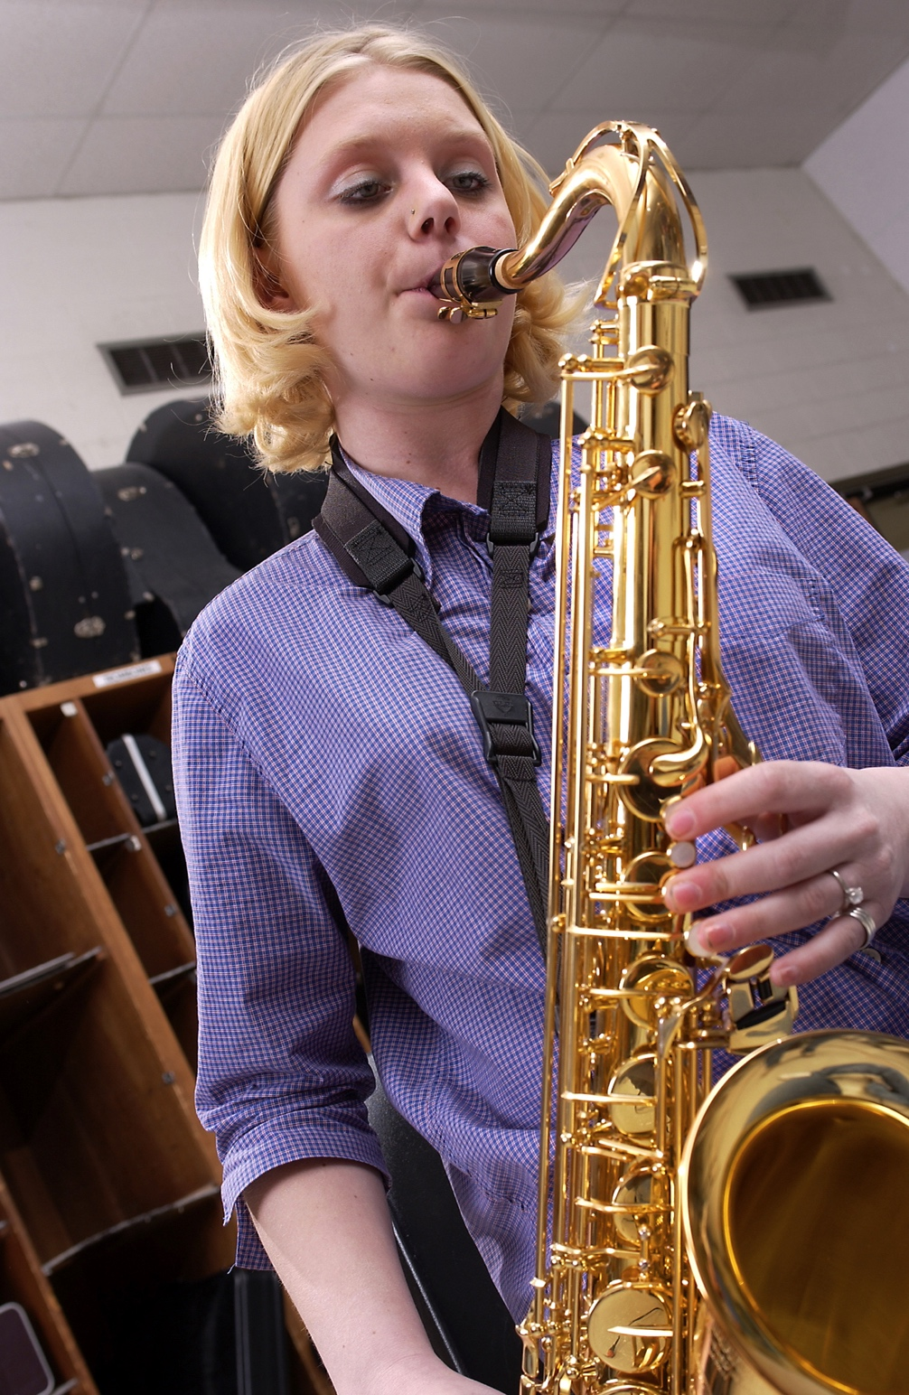
5 S.M.A.R.T.
Innovative Ideas for
Retaining Your Beginners
Marcia Neel
Master Educator
POSTED: www.musicedconsultants.net/conference-materials

Slide 2
The S.M.A.R.T. Approach to Retention
Keep “Success” in Mind
Keep “Modeling” in Mind
Keep “Activities” in Mind
Keep “Reflection” in Mind
Keep the “Total” Picture in Mind

Slide 3
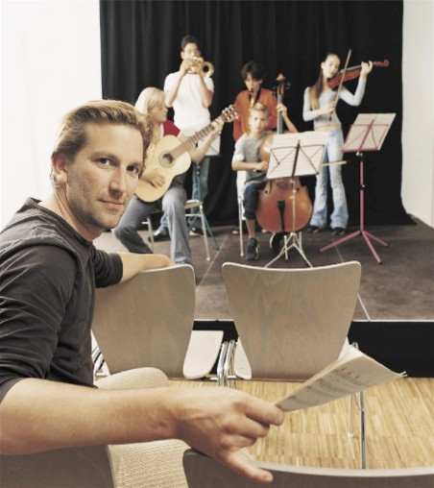
Keep “Success” in Mind
“Success is a Journey, NOT a Destination”
Arthur Ashe
Beginners want to be successful.
Parents want their kids to be successful.
You want your kids to be successful.

Slide 4
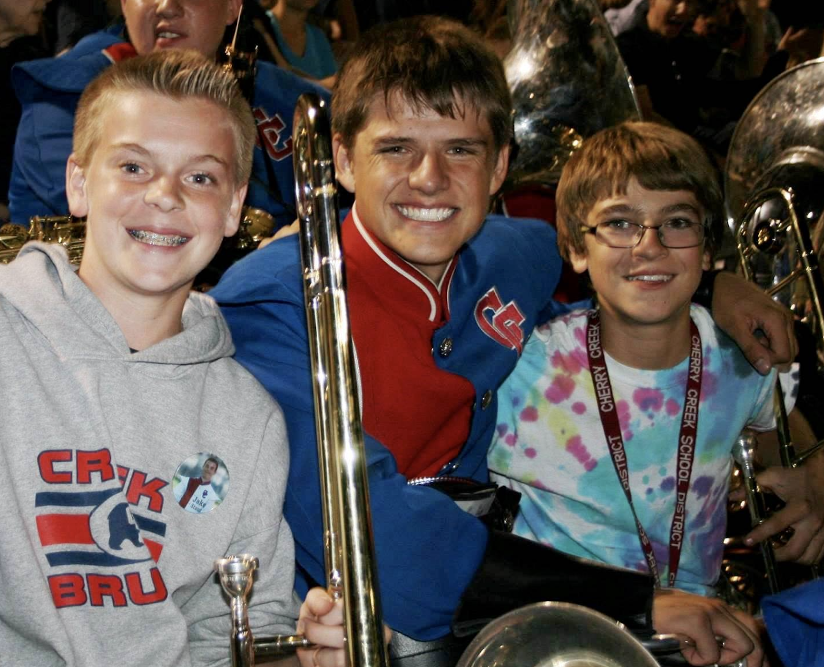
Keep “Modeling” in Mind
Middle school students admire high school students.
High school students develop leadership by mentoring younger students.

Slide 5
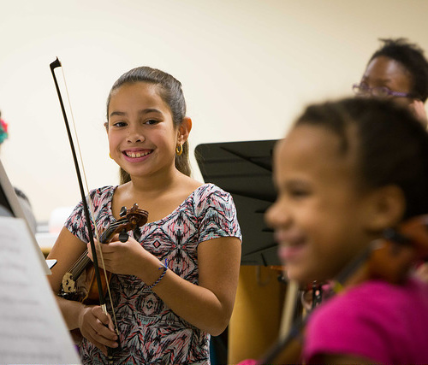
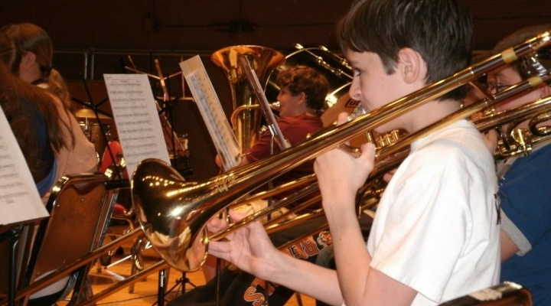
Keep “Activities” in Mind
Students thrive from rewarding experiences.

Slide 6
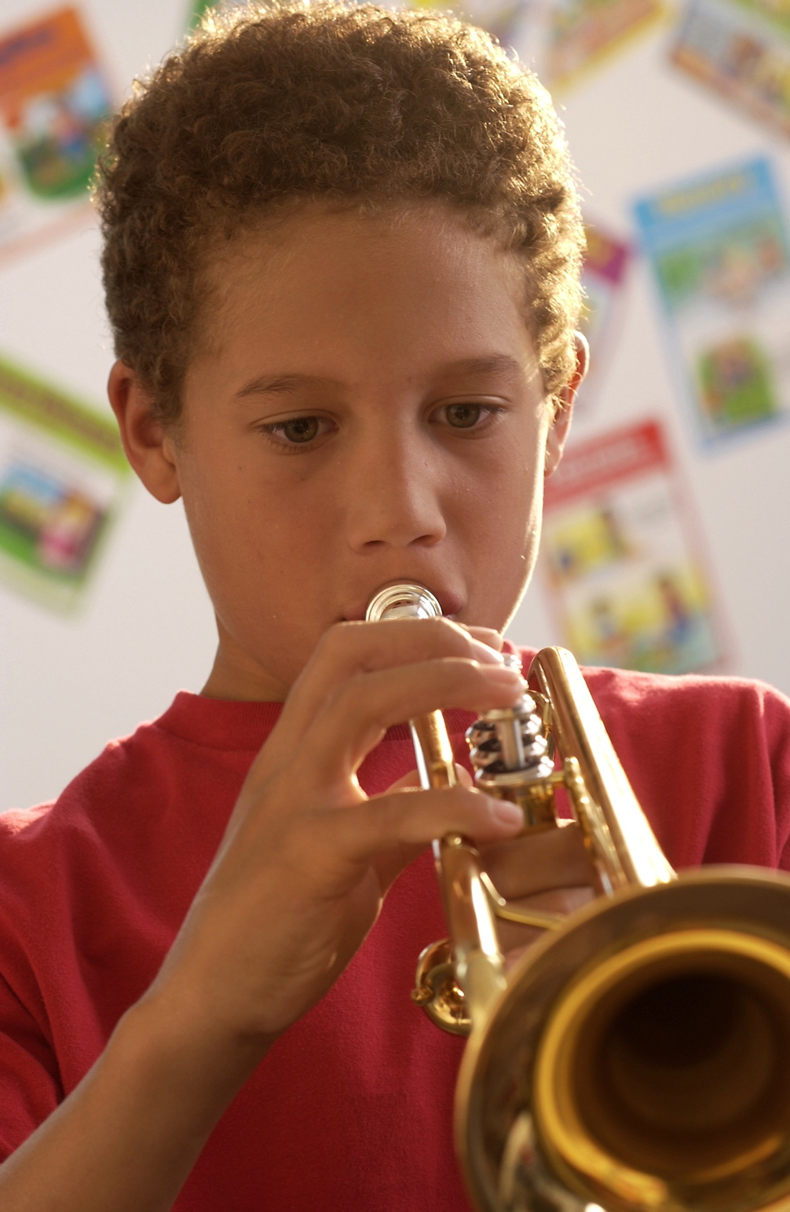
Keep “Reflection” in Mind
Students need to understand that music-making IMPACTS and ENRICHES their lives.
How does music make a difference?

Slide 7
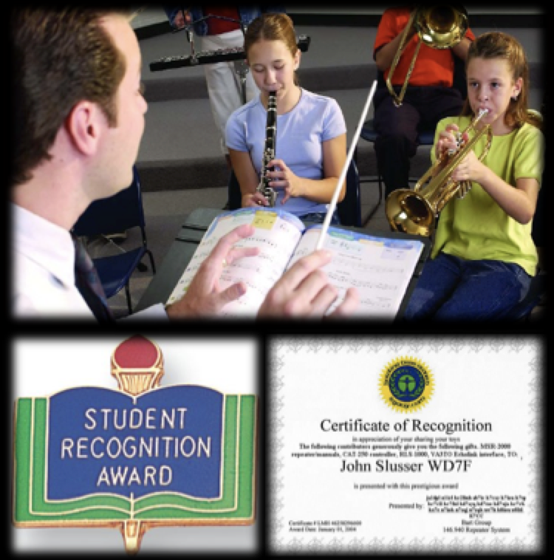
Keep the “Total” Picture in Mind
WHY Music?
It helps us to realize a
more fulfilling life.
It builds appreciation for the the tribe (ensemble)
It provides recognition and reinforcement

Slide 8
1. Have Students Play Early and Often

Slide 9
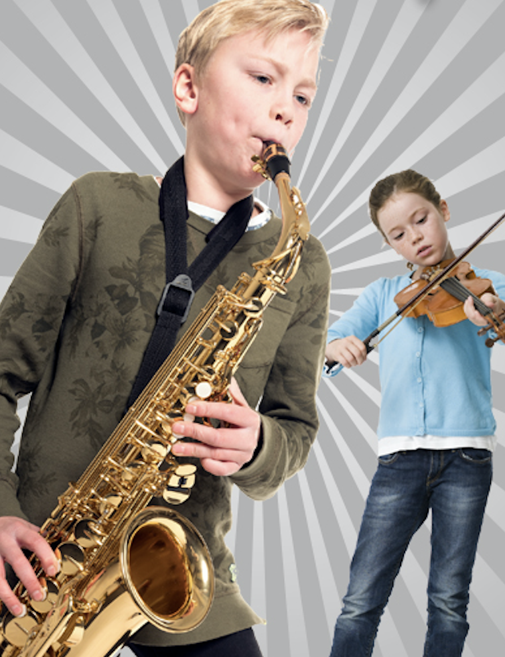
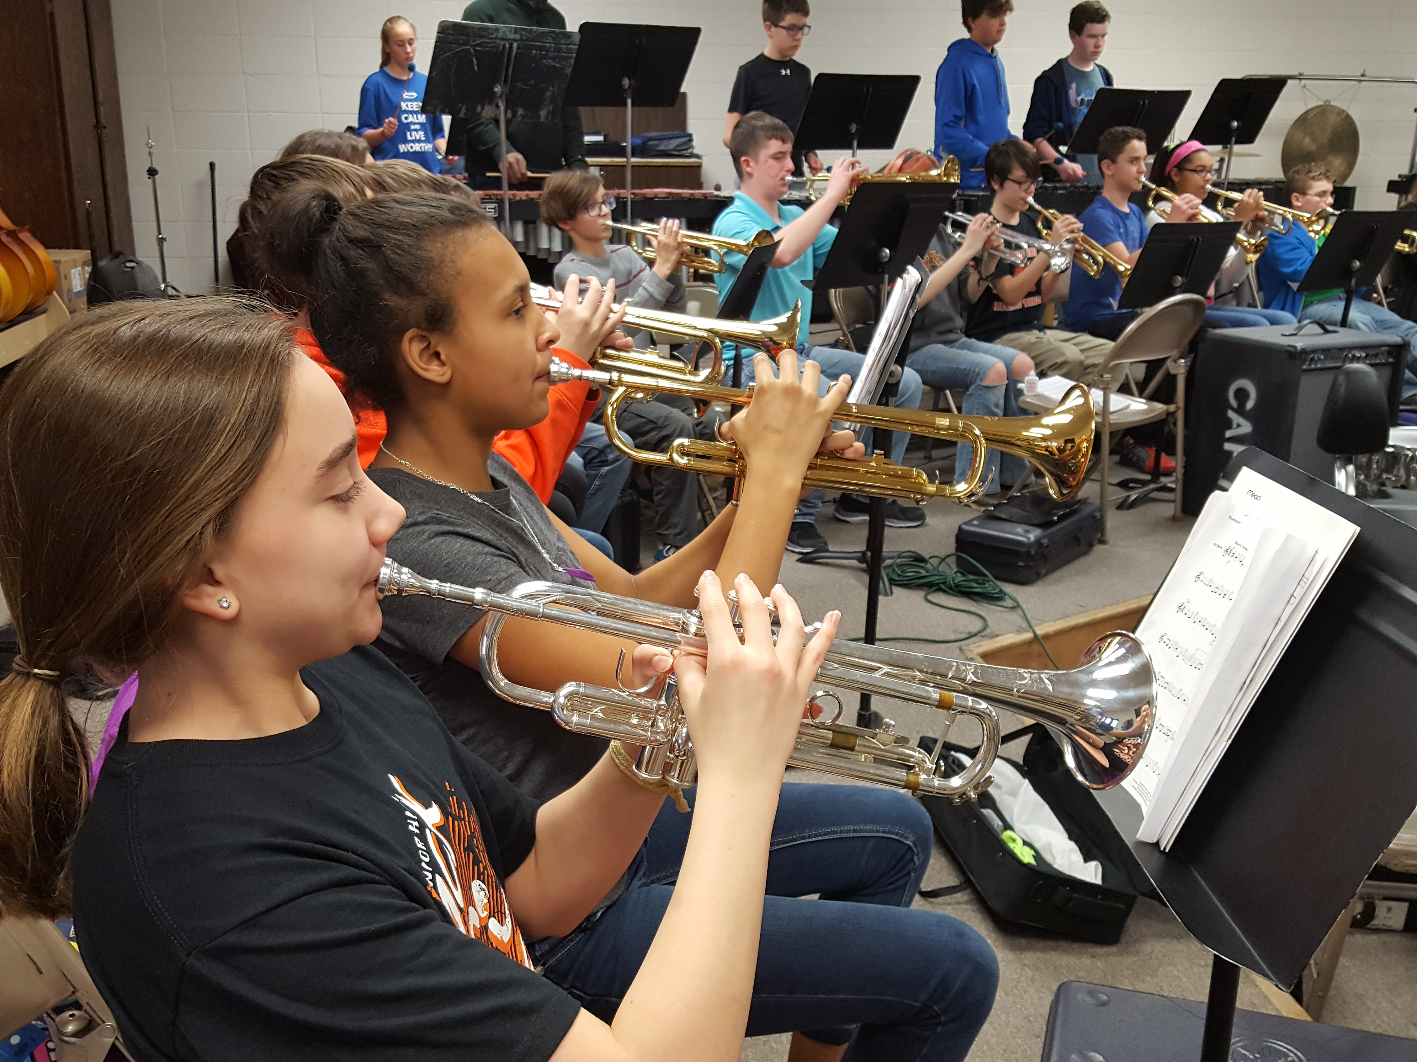
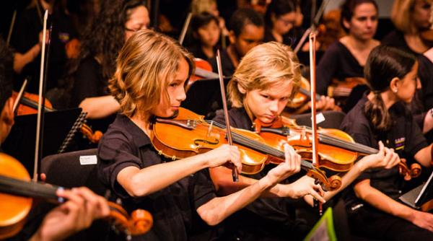
1. Have students play early and often
to show them the pathway to success.

Slide 11
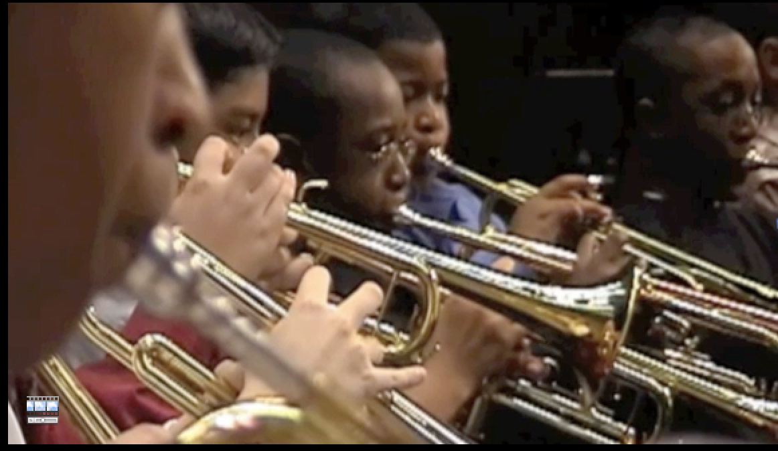
First Performance National Day of Celebration (Third Thursday of November Annually)
1. Have Students Play Early and Often

Slide 12
First Performance National Day of Celebration (Third Thursday of November Annually)
1. Have Students Play Early and Often

Slide 13
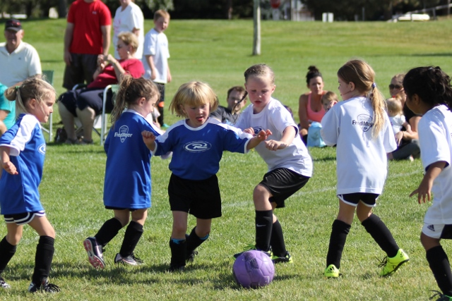

Slide 14
The Results. . .
Reduces Beginner Dropout
Provides Short-Range Achievement
Goals
Encourages Engagement with
Parents
Strengthens Administrative Support
Celebrates Musical Accomplishments
of Beginners

Slide 15
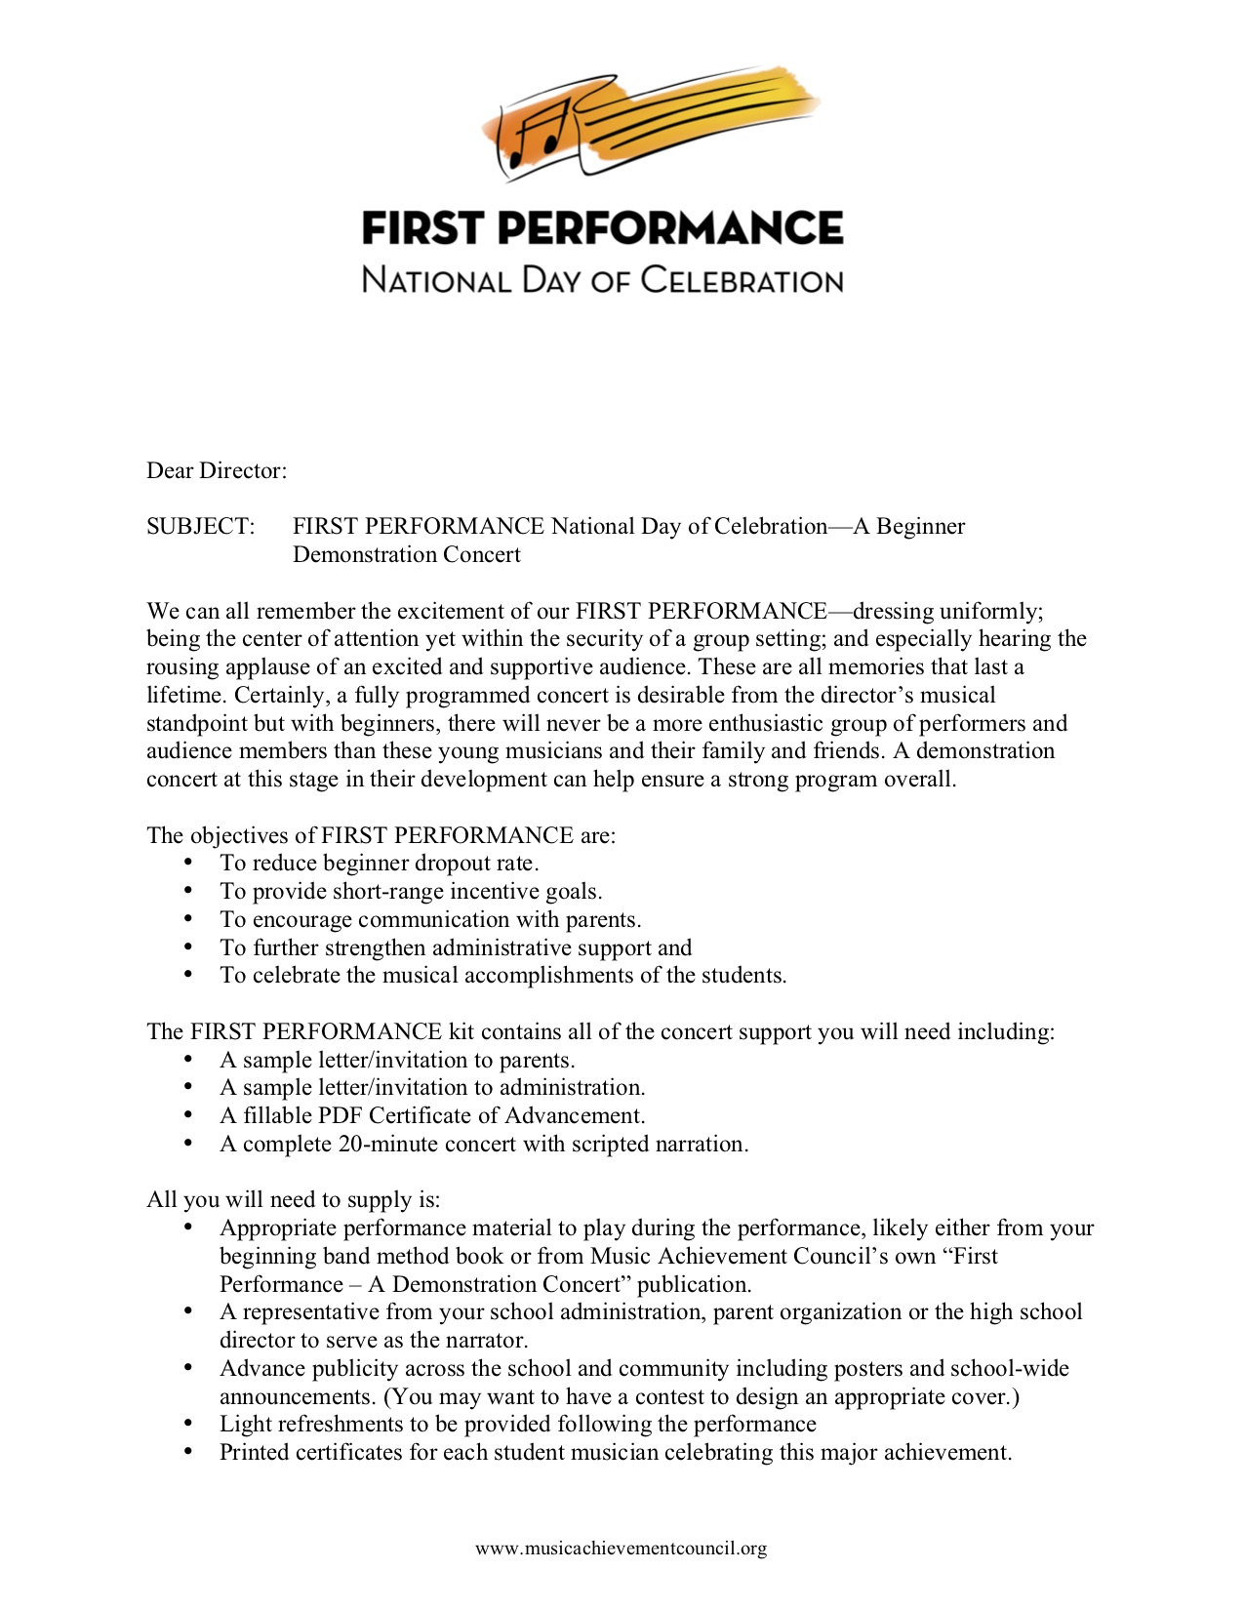
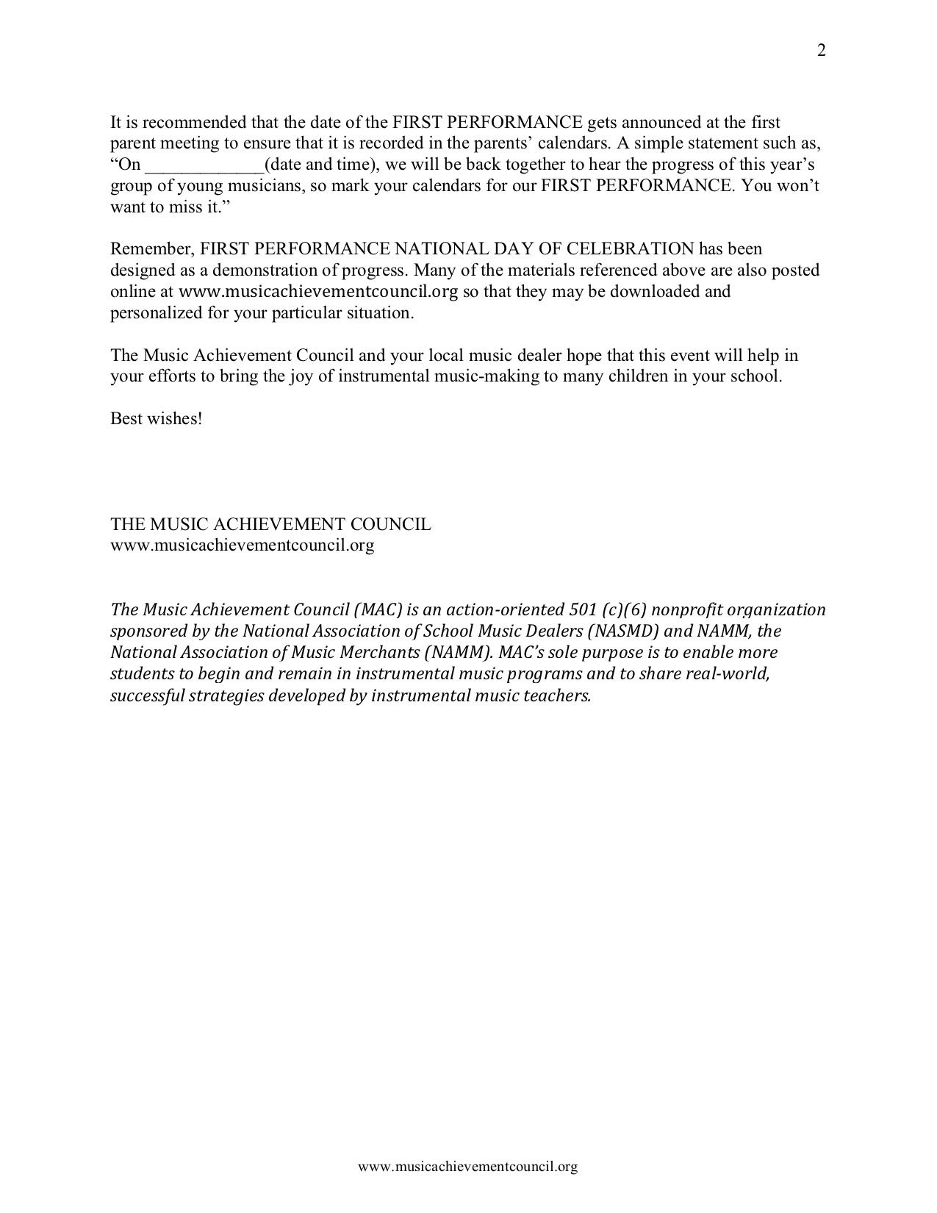
What’s Included?
a. Director Letter with Full Set of Instructions

Slide 16
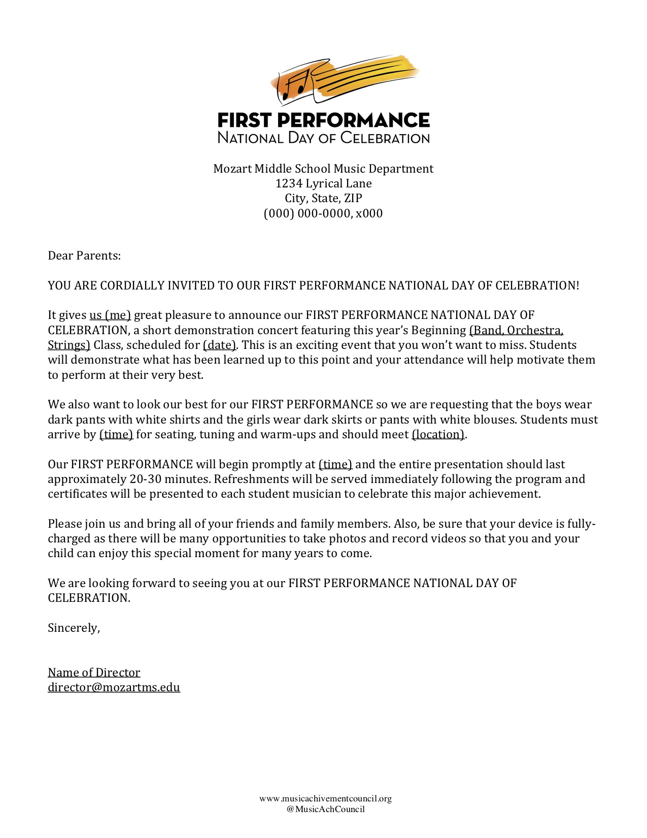
What’s Included?
b. Customizable Letter of Invitation to Parents

Slide 17
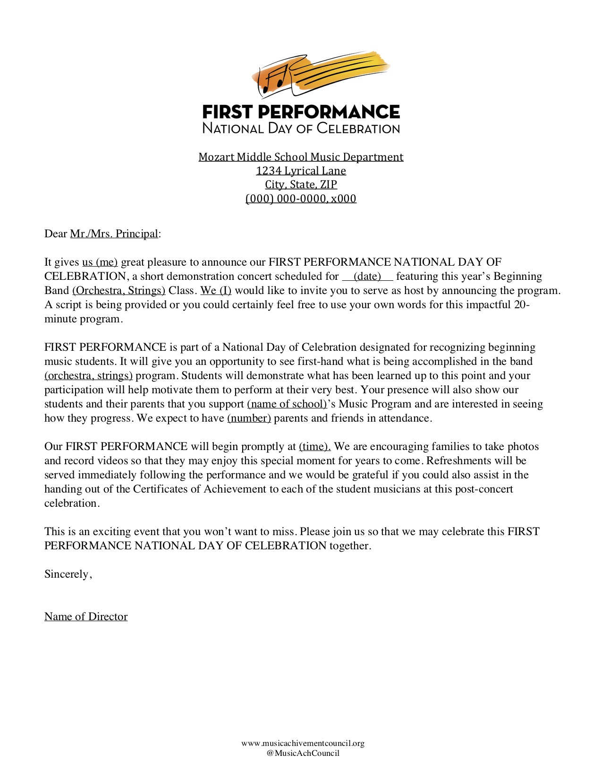
What’s Included?
c. Customizable Letter of Invitation to Principal

Slide 18
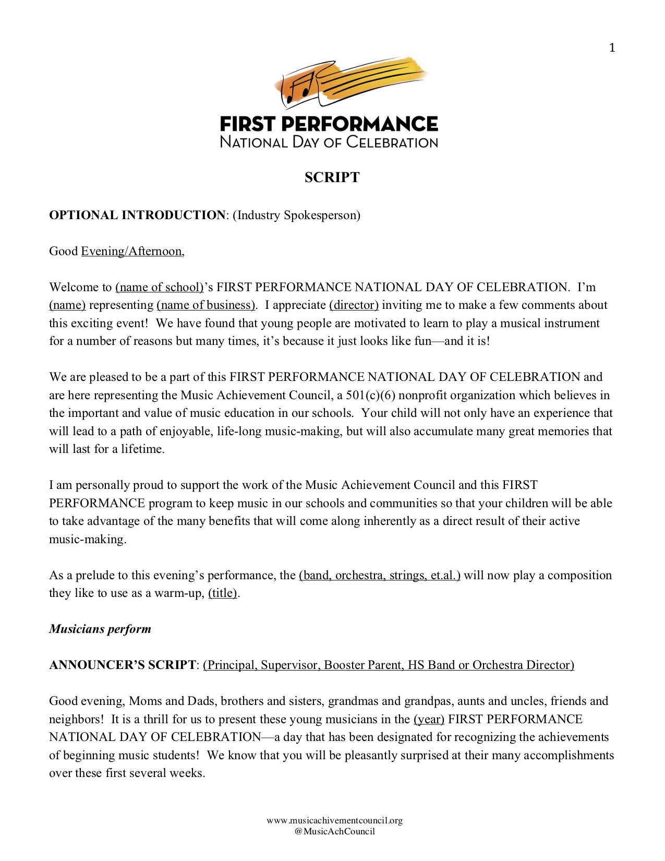
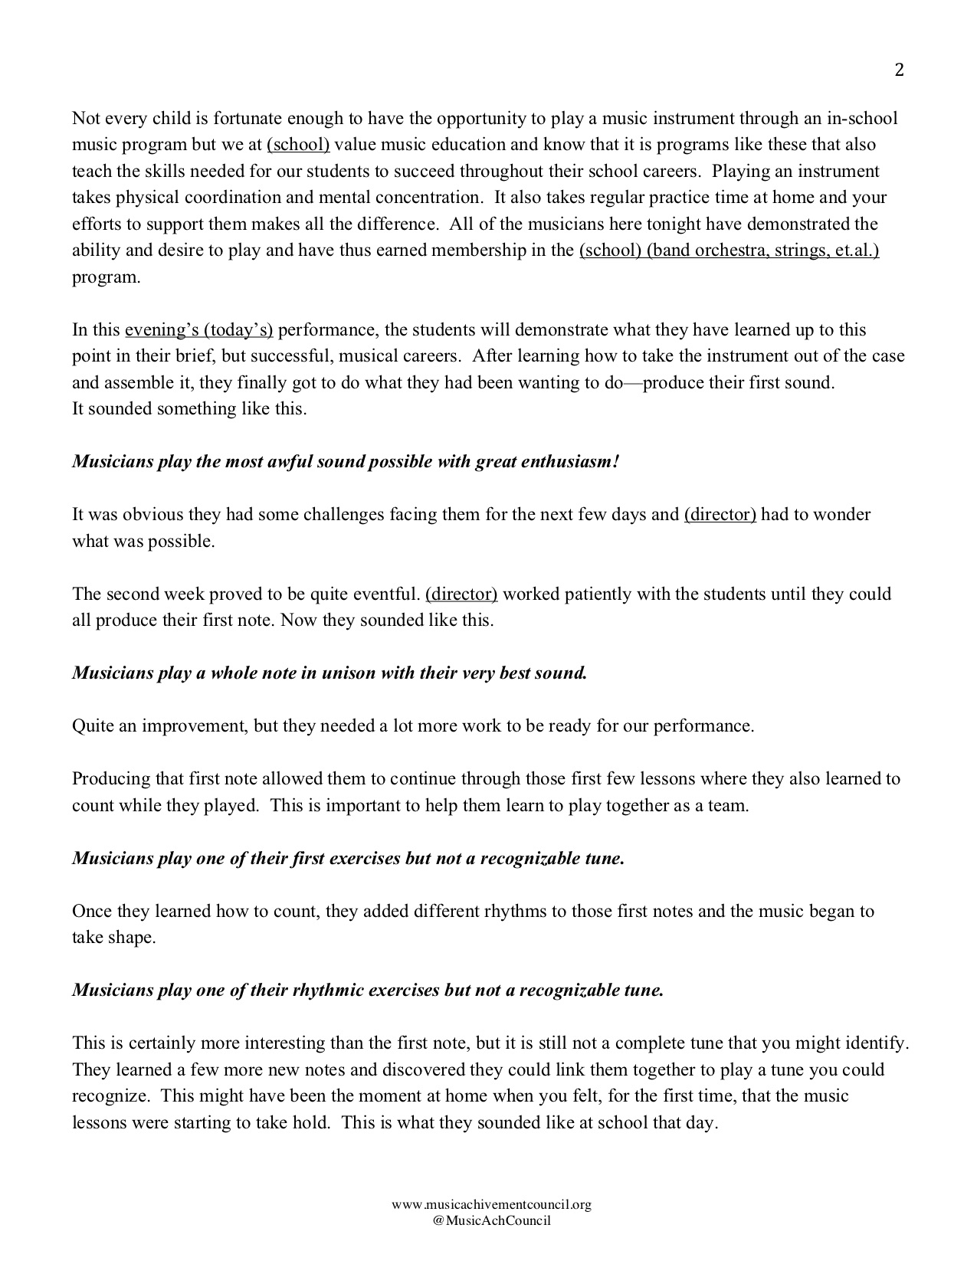
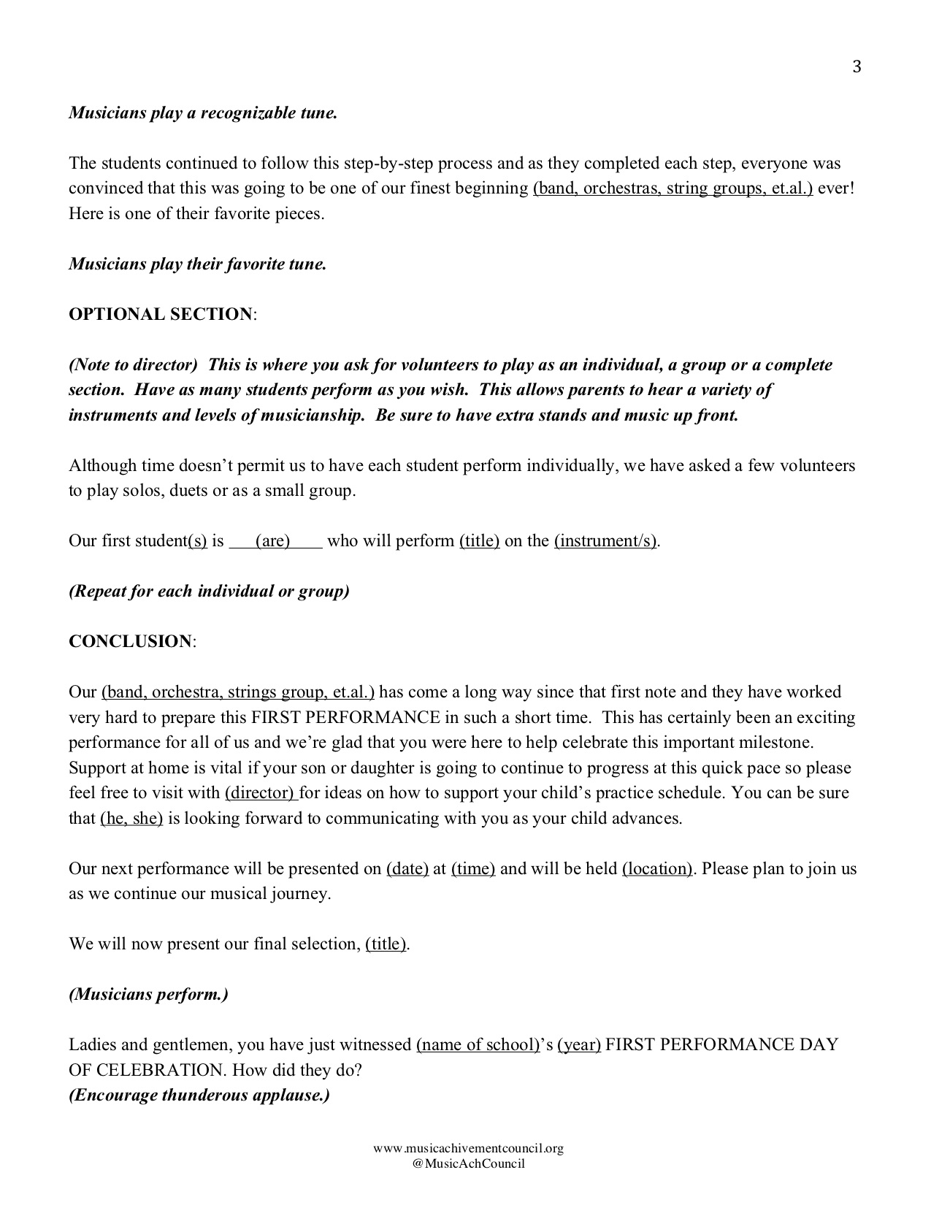
What’s Included?
d. Customizable Script to Make It Your Own!

Slide 19
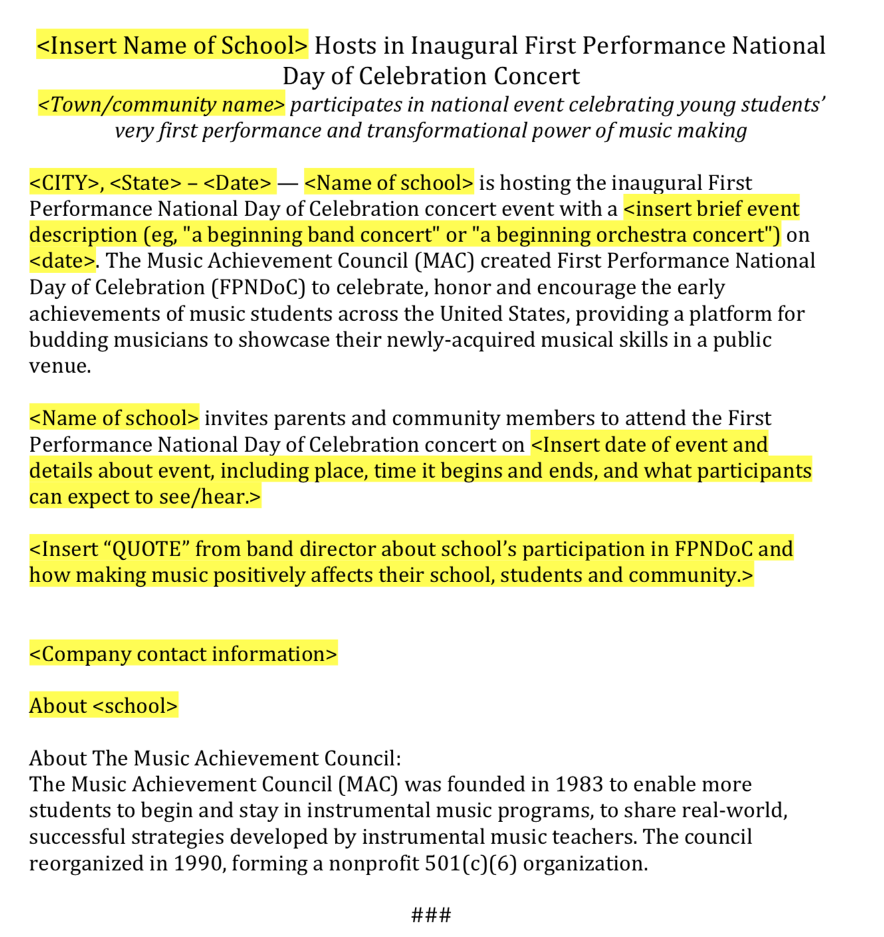
What’s Included?
e. Press Release Template

Slide 20
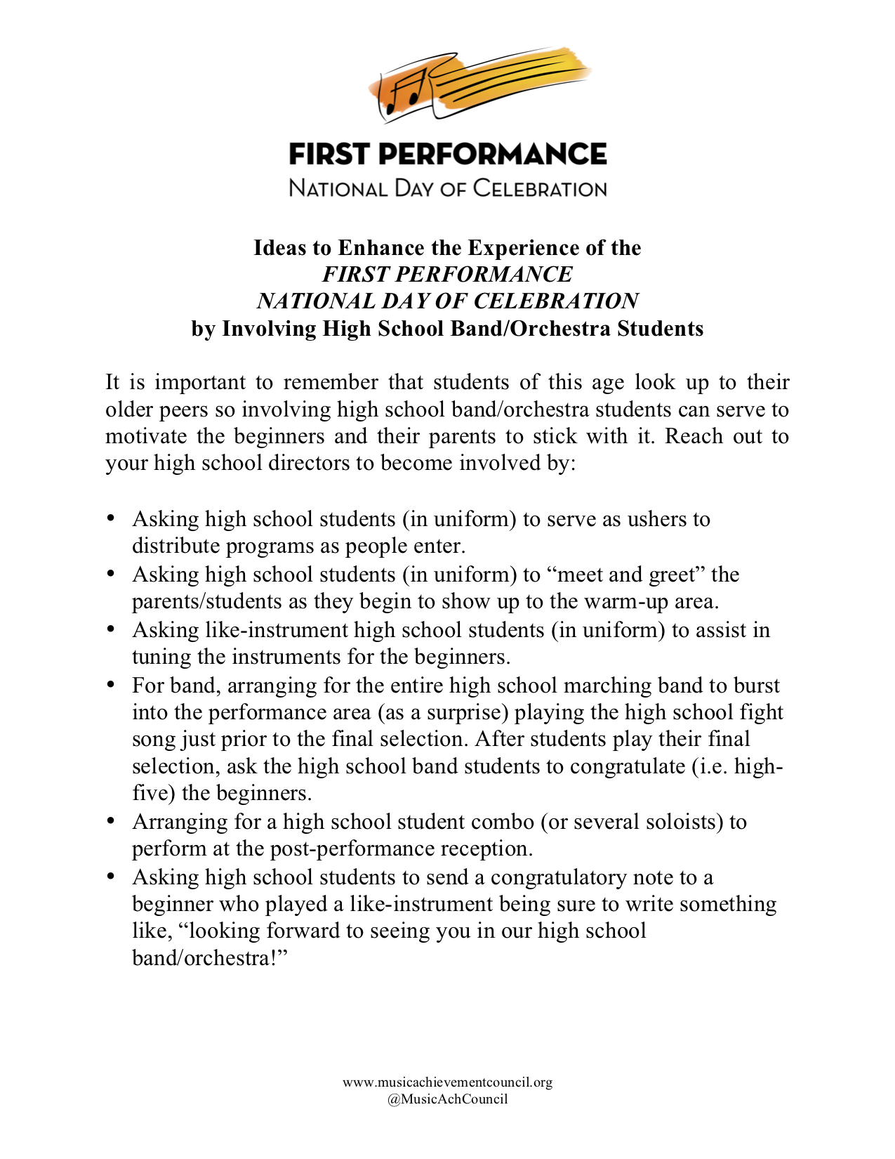
What’s Included?
f. Ideas to Enhance the Experience
with HS Students

Slide 21
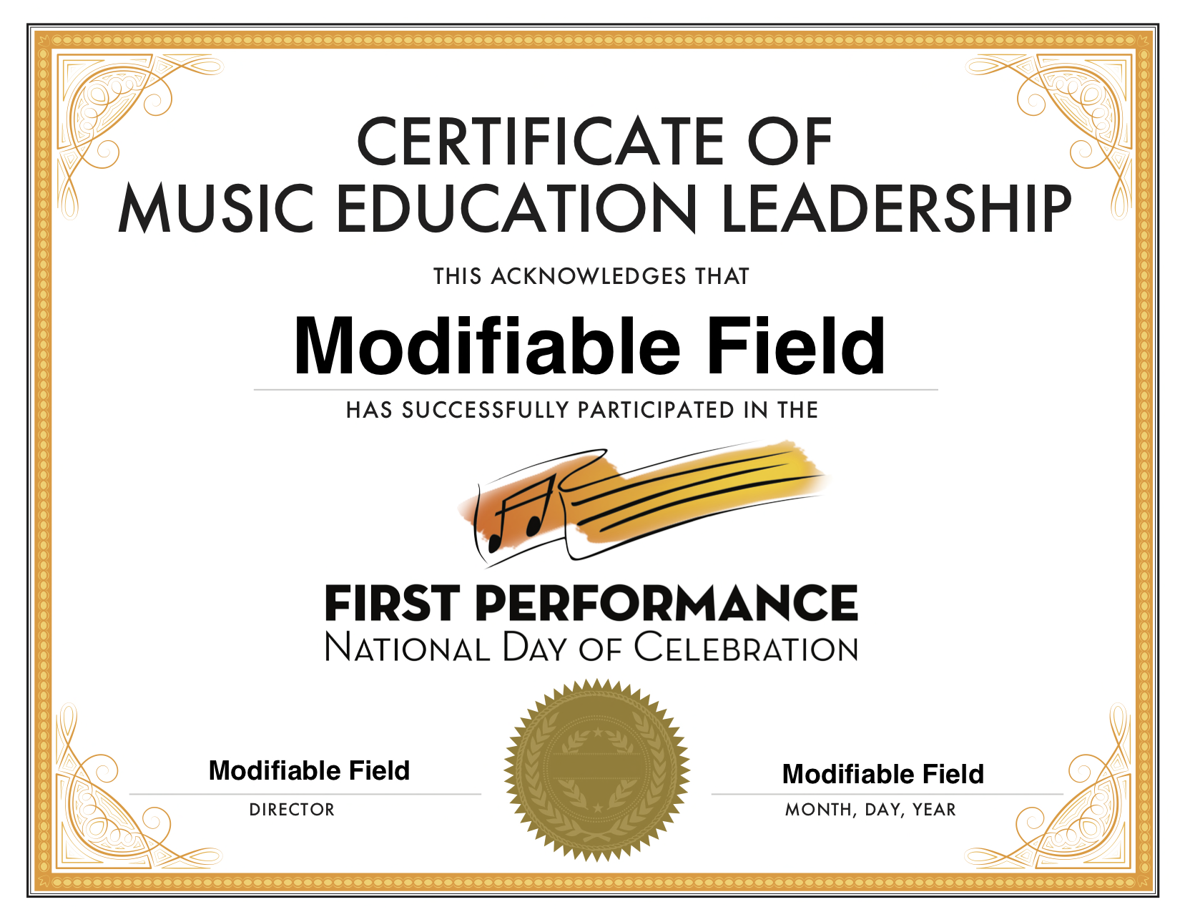
g. Certificate of Music Ed Leadership for
High School Student Participants

Slide 22
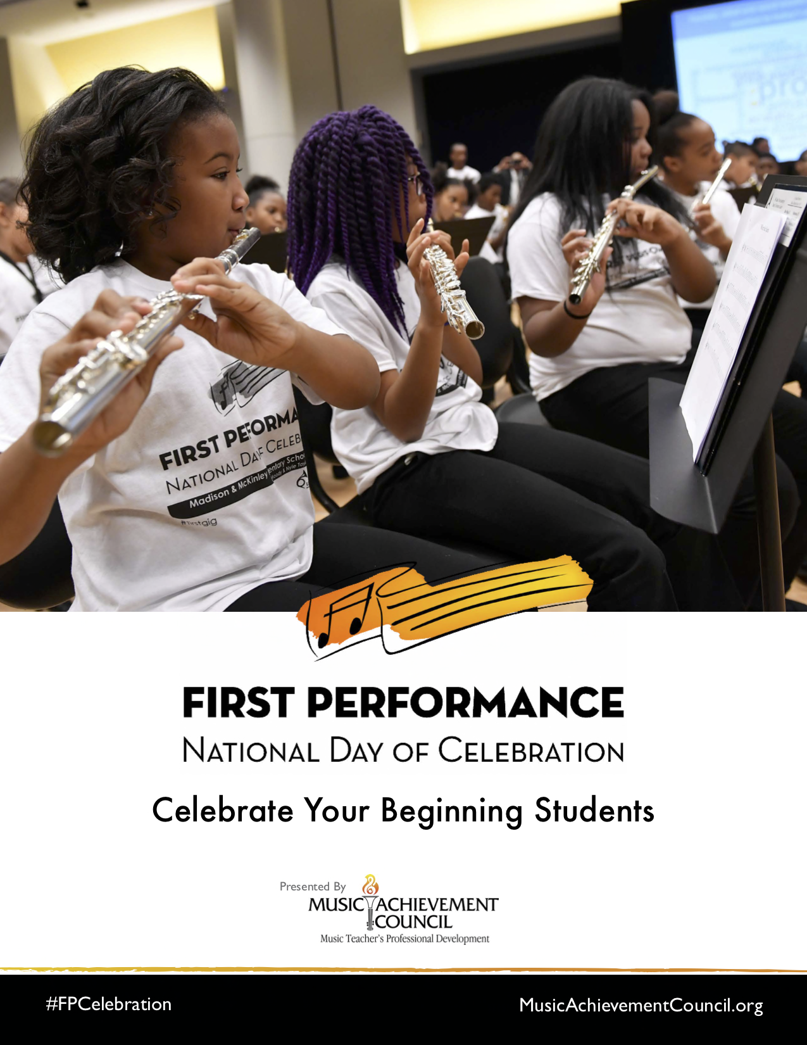
What’s Included?
h. #FPCelebration Toolkit

Slide 23
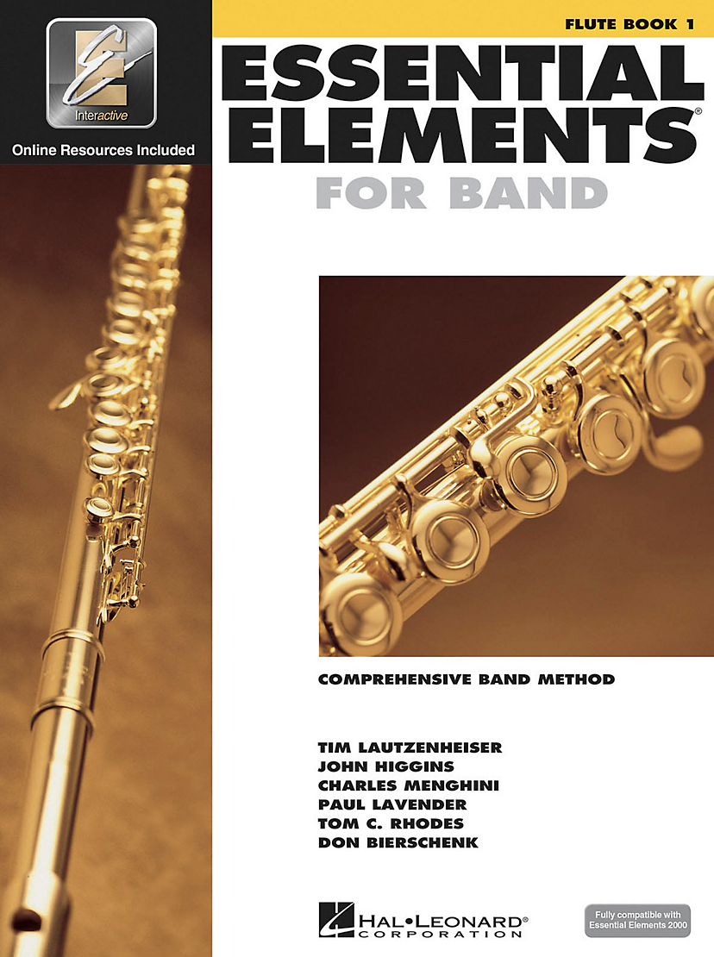
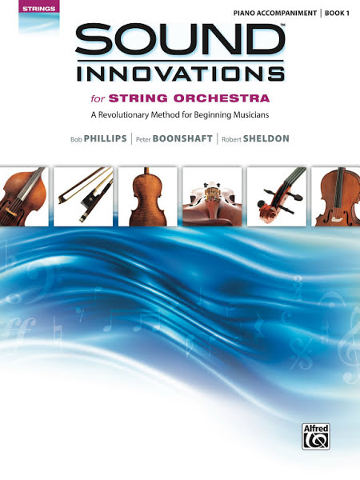
Music
Material
To Use:
Available for
Band or Orchestra at
Local Music Dealers
or online via
Hal Leonard

Slide 24
Response from LIVE at the 2017 Midwest Clinic Poll Everywhere via Smart Phone

Slide 25
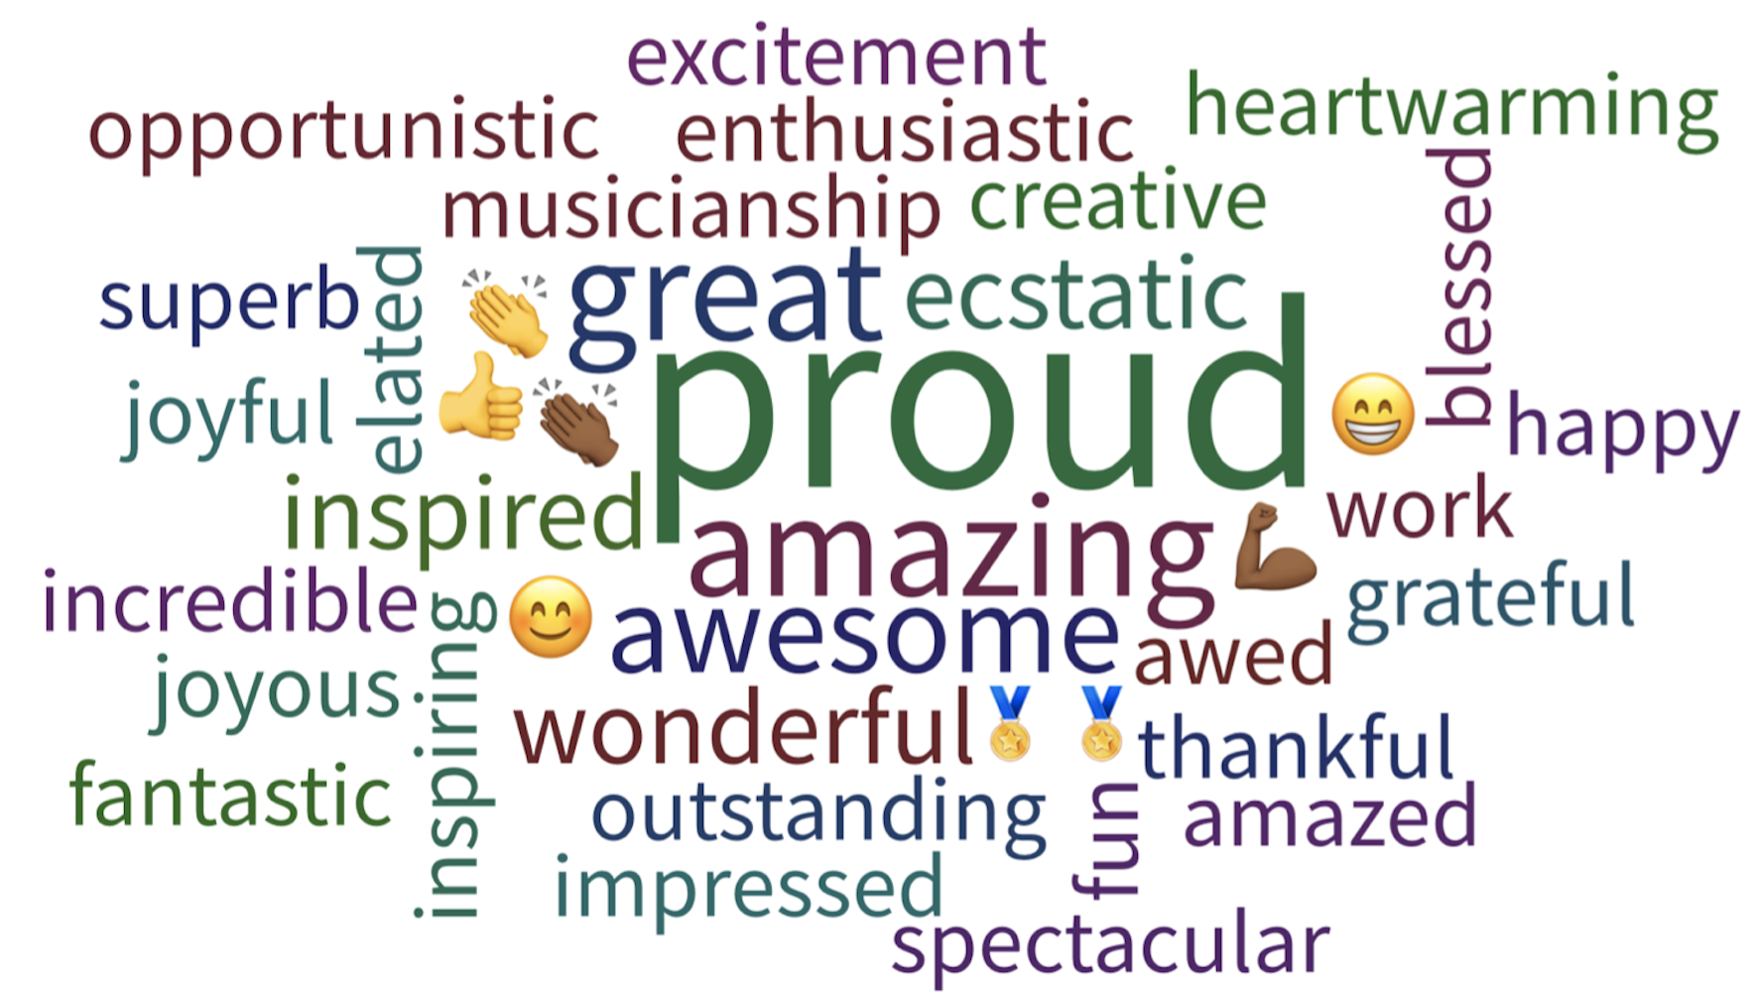
Response from LIVE at the 2017 Midwest Clinic

Slide 26
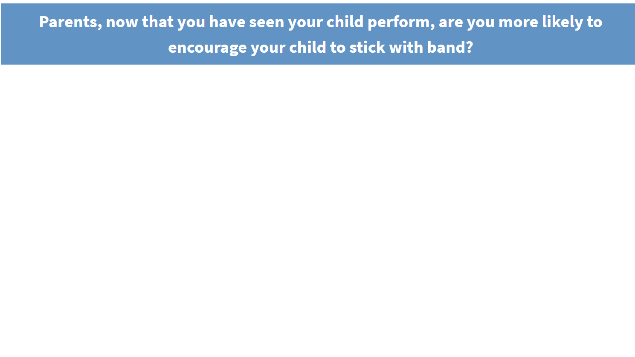
Response from LIVE at the 2017 Midwest Clinic

Slide 27
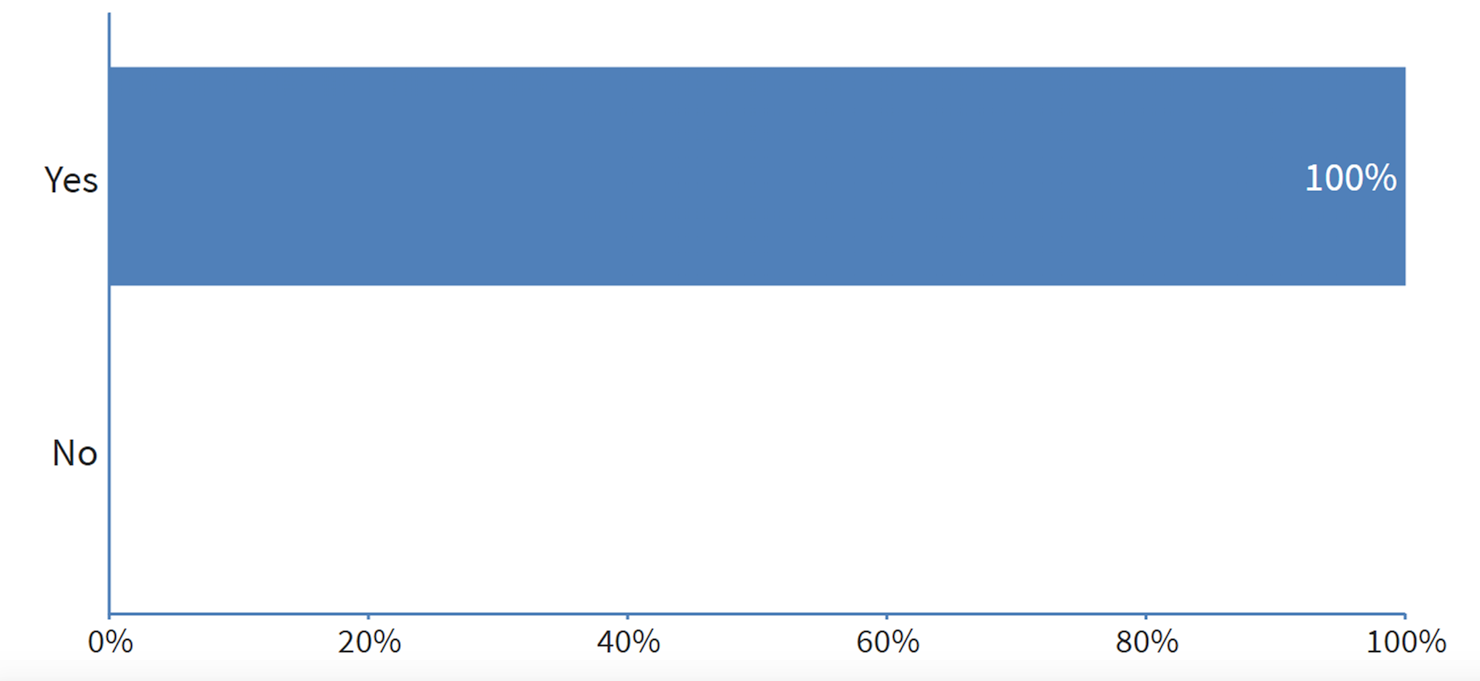
Response from LIVE at the 2017 Midwest Clinic

Slide 28
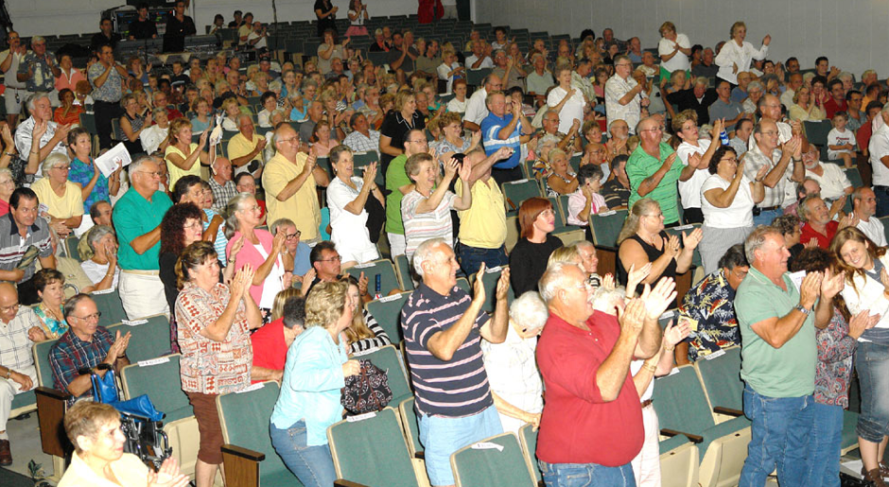
Family and Friends will be Amazed!

Slide 29
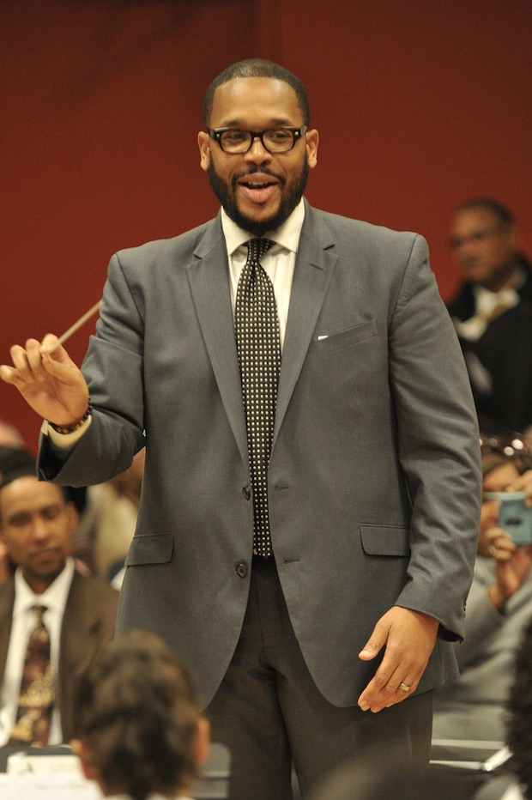
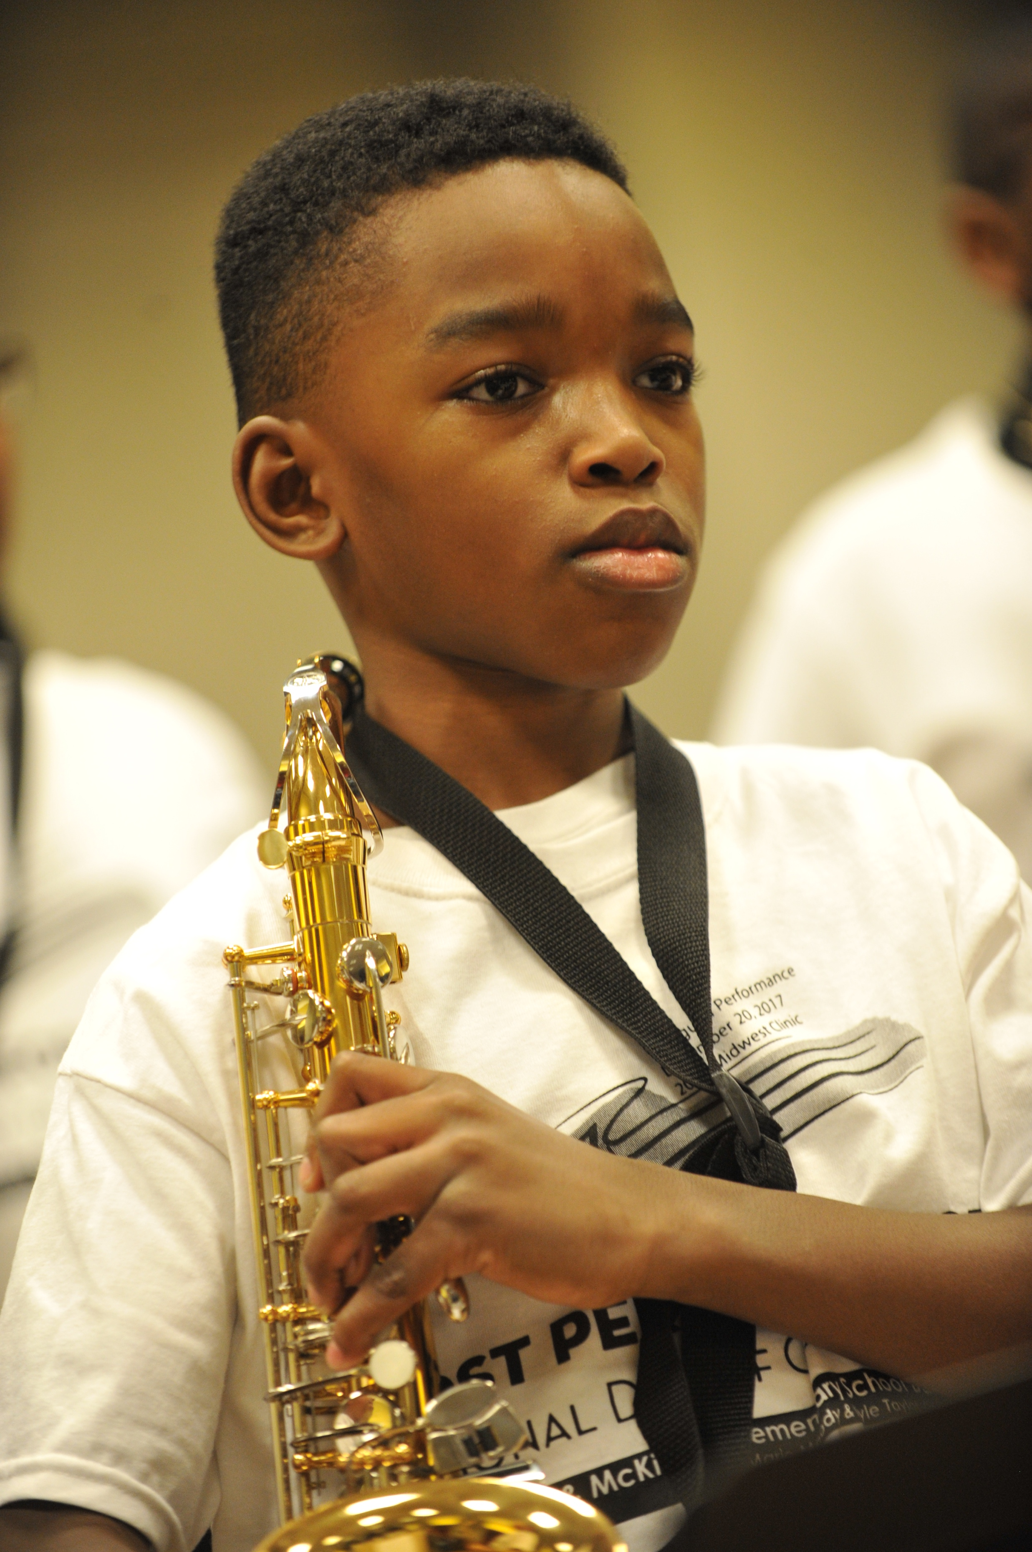
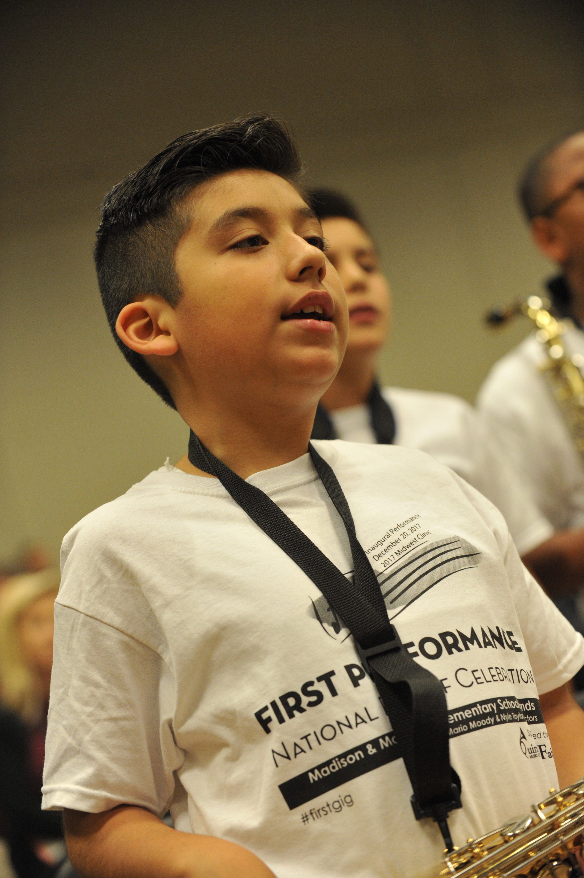
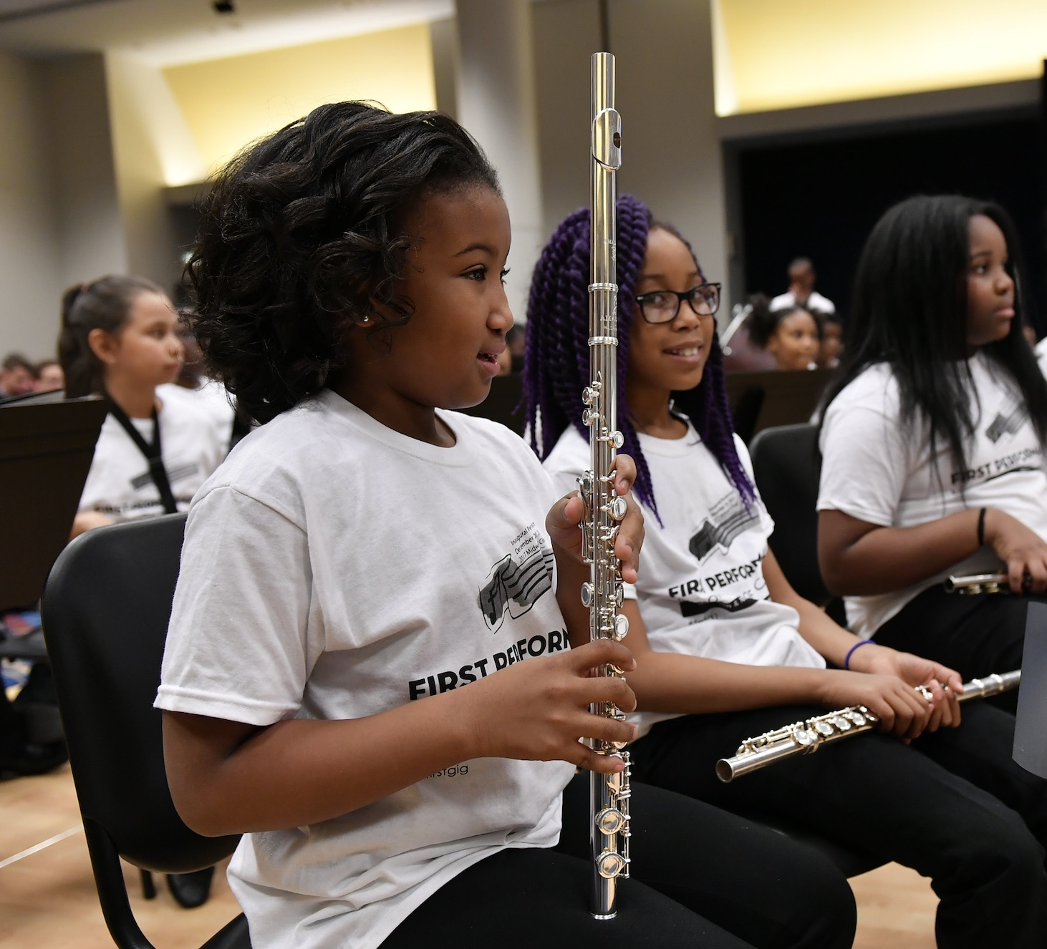
Response from Mario Moody, Director

Slide 30
Response from Mario Moody, Director
The experience of having our 1st year students perform after only playing for 8 weeks has had a profound impact not only on their confidence and expectations for themselves moving forward, it has challenged me to continually grow by making myself vulnerable and aware of what it feels like to "become a beginner." I can relate better to any feelings of apprehension they may feel, and our rehearsals are more effective when my students can feel that every practice counts.

Slide 31
It’s all FREE to Download!
www. nammfoundation.org/fpndoc
Share Your Student Success Stories on Video http://bit.ly/BegMus

Slide 32
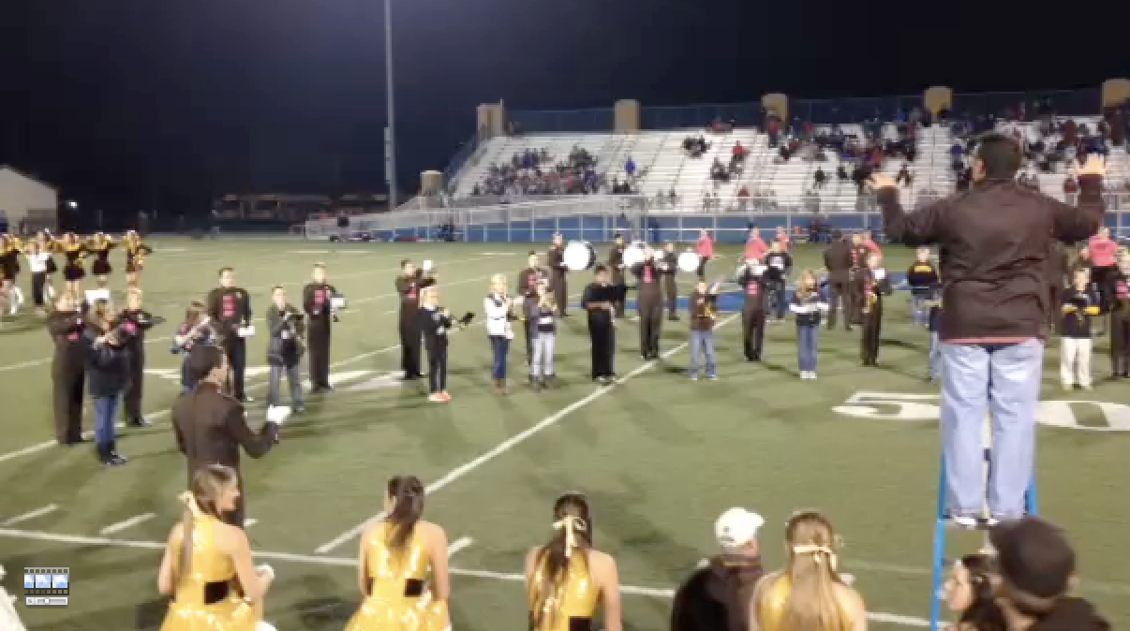
2. The “2-Note” Partnership Halftime Show provides a quality activity and good modeling.

Slide 33
2. The “2-Note” Partnership Halftime Show

Slide 34
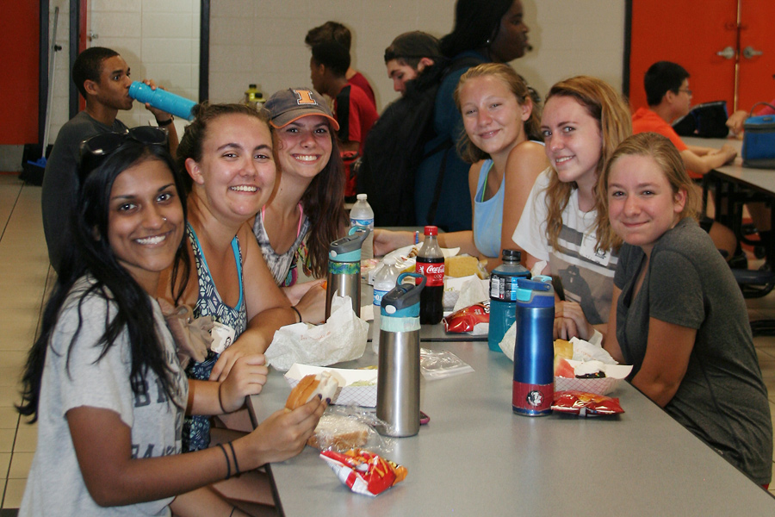
2. The Partnership Halftime Show:
Pre-game Activities
a. Have your high school students host the middle school students for a pre-game pizza party.

Slide 35
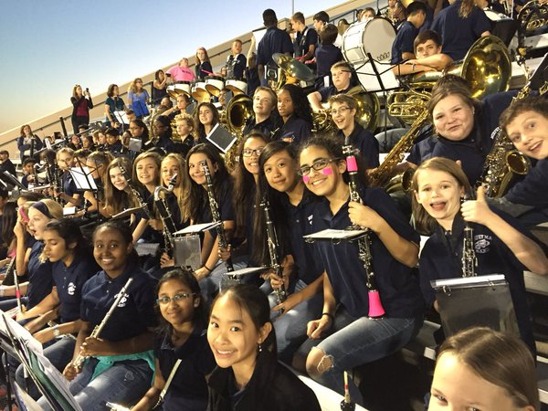
2. The Partnership Halftime Show:
Pre-game Activities
a. Have your high school students host the middle school students for a pre-game pizza party.
b. Have beginners sit/play with HS band at game.

Slide 36
2. The Partnership Halftime Show:
Pre-game Activities
a. Have your high school students host the middle school students for a pre-game pizza party.
b. Have beginners sit/play with HS band at game.
c. Have high school boosters host a middle school parent reception and invite principals to speak.

Slide 37
2. The Partnership Halftime Show:
Pre-game Activities
a. Have your high school students host the middle school students for a pre-game pizza party.
b. Have beginners sit/play with HS band at game.
c. Have high school boosters host a middle school parent reception and invite principals to speak.
d. Provide VIP seating in the stands for parents.

Slide 38
3. High School Students Can Help and Grow Too!

Slide 39
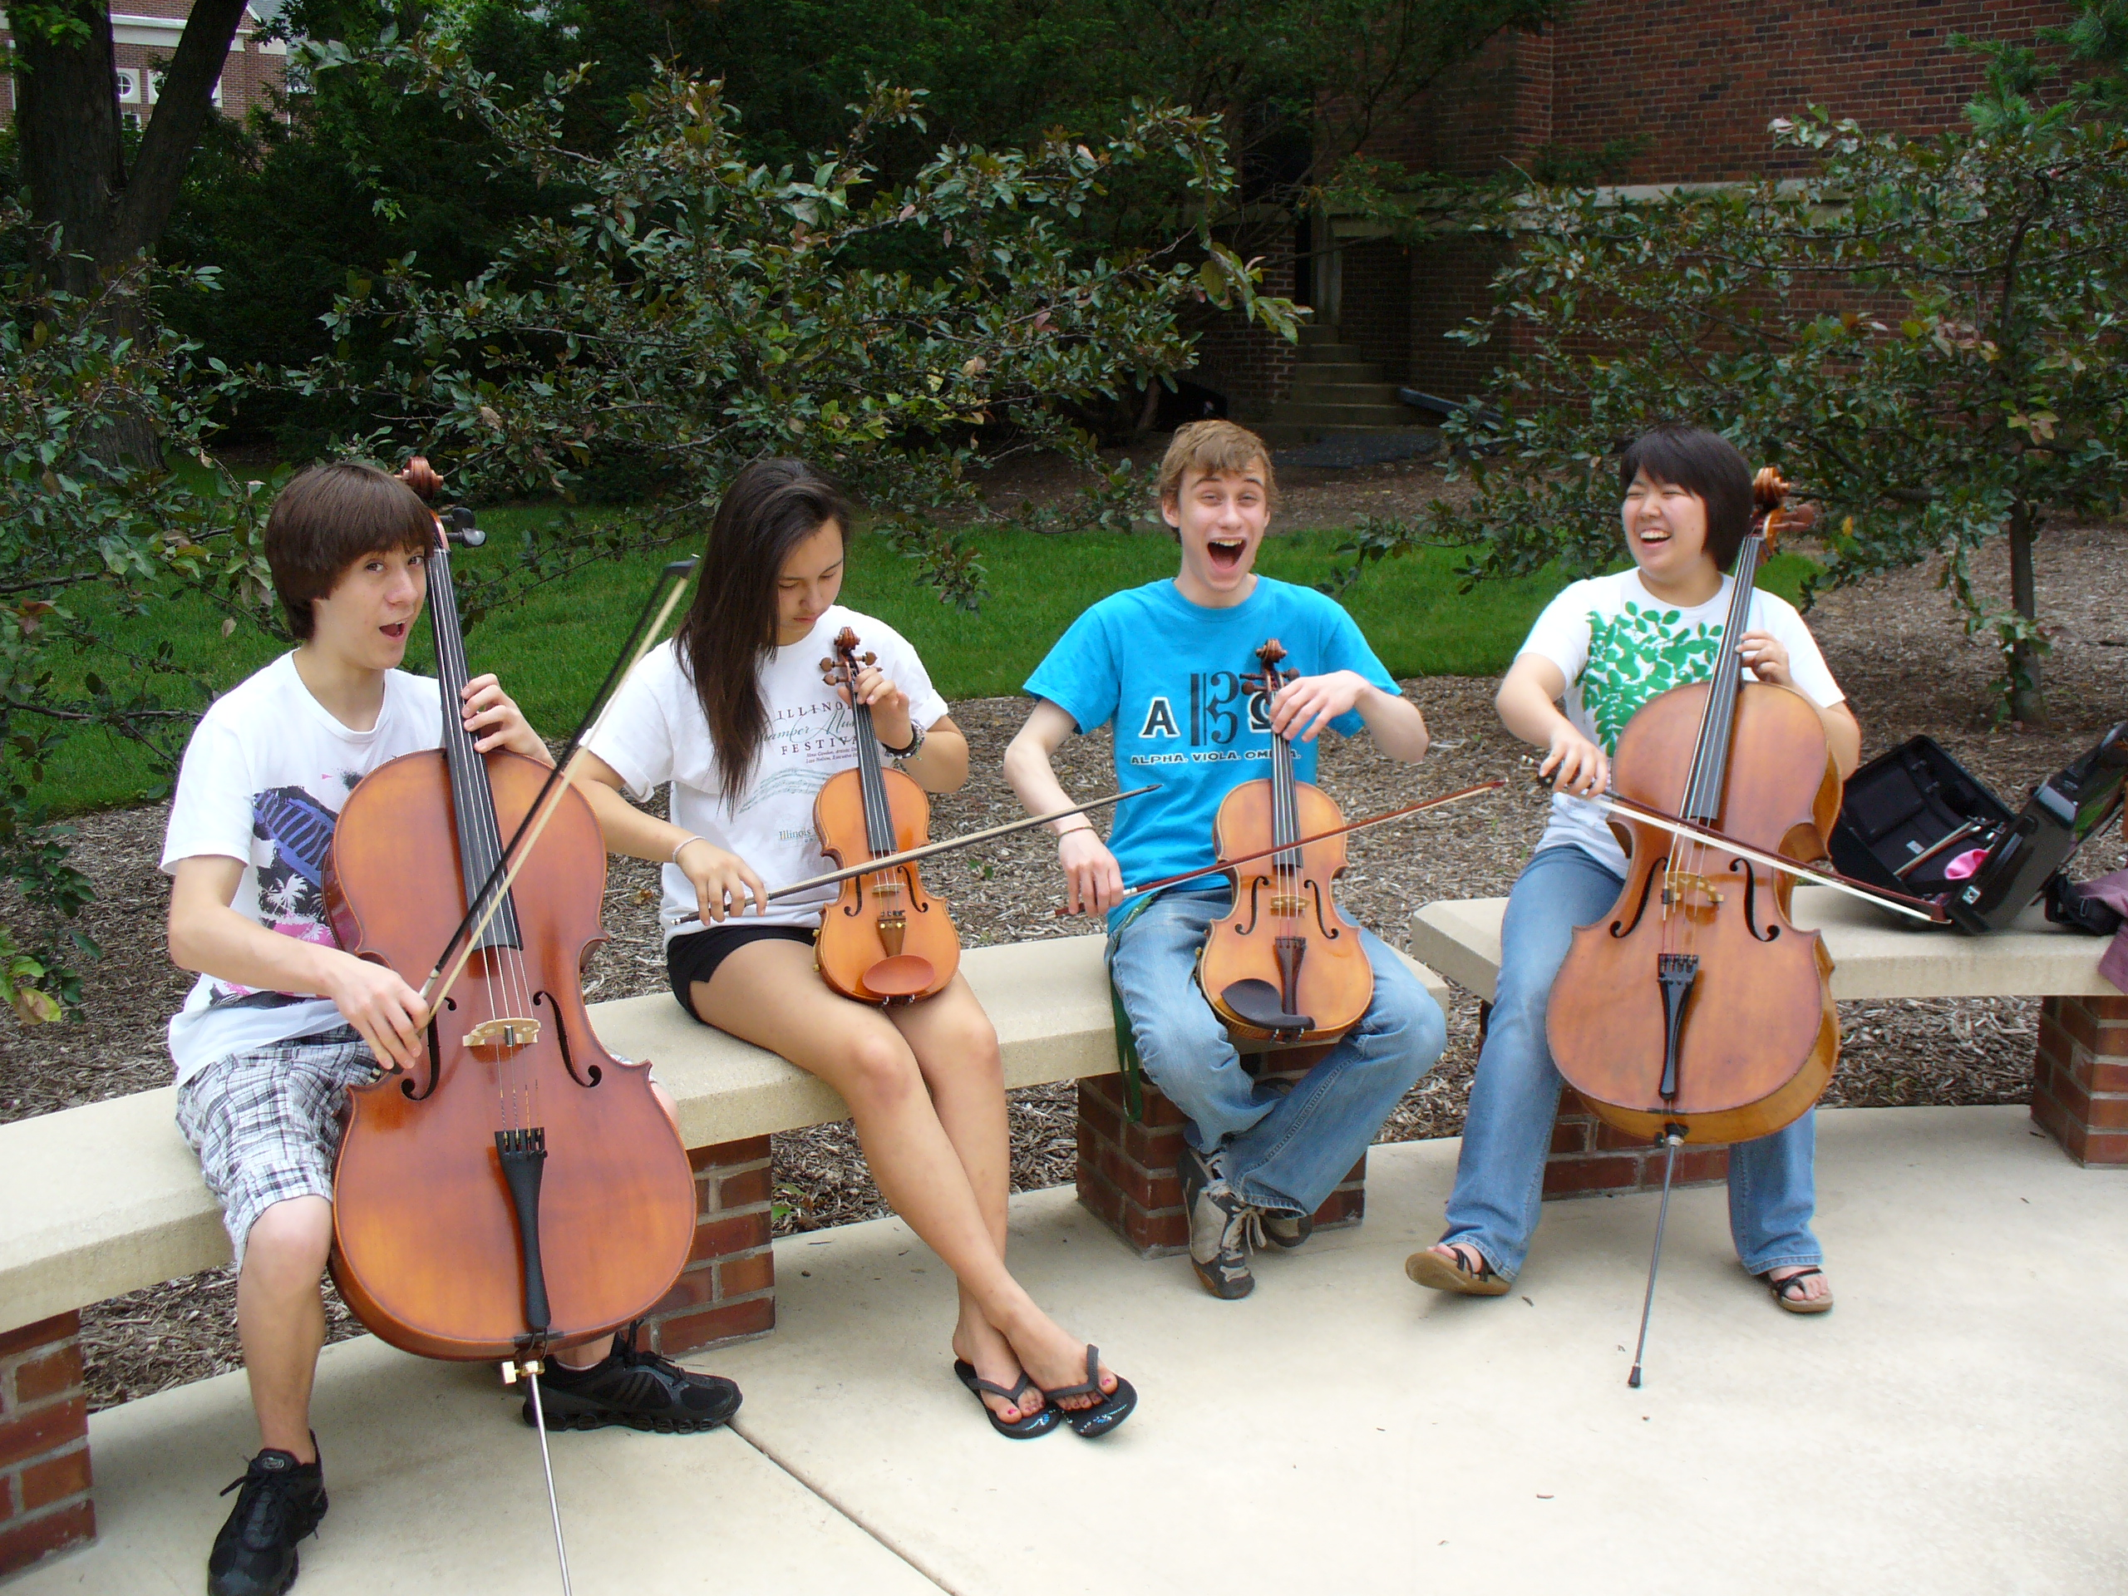
3. High School Students Can Help and Grow Too!
Serve as “Intern Instructors” for FREE
Summer Lesson Program for beginners.
Great modeling opportunity.

Slide 40
3. High School Students Can Help and Grow Too!
Student Testimonials are GREAT!

Slide 41
3. High School Students Can Help and Grow Too!
Student Testimonials are GREAT!

Slide 42
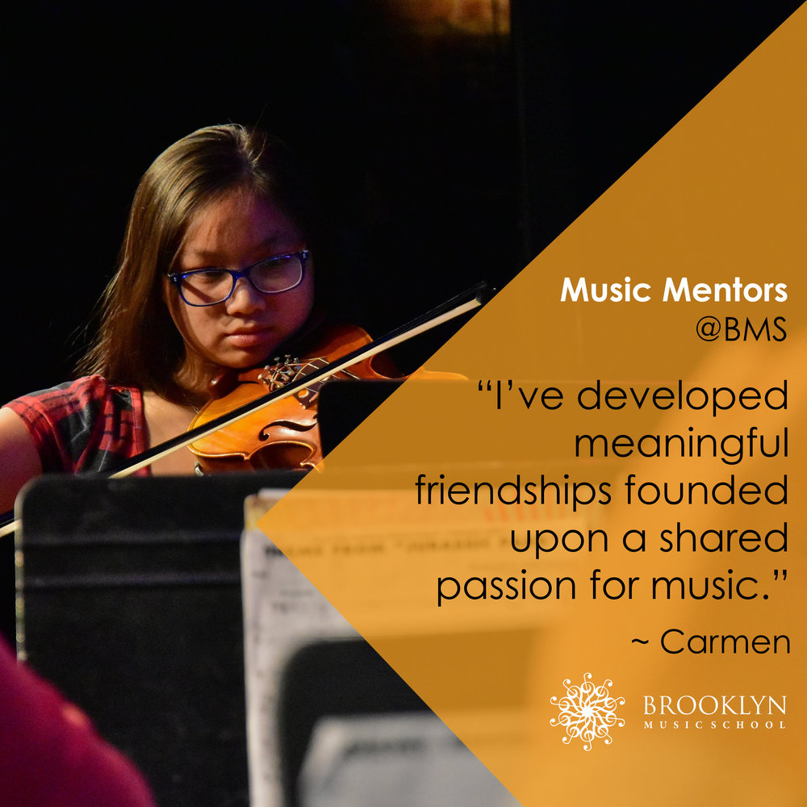
3. High School Students Can Help and Grow Too!
Remain engaged with former programs

Slide 43
3. High School Students Can Help and Grow Too!
Write letters of invitation (Big Bro/Sis)
and congratulations as appropriate
“Congratulations!
You have been chosen to
play (insert instrument)
in the (name of school) band!”
Giving a “Golden Invitation” to
band/orchestra makes them feel special!”

Slide 44
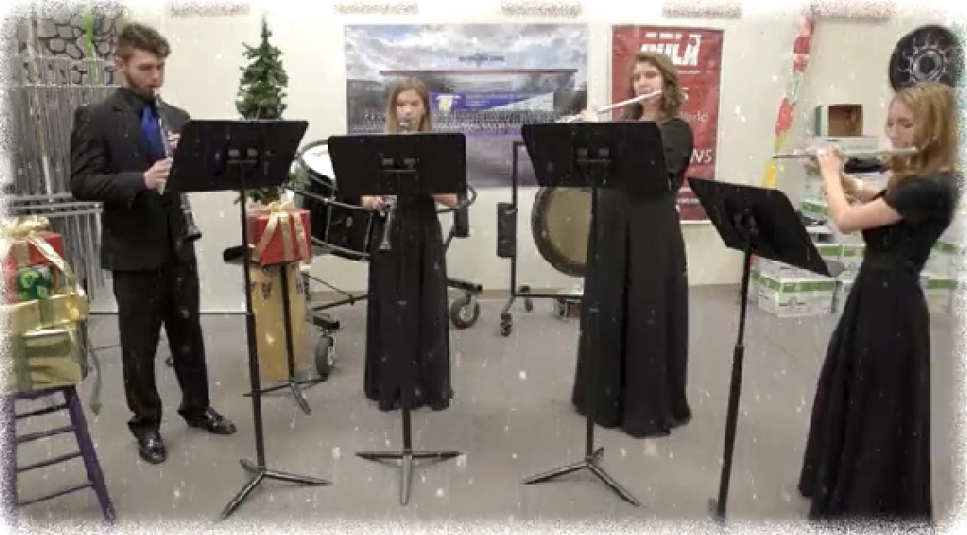
3. High School Students Can Help and Grow Too!
Send Musical Greeting Cards to Like Sections!

Slide 45
3. High School Students Can Help and Grow Too!
Send Musical Greeting Cards to Like Sections!

Slide 46
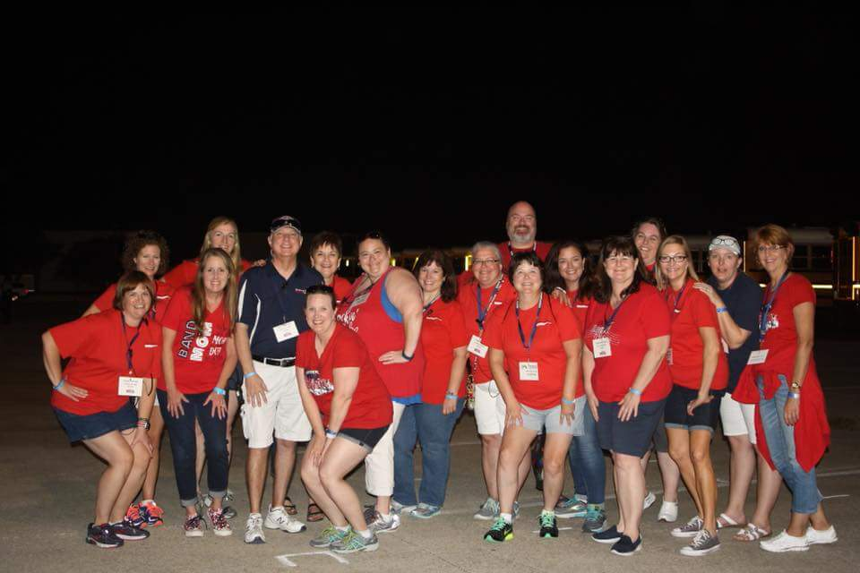
4. Students don’t quit if their parents
are involved ACTIVELY in the program!

Slide 47
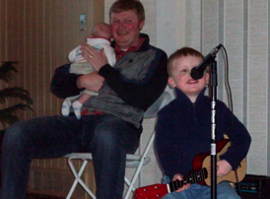
4. Students don’t quit if their parents are involved ACTIVELY in the program!
Teach PARENTS how to support their child’s practicing
Notes:
www.musiceducationconsultants.net/mmea2010
47

Slide 48
4. Students don’t quit if their parents are involved ACTIVELY in the program!
Teach PARENTS how to support their child’s practicing
Give PARENTS ideas of how to motivate their children
Notes:
www.musiceducationconsultants.net/mmea2010
48

Slide 49
4. Students don’t quit if their parents are involved ACTIVELY in the program!
Teach PARENTS how to support their child’s practicing
Give PARENTS ideas of how to motivate their children
Encourage PARENTS to play an active role in the learning process and to become involved
Notes:
www.musiceducationconsultants.net/mmea2010
49

Slide 50
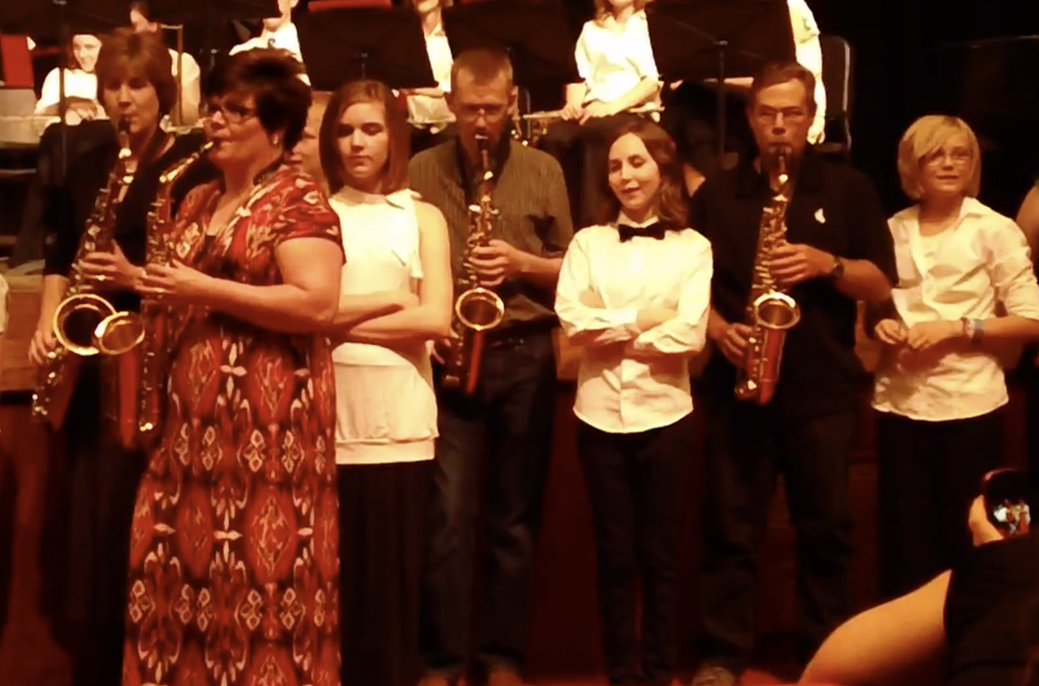
4. Students don’t quit if their parents
are involved ACTIVELY in the program!

Slide 51
4. Students don’t quit if their parents
are involved ACTIVELY in the program!

Slide 52
4. Students don’t quit if their parents are involved ACTIVELY in the program!
a. Schedule a VIP Parent Night at a joint
concert/halftime show performance
b. Host MS/ES parent meetings at the
high school
c. Mentor parent leaders of feeder
programs

Slide 53
5. Reflection
What am I really getting out of all of this?

Slide 54
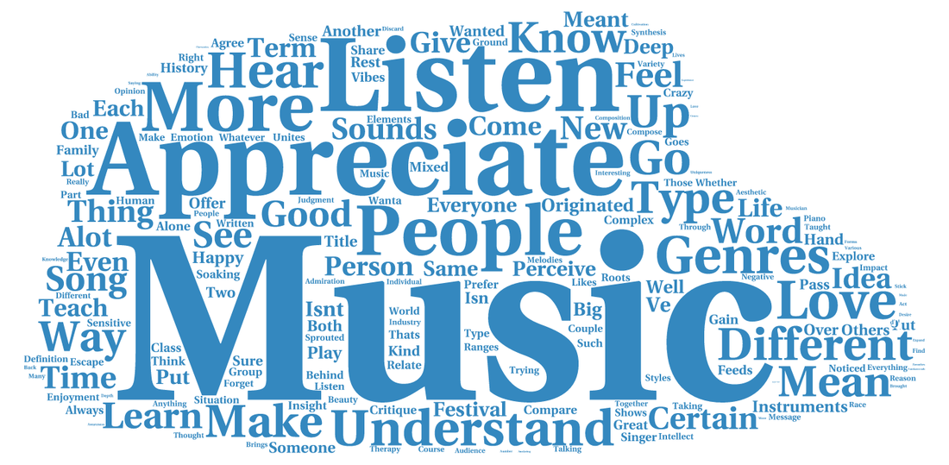
5. Reflection
a. Build a Word Cloud around “Music”
b. Music Makes a Difference Because. . .

Slide 55
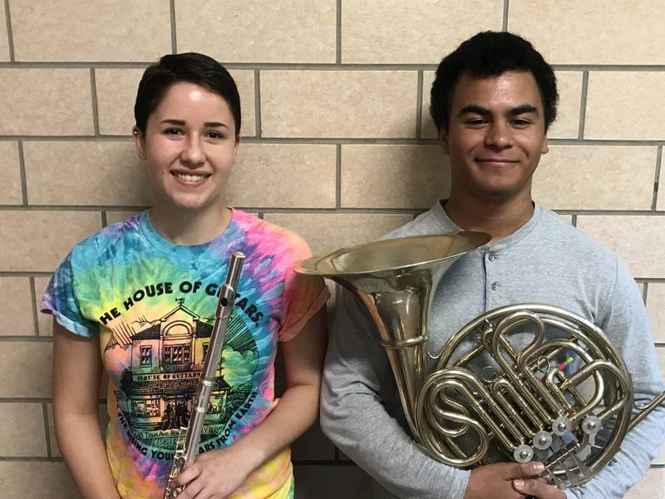
5. Reflection
Making New Friends!

Slide 56
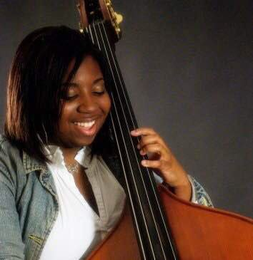
5. Reflection
The Joy of Making Music!

Slide 57
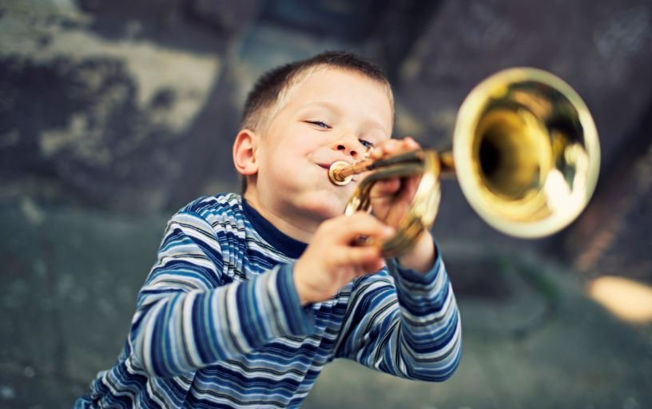
5. Reflection
It’s Fun!

Slide 58
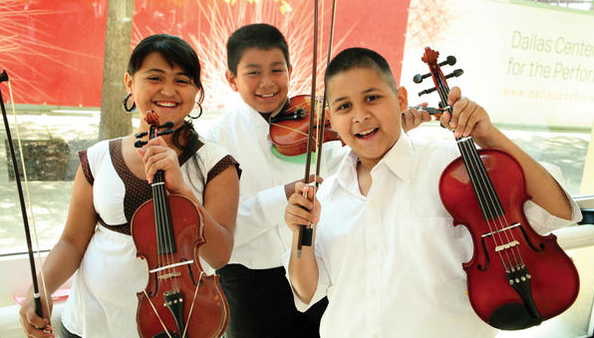
5. Reflection
It Gives Us a Unified Purpose!

Slide 59
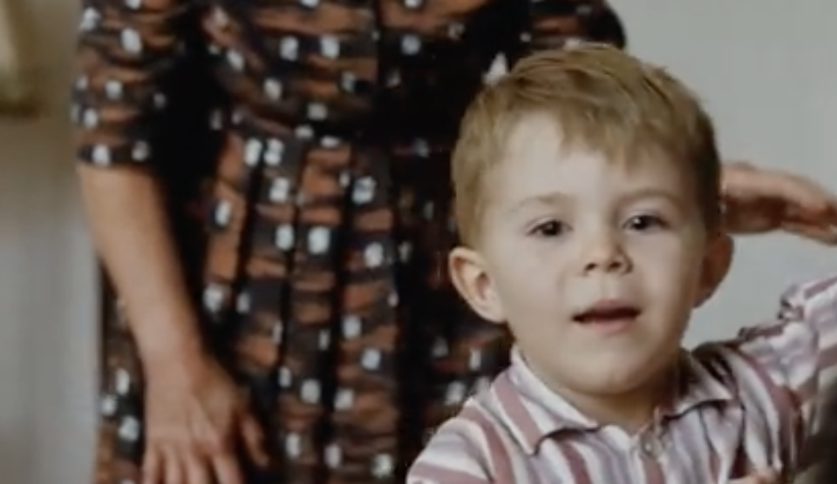
5. Reflection
It’s a Gift Unlike Any Other

Slide 60
5. Reflection
It’s a Gift Unlike Any Other

Slide 61
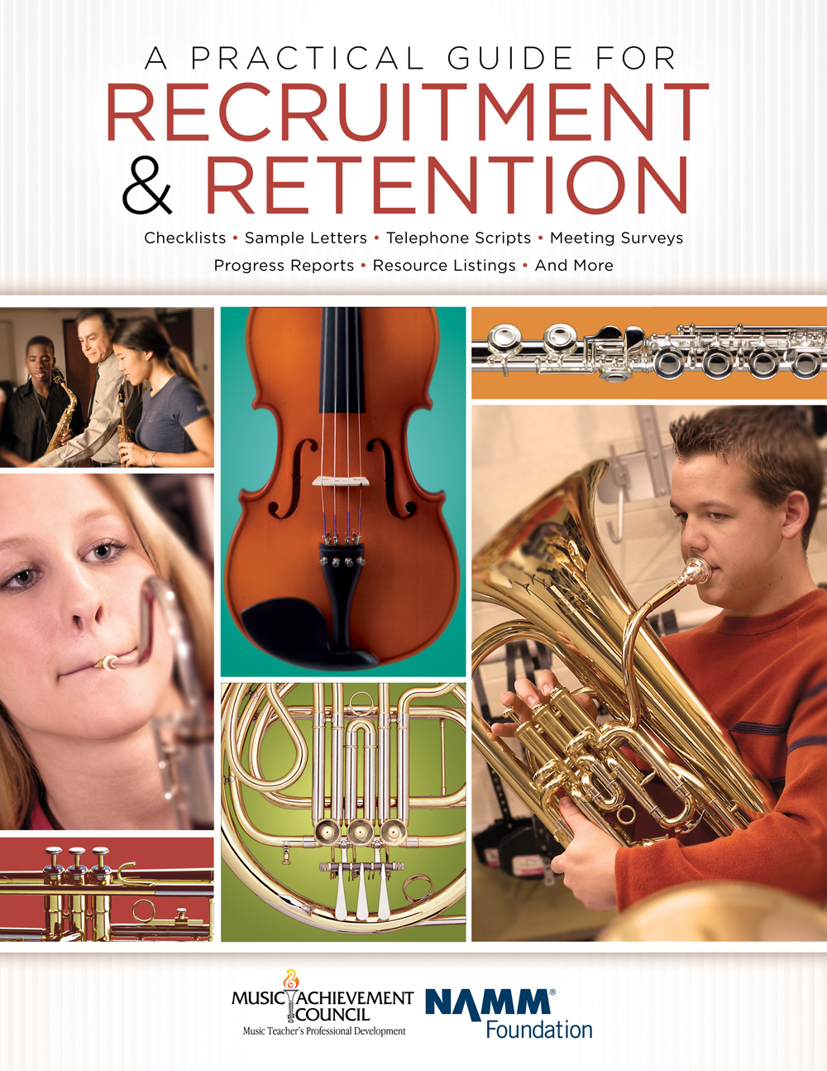
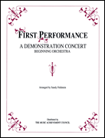
M.A.C. Resources
www.MusicAchievementCouncil.org
Notes:
61

Slide 62
Contact Information Marcia Neel marcia@musicedconsultants.net @MusicEdConsult on Twitter 702.361.3553 Complimentary Recruitment and Retention Materials www.musicachievementcouncil.org
Powerpoint, Videos & Materials Posted at:
www.musicedconsultants.net/conference-materials.net

